Slide 1
CIO Forum
October 10th, 2017

Slide 2
Agenda
Time | Topic | Topic Lead
1:30 – 1:35 | Welcome and Introductions | Matt Bailey
1:35 – 1:40 | OFM Update | Regan Hess, OFM Bryan Way, OFM
1:40 – 2:00 | WaTech Audit Update | Michael Cockrill, WaTech
2:00 – 2:20 | IT Classification Study | Franklin Plaistowe, OFM
2:20 – 2:35 | WaTech Rate Change Update | Wendi Gunther, WaTech
2:35 – 2:45 | SAW Modernization Update | Scott Barringer, WaTech
2:45 – 3:00 | Logging and Monitoring | Scott West, WaTech
3:00 – 3:25 | Update from the OCIO | OCIO Staff
3:25 – 3:30 | Good of the Order Updates, Questions, Answers, Agenda Ideas | Matt Bailey
3:30 | Wrap Up | Matt Bailey

Slide 3
OFM Update
Regan Hesse, OFM
Bryan Way, OFM

Slide 4
WaTech Audit Update
Michael Cockrill, WaTech
Rob St. John, WaTech
Heidi Geathers, WaTech

Slide 5
WaTech Audit Update
Michael Cockrill, WaTech
Rob St. John, WaTech
Heidi Geathers, WaTech

Slide 6
Findings
WaTech needs to improve price transparency
Some WaTech customers don’t think their feedback is taken into account
Could not demonstrate that all of our services are price competitive

Slide 8
IT CLASS IMPLEMENTATION
CIO Forum
October 10, 2017

Slide 9
Guiding Principles
Market Competitiveness to address stakeholder recruitment and retention concerns
Ability to respond to workforce issues by providing more detailed classification data by job family and level
Internal Alignment and Equity
Sustainable Structure that can adapt to changes in the technology industry while balancing fiscal constraints

Slide 10
Status of evaluations
OFM and Agency staff conducted an initial evaluation of 4,080 position descriptions. Following the initial evaluation, staff revaluated 504 positions for validation.
The evaluation process resulted in the following determinations:
  965 positions will come out of IT classifications. The positions would land in either:
    Paraprofessional classes;
    Other new; or
    Existing classes
3,200 positions will be in the new IT professional classification structure

Slide 11
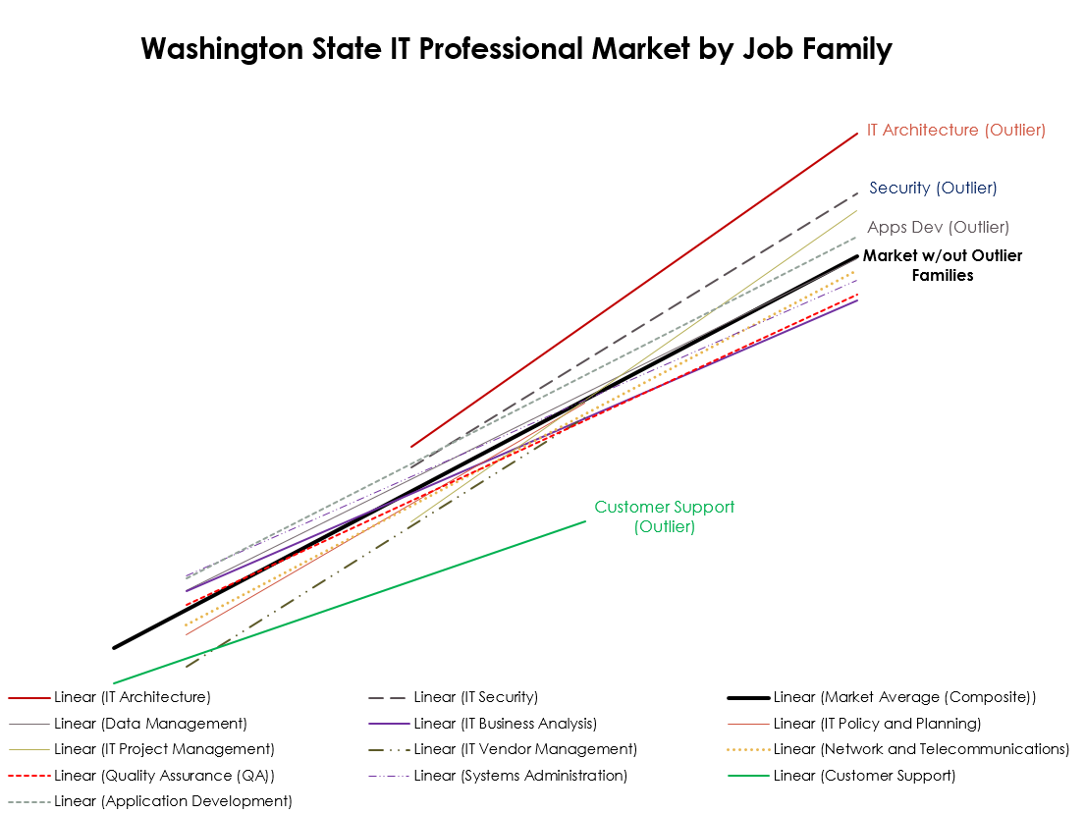
Preliminary Findings and Impacts
SHR prepared a draft compensation structure with a compensation “trend line” that tracked with, but was below the market rate.
When the results of the evaluations sessions were modeled in relation to that trend line, data indicated a large percentage of the state IT workforce would be Y-rated and a limited number of positions would have the opportunity for salary growth over time. This is not a tenable compensation structure.

Slide 12
Mitigation of risks
Further Assessment of Impacts
While the compensation structure establishes compensation for the classified IT positions, we need to identify potential inversion/compression impacts to leadership positions as well as potential inequities. State HR will work with agencies and institutions to assess impacts.
Our goal is to have all assessments completed early 2018. Mitigations of impacts will be dependent on several factors, primarily the effective date of the new structure now planned for July 1, 2019.
Sufficient Time for Labor Engagement
Discussions have already begun with the affected labor organizations to familiarize them with the proposed classification structure. We plan to continue these meetings, and hope to transition into compensation bargaining as soon as the data validation and agency engagement work is completed, probably early in 2018.
Any funding proposals will need to be completed by October 1, 2018, to be submitted with the regular successor bargaining funding requests.
Implementation of the new structure is planned for July 1, 2019.

Slide 13
Current work
Mitigate gaps in the process where positions were not evaluated.
How: State HR to pull together trained evaluation teams to conduct evaluations
Who: State HR, Agencies, Institutions – trained evaluators
When: October 10-12, 2017
Form an HR IT Implementation Advisory Committee as a forum for discussion and sharing of information in order to review, update, and prioritize IT Implementation processes and policy for successful implementation of the new classification and compensation structure.
How: State HR drafting committee charter and identifying membership
Who: State HR, Agencies, Institutions
When: October 24, 2017 Kick-off Meeting
Agency and institution feedback and review of initial evaluation results. State HR to schedule meetings starting mid-October.
How: State HR staff working individually with agencies and institutions to address concerns.
Who: State HR, Agencies, Institutions
When: by November 30, 2017

Slide 14
State HR contacts
Franklin Plaistowe, State HR Assistant Director
Franklin.Plaistowe@ofm.wa.gov
360/407-4104
Angie Hogenson, Project Lead
Angie.Hogenson@ofm.wa.gov
360/407-4111
Ann Mitchell, Lead Negotiator
Ann.Mitchell@ofm.wa.gov
360/407-4154

Slide 15
WaTech Rate Change Update
Wendi Gunther, WaTech

Slide 16
SAW Modernization Update
Scott Barringer, WaTech

Slide 17
Logging and Monitoring
Scott West, WaTech

Slide 18
OCIO Update
CIO Forum
September 12th, 2017

Slide 19

Supplemental Decision Package Review Process
Understanding the Scoring Criteria
Whitney Dickinson | IT Portfolio & Management Consultant
Office of the State CIO (OCIO)
o 360.407.8681 | m 360.688.4765

Slide 21
Decision Package Ranking
RCW – OCIO ranked list DPs with IT spend
  RCW 43.88.092
OCIO Scores - alignment to State’s Enterprise IT Strategy
Past – processes built around producing list
Heard you – too many mtgs – Lean process improvement
2 things needed
  Agencies understand IT strategy / DP scoring criteria
    Us to you info - to inform DP writing
  OCIO understand DP – what is proposed
    You to us info - to inform scoring
    Took out waste
    Meetings are Optional
  Info sessions: Wed & 9/26
  1:1 in-depth
  OFM mtg
    Scoring based on
  DP, IT Addendum, Self-Scoring Worksheet
  Submit to OCIO 10/9/17
    No required Concept Review
    No scoring presentation

Slide 22
Reference
2018 Supplemental Decision Package Prioritization Criteria
2018 Supplemental Self-Scoring Worksheet
Michael Cockrill’s 8/21/2017 letter - DP Reminder
Whitney Dickinson’s 9/7/2017 letter – DP Prioritization Instructions
Contact Laura Parma laura.parma@ocio.wa.gov | OCIO Consultants Pool OCIOConsultants@ocio.wa.gov

Slide 23
Good of the Order Updates, Questions, Answers, Agenda Ideas

