Slide 1
CIO Forum
December 12th, 2017

Slide 2
WaTech Zero Based Budget Review
Tim Gallivan, WaTech

Slide 3

Zero-Based Budget Review Project
Tim Gallivan, Technology Billing and Business Management

Slide 4

Agenda
Presentation Agenda
What is Zero-Base Budgeting
Zero Based Budget for WaTech
Anticipated Project Schedule
Goals / Keys to success
Customer Involvement
Project Resources and Contact info
Questions

Slide 5
Zero-Based Budgeting / Overview

Slide 6
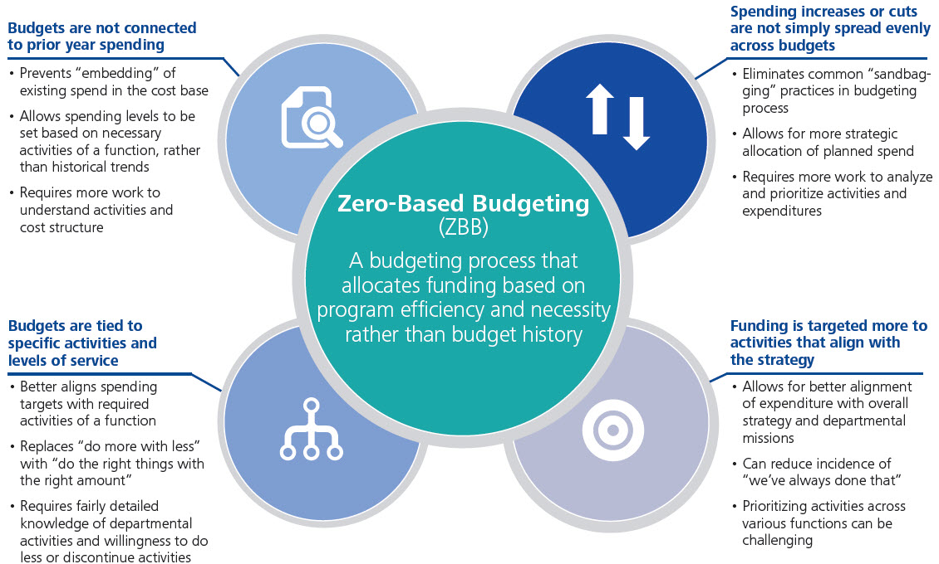
What is Zero-Based Budgeting (ZBB)?
What
What is Zero-Based Budgeting
Notes:
“Zero-based budgeting (ZBB) is a method of budgeting in which all expenses must be justified for each new period. Zero-based budgeting starts from a "zero base," and every function within an organization is analyzed for its needs and costs.
The goal is that budgets are then built around what is needed for the upcoming period, regardless of whether the budget is higher or lower than the previous one.”

Slide 7
Zero-Based Budget and Washington State Government
Introductions
Zero-Based Budget Evolution
JLARC Recommendations
Take a more active and direct role in agency activities.”
Focus on outcomes by routinely requesting and using “performance information in policy and budget decisions.”
Base legislative committee decisions on performance outcomes….around state governing priorities.”
POG Intent
What are the results citizens expect from government?
What strategies are most effective in achieving those results?
How should we prioritize spending to buy activities that are most critical to implementing these strategies?
How will we measure progress?
Recent Bill Proposals
“Allows legislature to specify … certain programs for which agencies must perform a zero-based budget review”
Requires agencies to submit a zero-based budget review … each biennium…”
“Requires the Governor and legislature to consider zero-based budget reviews when preparing the state budget.”
Early Origins
Priorities in Government (POG)
JLARC Performance Audit
Recent Bill Proposals
Session 2015-2016
  SB 6423 and HB 2656
Session 2017-2018
  SB 5066 and HB 1817

Slide 8
Project Purpose

Slide 9
WaTech’s Requirement in 17-19 Operating Budget
Zero-Based Budget Review Requirements
Section 150 (7) requires us to conduct a zero-based budget review of all WaTech services.
Requirement highlights:
  Services we provide and statutory basis for the service;
  Alignment to strategic plan and any associated performance measures;
  Cost analysis (Rates, How much does it cost to sustain, is it cost recoverable);
  Customers that receive the service
  Recommendations
  Should WaTech provide the service to customers?
    Provide the rationale why and the expected benefits customers should receive if WaTech must provide the service;
    If WaTech does not provide the service, what are the reasonable service delivery alternatives and associated transition costs?
  Is the service adequately resourced financially and do we have sufficient staffing to support the service?
Notes:
CTS has done a considerable amount of work to document and provide financial analysis for the service offerings provided to customers.
The Vendor shall consolidate and finalize the inventory of services and provide additional analysis of CTS service offerings to include:
Service description;
Statutory basis for creation of service or program;
How the service fits into the CTS strategic plan and goals;
Document any performance measures used to measure effectiveness and efficiency of service or program;
Current cost to maintain the service. This must include staffing levels, direct costs, indirect costs and any overhead costs;
Current state rate structure that CTS is charging for service or program;
Analysis whether this service is currently cost recoverable;
What level of service is provided today;
Customers that are receiving this service.
Analyze and develop recommendation report for each service to answer the following strategic questions:
Should CTS provide the service to customers?
Provide the rationale why and the expected benefits customers should receive if CTS must provide the service;
If CTS does not provide the service, what are the reasonable service delivery alternatives and associated transition costs?
Is the service adequately resourced financially and do we have sufficient staffing to support the service?

Slide 10
Why are we contracting this work out?
Contracting Requirements
“For the study to be accepted by the Washington State’s leadership, it needs to be conducted by an independent and objective third party organization that is not bound to WaTech, its customers, or to the many current and future vendors/suppliers who have a stake in its outcome.”
We looked for a vendor with these attributes:
Independent and objective Proven and rigorous process and methodology for service assessment Broad knowledge of industry trends and emerging practices that are disrupting service delivery models | 4. Extensive resources to IT Costing, staffing and performance metrics 5. Reputation for providing trusted advice 6. Seasoned project team with service and rate benchmarking experience

Slide 11
Anticipated Project Schedule

Slide 12
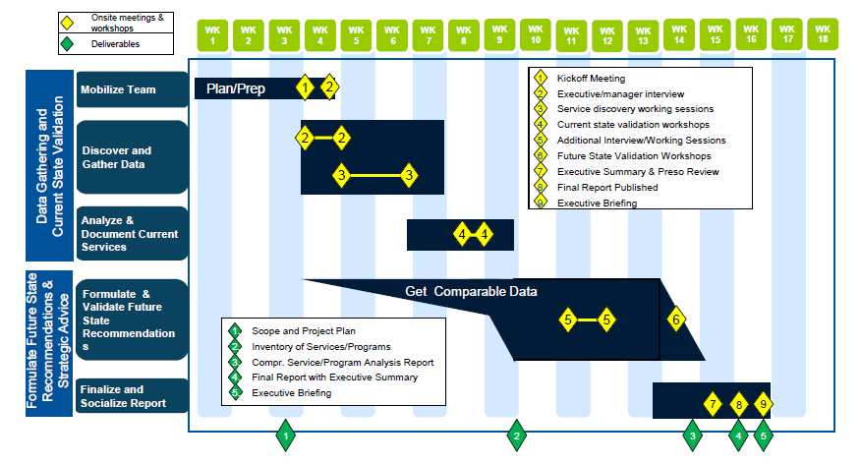
Anticipated Project Schedule
Notes:
At this point, we are anticipating the project will take approximately 16-18 weeks to complete.
This is a fast-tracked timeline as we are hoping to use the results of this analysis in the upcoming 2019-21 budget building conversation with OFM and our legislative partners.
This draft timeline will be fine-tuned when the vendor is selected and onboard.
We are estimating the official start date will be on or around 01/05/2018.
Phase 1 – Mobilize Teams
Objectives : Work closely with Gartner to set the foundation for a successful engagement that is delivered in time, within budget and meets the project’s objectives.
Expected outputs
Project Kickoff meeting
Project Schedule and Plan (final)
Data and information requests
Anticipated Time Frame = 2-3 Weeks
Phase 2 – Data Gathering and Discovery
Objectives: Gather and analyze all data and information required to fully understand the current services being delivered and the potential service delivery alternatives available for these services.
Expected outputs
Interview Notes
Potential comparison metrics
Potential Service alternatives
Anticipated Time Frame = 4-5 Weeks
Phase 3 – Analyze and Document Current Services
Objectives: Analyze and document current services to meet legislative requirements
Expected outputs
Inventory of Services/Programs
Current state service validation workshop materials
Anticipated Time Frame = 3-4 Weeks
Phase 4 – Develop Recommendations
Objectives: Analysis of services using research data and produce report regarding which services should be expanded/invested in, maintained, delivered through 3rd party / cloud service or discontinued, along with the rationale for each recommendation
Expected outputs
Comprehensive service/program analysis report
Future state recommendations workshop materials
Interview notes
Potential comparison metrics
Potential service alternatives
Anticipated Time Frame = 4-6 Weeks

Slide 13
Goals / Keys to Success

Slide 14
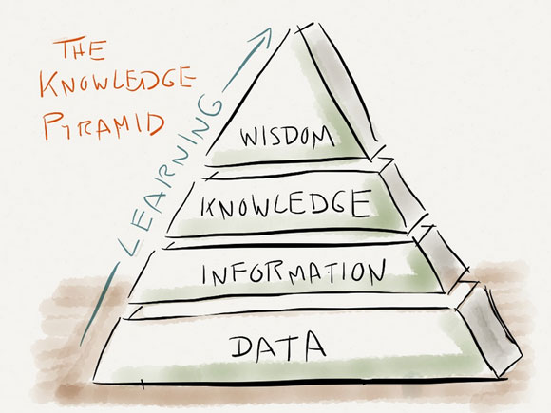
What is WaTech hoping to gain through this effort?
ZBBR Goals
Strategically, the results of this study will provide the data / information to help inform WaTech’s future evolution as the state’s information technology shared service provider.
For this to occur:
The data / information from this study must be honest, accurate, fact-based, and credible to our customers and funding partners, including OFM and our Legislative partners.
Notes:
Parable:
You and your partner decide to go out for a meal. You plan the date, set your budget and research a good place to eat. When you get to the restaurant, they keep you waiting longer than you should, the food doesn’t taste as nice as you thought and the meal costs more than advertised.
What opinion do you have at the end? You’re annoyed right? You feel a sense of injustice; you tell your friends; you leave an online review (if you haven’t already left it verbally at the restaurant); and never go back again.
And yet with a little more focus on the customer, the experience could have been so much more different.
When you arrived, if you had been told that there had been a price increase and that the food may take longer as they were really busy, then immediately your expectations would have changed and you would have a decision to make.
If you decide to eat elsewhere, then you have made that choice based on the information that you have. If you decide to stay, you know more or less what to expect.

Slide 15

Keys to Success
Participation – Be available, Get involved, speak up, and share ideas.
Communication - Talk early and often and inform customers on the process throughout the project.
Teamwork - Work together to keep projects going forward.
Timely Decisions – If feasible, use the 80/20 rule on complex items and rely on your Gartner experts for assistance.

Slide 16
Customer Involvement
Keys to Success
We partnered with OFM, agencies and our legislative partners to develop the criteria for the Request for Purchase (RFP).
How will customers be involved during the project?
  Simple answer --- It depends!
  We anticipate customers will be heavily involved toward the end of the project when the executive summary and associated recommendations are presented.
  However, when Gartner is looking at comparable services, it may be valuable to reach out to agencies for guidance and feedback.
Notes:
If you would like to be involved, please contact me and we will try to fit this into the project planning efforts.

Slide 17
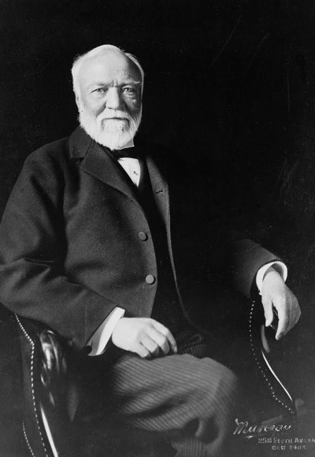
Final Thoughts
“Teamwork is the ability to work together toward a common vision. The ability to direct individual accomplishments toward organizational objectives. It is the fuel that allows common people to attain uncommon results.”
Son of a Scottish weaver
US industrialist and philanthropist
Founder of a Pittsburgh, PA based steel company
Mr. Andrew Carnegie, 1835 - 1919

Slide 18

Project Resources
Stay in Touch!
Tim Gallivan (Project Manager)
Email: tim.gallivan@watech.wa.gov
Phone: 360-907-8215
Wendi Gunther (CFO and Project Sponsor)
Email: wendi.gunther@watech.wa.gov
Phone: 360-407-8779
Zero-Based Budget Review SharePoint site: https://watech.sp.wa.gov/ask/Rates/SitePages/Home.aspx

Slide 19
Questions?

Slide 20
Cyber Security Trends
David Morris, Office of Cyber Security

Slide 21
Lynda.com Information Session
Miranda Culley, Department of Enterprise Services

Slide 22

lynda.com Introduction for State of Washington
December , 2017
Notes:
Thank you for taking the time today for my presentation.

Slide 23
Agenda
Introductions
lynda.com
Solutions
Lynda & WA State
“The only thing worse than training your employees and having them leave is not training them and having them stay.”
- Henry Ford
Notes:
Good morning. I’m Miranda Culley from Dept of Enterprise Services’ Workplace Learning and performance team. We provide learning solutions to the enterprise and I am here today to discuss Lynda.com in particular. DES has been able to secure a contract with Lynda.com that, by leveraging bulk purchasing, allows us to distribute the subscriptions to STATE Employees at 41 dollars per person per subscription year. If you were to purchase the same premium membership on your own it would cost over 350 dollars. Lynda.com is an online learning provider with thousands of IT, Business and Creative training courses that are taught by industry experts and available on demand and on the go.

Slide 24



Quick Facts about lynda.com
Global Leader in Online Skills Development
8,000+
Courses
…available in
5 languages
2,000+
Government Clients
…from Federal,
State & Local
4M+
Members
…with 350k paying
out of pocket
21
Years
lynda.com was founded in 1995
Government clients
Major US Government agencies including EPA, DOJ, CIA, FBI, Office of the President, and all branches of the US Military
State & Local agencies include NY Public Library, Delaware State Courts, Denver Int’l Airport
LinkedIn acquires lynda.com
In May 2015 lynda.com joined the LinkedIn family
Powerful combination with LinkedIn’s focus on helping organizations acquire top talent together with lynda.com’s development of employee skills. Has exceeded 500 million members.
Notes:
Highlight key facts about lynda.com
Global leader in online skills instruction
Have an abundance of courses - over 6,000 courses in 5 languages
A lot of clients that have put their trust in us – over 10,000 enterprise clients
Serve three key markets – Gov’t, Corp, Education
Over 1,650 clients in the Gov’t sector at Fed, State & Local levels
Examples of Gov’t
Fed – DOJ, FBI, all branches of the military
State & Local – Delaware State courts, Denver Int’l Airport, NY Public Library
Corp – more than ½ of Fortune 50
Education – 60% of US colleges, 100% of Ivies
------------------------------------------------------------------
Add’l examples of State & Local clients: NY Public Library, City of Aspen, Dallas City Hall, City of Bloomington, IN
The U.S. Armed Forces are made up of the five armed service branches: Air Force, Army, Coast Guard, Marine Corps, and Navy.
Ivy league: The eight institutions are Brown University, Columbia University, Cornell University, Dartmouth College, Harvard University, the University of Pennsylvania, Princeton University, and Yale University.
Languages: English, German, French, Spanish, Japanese, Mandarin (?)

Slide 25
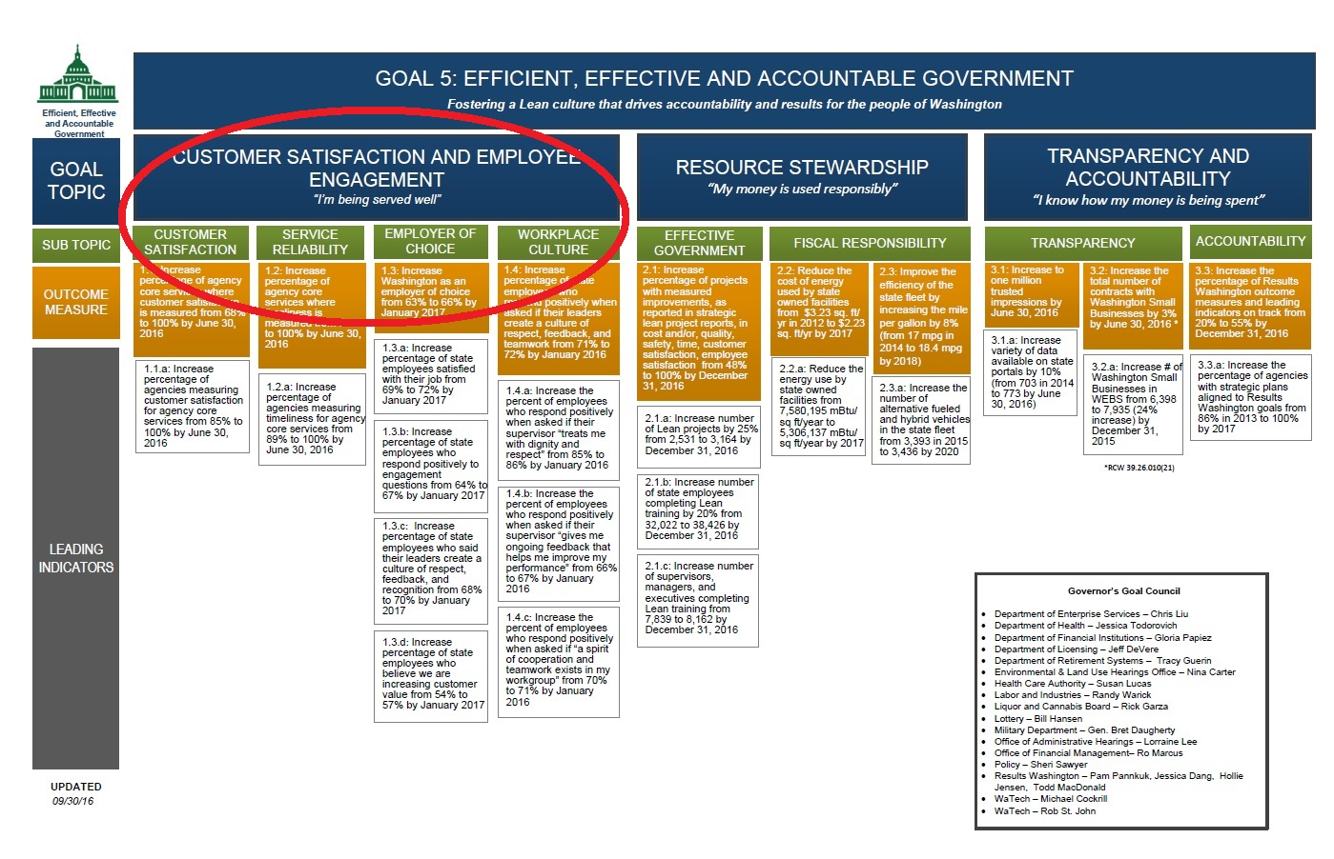
Lynda.com Supports Employee Engagement
1.3.b: Increase percentage of state employees who respond positively to engagement questions
Notes:
The reason we were so excited to be able to offer Lynda.com is because of a niche it can fill in training needs across the state. As you know, under the Governor’s goal 5 lies the objectives of increasing the % of state employees who are satisfied with their jobs and who respond positively to engagement questions.
the employee engagement survey showed that there is room to improve on the % of employees say they work in an environment with opportunities to learn and grow. Lynda.com is a popular, user friendly, and affordable way to give a vast library of development opportunity to employees.

Slide 26
Top Two Predictors of Employee Engagement
Learning & Growing
Job Skills Alignment
Innovation
Net Promoter
Rating
Fair
Treatment
Support for Health
Notes:
The survey results also indicated the likelihood of employees recommending their agency is most closely related to the five engagement topic areas shown. The top two, at both the agency and individual level, being Learning & Growing and Job Skills alignment. Lynda.com is an extremely cost effective way to enhance both learning and skills in the workplace. Using Lynda.com provides state employees a tool for development and a place to hone their skills to align to their jobs.
(Employees can create learning paths that build upon learning to lead them to higher competency in their role or even to promote or switch to another set of capabilities.)

Slide 27
Millennials are Requesting Training and Development
“Which three benefits would you most value from an employer?” % Ranking each 1st place, global
Source: “Millennials at Work:
Reshaping the Workplace” by PWC 2011
With the onset of the “silver tsunami”, offering lynda.com’s compelling instruction can help attract and retain new talent
Notes:
We understand that gov’t agencies are facing challenges with the silver tsunami:
IS THIS AN ISSUE WITH YOUR ORGANIZATION?
Growing number of the gov’t workforce reaching retirement age
The shrinking talent pool
Young people entering workforce have high expectations related to training and technology
Offering high-quality training using the latest technology becomes critically important
Millennials are expecting it, #1 benefit they want from employer
Lynda.com’s compelling instruction will help your agency attract and retain that top tier talent

Slide 28
Benefits of lynda.com Learning Solutions for Governments
Engaging
Close skill gaps
Mobile access
Top-quality training designed for optimal learning
Close mission-critical skills gaps with training for all skill levels
24/7 mobile, tablet, and offline access from anywhere
Ongoing support
Easy integration
Reporting
Onboarding and technical support
Seamless integration with
existing technologies
Usage reports, assessments, certificates of completion
Notes:
Lynda.com is designed to make training successful
The premium membership we have includes access to exercise files that enable the learner to work right along with the instructor.
The ease and full accessibility make Lynda.com ideal as the first go-to when there is an immediate need for a skill.
Our enterprise users get support from Lynda.com as well as from myself. I can help with finding and creating playlists that meet your needs and with setting up groups, administrators and running reports.
Since completed courses are uploaded into the LMS, Lynda.com can be used with overall learning plans, agency initiatives and individual PDPs.
Lynda.com has many reporting functions that allow agency administrators to view usage and completion at the agency, group or individual level.

Slide 29

High-Quality Training Designed for Optimal Learning
Engaging
Micro learning
Bite-size 1-4 minute videos
Just-in-time learning
Searchable, time-coded transcripts
for immediate answers
Visual
Videos
Closed
captions
Transcripts
Kinesthetic
Exercise files
Code practice
environment
Note taking
Self-paced learning
Speed/playback controls
Anytime/anywhere access
Blended learning
Complements Instructor-led Training (ILT)
Auditory
Notes:
Designed training to be effective for different learning preferences – Seeing, Listening, Doing
Seeing - Closed caption
Doing - Actively engage in learning through exercise files and newly released in-browser coding environment
Listening to the audio
We put control in the hands of user based on what works best for them
Can learn in short spurts, bite-sized videos
Searchable for just-in-time answers
Control speed

Slide 30
Significant Breadth and Depth Aligns with Mission-Critical Skills
Close Skill Gaps
Leadership and
Management
Professional Development
Productivity
Software
Project
Management
Breadth: Courses relevant to entire organization
35 new courses a week
Beginner, intermediate,
advanced, and appropriate for all
Your Company
Depth: Courses relevant to specific roles
Creative Skills
and Software
Online
Marketing
IT
Infrastructure
Software Development
Web
Development
Web
Design
Data
Science
Information
Management
Notes:
With breadth and depth, can train any employee and have it aligned with agency’s mission-critical
Have courses relevant across your organization, such as Leadership & management for current and rising agency leaders
Have depth relevant to specific roles
IT help desk – IT infrastructure, searchable library for quick answers and support
Productivity software – Stay up-to-date with technology and new software
Training stays relevant
Content library is constantly growing and staying fresh and current
~25 new courses each week
For different skills levels – from beginner to advanced

Slide 31
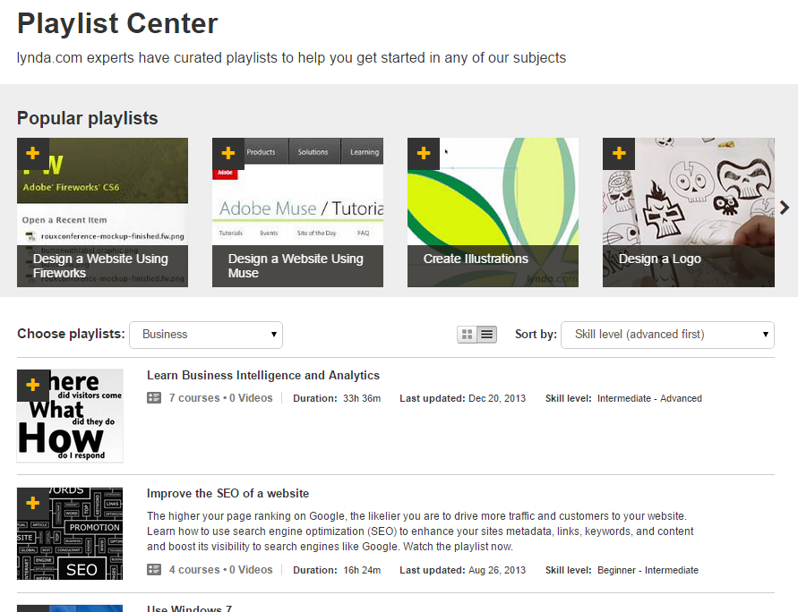
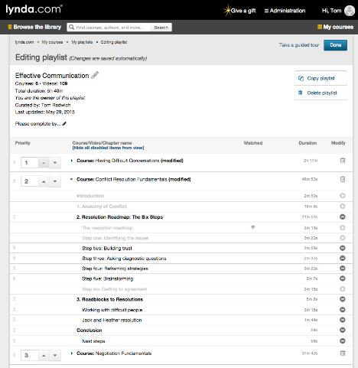
Design and Assign Custom Learning Paths
Close Skill Gaps
Curated playlists
Role-based (by function, level)
Competency-based
Design and assign your own playlist
Course-level or item-level
Start from scratch or modify curated playlist
Notes:
With playlists, can tailor training to close skill gaps
Leverage curated playlists developed by lynda’s content experts to develop expertise in certain areas
Or, design your own based on agency’s and an individual’s specific needs
Can address skills gap for any level of experience

Slide 32
Productivity Software Course Collection
Broad selection of courses for making your team more efficient and current with technology
Major Productivity Suites
Other Productivity Software
Microsoft
Office
PowerPoint
Excel
Word
Outlook
Project
Access
SharePoint
Publisher
InfoPath
OneNote
Google
Google Apps
Google Slides
Google Sheets
Google Docs
Google
Calendar
Google Drive
Gmail
Apple
iWork
Keynote
Numbers
Pages
Operating
Systems
Windows
iOS
Android
Mobile Devices
iPad
iPhone
Kindle
Nook
Project Collaboration
Basecamp
Evernote
Asana
Adobe
Acrobat
Reader
Presenter
Document
Cloud
Security/
Password Management
Norton 360
1Password
LastPass
Diagramming
Visio
OmniGraffle
Task
Management
Clear
ToDoist
OmniFocus
Any.do
2do
CARROT To-Do
Web
Conferencing
WebEx
GoToMeeting
Lync
Cloud Storage
Dropbox
Box
141 courses 6,018 videos
Notes:
Our training simplifies IT migrations to new software & keeps staff up-to-date w/ latest software & technologies
Have over 140 courses (and growing).
Cover all major productivity suites – Microsoft, Google, Apple
As well as specialty ones for password management, web conferencing

Slide 33
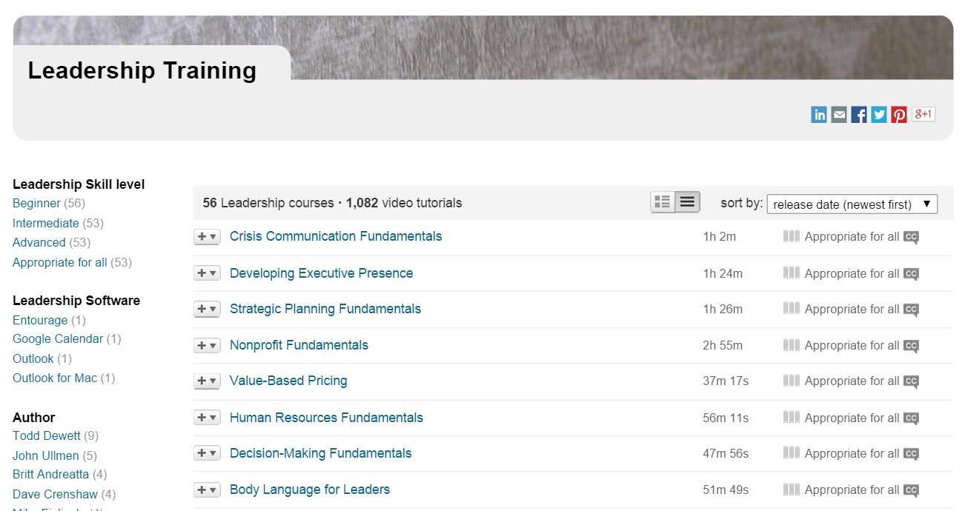
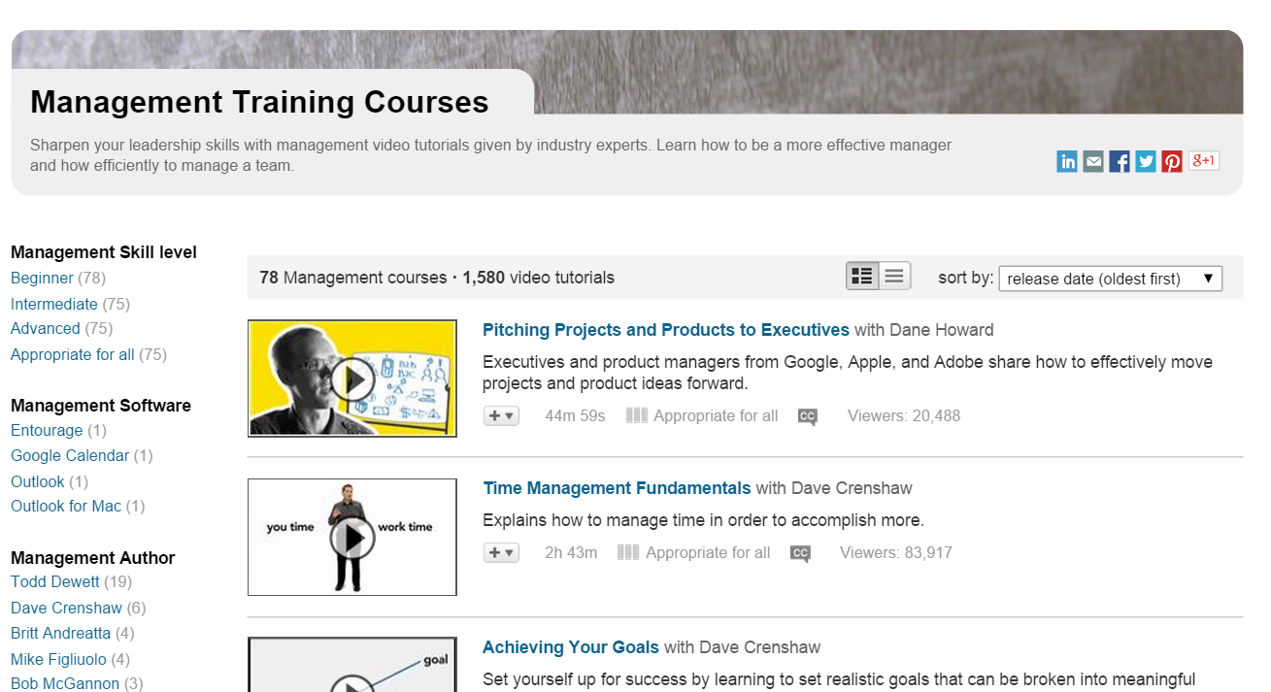
Leadership and Management Course Collection
For developing skills required to guide employees and lead change
Achieving goals
Building business relationships
Coaching & developing employees
Communication
Conflict resolution
Crisis management
Difficult conversations
High-performing teams
Influencing others
Leadership fundamentals
Management fundamentals
Performance reviews
Productive meetings
Time management
134 courses 2,662 videos
Notes:
You had mentioned that you were interested in knowing more about our leadership and management courses. As you can see, we have over 130 courses (and growing). Here is just a sample of topics we cover in this area.

Slide 34
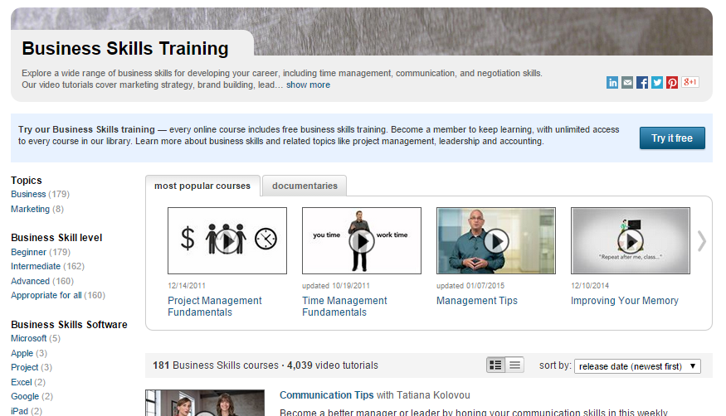

Professional Development Course Collection
For sharpenening employee business skills
Achieving goals
Communication
Leading a customer
Getting things done
Effective listening
Improving judgment
Leading customer-centric culture
Presentation fundamentals
Project management
Public speaking
Time management
Thought leadership
And more
181 courses 4,039 videos
Notes:
You had mentioned that you were interested in knowing more about our Professional Development courses. As you can see, we have over 180 courses (and growing). Here is just a sample of topics we cover in this area.

Slide 35

Project Management Course Collection
For helping employees run projects run like clockwork
Skills
Agile project management
Communication
Project management fundamentals
Leadership
Time management
Virtual team management
Software
Asana
Basecamp
Microsoft Office
Microsoft Project
70+ courses 1,297 videos
Notes:
You had mentioned that you were interested in knowing more about our Project Management courses. As you can see, we have over 50 courses (and growing). Here is just a sample of topics we cover in this area.

Slide 36
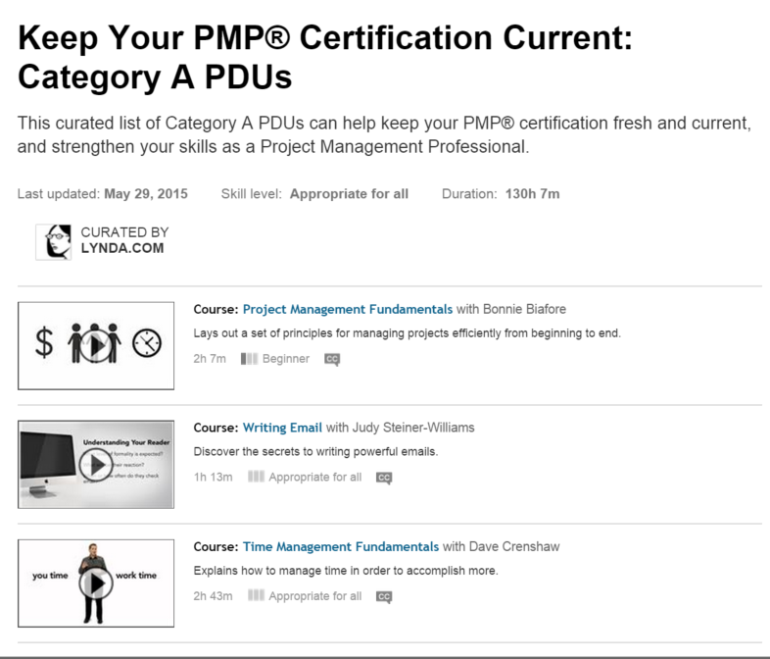

Project Management PMP Credentials
Help employees keep their PMP® credentials current
Registered Education
Provider (R.E.P.) for PMI
70+ eligible course in project management, leadership, and more
Up to 110 Professional Development Units
(PDUs) available
Notes:
We have also curated a playlist that aggregates the 50+ product management courses that are eligible for up to 110 PDUs.

Slide 37

Information Technology (IT) Course Collection
Practical instruction designed to help solve a wide range of everyday computing challenges
Software
Windows
Linux
Mac OS X
Exchange
SQL Server
VMware
Cisco
Azure
PowerShell
Skills
Network and hardware
Security
Cloud computing
Virtualization
Help desk
Mobile device management
Certification prep
130+ courses 3,500+ videos

Slide 38


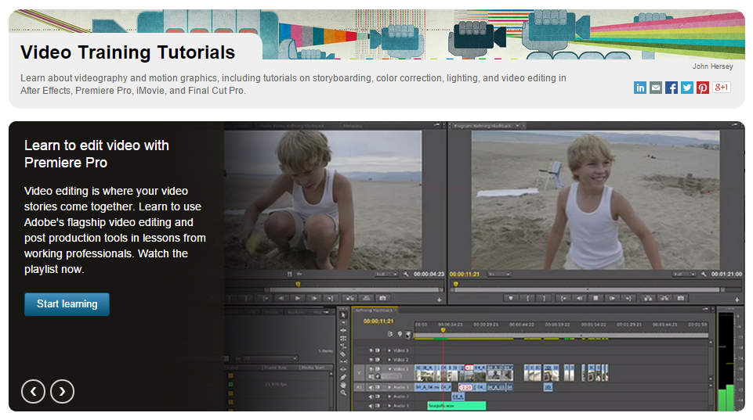

Creative Software and Skills Course Collection
Industry-leading instruction on a wide range of creative tools and professional skills
Design
Photoshop
Muse
Illustrator
InDesign
Sketchbook Pro
Typography
Color
Layout & Composition
Digital publishing
Art & Illustration
3D & Animation
Maya
3ds Max
Blender
Modo
Zbrush
ToonBoom
Game art creation
Texturing
Modeling
CAD
AutoCAD
AutoCAD Architecture
Revit Architecture
Revit MEP/Structure
Civil 3D
Infraworks
Inventor
SOLIDWORKS
Rhino
SketchUp Make/Pro
3D printing
CNC & CAM
Video
After Effects
Premiere Pro
Final Cut Pro
Avid Media Composer
Video production
Motion graphics
Visual effects
1,500+ courses 65,000+ videos

Slide 39
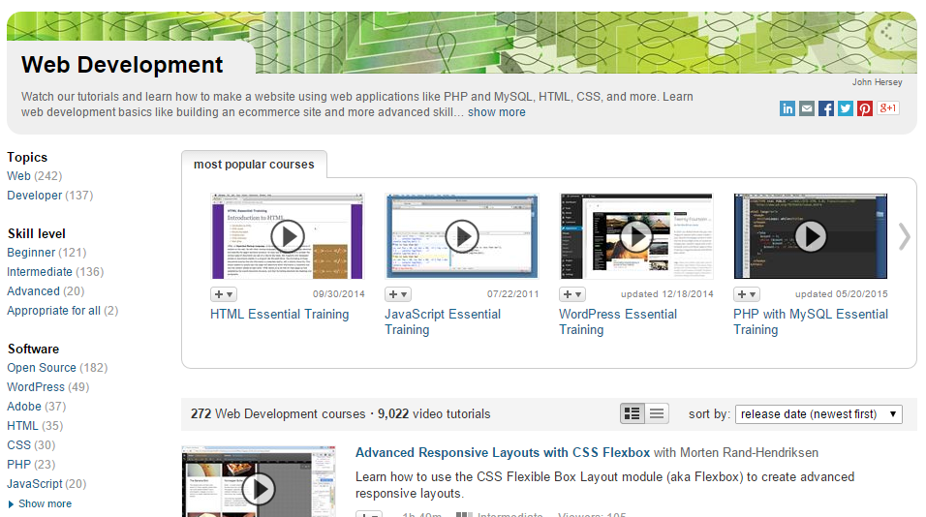
Web Development Course Collection
Instruction on the latest technologies for building websites and web applications
Web technologies and frameworks
PHP
MySQL
HTML
CSS
CakePHP
Ruby on Rails
Laravel
Django
Client side
JavaScript
AngularJS
jQuery
Bootstrap
LESS
Sass
Content management systems
WordPress and the Genesis Framework
Drupal
Joomla!
SquareSpace
260+ courses 8,700+ videos

Slide 40
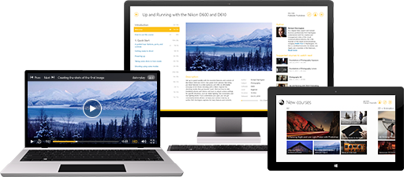
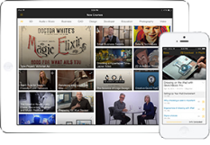
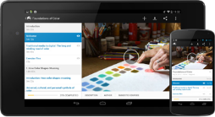
Mobile Access
Learn Anytime, Anywhere – Support Your Mission 24/7
lynda.com is optimized for smartphones, tablets, and desktop computers. It is available online or offline.
Notes:
Our training is always available, can fit into your workforce’s busy schedules
Online & offline access across multiple screens – mobile, tablet, computer
Remote workers can easily access and use training
mobile accessibility fits in wonderfully with the Mobile work initiative by being available on the go, and for those in travel status or out in the field it can even be used offline by downloading courses ahead of time.

Slide 41
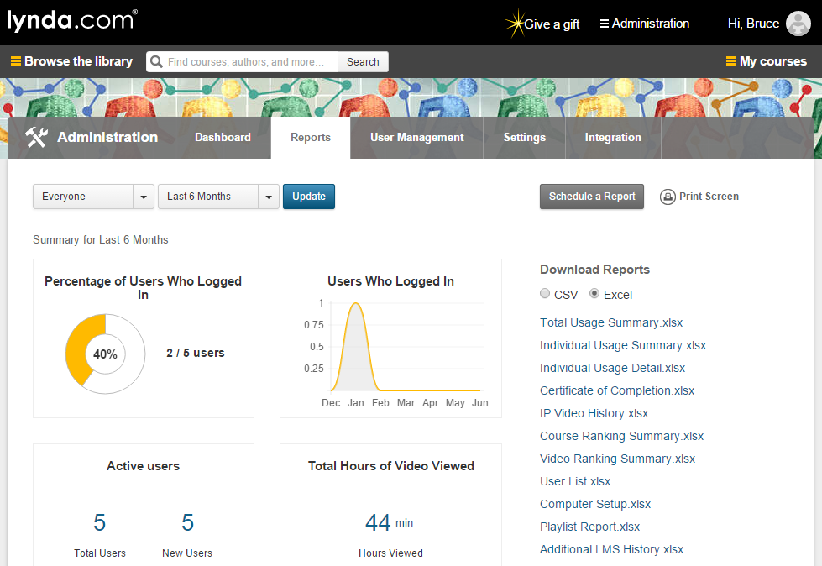
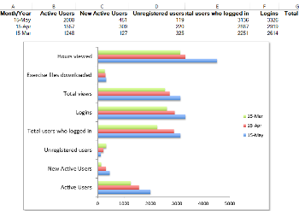
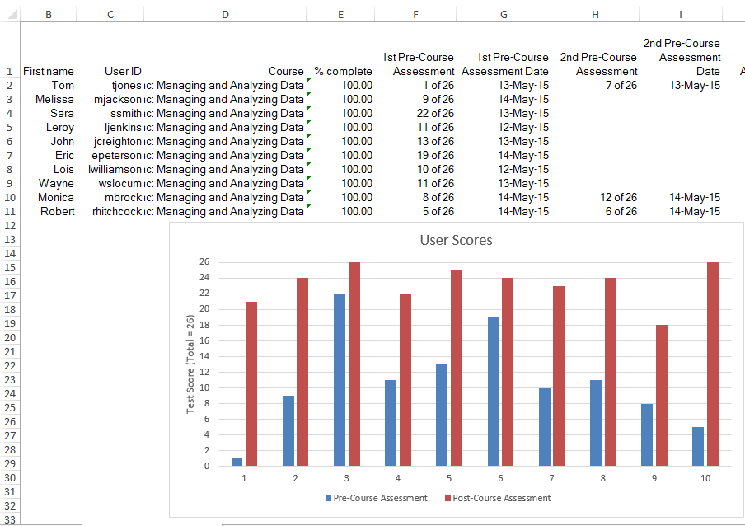

Measure Adoption, Usage, and Learning
Reporting
Reporting Dashboard
At-a-glance metrics on user activity
Usage Reporting
Gauge adoption with login and course view metrics
Assessments
Measure learning retention with assessment scores
Certificates of Completion
Encourage achievement and track user success
Notes:
After your agency deploys Lynda.com it can track and measure usage and completion of learning
This monitoring can be done at the agency, division, team and individual level. So, for example, when an agency wants to show what it provides employees as far as opportunities to learn and grow there are reports to show how many courses your employees are taking on Lynda.com.

Slide 42
Top Courses Across Washington State
Project Management Fundamentals
Migrating from Office 2007 to Office 2016
Excel 2013 Essential Training
Excel Essential Training
Leading with Emotional Intelligence
Communication Fundamentals
New Manager Fundamentals
Communicating with Confidence
Source: Lynda.com organizational usage reports.
Notes:
The courses most watched and completed by our users in Washington State range from Software application and project management, to leadership and communication. And while the online platform lends itself more toward the IT side of learning, Lynda.com is adding more and more to the leadership, business and communication skill departments.

Slide 43

Agency Lynda.com Usage Example:
Accessibility
“Lynda.com training is ACCESSIBLE to blind, visually impaired, and hearing impaired individuals so we don’t have to worry about accessibility. In fact, one of our blind users sent positive feedback to DES and asked why the State of Washington doesn’t utilize this accessible format for internal state training (the state system has accessibility issues.)”
– Mary Craig, Dept. of Services for the Blind
Notes:
Accessibility is a huge focus right now in the state and one of the great things about Lynda.com is that all of the training and exercise files are completely accessible. In keeping in accordance with the OCIO accessibility policy you can look to what is available on Lynda.com before deciding to spend money on re-doing inaccessible trainings.

Slide 44
Agency Lynda.com Usage Example:
Create custom learning paths
Agencies have developed custom playlists and then assigned them for use in PDPs.
Some agencies have developed custom learning paths for certain roles, individuals or divisions and then upload the completions into LMS for tracking
Customizable and curated playlists
Role-based (by function, level)
Competency-based
Start from scratch or modify curated playlist
Notes:
A custom learning path can be developed for each role -- or even each individual -- at your agency. These playlists can be assigned agency wide, or to groups or individuals and incorporated into PDPs. Complerted courses in Lynda.com are uploaded into the LMS manually.
We’ve curated playlists that:
are suitable for each role – for example, an SEO specialist or an IT manager
accommodate different levels – such as a new manager, experience manager, or department head
build certain competencies – such as conflict resolution and inspiring others
Administrators and users can choose to leverage any of our existing playlists, or can create customized ones to ensure the training is aligned with your agency’s performance objectives or individual employee needs.

Slide 45

Agency Lynda.com Usage Example:
Software Upgrade
“Revenue found Lynda.com very useful when we transitioned from Microsoft 2007 to 2016. We required staff to take the online training, Migrating from Office 2007 to Office 2016, before registering for any classroom training through DES resulting in saving training funds.”
– Cindy Nakano, Dept. of Revenue
Notes:
Lynda.com training can serve as a great resource when undergoing a change in an agency, division or team. There have been agencies that have assigned software training to all affected employees when switching systems or upgrading. This is a cost effective way to make sure all are prepared. Plus the monitoring ability of the Lynda.com system give the ability to track and report completion.

Slide 46

Agency Lynda.com Usage Example:
Cost & Flexibility
“Cost and Flexibility. Classroom courses can cost hundreds and with Lynda.com we are able to take multiple classes for $41 per YEAR. In addition, most of us have busy schedules and it would be difficult to be out of the office to attend these classes. Now we can take classes as we have time in my schedule. We can do so on work computers, cellphones – from virtually anywhere (with some caveats – especially for OT eligible staff.) We can even download classes if we won’t have Internet access available!”
Notes:
On top of Lynda.com being very affordable compared to many other types of training.
It is also mobile work friendly and great for a Remote workforce and
The fact that it is on demand and allows for micro learning make it easier and more likely to be utilized

Slide 47
Agency Lynda.com usage examples:
Agency has used Lynda.com in team development by assigning a short relevant course before a team meeting and discussing the learning together
Training Manager created and assigned playlists correlated to position duties to use in PDPs. Added the courses/playlist into LMS and gave credit once completed.
When consulting with supervisors to improve an employee’s performance we include applicable Lynda.com training as a first step. We also have had supervisors and leads look through courses and provide a recommended list of training to staff.

Slide 48
Testimonials
Our Help Desk staff are able to recommend Lynda.com training classes for end users who have a need for specific training.
Staff are able to download trainings so that when they are in travel status (riding in a car or via airplane) they are able to utilize the time for training.
I have been able to assign course lists to all of my staff to ensure that they all have the relevant training for their jobs.
HR appreciates that the staff training records are automatically updated for us (on a routine basis.)
The Certificates in Lynda.com can be tied to a user’s LinkedIn account and so their courses can show up in LinkedIn after completion.
As SEOs, we don’t get paid at the level we should because of state budget considerations. Perks like this membership mean a lot more in the field than HQ might know.
I am a supervisor and I have all of my staff taking Lynda.com classes as part of their annual training plans
I love having Lynda.com training provided as an option at work. I use it to build skills in a hurry to accomplish a new kind of task, research the structure of online training for some topics and to fill in knowledge gaps at my own pace
I have been employed with companies in social services, banking services, and customer service and this is by far the most beneficial program that has been provided by an employer. I hope that the state employees continue to take advantage of the many programs Lynda has to offer as they will have a positive impact on their personal and career development.

Slide 49
Good of the Order Updates, Questions, Answers, Agenda Ideas

