Slide 1
CIO Forum
March 13th, 2018

Slide 2
2018 Legislative Update 2019 Legislative Session
Connie Michener, WaTech

Slide 3
IPMA Update
Connie Michener, WaTech

Slide 4
2018 NASCIO Awards Submissions
Connie Michener, WaTech

Slide 5
2018 NASCIO | OCIO State IT Awards Timeline
March
April
May10
OCIO
Information packets released to agencies
Communications to agency CIO’s
Nominations must be reviewed and approved by the OCIO
Final nominations must be submitted by the OCIO
Only one nomination per category
Agencies
Review information packets
Pay close attention to the criteria in the submission information
Take time to research the NASCIO Awards Library www.nascio.org/Awards/SIT
Start the conversation with the project team leader
Start the conversation with your communication team
OCIO
Communications & outreach continue
Consults with each agency project point of contacts & communication office
Start reviewing drafts
April 6 - OCIO reviews alignment with nominations, project eligibility and categories
Develop recommendations for State CIO
Agencies
April 6 - Drafts submitted to OCIO
Consults between OCIO | agency lead point of contact
Agreement on category selection
May 4 - Final drafts completed and resubmitted to OCIO
Agency notified by OCIO on final selections
OCIO
May 10 - Final nominations selected
May 21 - OCIO submits nominations to NASCIO
Notifications sent to agency
NASCIO
Nominations undergo NASCIO review for compliance
If the nomination does not meet guidelines the nominator will be notified and granted 48 hours to resolve the situation.
Agencies
If notified, resolve compliance issues
Finalists announced in July
Recipients announced at NASCIO Annual Conference in October
OCIO Point of Contact: Connie Michener | connie.michener@watech.wa.gov | 360.407-8689

Slide 6
INFORMATION PACKET
Submission Information Category Descriptions Scoring Guidance Nomination Example
Page 2
Pages 3 ‐ 11
Pages 12 ‐ 13
Page 14
The NASCIO State IT Recognition Awards honor
innovation and excellence in the use of information technology in state government.
NASCIO is seeking nominations of transformational projects and initiatives that address critical business problems, improve business processes and increase citizen engagement in state government.
2018 CATEGORIES
Business Process Innovations **NEW**
Cross‐Boundary Collaboration & Partnerships
Cybersecurity
Data Management, Analytics & Visualization
Digital Government: Government to Business
Digital Government: Government to Citizen
Emerging & Innovative Technologies
Enterprise IT Management Initiatives
Information Communications Technology Innovations
State CIO Oﬃce Special Recognition
Nominations due to OCIO by May 10, 2018 by 11:59 p.m.
6

Slide 7
SUBMISSION INFORMATION
SUBMISSION GUIDELINES
NASCIO state and territory members in good standing may submit a nomination. Corporate, academic and nonproﬁt members must work with a state CIO oﬃce to coordinate submissions.
Nominations must be made by the state CIO oﬃce or other state agencies with the state CIO approval.
Only one nomination per category per state is permitted.
A project may only be submitted in one award category.
PROJECT ELIGIBILITY
Projects must be state‐focused (not regional, local or national).
Multi‐state projects are encouraged and must be submitted by the lead state. (If the project is a ﬁnalist, all states included will be recognized).
All projects must have been fully implemented between December 2015 and December 2017. Projects submitted in the Emerging & Innovative Technologies award category can be in implementation or beta stage through June 2018.
Outsourced projects will be considered as long as they are managed and controlled by the state.
The project must be able to stand on its own. If the project is a phase of a larger initiative, only the beneﬁts of the phase will be evaluated and recognized.
Projects previously recognized as an award recipient are not eligible. All other previous submissions (ﬁnalists or non‐ﬁnalists) may be resubmitted provided they meet the guidelines.
NOMINATION DOCUMENT REQUIREMENTS
Length of nomination not to exceed seven (7) pages total
Nomination should be easily readable in font choice/size and margin size
Nomination must be submitted in PDF via the Award Website (email submissions not accepted)
REQUIRED SECTIONS & PAGE ALLOTMENTS
Cover Page (title, category, state, contact, project initiation and end dates)
Executive Summary
Pages 3‐7 Project Narrative: Concept, Signiﬁcance and Impact
SUPPLEMENTAL MATERIALS
Nominations may include URLs of public‐facing project‐speciﬁc sites.
Judges may visit a site for clariﬁcation, but the project narrative will be the main basis of scoring. When writing the narrative, please assume judges will not visit the site. The inclusion of URLs is beneﬁcial to other states when the nomination is included in the NASCIO Awards Library.
Do not include supplemental materials (brochures, news articles, marketing materials, CDs/DVDs), as these items will not be reviewed.
Page 1
Page 2
NASCIO REVIEW
NASCIO will review all nominations for compliance with eligibility,
requirements and alignment with selected award category. If the nomination does not meet the guidelines, the nominator will be notiﬁed and granted 48 hours to resolve the situation. Nominations that remain non‐compliant will not be reviewed by judges.
CONTACT : Connie Michener, connie.michener@watech.wa.gov or 360-407-8689

Slide 8
BUSINESS PROCESS INNOVATIONS
KEY ATTRIBUTE
Projects recognized in this category optimize the way people, processes and technology work together to transform government.
NOMINATION GUIDANCE
Projects include technology initiatives and business process improvements implemented to make government operations more eﬃcient and eﬀective, such as:
Improving communication channels or decision making
Increasing security or customer satisfaction
Eliminating redundancies or streamlining workﬂows
Forecasting changes
Projects can focus on methodologies, such as Agile and Design Thinking, or technical innovations such as Blockchain.
EXAMPLES
Relevant projects include, but are not limited to:
ERP implementation
Project management methodologies or innovations
Cyber dashboards/risk management
Customer service/experience
Decision modeling and management
Regulatory/compliance management
System modernization
Procurement modernization
Workforce/personnel reforms or modernization
CONTACT: connie.michener@watech.wa.gov or 360-407-8689

Slide 9
CROSS-BOUNDARY COLLABORATION & PARTNERSHIPS
KEY ATTRIBUTE
Projects recognized in this category demonstrate what is possible when jurisdictions and agencies work together to solve a problem, address a need or pursue a new opportunity.
NOMINATION GUIDANCE
Projects should address identifying, planning, coordinating, sharing, integrating and/or joining formerly non‐integrated, IT‐related organizational goals and strategies.
Projects should include signiﬁcant collaboration with other public groups such as localities, special purpose districts, higher education institutions or tribal governments, not‐for‐proﬁt organizations, or private sector collaborators.
SPECIFIC REQUIREMENTS
Nominated collaborations:
Must involve at least one state government entity*
Document the state government’s leadership role
*Multi‐state initiatives are encouraged, with the lead state submitti ng
EXAMPLES
Relevant projects include, but are not limited to:
Governance and management policies
Business processes
Data and information
Systems and applications
Services
Technologies and infrastructure.
Relevant functional/service areas include, but are not limited to:
Performance management
Budgeting
Criminal justice
Emergency management
Taxation/revenues
Health and Human services
Education
Workforce training
CONTACT: connie.michener@watech.wa.gov or 360-407-8689

Slide 10
CYBERSECURITY
KEY ATTRIBUTE
Projects recognized in this category demonstrate the importance of security and risk management and are commensurate with cybersecurity’s consistent ranking as a top priority of state CIOs.
NOMINATION GUIDANCE
Projects should incorporate IT security and privacy into strategic state initiatives, disaster recovery and planning and continuity of government operations.
Projects should help states identify security risks, implement appropriate safeguards, detect the occurrence of an event, contain the impact and maintain plans for resiliency and recovery of services aﬀected due to a cybersecurity event.
EXAMPLES
Relevant projects include, but are not limited to:
IT security challenges related to threats and vulnerabilities; compliance and incident management and response.
Related IT security initiatives such as governance frameworks; enterprise security policies; assessments; I&AM; auditing; and education and awareness programs.
Data privacy activities that address protection of business and citizen PII; security of data in the event of a cyber incident or disruption; data protection policies and practices.
DRP and COG eﬀorts to support ongoing government operations through planning; infrastructure protection; recovery mechanisms; disaster recovery; and contingency planning.
CONTACT: connie.michener@watech.wa.gov or 360-407-8689

Slide 11
DATA MANAGEMENT, ANALYTICS & VISUALIZATION
KEY ATTRIBUTE
Projects recognized in this category showcase the transformative power of data for decision making and insight.
NOMINATION GUIDANCE
Projects should use data to uncover insights and create understanding to inform decision making.
Projects can also focus on the creation of a system or policies that allow for the strategic use of data.
Projects should focus on harnessing and leveraging data for public policy decisions.
EXAMPLES
Relevant projects include, but are not limited to:
Analytics, business intelligence, predictive analytics, performance management
Visualizations
Data governance and information architecture
Data warehouses, data mining and repositories
Data and information integration
Personalization
Master data management
Roles and responsibilities
CONTACT: connie.michener@watech.wa.gov or 360-407-8689

Slide 12
DIGITAL GOVERNMENT: GOVERNMENT TO BUSINESS
KEY ATTRIBUTE
Projects recognized in this category foster improved interaction between government and business.
NOMINATION GUIDANCE
Projects/applications may include, but are not limited to, those that improve service at less cost to business for regulatory compliance, new business formation and day‐to‐ day government‐to‐business interactions.
As applicable, include detailed information about:
Longevity of the service
Target audience and the current adoption rate
Outreach campaigns to encourage use
Steps taken to ensure data and transactional security
Performance measures and client satisfaction data
Include any development and/or training initiatives that ensure expanded access to, and independent use of these services by people with disabilities or others who would not normally have easy access to digital government initiatives.
EXAMPLES
Relevant projects include, but are not limited to:
e‐Licensing
One‐stop registration
Permitting
Payment
Reporting
Notiﬁcations
Compliance tracking
CONTACT : Connie Michener, connie.michener@watech.wa.gov or 360-407-8689

Slide 13
DIGITAL GOVERNMENT: GOVERNMENT TO CITIZENS
KEY ATTRIBUTE
Projects recognized in this category foster improved interaction between government and citizens, stimulate citizen engagement and/or provide access to data and information for citizen use.
NOMINATION GUIDANCE
Projects may include, but are not limited to, innovative services or communication channels for citizens, open data and open government initiatives, applications to increase government’s eﬃciency and/or stimulate citizen engagement and interaction.
As applicable, include detailed information about:
Longevity of the service
Target audience and the current adoption rate
Outreach campaigns to encourage use
Steps taken to ensure data and transactional security
Performance measures and client satisfaction data
Include any development and/or training initiatives that ensure expanded access to, and independent use of these services by people with disabilities or others who would not normally have easy access to digital government initiatives.
EXAMPLES
Relevant projects include, but are not limited to:
Innovations in online transactions
Social networking
Citizen feedback and commenting
Personalized mapping and service location trackers
Mobile apps and services
Alerts and notiﬁcations
Open data portals and transparency initiatives
*Submissions that address high‐volume, mission‐critical services such as unemployment services, veterans' services, comprehensive beneﬁts availability and eligibility determination, justice programs, and revenue and tax collection are encouraged.
CONTACT : Connie Michener, connie.michener@watech.wa.gov or 360-407-8689

Slide 14
EMERGING & INNOVATIVE TECHNOLOGIES
KEY ATTRIBUTE
Projects recognized in this category utilize technologies on the cutti ng edge of the industry to deliver value.
NOMINATION GUIDANCE
Projects can include the release, implementation and/or distribution of the technology.
In the case that your oﬃce does not utilize/implement the technology directly, but provide oversight, your nomination may be based on new processes for encouraging innovation or policy and guidelines development and implementation.
SPECIFIC REQUIREMENTS
Projects nominated in the category:
Do not have to be fully implemented by December 2017 and may be in implementation or beta stage through June 2018.
EXAMPLES
Relevant projects include but are not limited to:
Wearables
3‐D printing
Autonomous automobiles
Unmanned aerial systems
Sensors
Artiﬁcial Intelligence or Machine Learning
CONTACT : Connie Michener, connie.michener@watech.wa.gov or 360-407-8689

Slide 15
INFORMATION COMMUNICATIONS TECHNOLOGY INITIATIVES
KEY ATTRIBUTE
Projects recognized in this category leverage communication technologies to transform government and/or promote economic development, interoperability and improved quality of life.
NOMINATION GUIDANCE
Projects may provide communication capabilities that increase citizen access, enable state government to operate more eﬃciently and eﬀectively, or oﬀer more innovative, responsive and personalized services to citizens.
Initiatives or services can be unique uses of current technology or the application of leading‐edge technology.
Submissions that include mobile solutions and services are encouraged.
EXAMPLES
Relevant projects include, but are not limited to:
Online learning
Geographic information systems
Wireless applications
Mobile services
Software as a service (SaaS)
Cloud computing
Broadband applications
CONTACT : Connie Michener, connie.michener@watech.wa.gov or 360-407-8689

Slide 16
STATE CIO OFFICE SPECIAL RECOGNITION
KEY ATTRIBUTE
Projects recognized in this category honor the leadership and innovation of state CIOs and their oﬃces.
NOMINATION GUIDANCE
Projects should be initiated and implemented by the state CIO’s oﬃce.
This category is open to a variety of projects.
Utilize this opportunity to showcase your oﬃce’s innovations.
SPECIFIC REQUIREMENTS
Projects much be initiated and implement by the State CIO’s oﬃce (or equivalent)
Projects can involve partnerships and collaborators, but the State CIO’s oﬃce (or equivalent) must take a leadership role.
EXAMPLES
Relevant projects include, but are not limited to:
Procurement
Workforce reform
Talent management
Performance management
Technology business management innovation
Internal collaboration
Business process improvements
Customer service
Private‐public partnerships
Also relevant are projects inherited that have been renovated.
CONTACT : Connie Michener, connie.michener@watech.wa.gov or 360-407-8689

Slide 17
SCORING ELEMENTS AND GUIDANCE
SCORING ELEMENTS
Each element is scored on a 10 point scale. The exemplar, concept and signiﬁcance scores are weighted at 20% of the overall score and the impact score at 40%.
EXEMPLAR
Key Point: The project represents visionary and transformational use of information technology in state government.
Information technology is no longer the foundation on which government services sit, but an integral part of how government functions. Nominations should demonstrate how the project serves as a model of this integral role.
While supporting the public policy goals of state leaders, nominated projects should transform critical business problems, improve business processes or promote a customer‐centric way for citizens to interact with their government.
Nominations should showcase how the project takes a foundation of best practices to the next level, exemplify leading and innovative practices or applying common practices in a transformational way.
CONCEPT
Key Point: The project successfully addresses a need in state
government.
Nominations should clearly explain the business problem the project is solving or the opportunity on which the project is capitalizing. It should be clear to the review how the project moved from idea, to design, to implementation.
Provide background on how the problem/opportunity came to be, context for the environment in which you were working and why the project is the best solution.
Describe the solution architecture of the project:
Is the initiative part of a larger project?
What project management approach was taken?
What are the costs (people, time, dollars)?
How will the initiative be assessed?
What eﬀorts are made to ensure accessibility and information security?
To what extent is the state responsible for oversight of the initiative and outcomes of the initiative?
Brieﬂy outline an associated communications plan to educate users and/or promote awareness and adoption.
CONTACT : Connie Michener, connie.michener@watech.wa.gov or 360-407-8689

Slide 18
SCORING ELEMENTS AND GUIDANCE
SIGNIFICANCE
Key Point: The project is consequential, relevant and
transformational for state government and/or constituents.
Deﬁne the scope of the initiative and beneﬁciaries/ stakeholder groups.
Highlight what makes the initiative innovative and distinct from similar projects.
Outline what successful implementation looks like and why that is important. What change will the initiative have on the nominating agency, the state, constituents?
Describe how the initiative ﬁts into the larger picture: policy, strategy and goal alignment with gubernatorial priorities; IT strategic plans; enterprise architecture; agency business plans, goals and strategies; state and federal mandates; and/ or NASCIO’s State CIO Top Ten Priorities.
IMPACT
Key Point: The project leads to substantial and measurable
change; it makes state government better.
Compare the environment before the initiative was implemented and after it was completed. How is state government better?
Detail the immediate and longer term impact of the initiative. Address the ﬁnancial and non‐ﬁnancial reasons why this project was worthy of the investment made.
Describe the beneﬁts and the impact of the beneﬁts for both the nominating agency and constituents, such as services to constituents, operational improvements, security and/or privacy, transparency of government, and transformation of government.
Note quantitative metrics (cost savings/avoidance, ROI, usage, transaction times, etc.) and qualitative beneﬁts (citizen, business or employee experience, etc.).
REVIEW
Nominations are scored by a volunteer panel of NASCIO state and corporate members. Judges do not score projects from their own state or in which their company played a role. NASCIO makes every eﬀort to avoid potential conﬂicts of interest.
In each award category, the three (3) highest rated nominations will be named as ﬁnalists; the highest rated will be named the recipient.
A state can be recognized as an award recipient in no more than two categories a year. If a state has recipient‐level scores in more than 2 categories, the two highest scored nominations will be selected as the recipient in the respective categories. Multi‐state initiatives and the State CIO Oﬃce Special Recognition category are exceptions.
CONTACT : Connie Michener, connie.michener@watech.wa.gov or 360-407-8689

Slide 19
PROJECT NARRATIVE EXAMPLE
Example is condensed from the 2015 award recipient nomination, Electronic Death Registration & Birth Certiﬁcates On Demand (Virginia)
CONCEPT
The state’s death certiﬁcation process was a manual exercise with information required from multiple signatories. Once paperwork was completed, the death would be oﬃcially documented by the state, again through a manual entry; the entire process took days to complete. Obtaining a birth certiﬁcate posed similar challenges. The Department of Health (DH), located in the state capital, was the only location at which to obtain same‐day birth certiﬁcates. Citizens could request certiﬁcates without traveling to the capitol by mailing a vital records application to the DH, the certiﬁcate would then be mailed back to the citizen; this cumbersome process took an average of three days plus mailing time on either end. Expedited certiﬁcates via mail were available at a high cost through a third‐ party vendor. The state recognized that the important government services, that often require immediacy, had limited availability to state citizens and sought a new solution.
SIGNIFICANCE
Two projects in the state have enhanced the government‐to‐citizen experience in obtaining two vital records. The Department of Health’s (DH’s) Electronic Death Registration System (EDRS), enables participants in the death registration process to ﬁle death records online with DH vital records. DH joined the Department of Motor Vehicles (DMV) for the second project, to permit citizens to obtain same‐day birth certiﬁcates at nearly 80 DMV customer services centers across the commonwealth. The EDRS is a secure, completely web‐based tool that enables a critical, real‐time data exchange between DH and DMV. Both projects have enables the state to create distributed service models that generate revenue, save citizens time and money, and leverage signiﬁcant commonwealth investment in existing facilities and technology infrastructure to provide critical services.
IMPACT
Approximately 130,000 birth certiﬁcates have issued the same day as requested in the 14 months since implementation. DMV charges a small processing fee of $2 in addition to the
$12 fee at vital records. This represents more than $250,000 in new revenue to the
commonwealth in the ﬁrst year, while actually saving citizens time and money. The numbers of transactions are impressive, but the real value comes in the convenience to customers. Travel, long lines at the single vital records oﬃce, waiting on the mail and high cost of obtaining birth certiﬁcate from a vendor have been eliminated. Through the VDH and DMV collaborative project and the VDH individual project, the state has created distributed service models that generate revenue, save citizens of the Commonwealth time and money, and leverages signiﬁcant commonwealth investment in existing facilities and technology infrastructure to provide critical services.
14

Slide 20
Dial.wa.gov
Heidi Geathers, WaTech

Slide 21
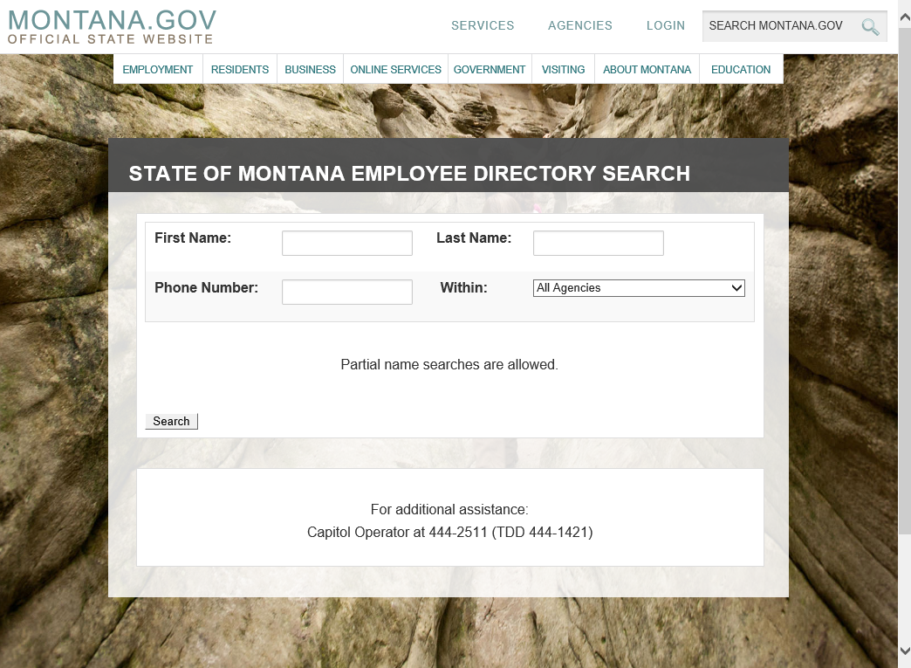
Montana Public Directory home page

Slide 22
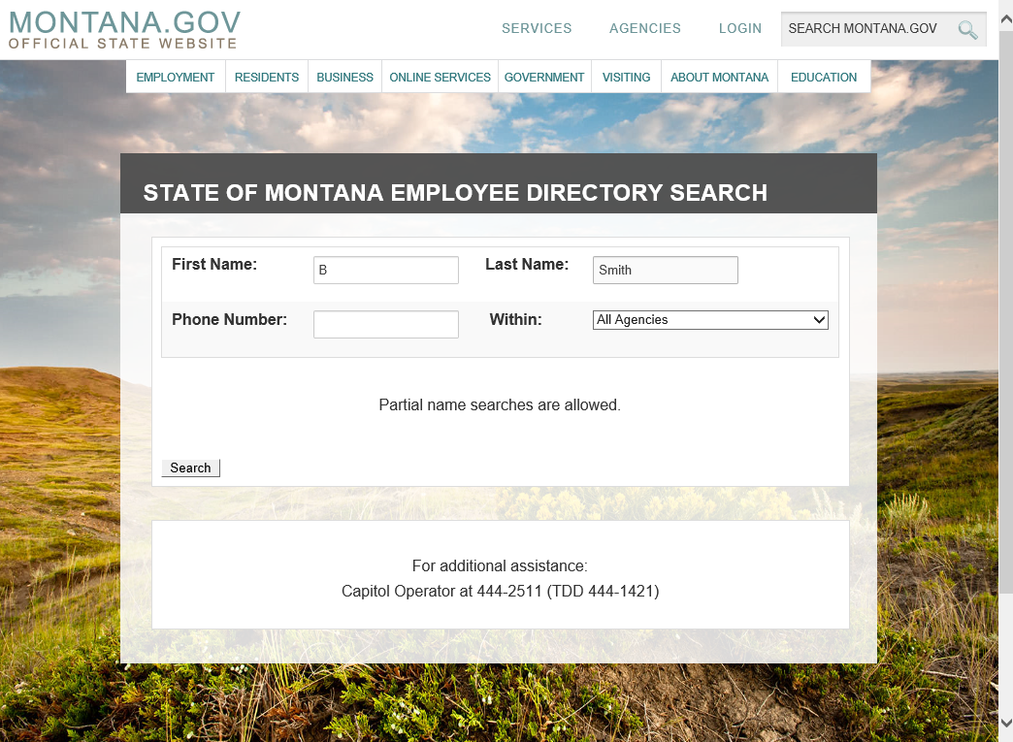
Enter Search Criteria

Slide 23
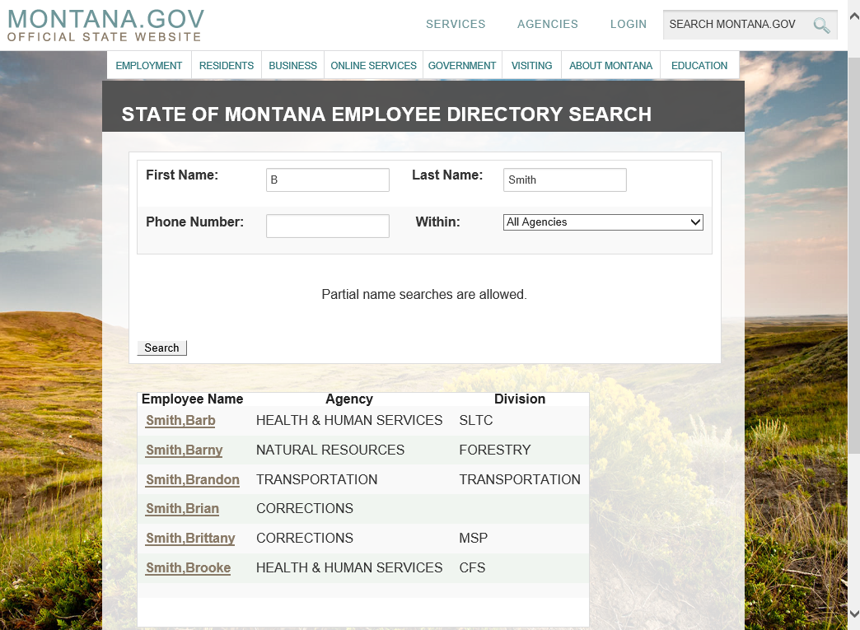
Search Results

Slide 24
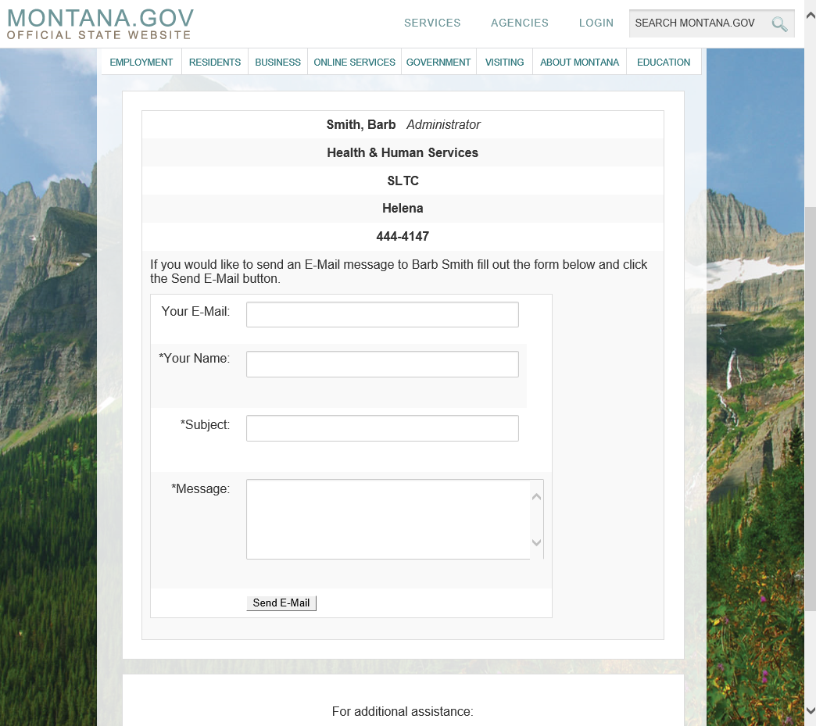
Employee selected

Slide 25
Exchange 2016 Update
Lance Calisch, WaTech

Slide 26
OCIO Update
Laura Parma, OCIO
Rich Tomsinski, OCIO
Cammy Webster, OCIO

Slide 27
WaTech Customer Satisfaction Survey
David Brummel, WaTech

Slide 28
WaTech Customer Satisfaction Survey March Update
ACB
AGR
AOC
APA
ART
ATG
CAA
CFC
CHA
COM
COS
CRAB
DAHP
DEL
DES
DFI
DFW
DNR
DOC
DOH
DOL
DOR
DOT
DRS
DSB
DSHS
DVA
ECY
ELUHO
ERFC
ESD
GMC
HCA
HRC
HUM
BIIA
KINGC
L&I
LCB
LEOFF
LOT
MIL
OAH
OCLA
OMWBE
OST
PARKS
PDC
PERC
PLIA
PSP
RCFB
SAC
SAO
SCC
SEC
SIB
SPI
STS
TIB
UTC
WHS
WSP
WSTIP
Project Kickoff 3/2
Contact List Developed
Draft Survey Tool Developed
Contact Letters Later This Week
20 a week for 4 weeks
Questions included
1st Survey Interviews Start ≈ 2 Weeks
Results in May
https://watech.sp.wa.gov/ask/customersurvey/SitePages/Home.aspx

Slide 29
Good of the Order Updates, Questions, Answers, Agenda Ideas

