Slide 1
CIO Forum
May 8th, 2018

Slide 2


CIO Forum– Privacy Update
Alex Alben
Chief Privacy Officer
Washington State

Slide 3
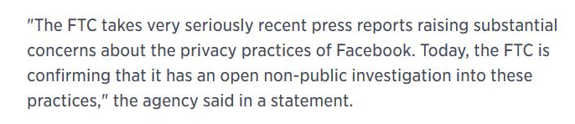
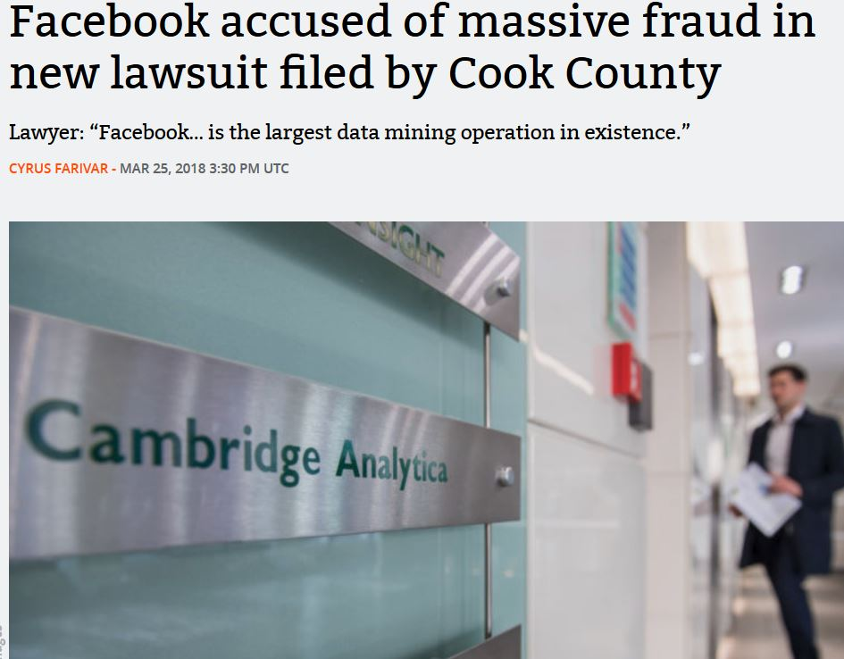

In the News . . .

Slide 4
What happened?
Is this a data breach?
Who is at fault?
What is the consumer damage?
What is the consumer remedy?
What should Facebook do voluntarily?

Slide 5

The Age of Big Data
Consumer Profiling
Data mining
Data analytics
Google matches advertisers with search
Facebook matches advertisers with user profiles
New types of identifiers

Slide 6
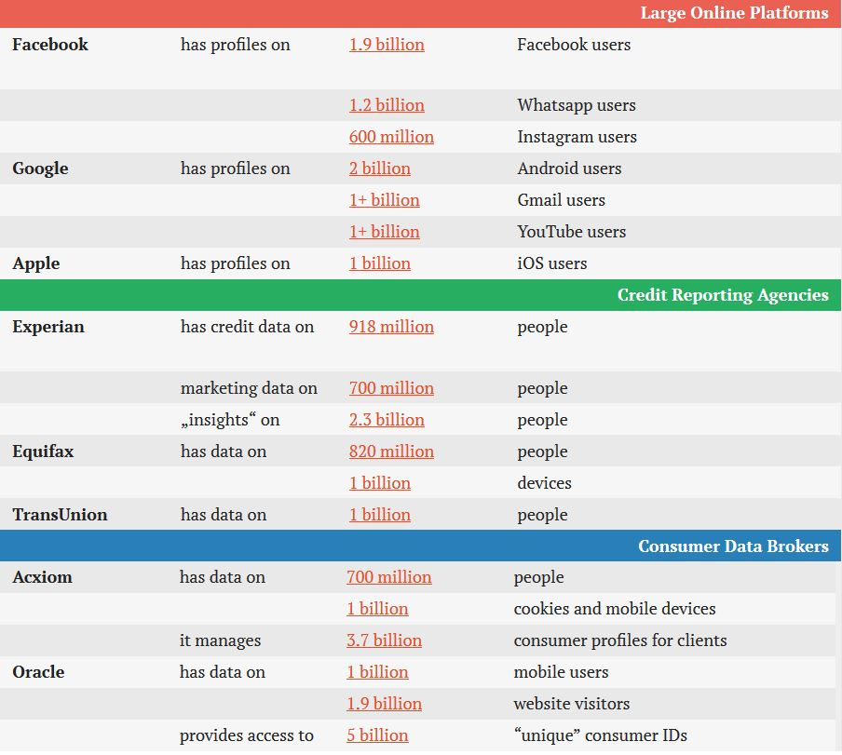
Scope of data profiling:

Slide 7
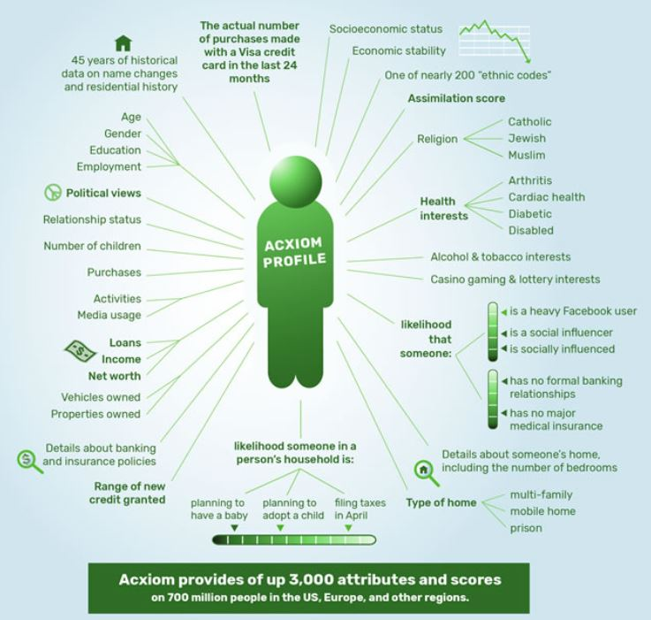

Slide 8
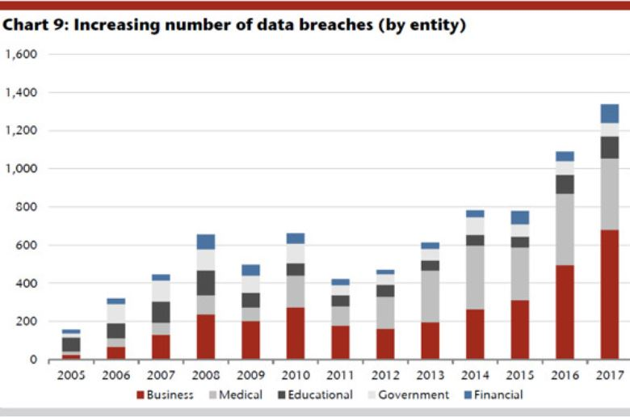
Data Breach
Identity Theft Resource Center, 2018

Slide 9
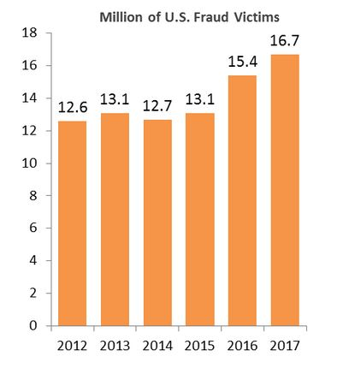
Identity Theft
2018 Identity Theft Study, Javelin Research

Slide 10
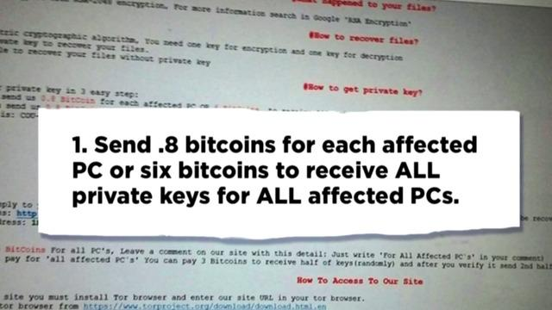
Ransomware!

Slide 11
Ransomware!
45% of US companies hit with a ransomware attack last year paid at least one ransom, but only 26% of these companies had their files unlocked. Companies paying the ransom were attacked again 73% of the time.
Almost every company reporting an attack (97%) said that they had backups for the files affected by the ransomware, and 51% said backups and the ability to self-recover were their reason for not paying the ransom.
Sentinel One Global Ransomware Report, 2018

Slide 12
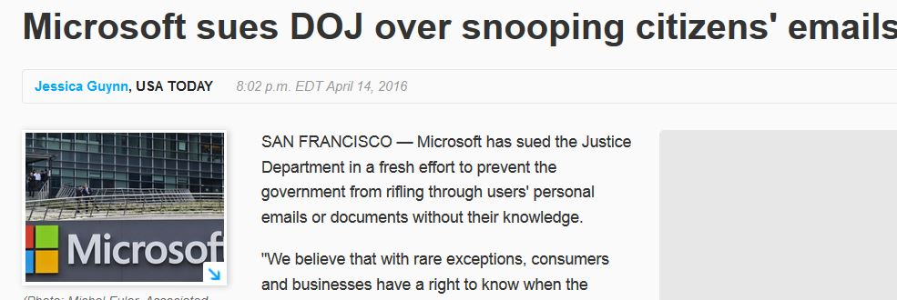


Cyber Crime
Atlanta Ransomware Attack
Does the Facebook event violate the Privacy Shield?
Cloud Computing Act of 2018

Slide 13
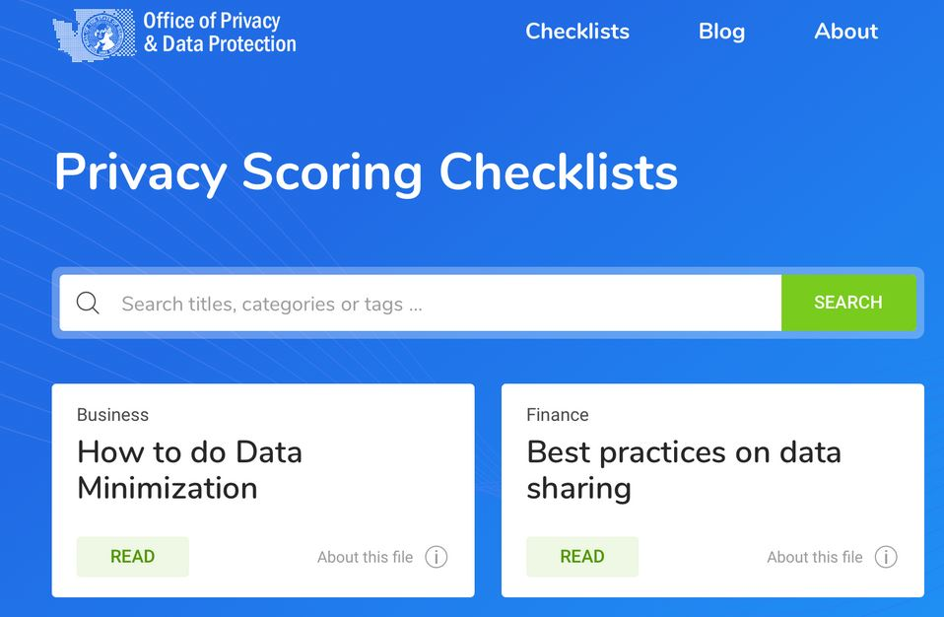
Initiatives: Privacy Modeling & Privacy Checklists
Addressing the need to educate state agencies about privacy law and best practices.

Slide 14

Next privacy assessment– coming this summer.
Consumer legislation.
Training is available!
Office of Privacy and Data Protection
P

Slide 15
privacy.wa.gov alex.alben@ocio.wa.gov
Alex Alben
Chief Privacy Officer
Washington State

Slide 16
State CIO Update
Rob St. John

Slide 17
Updates and Information

Slide 18
Exchange Migration

Slide 19
Exchange Migration Update
40 Agencies Migrated = 23,407 Mailboxes!
No major challenges reported during/after migration
Looking solid for June 4th completion date

Slide 20
Cloud Highway

Slide 21
Cloud Highway Update
All originally specified equipment except for the Performance Edge device have been acquired
Customer IAAs/SLAs
  All IAA’s between agencies are signed
  $1.6 million in reimbursement has been sent and payment received
  Customer Cloud Highway Service SLA draft is being reviewed by OLS
Network and Security Teams continue to architect secure highway roadmap
  Final decision may require additional security device hardware

Slide 22
Cloud Highway Update
Circuits
  SDC to Seattle 10GB circuit
    WaTech has a signed agreement with University of Washington; expected delivery May
  Quincy to Seattle 10GB
    WaTech is in final negotiations; anticipated delivery May/June
    Plan B RFQ also released
The project team has been working with HCA and DSHS on their current use cases, application flows, and preliminary Cloud Highway onboarding planning

Slide 23
Cloud Highway Update
Development of base connectivity/security model (this will allow speed of execution for customers to complete Security Design Reviews (SDRs))
  95% complete on AWS
  1-2 weeks away from being done on Azure
Working on technical options for using WaTech’s Cloud VPN service as a backup for the Cloud Highway Service with AWS
Contract negotiations with Equinix (the COLO provider in Seattle) has started

Slide 24
Microsoft Tenants

Slide 25
Shared Tenant Governance Committee
Governance group created – CEAC (Cloud Enablement Advisory Committee)
May 22nd Docket – IRM / DLP
  Information Rights Management / Data Loss Prevention
  Goal is to form policies for the tenant
Azure Active Directory Workshop taking place as we speak – IDFIX
  Working with agencies to complete IDFIX as timely as possible so testing in hybrid mode can proceed
Microsoft Identity Manager Workshop
  3 days July 10 -12 – Microsoft / WaTech sponsored event

Slide 26
Multiple Tenants
Working with Microsoft to architect multiple tenant design
  In association with DSHS, ECY, WaTech and Microsoft
Preliminary designs are 90% completed
  Microsoft to present high level architecture by May 18th or sooner, incorporating both designs
Outcome is to build impact models for agencies, will still require OCIO policy exception

Slide 27
SAW Modernization Update

Slide 28
SAW Modernization Update
Technical and Governance Groups to meet to decide on release date:
  July 10 – August 10 time frame
    New User Interface
    Agency branding
    Enhanced Tool Tips
    Ask for Help Streamlined
IBM engaged to assist with LDAP Tune-Up
  Performance improvements
SAW infrastructure architecture being reviewed and planning for enhancements

Slide 29
Questions?

Slide 30
WaTech Customer Satisfaction Survey
ACB
AGR
AOC
APA
ART
ATG
BTA
BVFFRO
CFC
CHA
CJTC
COS
DAHP
DEL
DES
DFW
DNR
DOC
DOH
DOL
DOR
DRS
DSB
DSHS
DVA
ECY
ELUHO
ESD
EWU
FMSIB
GMC
GOV
HCA
HRC
HUM
INS
L&I
LCB
LEOFF
LOT
MIL
OAH
OCLA
OFM
OMWBE
OST
PARKS
PDC
PERC
PLIA
PSP
RCFB
SAC
SCC
SDA
SEC
SIB
SPI
STS
TESC
UTC
WHS
WSP
DSHS/ALTSA
DSHS/CA
DSHS/ESA+DCS
DSHS/JRA
DSHS/TSD
Interviews complete (71)
85% response rate
Vendor analyzing results
Results expected end of May

Slide 31
OCIO Update
Sue Langen, OCIO
Laura Parma, OCIO
Whitney Dickinson, OCIO
Amy Pearson, OCIO

Slide 32
Round Table Discussion
One Washington, Stacey Scott, OFM
Budget Process

Slide 33

May 8, 2018
CIO Forum

Slide 34
Agenda
Topic
1. One Washington Program overview
2. Integration Implementation Plan
3. One Washington ERP Experience
4. Governance Advisory Groups
5. Supplemental Budget Request
6. Timeline and Deployment Waves
7. Biennial Budget Requests

Slide 35
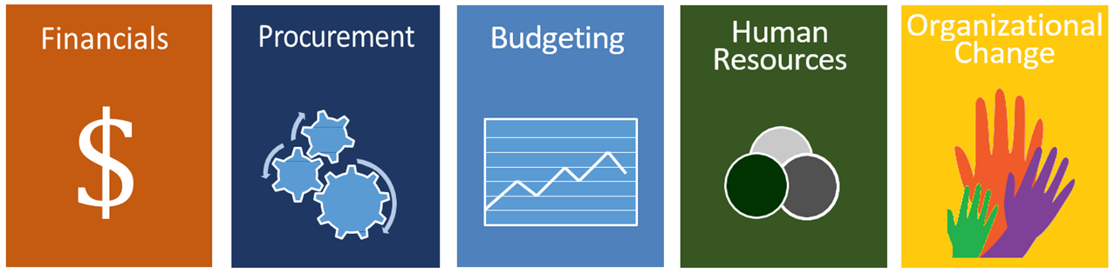
One Washington Program
One Washington is a comprehensive business transformation program to modernize and improve aging administrative systems and related business processes that are common across state government.

Slide 36
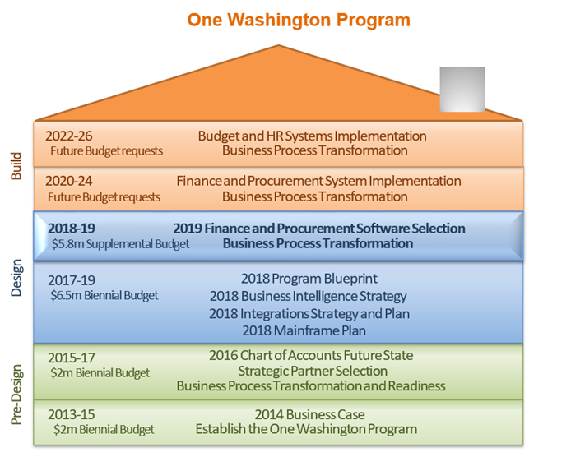
Building One Washington

Slide 37
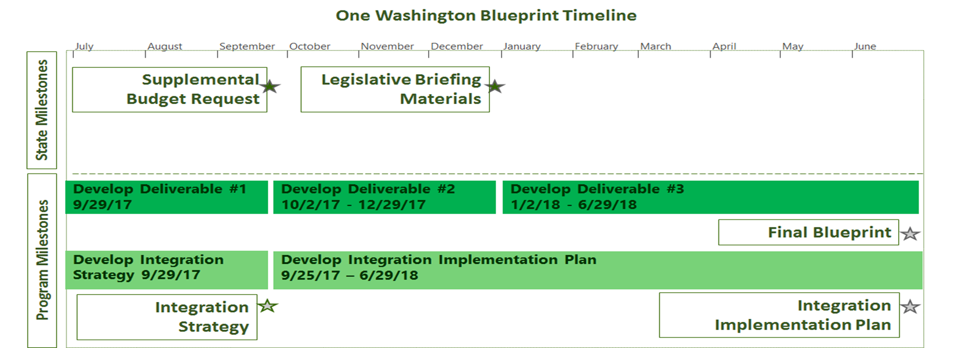
Program Blueprint
The One Washington program has been working with stakeholders in interviews and workshops to complete the Program Blueprint. The final version will be published in June.

Slide 38
Program Blueprint
Blueprint version 3 (final version) will provide more details on:
  Performance measures – Defines the metrics and targets that One Washington will use to measure success
  Master Data Management – Current processes, challenges and governance
  Risk Mitigation – Defines program risks and mitigation plans
  Implementation phasing – Alignment of agencies to waves
  Finance Strategy – Funding of program costs
The Program Blueprint will be published in June

Slide 39
Integration Implementation Plan
One Washington has been meeting with agencies to complete System Impact summaries for systems that interact with AFRS (~44 agencies and 280+ systems)
The objective of the system impact summaries is to:
  Determine if an integration (system will remain) or data conversion (system will be retired) is needed
  Collect key information (i.e. business process, regulatory requirement, etc.) on agency systems
The system impact data will aid agencies and One Washington in the budget planning process and the business capabilities work starting in July
A consolidated report of the system impact analysis will be published in the Program Blueprint Integration Implementation plan in June

Slide 40
ERP Experience
Each of four vendors will have two days to present their software
A third day will focus on WSDOT, Technical and Financing topics
Participation is by invitation only
Attendees will need to register through LMS

Slide 41
ERP Experience - Goals
Create awareness for Washington state leaders on what is possible in an ERP solution and what One Washington transformed business processes will be like.
Allow for the top solution vendors in the public sector to showcase integrated, business functionalities and how they can support our vision.
Identify key functionalities and specifications to include in our procurement process beginning July.
Provide WSDOT and WaTech an opportunity to understand how software solutions could meet their specific technical and business needs.

Slide 42
One Washington Governance

Slide 43
One Washington Advisory Groups
One Washington will establish and implement the following advisory groups to support the Executive Steering Committee:
  Finance
  Procurement
  Budget
  HR/Payroll
  Change
  Technical Advisory
  Data Governance
These advisory groups will be kicked-off in June

Slide 44
Supplemental Budget Request
Initiatives
Procurement of Finance and Procurement Software | Assess Procurement Organizational Strategy | Assess Finance Organizational Strategy and Readiness
Work with stakeholders to gather business and technical requirements Work with WaTech to ensure infrastructure readiness Facilitate software demos Evaluate and select software Continue to coordinate change readiness activities | Assess current business processes with procurement organizational strategy Conduct review of laws, regulations, and policies in readiness for a new procurement system Launch strategic sourcing assessment for a select group of categories | Assess current business processes with finance organizational strategy Consolidate statewide master payee files Conduct a review of laws, regulations, and policies in readiness for a new financial system Review business processes that could be improved with existing technology Standardize accounting practices and data in preparation for a new system

Slide 45
Business Capabilities/Technical Specifications Process
The system impacts data will be inputs into Finance/Procurement business capabilities and technical specifications definition work starting in July
Each of the 3 workstreams will follow a similar process (summarized below)
  A Finance stakeholder team, focused on business capabilities for Finance and Business Intelligence
  A Procurement stakeholder team, focused on business capabilities for Procurement and Business Intelligence
  A Technical stakeholder team, focused on technical specifications across all business areas including Business Intelligence
Compile common capabilities
Review and finalize unique capabilities
Consolidate capabilities
Review common capabilities
Finalize common capabilities
Incorporate stakeholder feedback
Conduct workshops with stakeholders and business owners
Incorporate stakeholder feedback from workshops and finalize capabilities
Consolidate all capabilities into master list
Workshops to review list with stakeholders
Duration 2 weeks
Draft list based on other state examples
Duration: 4 weeks
Identify unique capabilities
Document Use Cases and business outcomes
Duration: 14 weeks
Duration: 2 weeks
Duration 1 weeks
Duration 1 weeks
Feed into CPP documents
24 weeks (6 months)

Slide 46
Procurement Timeline
These activities are planned for 12 months in FY19 and 4 months in FY20
Business capabilities and technical specifications is concurrent with the creation of the CPP documents
Major Activity | Spring FY18 | FY19 July 1, 2018 - June 30, 2019 |  |  |  |  |  |  |  |  |  |  |  | FY20 July 1, 2019 - June 30, 2020
Program month |  | Jul | Aug | Sep | Oct | Nov | Dec | Jan | Feb | Mar | Apr | May | Jun | Jul | Aug | Sep | Oct | Nov | Dec | Jan | Feb | Mar | Apr | May | Jun
Implementation month |  |  |  |  |  |  |  |  |  |  |  |  |  |  |  |  |  | 1 | 2 | 3 | 4 | 5 | 6 | 7 | 8
Fin/Proc ERP & BI Capabilities Definition and Procurement Activity
Initial ERP Software Acquisition
Market research/ERP software demonstrations
Defining business capabilities/technical specifications
Drafting the CPP documents and merging business capabilities/technical specification
Final merge and publish the CPP documents
Time for vendors to develop proposals
Evaluation, demos, orals, and selection
Final negotiations and contracting

Slide 47
Business Capabilities/Technical Specifications Staffing
The following resources are budgeted:
  2 state SMEs for Finance
  2 state SMEs for Procurement
  1 state Technical Manager
  1 state Data Governance specialist
  1 Accenture Project Manager
  1 Accenture SME for Finance
  1 Accenture SME for Procurement

Slide 48
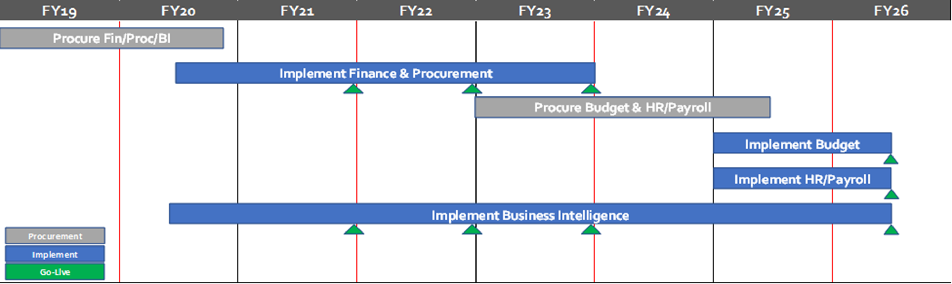
Timeline and Deployment Waves
Wave 1 will be a pilot roll-out followed by a Wave 2 for the remaining agencies. Wave 3 will be reserved for agencies that require expanded functionality to meet their business needs.
Wave 1
Wave 2
Wave 3

Slide 49
Timeline and Deployment Waves
Wave | Agency phasing
Description | Wave 1 will be a pilot roll-out followed by a wave 2 “big-bang” implementation of more complex agencies with complex business processes. Option would lower technical risks, provide a longer runway for organizational change management efforts for complex agencies, and decrease the risk to target go-live dates.
Initial Release Wave 1 - July, FY22 | OFM Governor’s Office WaTech DES (+ small agencies except for Payroll only) DOC Services for the Blind Treasurer DOH UTC WTB UW (*Integration only)
Initial Release Wave 2- July, FY23 | All other agencies
Expanded Release Wave 3 | Agencies that require expanded functionality to meet their business needs
Notes:
OFM – Sponsor agency for One Washington. Will be on the forefront to support governance and organizational change management efforts. Business owner for finance and accounting.
Governor’s Office – OFM provide finance and accounting services to the Gov’s Office. Will provide leadership for organizational change management efforts.
WaTech – OFM’s IT service provider and business partner. Manage the network connectivity/infrastructure and will support integration services between the new ERP and interfacing systems. Will also provide support to enable business intelligence capabilities.
DES (+ non-payroll only small agencies) - Will be on the forefront to support governance and organizational change management efforts. Business owner for enterprise procurement services. They bring all the small agencies with them.
DOC – Large agency with large general fund and spend. Going in wave 1 will allow DOC to get the visibility they require. Not overly complex. Sends payments via Provider 1 (will serve as a pilot for the integration strategy for Provider 1 and DSHS/HCA). Decentralized so we will get that diversity of change management. Very much like DSHS with spread out field offices.
AOC (+3) – AOC has a separately elected official. Expressed strong desire to go wave 1. They also provide finance and accounting services for law library, supreme court, and appeals court.
Services for the Blind – Going wave 1 ensures accessibility is prioritized in the implementation.
Treasurer – need discussion with them to determine which systems will go wave 1. Separately elected official. Complex integrations for cash management (needed for wave 1). Strongly expressed desire to refine business processes.
DOH - Heavily federally funded with deep grants management expertise. Outstanding is a discussion with their leadership to understand willingness to go with wave 1.
Military - FEMA agency with unique reporting requirements. Recipient of federal funding. Outstanding is a discussion with their leadership to understand willingness to go with wave 1.
University of Washington – Their projected go-live aligns with our Wave 1. Ideally, we would have them integrate directly with the new ERP vs. AFRS. This would alleviate them from having to build a temporary integration to AFRS to be replaced by the integration to the new ERP.

Slide 50
Biennial Budget Request
One Washington will provide guidance to assist agencies with quantifying impacts to support the program
The guidance will reference the following support documents:
  Program Blueprint
  Integration Implementation Plan
  Change Management Strategy
This guidance is under development and will be provided through the biennial budget instructions
Agency impacts will go through a review process for consideration of inclusion in the One Washington Decision Package

Slide 51

FOR MORE INFORMATION:
http://one.wa.gov
OneWA@ofm.wa.gov

Slide 52
Good of the Order Updates, Questions, Answers, Agenda Ideas

