Slide 1
SIEC Meeting Thursday, February 21, 2019
State of Washington
State Interoperability Executive Committee

Slide 2
Introductions

Slide 3
Agenda For Review
Welcome and Introductions
Approval of October Meeting Minutes
News and Information Roundtable
WSP License Request for Federal LE/IR Channels
Verizon 5G Presentation
911 Outage Updates
SIEC Subcommittees Update
DES Procurement Update
Washington OneNet (WON) Status
Good of the Order/Public Comments
Future Agenda Topics

Slide 4
Approval of October 18, 2018 Meeting Minutes

Slide 5
Safety Tip!

Slide 6
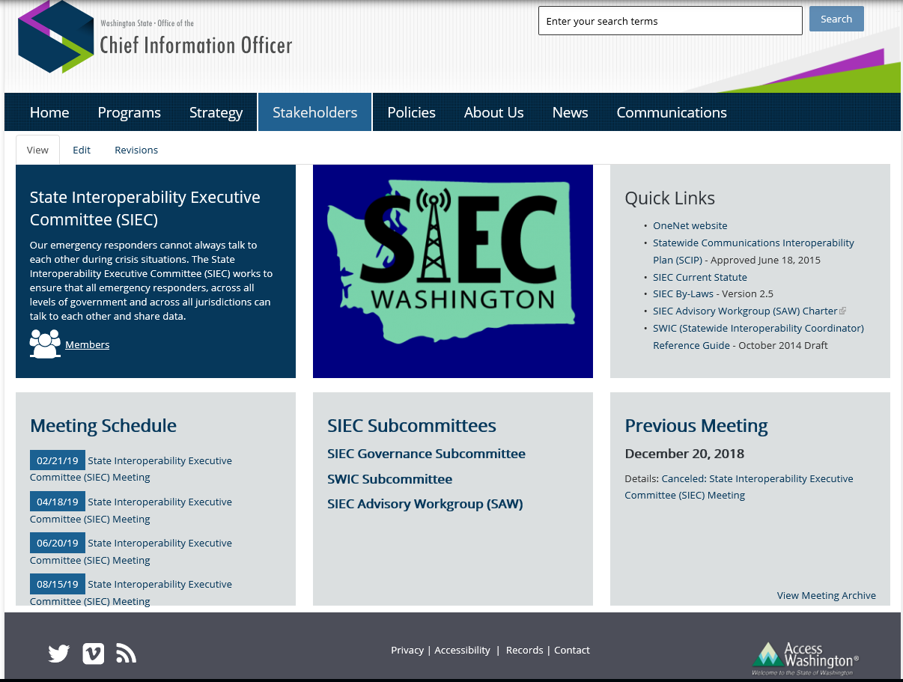
SIEC Webpage

Slide 7
News and Information Roundtable

Slide 8
WSP License Request for Federal LE/IR Channels Robert Schwent

Slide 9
WSP LMR System Upgrade Project Status Report Robert Schwent

Slide 10
Verizon 5G Presentation Arvin Singh, Public Strategy for Government

Slide 11
911 Outage Updates Adam Wasserman Andy Leneweaver

Slide 12
SIEC Subcommittee Update Tom Wallace Alex Alben

Slide 13
DES Procurement Update Neva Peckham

Slide 14
Washington OneNet Update Shelley Westall

Slide 15
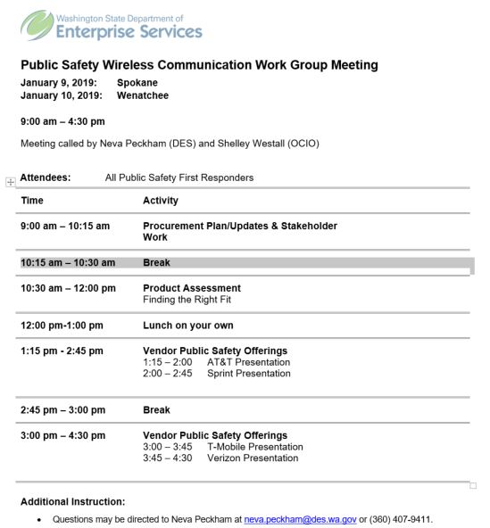
Sample PS Wireless Broadband Listening Session Agenda

Slide 16
Technology Systems Assessment Matrix
For Public Safety Technologies
Alisha King

Slide 17
Challenges with Traditional Processes
Lack objectivity
Lack transparency
Fail to meet the needs of the agency
Often leads to unnecessary duplication of effort
Often leads to unnecessary duplication of cost

Slide 18
Benefits of using the Assessment Matrix Tool
Improved objectivity
Fully transparent
Fail to meet the needs of the agency
Eliminates unnecessary duplication
Eliminates unnecessary costs

Slide 19
Good of the Order/ Public Comments Next Meeting: April 18, 2019 Location: Helen Sommers Bldg

