Slide 1
SIEC Meeting
Thursday, JUNE 15, 2017
State of Washington
State Interoperability Executive Committee

Slide 2
Introductions

Slide 3
Agenda For Review
Welcome and Introductions
Approval of April Meeting Minutes
News and Information Roundtable
Wildfire Communications Interoperability – Best Practices
SIEC Advisory Workgroup (SAW)
Washington OneNet (WON) Status
Good of the Order/Public Comments
(Modify this agenda?)

Slide 4
Approval of
April 20, 2017
Meeting Minutes

Slide 5
News and Information Roundtable

Slide 6
Wildfire Communications Interoperability -
Best Practices
Hon. Soo Ing-Moody

Slide 7
SIEC Advisory Workgroup (SAW)
Michael Marusich
Tim McDowell
Anton Damm
Lt. Philip Johnson

Slide 8
SIEC Advisory Workgroup (SAW)
Ongoing Projects Update
Shared Radio Infrastructure Group Update
WSDOT Radio System Procurement Update
DNR Programmatic Updates

Slide 9

Washington OneNet Update
Shelley Westall

Slide 10

FirstNet State Plan Portal
FirstNet will deliver its plan for a state’s radio access network (RAN) and service offering using an internet web portal
The portal will have two sides
  A public side for public safety agencies containing service cost, coverage, and device information
  A private side for sensitive information accessible by the Governor’s Office and SIEC
State of Washington
Courtesy of FirstNet

Slide 11

State Plan Review Approach
Based on the Guidance Package and 5/1 Webinar, reviewers won’t be grading the plan as much as stating things that were missed or incomplete
Therefore, given the limited time for review, an approach is:
Identify key focus areas important to Washington for team’s review
Create work groups for each focus area and assign reviewers with instructions to:
  Identify what items, if any, are showstoppers for Washington if the plan were to be implemented unchanged
  Enter any other comments online using the process provided by FirstNet

Slide 12
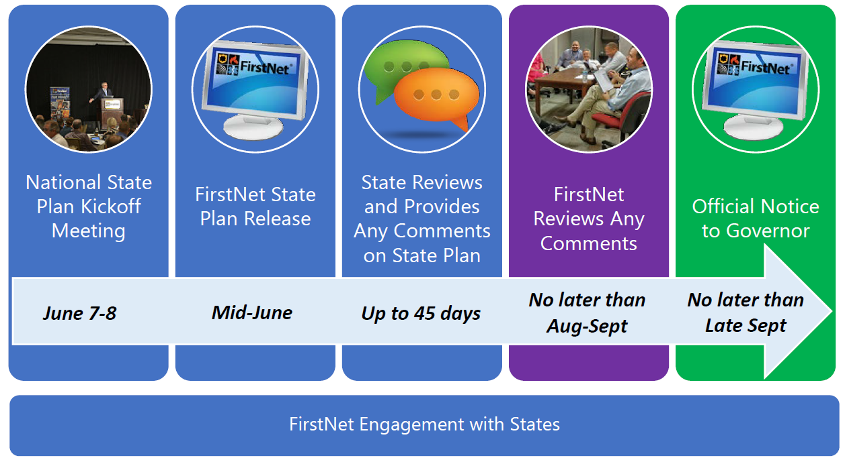
Steps to State Plan Release
Courtesy of FirstNet

Slide 13
Upcoming Events
June 21: FirstNet State Plan Portal (SPP) Kick-Off Meeting (Oregon, Idaho, and Washington States) - Portland International Airport

Slide 14
Good of the Order
Next Meeting:
August 17, 2017
Location:
1500 Jefferson St SE,
1st Floor Presentation Room

