Slide 1
SIEC Meeting Thursday, August 16, 2018
State of Washington
State Interoperability Executive Committee

Slide 2
Introductions

Slide 3
Agenda For Review
Welcome and Introductions
Approval of June Meeting Minutes
News and Information Roundtable
Verizon Presentation
WDFW Radio UHF Channel Frequency Request
The Future of the SIEC
WSP Radio Upgrade Project Update
Washington OneNet (WON) Status
Good of the Order/Public Comments
Future Agenda Topics

Slide 4
Approval of June 21, 2018 Meeting Minutes

Slide 5
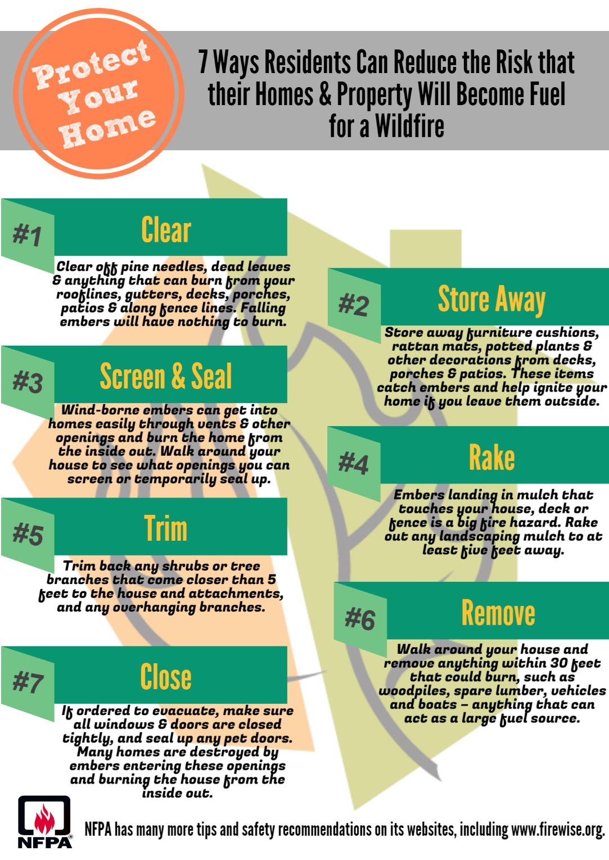

Slide 6
News and Information Roundtable

Slide 7
Verizon George Barela

Slide 8
WA Dept. of Fish & Wildlife Phil Johnson John McIntosh

Slide 9
The Future of the SIEC Sheri Sawyer Matt Modarelli

Slide 10
WSP Radio Upgrade Project Update Bob Schwent

Slide 11
Washington OneNet Update Shelley Westall

Slide 12
NASPO ValuePoint Update Shelley Westall Neva Peckham Marci Disken ATT Participating Addendum Link: https://fortress.wa.gov/es/apps/contracting/06012 PA_ATT.pdf Verizon Participating Addendum Link: https://fortress.wa.gov/es/apps/contracting/06012%20PA_Verizon.pdf

Slide 13
Good of the Order/ Public Comments Next Meeting: October 18, 2018 Location: 1500 Jefferson St SE, 2nd Floor | Room 2208

