Slide 1
Privacy & Records
Better Together
…………………………………………………………………………………………….
Will Saunders – Open Data Guy, Office of Privacy & Data Protection
Leslie Turner – Records Goddess, Washington State Archives

Slide 2
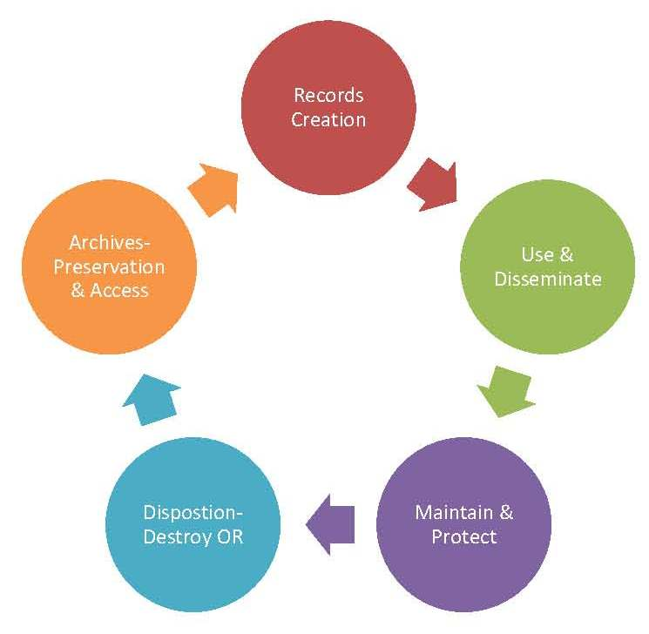

Records Life Cycle
In the Beginning – Prepared, Owned, Used or Retained (POUR)
Doing the Work: Use and Sharing of Information To Get Work Done
Done the Work: Data Collected, Reports Filed, Project Completion, Payment Made, On to the Next
After Work: Maintain/Protect to Meet Retention Requirements
Disposition – An Action to Either DESTROY (95%) or ARCHIVAL TRANSFER (Other 5%)

Slide 3

Information Life Cycle
Minimization
Training
Privacy Policy
Data Sharing Agreements
Breach Response
Encryption
De-Duplication
Privacy Impact Assessment
Records Center / Archive
Privacy Modeling
Design
Collect
Process
Store
Share
Use
Retain
Delete
Design
Collect
Process
Store
Share
Use
Retain
Delete

Slide 4
Data Sharing
How are we sharing data?
  Accidental, or by agreement?
  With whom
  For what?
  How long?
  How do you know when it’s gone?
Minimization
Training
Privacy Policy
Data Sharing Agreements
Breach Response
Encryption
De-Duplication
Privacy Impact Assessment
Records Center / Archive
Privacy Modeling
Design
Collect
Process
Store
Share
Use
Retain
Delete
Notes:
o Shared data/documents – who own’s em? Who shares ‘em? Hoo boy. Nancy Krier from the AG’s office talks about POUR – Prepared, Owned, Used or Received as a definition of a public records and who’s on the hook for what…murky waters here AND some recent lawsuits have not given agencies any leeway with claiming “not my stuff”. Maybe some talking points with managing flow of information and processes which can lead to “ownership” and “responsibility”??
o Data brokers (e.g. voterrecords.com) Know your data, know your audience, know your risk….
o Data sharing agreements – did you share with a swiss bank, or wikileaks? Know before you click “I Agree!”

Slide 5
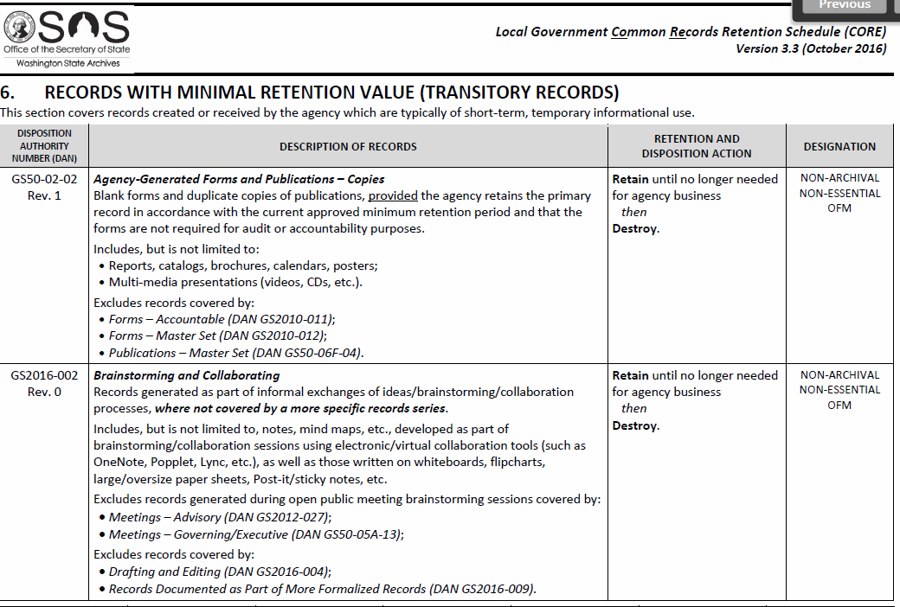
Latest + Greatest
  Recent updates to CORE re: Records with Minimal Retention and upcoming Legal/HR/Payroll but nothing brand spanking new…
  Executive order 16-01 on minimization and documentation

Slide 6


HB 1594 Passed!
Grants
Training
Portal Study

Slide 7

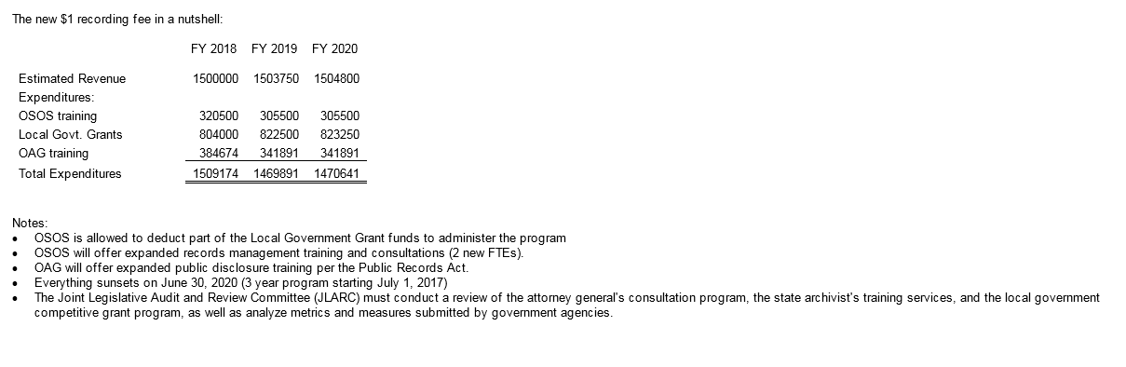

Latest and Greatest – More Resources

Slide 8
Other Bills of Interest
HB 1717 – Biometrics Data (Collection, Use & Retention)
(On Governor’s Desk)
HB 1904 – Data Broker (Tax on Brokers)
HB 2200 – ISP Privacy

Slide 9
Broadband Data + Mapping
Stevens County IT builds from beta
Trevor Sellars, Stevens County IT

Slide 10
Fed/State Broadband Map
$1,686,000 over 4 years
Built on
ArcGIS analysis server
jMapQuery web map
Custom development
Dedicated hardware server
3rd party vendor
12 months to build

Slide 11
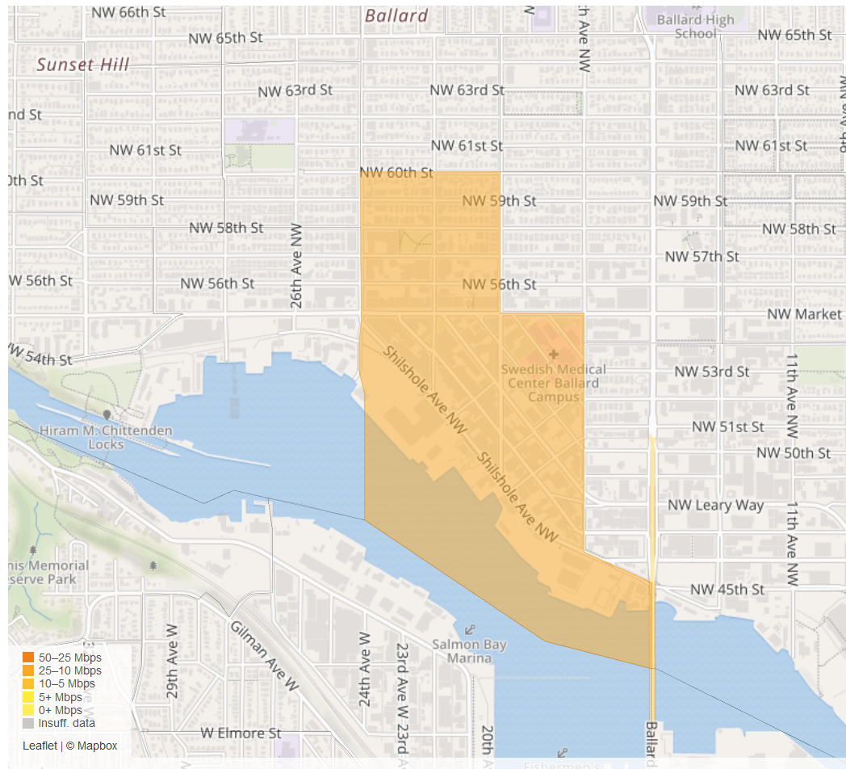

Seattle Broadband Map
http://www.seattle.gov/broadband-speed-test
2 IT staff
Mayor’s priority
Open Source software (PieceWise)
On Prem server
Budget: under $50K

Slide 12
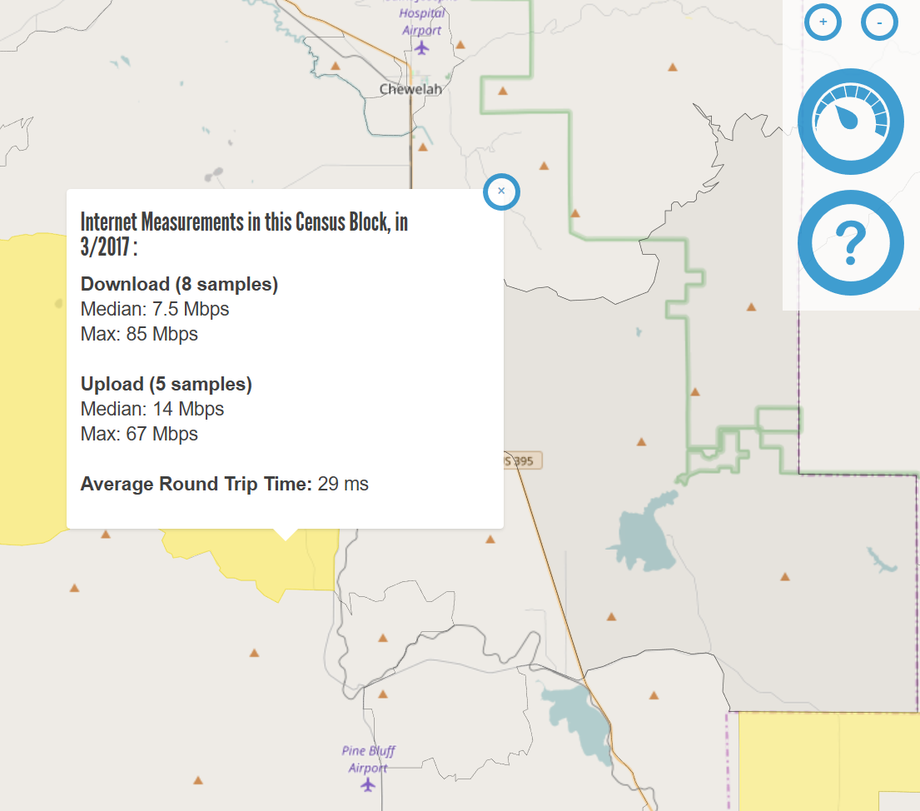

Stevens County Broadband Map
https://stevenscountybroadband.net/
1 IT staff person
Broadband Action Team of 8
Kickoff at Tech day event
Open Source software (Piecewise)
Azure VM
Budget $0
Stevens County broadband [Trevor]
  Open source from OTI [Screen shot from Trevor?]
  VM from Azure [Screen Shot from Trevor?]
  Not just for Seattle any more Screen shot from Seattle [Will]
  Voila! Show the map. [Trevor]
  mLabs data viz [Will]

Slide 13


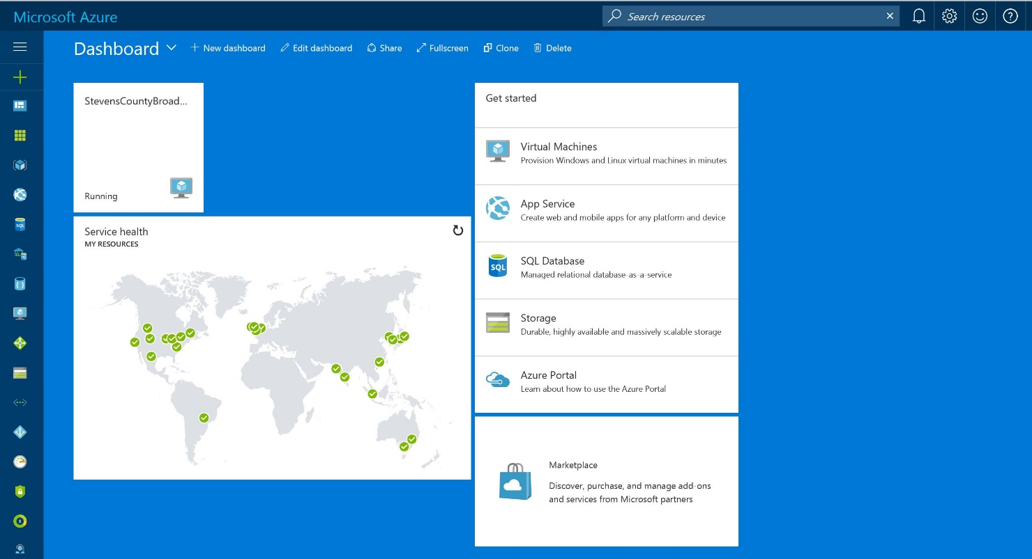


Slide 14
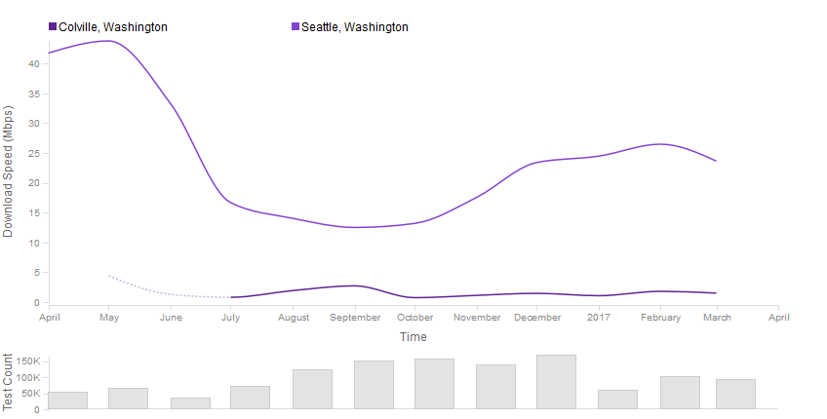
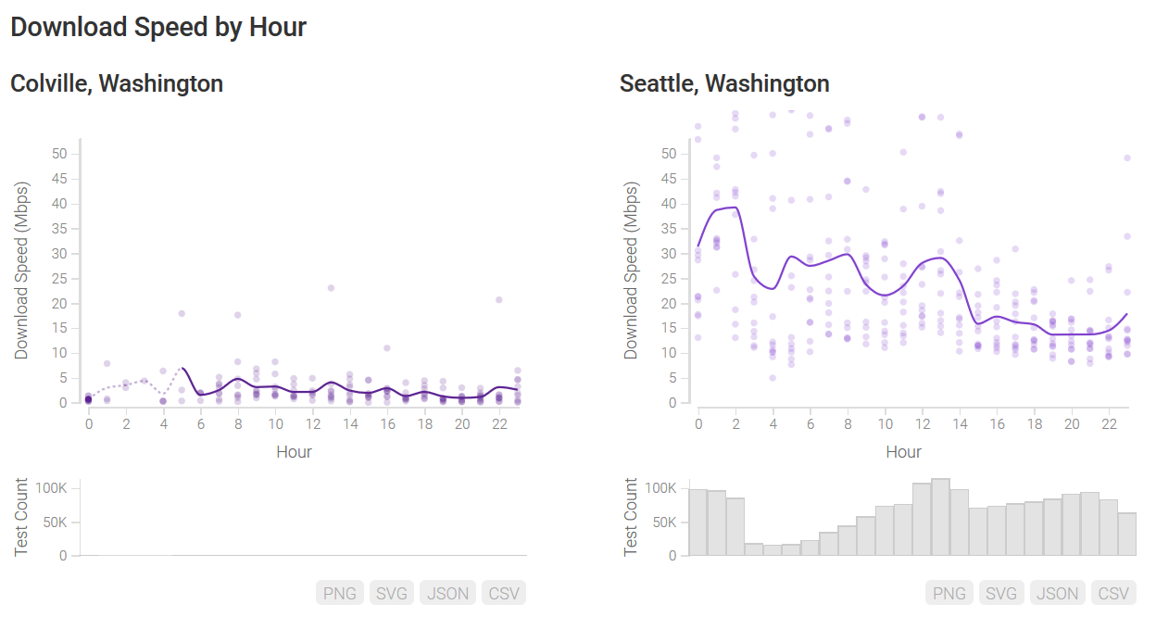
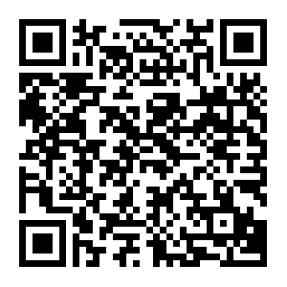
Broadband data: Colville vs. Seattle
Now we have the data
Try it yourself:
https://viz.measurementlab.net/compare/

Slide 15
What’s Next?
Community Connectivity Initiative
Stevens and King Counties are beta testers for new federal data tool

Slide 16

Community Connectivity Initiative
Community Connectivity Initiative in Stevens Cty [TBD]
  Web app collects and wraps federal data
  Then it lets you correct what’s missing
Quick Start Framework Assessment Local Report Resources

Slide 17
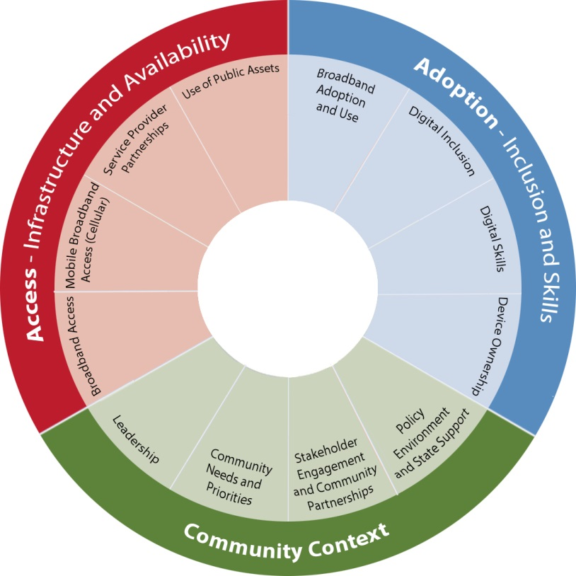
BroadbandUSA Connectivity Assessment Tool
Three sectors
12 modules
~160 questions
Localized data from U.S Census, NTIA Digital Nation, FCC 477
Action reports
Recommended resources

Slide 18
Timeline for Client Beta
April | RSVP to Beta Invitation (4/24) Identify up to 12 team members (4/30)
May | Beta Testing Kick Off (5/18) Kick off meeting (virtual) Use logins available for team leads NTIA point-of-contacts
June July August | Community use, test, feedback Local team use tool to support planning processes Bi-monthly calls available for questions and feedback NTIA available for support
Sept | Evaluation period ends One-on-one debrief calls NTIA produces summary of feedback/actions

