Slide 1
SIEC Meeting Thursday, December 15, 2016
State of Washington
State Interoperability Executive Committee

Slide 2
Introductions

Slide 3
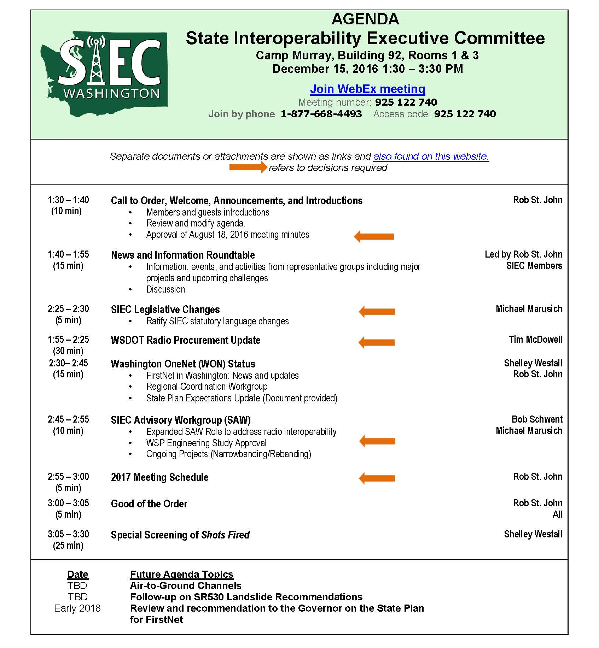

Slide 4
Agenda For Review
Welcome and Introductions
Approval of August Meeting Materials
News and Information Roundtable
SIEC Legislative Changes
WSDOT Radio Procurement Update
Washington OneNet / FirstNet In Washington
SIEC Advisory Workgroup (SAW)
2017 Meeting Schedule
Good of the Order
Special Screening of Shots Fired
(Modify this agenda?)

Slide 5
Approval of August 18, 2016 Meeting Minutes + Bullet Points

Slide 7
News and Information Roundtable

Slide 8
SIEC Legislative Changes Michael Marusich

Slide 9
Proposed Changes to SIEC
Ratify email approval of the proposed legislative changes.

Slide 11
WSDOT Radio Procurement Update
Tim McDowell

Slide 12
Washington OneNet Update Shelley Westall

Slide 13
FirstNet in Washington:
News & Updates
FirstNet Update and Impacts to OneNet,
Regional Coordination Center (RCC)
State Plan Expectations (Document Provided)

Slide 15
SIEC Advisory Workgroup (SAW) Michael Marusich Bob Schwent

Slide 17
2017 Meeting Schedule 2017 Meeting Schedule
February 16, 1500 Jefferson Bldg, First Floor Presentation Room
April 20, Bldg 92, Rooms 1 & 3
June 15, Bldg 92, Rooms 1 & 3
August 17, Bldg 92, Rooms 1 & 3
October 19, Bldg 92, Rooms 1 & 3
December 21, Bldg 92, Rooms 1 & 3

Slide 18
Good of the Order Next Meeting: February 16, 2017 Location: 1500 Jefferson St First Floor Presentation Room

Slide 19
Special Screening
Shots Fired
Shelley Westall

