Slide 1
SIEC Meeting
Thursday, April 21, 2016
State of Washington
State Interoperability Executive Committee

Slide 2
Introductions

Slide 3
Agenda For Review
Welcome and Introductions
Approval of December Meeting Materials
News and Information Roundtable
Public Comment
Ongoing Projects
Washington OneNet / FirstNet In Washington
Good of the Order
FirstNet Presentation
Modify this agenda?

Slide 4
Approval of December, 2015
Meeting Minutes + Bullet Points

Slide 5
News and Information Roundtable
Public Comment

Slide 6
Ongoing Projects:
SAW – DNR (Dept. of Natural Resources) Implied Consent Licensing Proposal

Slide 7


Slide 8
Department of Natural Resources
Implied Consent Radio Sharing Agreements

Slide 9
Based on feedback from the 2014-15 fire seasons, DNR has identified gaps in our radio system sharing procedures.
We would like to streamline the sharing agreements and more widely share system information with our cooperators.

Slide 10
The existing procedure:
DNR region staff or local cooperator initiates contact, usually part of a five year Forest Land Response Agreement (FLRA)
FLRA or standalone radio agreement is signed by both parties
Radio System Information is distributed to cooperator
This has not been 100% successful in providing up to date information to our cooperators. We also believe we are missing out on some organizations who could benefit from having DNR radio agreements but do not use the FLRA (Law Enforcement, EMS, Search and Rescue, ?). Furthermore, the FLRA has no mechanism for updating radio system information.

Slide 11
The “Implied Consent” Procedure
Radio sharing agreement application form available 24x7 from the DNR.WA.GOV website
Cooperator applies with:
Organization Name, email and phone
Applicant name
Agrees to “Terms of Contract”
Clicks “Apply”
If system updates occur, and / or annually, DNR sends email update and communicates that there has been a change through media and SIEC partners. Mid season updates should be extremely rare.
DNR receives application, makes determination, “e-signs” and within three business days emails the agreement, system information and user guide to cooperator

Slide 12
DNR would like your help:
What are we missing?
Spread the word to your constituents.
  SIEC / OneNet outreach effort?
Support and encourage annual maintenance and programming of radios.

Slide 14
Ongoing Projects:
Washington State Patrol Narrowbanding Project Status
Bob Schwent

Slide 15

WSP Narrowbanding Project
State Interoperability
Executive Committee (SIEC)
~ April 21, 2015 ~
Bob Schwent, WSP Electronic Services Division
Statewide Interoperability Coordinator

Slide 16
WSP District Map

Slide 17
P25 Narrow Band Project
Major Tasks Completed or In Process
District 1 (Tacoma)
  Detailed planning is in place
  Cutover Expectation Approval Document approved by district leadership
  700 MHz trunked site addition (Olympia area)
    Awaiting permitting
District 2 (Bellevue) – complete
  North Bend site addition – awaiting final site location
District 3 (Yakima) – complete
District 4 (Spokane) – complete
District 5 (Vancouver) – complete
District 6 (Wenatchee) is pending
  Early subscriber reprogramming plans are in process
  Wideband – narrowband impact assessment is pending
  Site readiness assessments are in process
District 7 (Marysville) – complete

Slide 18
P25 Narrowband Project
District 8 cutover started April 19
Coverage concerns in key areas required mediation
  Neilton site addition – communications enhancement
  Cosmopolis site relocation – narrowband impact remediation
  Minot site addition – narrowband impact remediation
  Holy Cross site addition – communications enhancement
District 2 coverage mitigation
North Bend area coverage issues
  Installation of a new base station to cover the area of the I90 – SR18 interchange area is pending
District 1 (Olympia) 700MHz expansion
Long standing coverage problems in the Olympia / Shelton areas
  Will be addressed prior to cutover of District 1
  Addition of a 700MHz trunked site at Maxwell Hill

Slide 19
P25 Narrow Band Project
Next Steps
District 1
  Continue pre-cutover work
  Maxwell 700 MHz site permitting, site preparation, and installation
District 6
  Re-initiate wideband analog/narrowband analog conversion assessment
  Draft Cutover Expectation Approval Document for command and sponsor approval
  Begin expedited subscriber reprogramming
District 8
  Complete district cutover
Performance to Budget

Slide 20
P25 Narrow Band Project
Project Issue Pace-Setters
Project Pace-Setters | Risk to the Project | Notes
Budget Availability |  | Current budget remains sufficient, given the approved project scope.
Human Resource Availability |  | Close management continues to mitigate the impact of resource constraints on the project.
Schedule Stability |  | Schedule risk exists with regard to potential D6 coverage requirements.
Scope Management |  | Scope has been re-baselined and is stable. D6 remains a risk.
Technology |  | The technology available for the project appears adequate.
Coverage Survey Progress |  | D6 wideband/narrowband coverage surveys are lagging, but are not yet impacting schedule.
Training Progress |  | District leadership continues to take ownership over Trooper training.

Slide 21
P25 Narrow Band Project

Slide 22
Interoperability Efforts
Advanced System Key sharing agreement with Pierce County CCN completed.
Advanced System Key sharing agreement with City of Tacoma completed.
Advanced system Key sharing agreement in progress for City of Seattle system. Cross programming has begun on WSP portables.
ISSI discussions with Snohomish County (SERS) underway. Talkgroup access request sent to Snohomish County Sheriff and Everett PD
TRIS patch enhancement work underway at Bellevue WSP
Presentation at IWCE regarding system sharing and P25 lessons learned.
WA Tactical Interoperable Communications Field Operations Guide (TIC-FOG) data collection underway.

Slide 23

Questions?
Bob Schwent
Robert.schwent@wsp.wa.gov
(360) 534-0601

Slide 24
Ongoing Projects:
800 MHz Rebanding Project
Michael Marusich

Slide 25
Washington OneNet Update
Shelley Westall

Slide 26
2016 Activities
Date | Activity | Status
January 13 | FirstNet issues RFP. | Completed
January 28 | OneNet conduct F2F strategic planning mtg. with MIL/EMD, Contractors & FirstNet | Initial survey results submitted to FirstNet
January | Work on Active Shooter Video Begins | Ongoing
February | Discovery Work on Wildfires video begins | Ongoing
 | ATNI passes Resolution 16-17 requesting continued funding for OneNet from the Federal & State Gov’t | Completed
February26-29 | West Region EMS Washington State Fire Training @ Safety Officers Senate Tribal Broadband workgroup American Indian Lobby Day | Completed
March 2 | Idaho’s FirstNet Consultation & Regional Coverage Planning | Completed
 | Stevens County Broadband Action Team | Ongoing
March 20-22 | NTIA Broadband Mtg. and T3 work session
March 21-25 | IWCE – OneNet moderated 1 panel and presented at 5 sessions. | Completed
April 12-13 | National SPOC Meeting | Completed
TBD | FirstNet Applications Workshop Cascadia Tabletop Devices Workshop | Planning underway
TBD | Regional Planning | Ongoing

Slide 27
Upcoming Outreach Activities 2016:
4/20/16 Grays Harbor PUD – Utility Coordination Group
05/03/16 Colorado XPSLTE 2016 Operational Tabletop
05/05/16 Joint Tribal Emergency Preparedness Conference
05/06/16 Makah Fisherman’s Fund
05/12/16 FirstNet Consultation Task Team Mtg. (Tentative)
05/23-27/16 ATNI Mid Year Conference
WASPC Spring Expo & Training
WA Fire Chiefs Annual Conference & Expo
05/31/16 Jefferson Emergency Preparedness Fair
06/07-09/16 Public Safety Communications Research (PSCR) program Public Safety Broadband Stakeholder Meeting
06/27-30/16 National Congress of American Indians Mid-year conference

Slide 28
Outreach Milestones 2016:
ATNI Resolution 16-17:
“that the ATNI does hereby request that FirstNet and the States find a permanent, long-term funding solution so that Washington OneNet, FirstNet in Oregon, and the Idaho First Responder Net can continue to engage tribes and tribal internet businesses in the design for FirstNet as Congress intended.”
Stakeholders engaged last quarter (January-March): 36,749
Twitter Reach: 43 tweets, 461 followers
Facebook: 40 posts, 99 Followers
GovDelivery: 4 bulletins, 3886 subscribers
Web Stats: 1898 views, 5 YouTube plays, 323 Vimeo plays
Began production on Active Shooter in Schools video. Pre-production on Wildfire video.

Slide 29


Draft Infographics (not for distribution):
Draft

Slide 30
Good of the Order
Next Meeting: June 16, 2016
Location:
1500 Jefferson Room 2208
Olympia WA 98504

Slide 31
FirstNet Update
TJ Kennedy,
FirstNet President

Slide 32
FirstNet Update to Washington SIEC
Addressing Washington’s Interests
TJ Kennedy
President

Slide 33
Addressing Washington’s Interests
Timeline to FirstNet implementation in Washington
Highlight of RFP answers
State Plan Development and Delivery to SIEC
How FirstNet will consult with States
Definition of Public Safety
Support for Tribal Nations

Slide 34

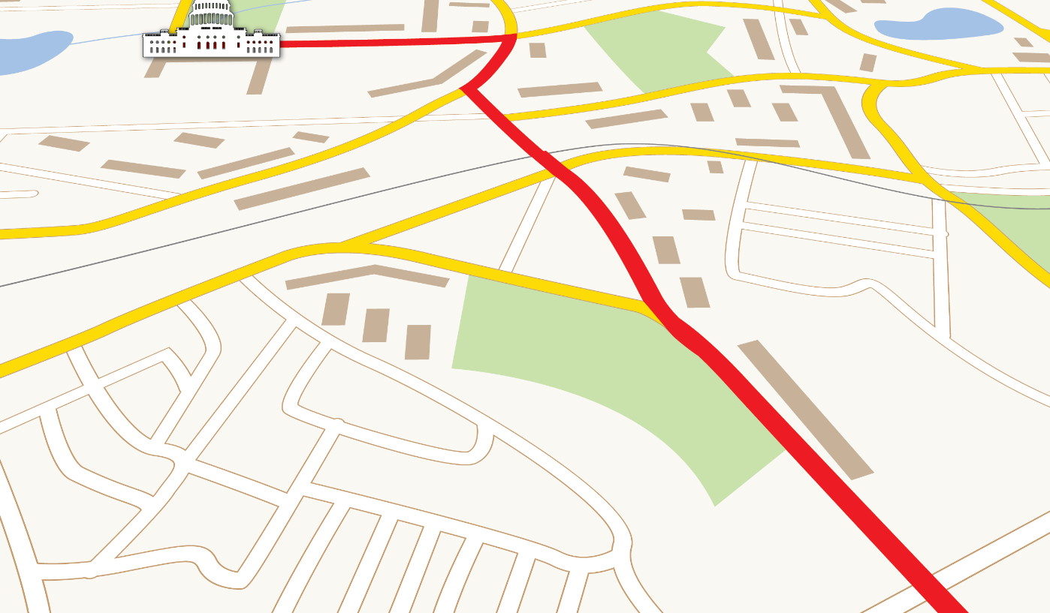


Strategic Program Roadmap
From: Middle Class
Tax Relief Act of 2012
To: Nationwide Public Safety Broadband Network

Slide 35
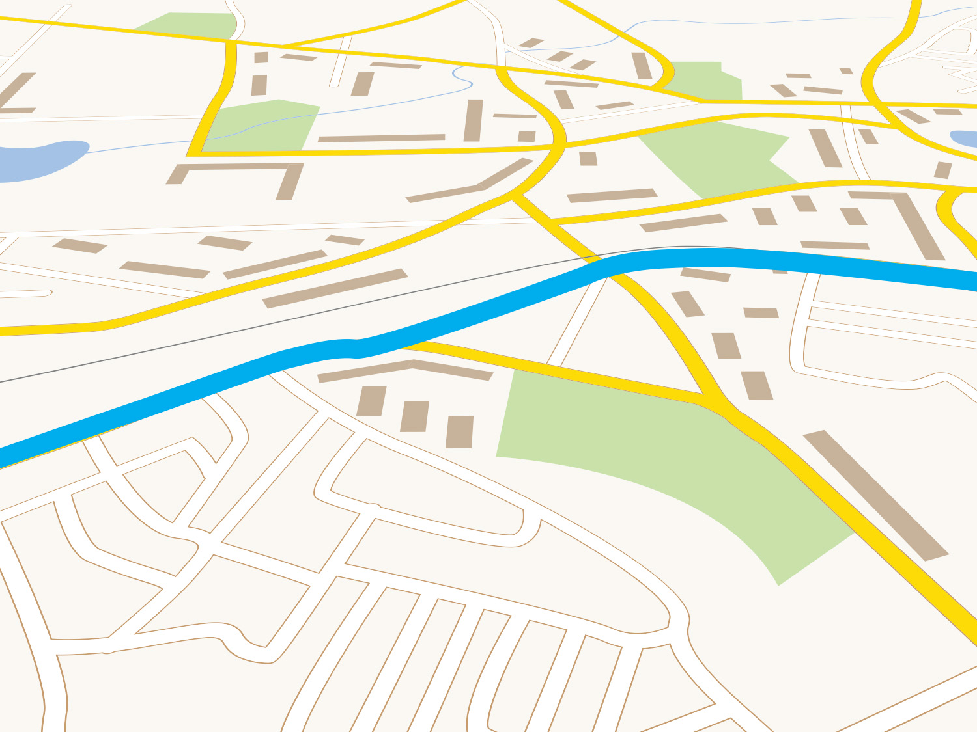









From: Strategic Program
Roadmap Release
To: RFP Release
Gather Early Builder Key Lessons
Receive PSAC Findings
Start Expanded Outreach & Consultation
RFP Released
Release Draft RFP
Documents
Initial State &
Territory
Consultations
Public Notices
& Comments
2015{}2016
Release Strategic Program Roadmap
Initial Consultation meetings in 55 states/territories
Data Collection in state/territories
Industry Days with 400+ attendees
Tribal outreach and consultation
NEPA/HIPA consultation
Phases I & II
2014-15

Slide 36
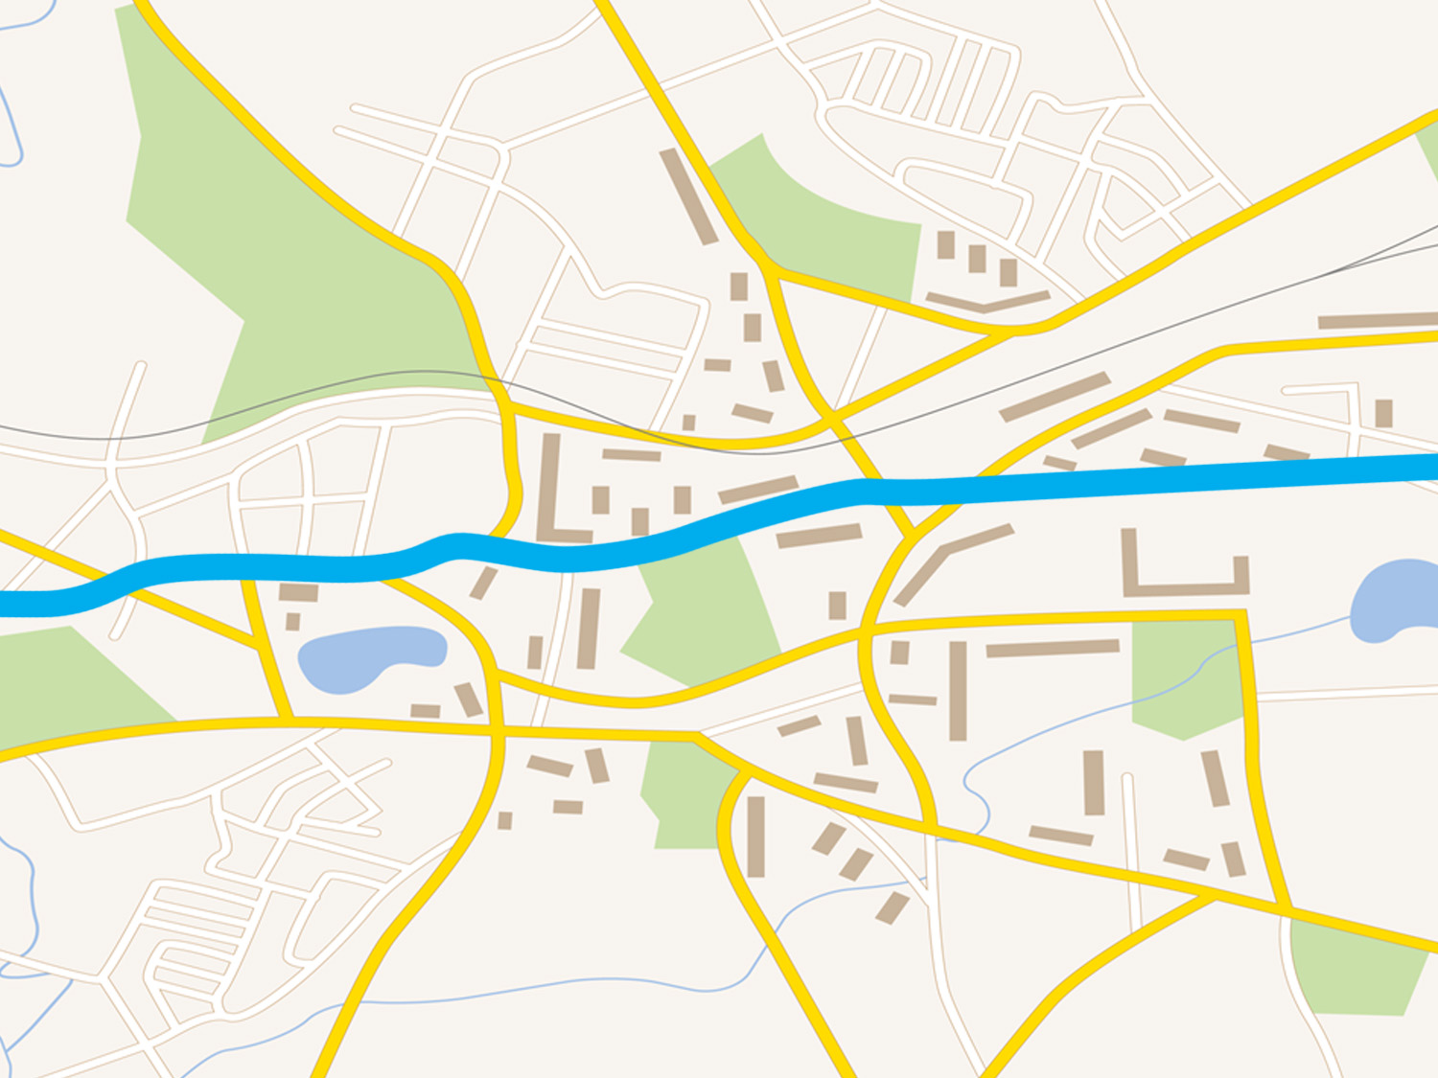






From: RFP Release
To: Complete Draft State Plans
Final FCC Opt-Out Rules and Further NTIA Opt-out Grant Guidance
Architect State Plans Process & Elements
Finalize Priority
Network Policies
Complete Draft State Plans
Award RFP for Network Partnership
FCC
opt-out NPRM and Spectrum Relo. Order
NTIA
opt-out Review Notice
Focused Consultation with Expanded Outreach
NTIA Final Fee Review Rules
May
2016{}2017
March
Culmination of:
Extensive Q&A Process
Pre-proposal Conference
Capabilities Statements
Proposal Submissions
Best Value Determination
Consultation Task Teams
Governance Body Mtgs
Executive Consultations
In-Person SPOC meetings
PSAC Findings
Phase III
* “These milestone are exclusively controlled by the respective agencies and we have provided target dates based on the best current information available to FirstNet. However, the final timing and outcomes from the relevant proceedings may materially change based on the decisions of the relevant agency."

Slide 37
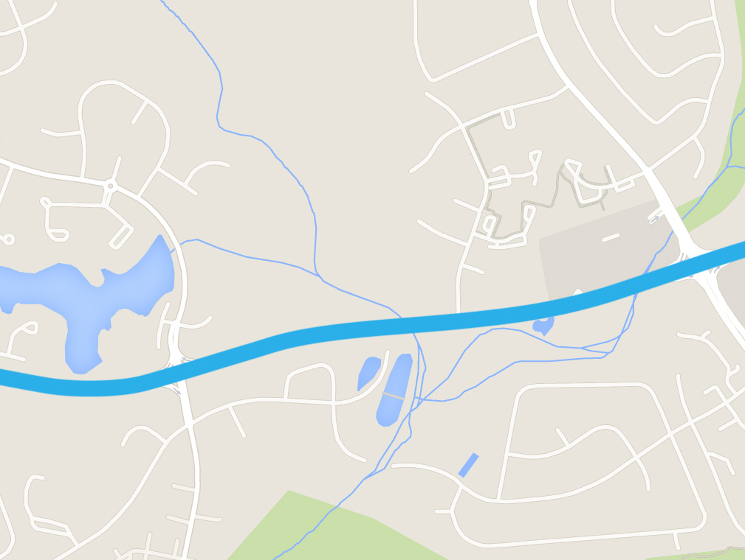






From: Deliver Draft State Plans
To: Initial Markets Launch
National Deployment Initial Markets Launch
National Deployment
Initial Markets Release
opt-out State plan due to FCC from State
Update Network
Policies
Synchronous Delivery of 56 State Plans
Governors’ Decisions
August
Deliver & Discuss Draft
State Plans
NTIA FFO Release
Finalize
State Plans
2017{}2018
Initial markets installed by national partner and ready for “Go Live” testing and activation of PSE devices on the NPSBN
May
Phase IV
* “These milestone are exclusively controlled by the respective agencies and we have provided target dates based on the best current information available to FirstNet. However, the final timing and outcomes from the relevant proceedings may materially change based on the decisions of the relevant agency."

Slide 38







State Plans Consultation in 2016
J-18 Delivery Mechanism Objectives
J-19 State Plan Template
State Plans
Prep
FirstNet Contract Award
FirstNet RFP Release
Jan 2016
April
2016
As Scheduled
Nov
2016
Governance Group Meetings
SPOC Team Interactions
Executive Consultation

Slide 39










State Plans Development and Delivery
FirstNet Contract Award
Feedback Received
State Plan
Final Prep for Delivery to Governor
Develop State Plans & Prepare for Delivery
State Plan Delivery to Governor
(90 Day Review)
Nov 2016
Set during contract negotiation
Fixed timeframe
ASAP
Release of
Draft State Plans
State Plan Draft Review
State Plan
State Plan
Notes:
**Note: Are we retaining “draft” and “review” language, or changing to “preview” (as discussed)? → follow up with Rich.

Slide 40
Addressing Washington’s Interests
Timeline to FirstNet implementation in Washington
Highlight of RFP answers
State Plan Development and Delivery to SIEC
How FirstNet will consult with States
Definition of Public Safety
Support for Tribal Nations

Slide 41
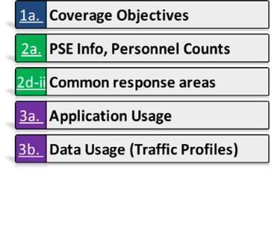
Ongoing Washington Consultation
Future Washington Governance Body Meetings
Present and discuss more detailed content:
State Plans
Key Influencers and Road to Governor’s Decision
On-Going Data Collection
(Post Sept 30, 2015)
Optional / State Decision
Further Inform State Plan (If received by Sept. 30, 2016)
Considered for product and enhancement decisions
Helps State better understand its needs and environment

