Slide 1
SIEC Meeting Thursday, AUGUST 18, 2016
State of Washington
State Interoperability Executive Committee

Slide 2
Introductions

Slide 3
Agenda For Review
Welcome and Introductions
Approval of June Meeting Materials
News and Information Roundtable
Public Comment
SIEC Legislative Changes
Washington OneNet / FirstNet In Washington
State Plan Expectations Document
State Plan Decision Process Approval
Systems Procurement Updates
Ongoing Projects
Good of the Order
Modify this agenda?

Slide 4
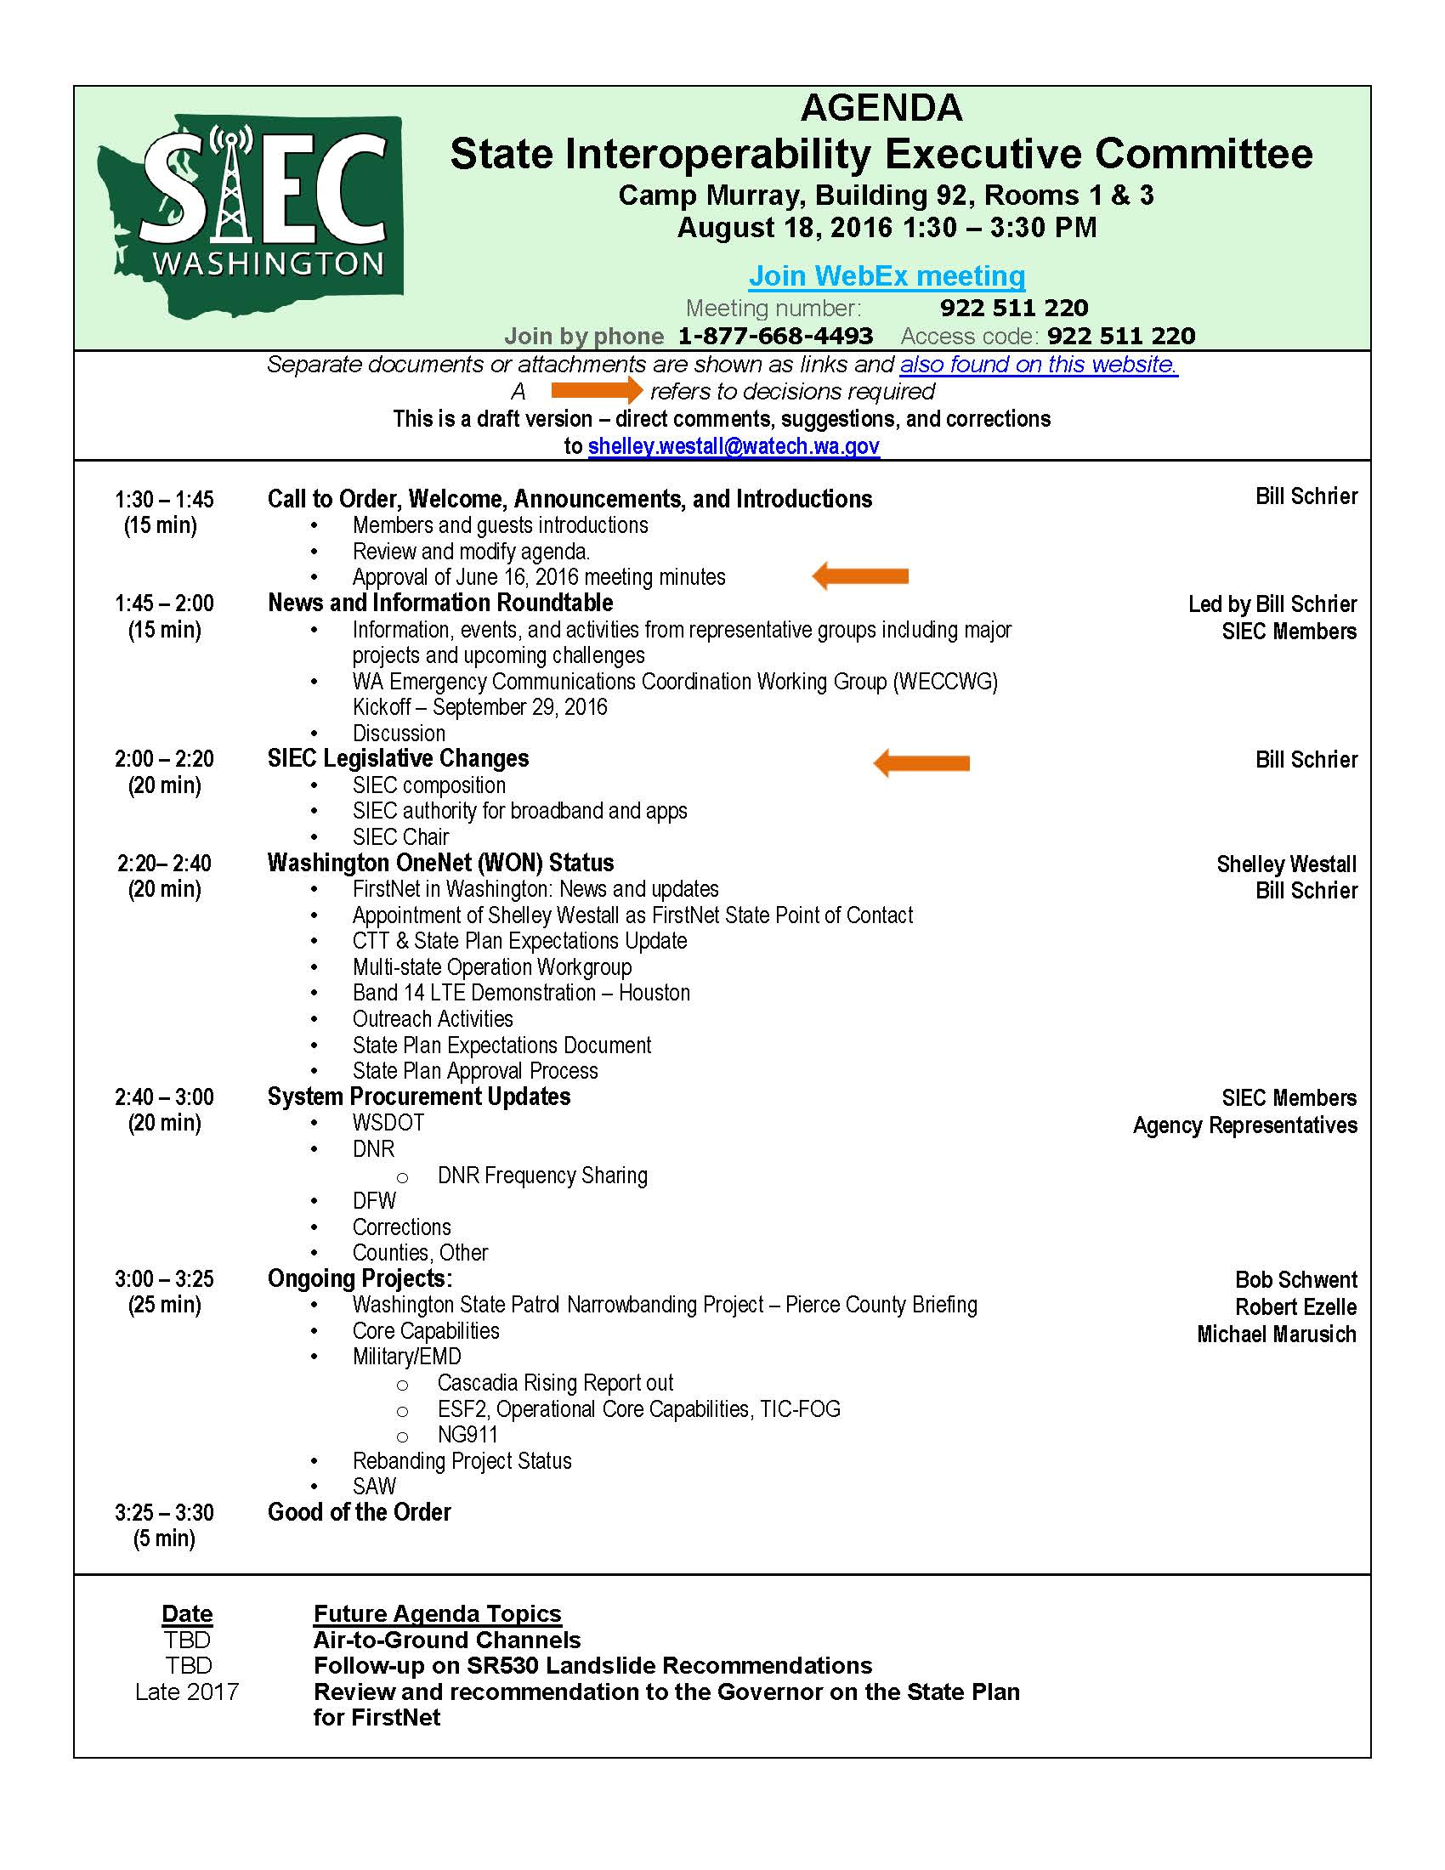

Slide 5
Approval of June 16, 2016 Meeting Minutes & Bullet Points

Slide 6
News and Information Roundtable / Public Comment

Slide 7
Proposed Changes to SIEC
SIEC Composition
SIEC Authority for Broadband and Apps
SIEC Chair

Slide 8
SIEC Chair Alternatives
Election by the Committee
Appointment by Decree
Volunteer, Interim or Permanent
Punt

Slide 9
Washington OneNet Update Shelley Westall

Slide 10
FirstNet in Washington:
News & Updates
Appointment of Shelley Westall, FirstNet State Point of Contact
CTT
Multi-State Operation Workgroup
Band 14 LTE Regional VI & X Meet up
APCO National Conference

Slide 11
Outreach Activities June 16 – August 18, 2016:
06/07-09/16 Public Safety Communications Research (PSCR) program Stakeholder Meeting
06/27-30/16 National Congress of American Indians Mid-year conference
06/22-24/16 APCO-NENA Summer Conference
07/28/16 7th Bi-Annual NW Alcohol Conference
08/04/16 Regional Consultation Task Team Meeting
08/15-17/2016 APCO National Conference
Outreach Activities August-October 2016:
08/29-09/01/16 Texas Early Builder Demonstration Visit
09/29/16 Washington Emergency Communications Coordination Working Group (WECCWG) Kickoff
12/??/16 FirstNet Applications Workshop
Early 2016 FirstNet Devices workshop

Slide 12
Shots Fired Trailer

Slide 13
State Plan Expectations Bill Schrier

Slide 14
Expectations for a State Plan for FirstNet in Washington - Review
What is important to Washington’s Responders?
Draft based upon input from our many outreach meetings
Submit to FirstNet in September
Vetting with our stakeholder, technical and operations committee
Webinars, in-person meetings, survey

Slide 15
Expectations for a State Plan for FirstNet in Washington - Details
Coverage: all highways
Coverage: all seats of population, tribal seats of government
Coverage: extensive deployables
Coverage: equal to or greater than commercial
Users: a broad definition + Federal partners
Services and support with a concern for public safety agencies
Price
Security, cybersecurity, public safety grade

Slide 16
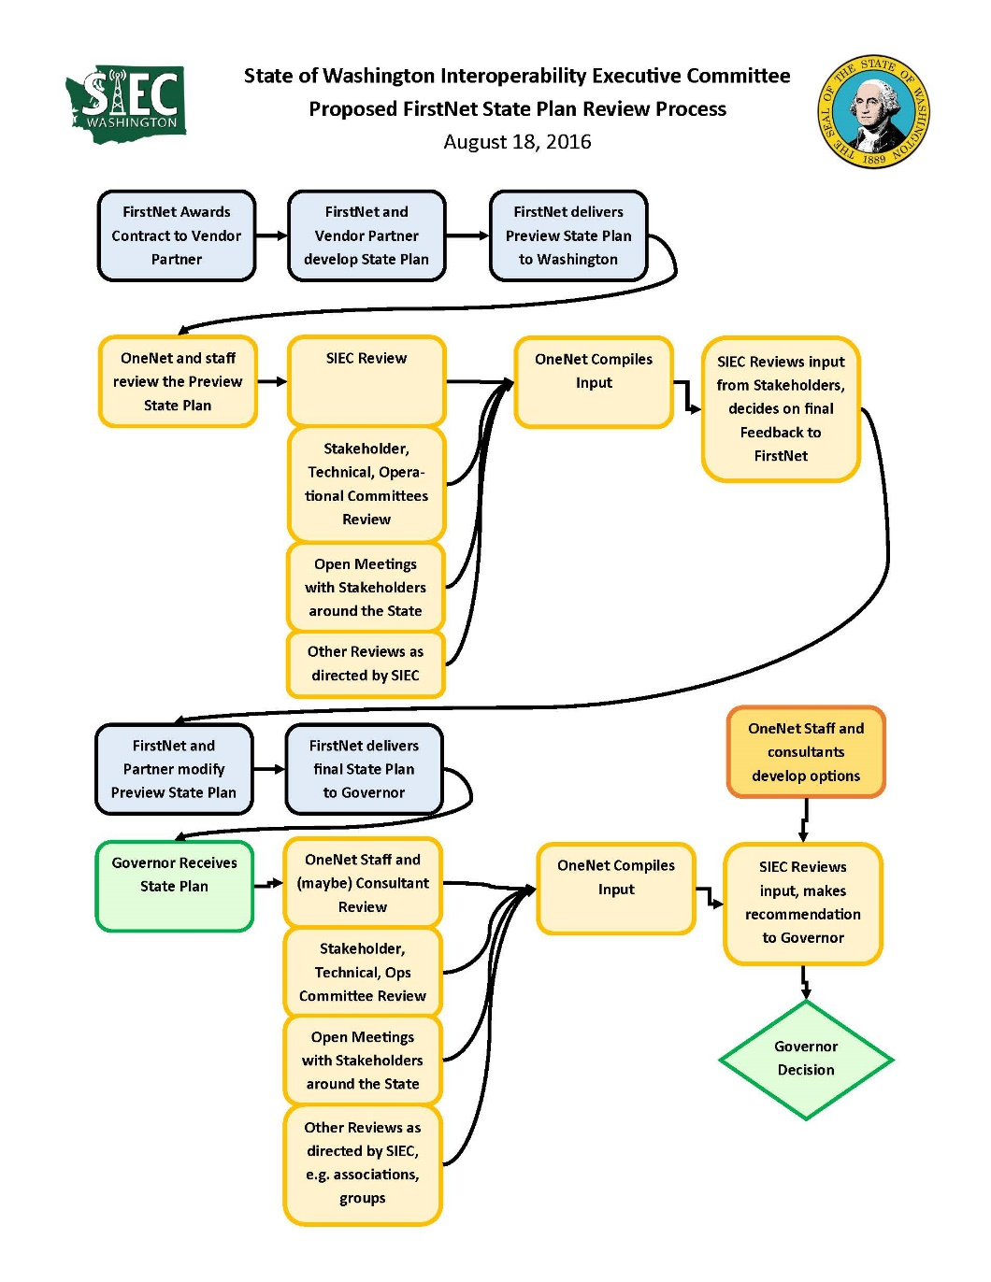
State Plan Approval Process

Slide 17
System Procurement Updates:
WSDOT DNR DFW Corrections Counties/other

Slide 18
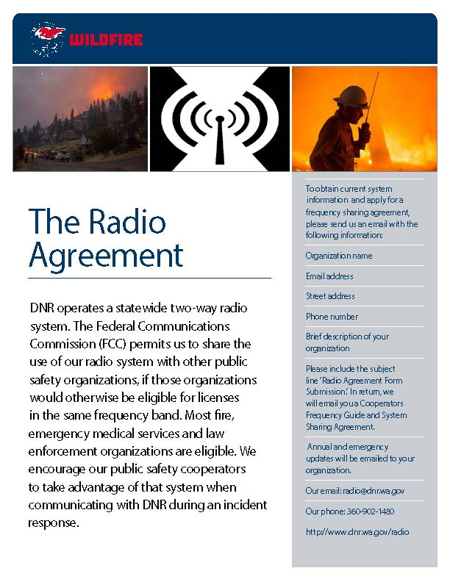
DNR Frequency Sharing

Slide 19
Ongoing Projects: Washington State Patrol Narrowbanding Project Status Bob Schwent

Slide 20
Ongoing Projects: Core Capabilities Michael Marusich

Slide 21
Ongoing Projects: Washington Military/Emergency Mgmt Div. Update Cascadia Rising Report Out ESF-2 Operational Core Capabilities TIC-FOG NG911 Robert Ezelle

Slide 22
Ongoing Projects: Rebanding Project Status Michael Marusich

Slide 23
Ongoing Projects: SIEC Advisory Workgroup Michael Marusich

Slide 24
Good of the Order Next Meeting: October 20, 2016 Location: Building 92, Rooms 1 & 3 Camp Murray

