Slide 1
Technology Services Board Portfolio/Policy Subcommittee Meeting
January 9, 2020
10:00 a.m. – Noon

Slide 2
AGENDA
TOPIC | LEAD | PURPOSE | TIME
Welcome and Introductions | Jim Weaver | Introductions | 10:00
Approve Minutes from November 14 Subcommittee Meeting | Jim Weaver | Approval | 10:04
Policy/Standard Review Policy 111 - Planning for IT Portfolios (RESCIND and combine with Policy 112) Policy 112, 112.10, 112.20 - Portfolio Management (UPDATE) Policy 113, 113.10, 113.30 and 113.40 - Technology Business Management (NO CHANGE, new sunset review date) 161.01 – Geodetic Control Data Standard – Update 161.02 – Geospatial Metadata Standard - Rescind 161.03 – Hydrography Data Standard – Update 161.05 – Geospatial Application & Data Services Metadata Standard - Rescind 187.10 – Metadata Standard – Update Policy 188 - Accessibility (UPDATE) 188.10 – Minimum Accessibility Standard (UPDATE) | Sue Langen Cammy Webster Joanne Markert | Brief Review/Approval | 10:05
Project Status – Liquor and Cannabis Board (LCB) Marijuana Traceability Project Megan Duffy, Executive Sponsor, LCB Kendra Hodgson, Business Sponsor, LCB Clare Olson, Project Director, LCB Mary Mueller, Chief Information Officer, LCB Julie Boyer, Quality Assurance, Stellar Associates | Sue Langen Rich Tomsinski | Project Status | 10:15
Project Status – Department of Health (DOH) Healthcare Enforcement & Licensing Modernization Solution (HELMS) Kristin Peterson, Executive Sponsor, DOH Darrell Price, Project Director, DOH Jennifer McNamara, Chief Information Officer, DOH Gena Cruciani, Quality Assurance, Integrated Solutions Group | Sue Langen Pamela Davis-Taggart | Project Status | 10:45
Project Status – Department of Licensing (DOL) Professional Online Licensing and Regulatory Information System (POLARIS) Jennifer Clawson, Business Sponsor, DOL Craig McElfresh, Enterprise Project Management Director, DOL Dick Sperry, Ph.D., Quality Assurance, Case Associates | Sue Langen Laura Parma | Project Status | 11:15
OCIO Staff Update – ctcLink | Sue Langen Whitney Dickinson | Staff update only | 11:45
Public Comment |  |  | 11:55
Notes:
Presenter: Jim

Slide 3
Current TSB Members
Industry Members Butch Leonardson – Retired CIO (via WebEx) Paul Moulton – Costco (via WebEx) | Legislative Members Rep. Matt Boehnke – House R (via WebEx) Rep. Zack Hudgins - House D Sen. Patty Kuderer – Senate D Sen. Ann Rivers – Senate R (via WebEx)
Executive Branch (Agency Directors) Jim Weaver – State CIO & Chair David Danner – UTC Tracy Guerin – DRS Vikki Smith – DOR | Other Government Viggo Forde – Snohomish County (via WebEx)
Members present
Members absent

Slide 4
Welcome/Introductions/Approve 11/14 Minutes

Slide 5
Policy / Standard Review

Slide 6
Where Are We?
Work Group Drafts
CIOs Review
TSB Sub Committee Recommends
CIO Adopts
Full TSB Approves
Notes:
Presenter: Sue

Slide 7
Information Technology Portfolio Foundation
Key objectives
Purpose of action
Request approval of existing policy and standards updates
Business case
Implementation
Success criteria
RCW 43.105.225 , RCW 43.105.230 and RCW 43.105.341 for Portfolio Program
Supports efficient, effective and accountable government by clarifying portfolio requirements
Eliminate obsolete portfolio requirements
Strategic alignment
Improves portfolio alignment to business outcome
Streamlines technology portfolio management policy
Reduces complexity to program participants
Improves ability to show technology portfolio alignment to business outcomes
Agency can attest to portfolio standards during annual certification process
Reduced reporting complexity for agencies
Increase number of agencies that can identify and report on portfolio components
Improves alignment with existing practices
Request rescind of outdated policy
Reduced questions related to obsolete IT portfolio requirements
Notes:
Presenter: Cammy

Slide 8
Technology Business Management
Key objectives
Purpose of action
Request approval of sunset review update of existing policy and standards
Business case
Implementation
Success criteria
RCW 43.105.054 Section 2(f) requirement for TBM Program
Agency reporting is 100%
Supports efficient, effective and accountable government by using industry standard taxonomy and common terms
Program has been operationalized with agencies performing review and update on a bi-yearly basis
Strategic alignment
Use data driven analytics to identify opportunities for efficiency and savings of IT expenditures
Shows what agencies get with their IT investments
47 agencies are using standardization to categorize IT spend by technology tower
Increased accuracy in coding IT spend
More agencies can show value of IT to business service and monitor performance of investment
Bi-yearly check in with each agency to ensure accuracy in their reporting
Link IT expenditures to technology investment
Notes:
Presenter: Cammy

Slide 9
161.01 Geodetic Control Standard
Key objectives
Purpose of action
Implementation
Success criteria
This is already a successful policy
Essentially the same standard, but added clarifying language
Strategic alignment
Sunset review
Clarifying language in the standard to assist with agency implementation.
Business case
Clarified codes to use for geospatial data.
This standard is still need to facilitate data exchange among state, local, tribal and federal users of geospatial data.
Confirm the standard is still useful and valid.
Monitor for expected changes in RCW due to changing federal standards. Review and update again as needed.

Slide 10
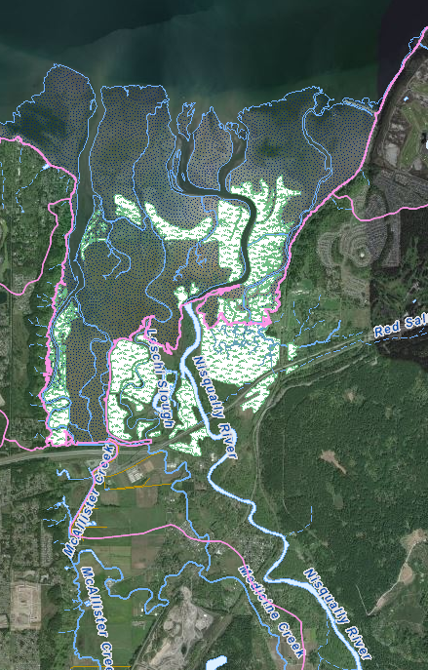
161.03 Hydrography Standard
Key objectives
Purpose of action
Implementation
Success criteria
This is already a successful policy
Essentially the same standard, but added clarifying language
Strategic alignment
Sunset review
Clarifying language in the standard and update hyperlinks.
Business case
Minimal language changes.
This standard is still need to facilitate data exchange among state, local, tribal and federal users of geospatial data.
Confirm the standard is still useful and valid.

Slide 11
161.02 Geospatial Metadata Standard 161.05 Geospatial Application & Data Services Metadata Standard
Key objectives
Purpose of action
Implementation
Success criteria
Strategic alignment
Rescind and incorporate into 187.10
Business case

Slide 12
187.10 Metadata Standard
Key objectives
Purpose of action
Implementation
Success criteria
This is already a successful policy
Should simplify the implementation for agencies
Strategic alignment
Combine three separate metadata standards into one
Agencies have a single standard to reference for creating metadata
Business case
Combine three metadata standards into one
This standard is still need to facilitate data exchange among state, local, tribal and federal users of geospatial data.
Metadata is need for documenting data and facilitate sharing
Geospatial community is creating guidelines to augment this standard
Notes:
What is metadata and why is it important?

Slide 13
Policy 188 & 188.10 - Accessibility
Key objectives
Purpose of action
Update existing policy and standard
Business case
Implementation
Success criteria
Supports efficient, effective and accountable government by aligning with current federal standards
Strategic alignment
Removes obsolete deadline dates from previous version
Aligns with federal & industry standards
Ensures agencies are using most recent federal standards
No significant impacts to agencies related to policy updates. The comments do highlight need for ongoing education on accessibility.
Sets minimum accessibility standards
Support agency compliance with state and federal requirements
Notes:
Presenter: Sue

Slide 14
Project Update – Marijuana Traceability

Slide 15
WSLCB MTP Lessons Learned

Slide 16
Traceability Project Overview
The state’s first contracted cannabis traceability system, BioTrack THC, went live in 2013
The system tracked product from seedling to sale
System did not meet OCIO standards; neither WaTech nor OCIO were invited to participate in the original procurement
System was not scalable or configurable
Maturing cannabis marketplace outgrew the capabilities of former system
The LCB unsuccessfully attempted to secure a contract extension with BioTrack THC
Faced a “burning platform” with an Oct. 31, 2017 contract expiration
In 2017, the agency rebid the traceability system, which was awarded to MJ Freeway, who hosts Leaf Data Systems
LCB signed a contract in mid-July 2017 to implement a new system that had to be in place by October 31, 2017
Typically, development takes no less than 12-18 months for a project of this complexity
The Leaf system was initially implemented February 1, 2018, and was scheduled to be fully implemented by Dec. 31, 2018
Two significant software releases in 2018 and 2019
1.35.6 in Aug. 2018
1.37.5 in July 2019
Service Contract signed Dec. 20, 2019

Slide 17
Current Status
Partially Functioning, Stable
System is partially functioning
Functioning with known and published workarounds
Functioning in part with known workflows
Functioning with collaboration with integrators to keep the system stable
To mitigate further disruption to the industry and degradation in functionality, LCB will maintain current state functions
Service and Maintenance Contract
Service Contract signed Dec. 20, 2019
Six month service and maintenance contract only – no work toward future releases
Focused on maintaining stability (no fixing bugs)
Four, six-month extensions following June 2020
$265, 000 in credit payment to LCB

Slide 18
TSB Follow-Up Questions
How do revenue forecast/projects compare to actual revenue realized? Is WA experience similar to CA in terms of legal sales vs. grey/black market?
Marijuana excise taxes have outperformed Forecast Council forecasts consistently since the first forecasts five years ago. Over the last five years the forecast has been revised upward in most forecasts, and revenues continue to rise. Over the first few years, increased demand was sufficient to cause overall revenue to increase despite rapidly falling prices. Now that prices have stabilized we are seeing the effect of increased demand without the tempering effect of declining prices. As a result, revenues continue to increase and are up 10% year over year through the first six months of this fiscal year.
Our experience has been very different from California’s. Our overall regulatory system is more robust, and there has been ample participation in the regulated market by growers.
Who is bearing unanticipated costs of the project and how has that impacted revenue and/or costs to licensees?
The unanticipated costs have been covered through vacancy savings in our operating budget. Licensees were assessed an additional license fee of $480 in FY18, which generated $1.4 million in revenue for project expenses. No additional direct project expenses have been passed on to licensees. Survey results from licensed businesses indicate that labor costs have increased due to ongoing traceability issues; however, we do not have an estimated average.

Slide 19
Where We’re Going
Broad Vision -- Cannabis 2. 0
The Liquor and Cannabis Board is looking to take stock of developments in public policy and other factors that will affect cannabis activities over the next five years.
As more states enter this arena, Cannabis 2.0 is the Board’s effort to look ahead to anticipate how that and other developments will affect us and what strategic choices that creates for state policy makers.
Cannabis 2.0 can be broadly defined to include regulation, policy, taxation and other elements, including traceability
Going Forward on Traceability
Consistent with Cannabis 2.0, the LCB is looking ahead to the future of traceability
Working collaboratively with industry stakeholders on the future of traceability
LCB appreciates the involvement and partnership with industry
Traceability Workgroup
Three meetings with industry traceability workgroup so far
Running ideas and workflow strategies by industry for input
Reviewing and listening to industry feedback
Involvement from staff

Slide 20
Project Lessons Learned

Slide 21
Project Lessons Learned
Planning
Avoid reactive decision making
Stakeholder concerns
Vendor push-back
Internal pressures
Ensure there is adequate time in legacy contract for replacement
Be realistic
Save time for planning
Don’t move beyond planning until there is universal agreement on:
Business objective
Product ownership
Definition of key terms, e.g. Traceability
Functional and non-functional requirements
Priority of scope, schedule, budget and quality
Procurement approach
Project management approach
Vendor management approach
Resource project according to risk
For agencies, teams or vendors that are not accustomed to project or SDLC rigor, hire a greater number of PMO members
Don’t save money by scrimping on technical BAs during requirements elicitation or SQA during testing

Slide 22
Project Lessons Learned
Procurement
Be willing to start over
Improve proposal process
Do not conduct blind procurements, where proposing vendor names and product names are redacted for reviewers
Provide adequate time for procurement
Test for product and vendor maturity via various means
Don’t use terms without definition, e.g. Agile
Conduct a workshop with the ASV to review each requirement and expected deliverables prior to contract negotiations and BAFO
Improve contract negotiation strategy
Engage Attorney General’s IT contracts office during planning phase; do not wait until contract is ready to be signed
Do not give up performance bond
Do not give up SDLC standards
Do not give up project management standards
Document every discussion and decision
Align project phases with Deliverables in the contract
Include Acceptance Criteria in contract
Project Management
Resource PMO according to risk
Be clear on which internal standards must be met
Maintain a detailed, visible schedule measured against baseline

Slide 23
Project Lessons Learned
Scope
Have approved, detailed functional and non-functional requirements prior to procurement
Do not waiver on change management processes
Do not change strategies mid-flight
Ensure each requirement is supported in standard, policy, rule or law
Document business case for data access rights
Keep it simple
Stakeholder Management
Define stakeholders and their roles up front
Take time to document impact of each stakeholder
Leverage advisory committees appropriately
Organizational Change Management
Have clear objectives for OCM during planning phase
Hire and integrate OCM into the effort early in the process
OCM is not just communications
Whenever possible, align processes and deliverables to existing agency/state standards and lingo

Slide 24
Applying Lessons Learned

Slide 25
Impact of Lessons Learned
Current
Shaped decisions related to current traceability system
Informal MTP and over 230 documented SMP lessons learned being applied to structure and approach of SMP2
Agency-wide focus on:
Project management standards
Benefits of QA
SDLC and Release standards
Vendor Management
Formalizing commercial integrator relationships:
Requiring documentation of their relationship with licensees
Annual data sharing agreement
Must comply with state security, data management and architectural standards (OCIO standard 141.10)
Operate as program; Maintain bi-weekly integrator collaboration meetings
Project Advisory Committees
Be explicit with role that the advisory committee members play
Enforce roles
Document advice presented and agency decisions made in relation
Create a change advisory board with industry and integrator representation
Exit Strategy
Every project, build and release must be accompanied by an exit strategy and roll-back plan

Slide 26
Impact of Lessons Learned
Lessons Learned | SMP
Project management | Appropriately resourced, approach outlined in draft, initial project schedule developed
Vendor management | Contract manager designated, vendor management plan in draft, designated vendor manager from contracts office in conjunction with the Project Manager
Someone to check PM and Steering Committee | Engaged OCIO for this and hired QA to support this need
Resourcing | Universal dedication to resourcing according to risk and need; detailed roles and responsibilities of state and vendor
Procurement | Leveraged Master Contract; submitted full requirements to software vendor for confirmation; in the middle of an RFQQ for integration services
Ensure state and vendor have a shared definition of all requirements | Several meetings with software provider; Implementation workshop is planned prior to signing the ASV
Contract negotiation | AAG is engaged and reviews all procurement and contract docs; Performance bond included in model contract; SDLC, PM, and vendor management standards included in RFQQ

Slide 27
Impact of Lessons Learned
Lessons Learned | SMP
Reactive decision making | Consistently analyze decisions against objective and priority
Realistic planning | Staged planning in alignment with OCIO
Time for planning | Planning phase was budgeted and resourced
Business objective | Scope, objective and functional priorities have been established and agreed on
Detailed requirements prior to procurement | Requirements elaborated and approved by SMEs and sponsors prior to procurement
Procurement approach | Procurement plan

Slide 28
Project Update – HELMS

Slide 29
HELMS Project Overview
January 9, 2020
TSB Subcommittee

Slide 30
Introductions
Kristin Peterson, HELMS Project Executive Sponsor
Jennifer McNamara, DOH Chief Information Officer
Gena Cruciani, Quality Assurance Consultant (ISG)
Ashley Daniel, HELMS Business Project Manager
Kelly Foster, HELMS Organizational Change Management Practitioner
Dee Turco, HELMS IT Project Manager

Slide 31
Contents
HELMS Background and Benefits
Current Project Status
HELMS Governance
Gated Funding
Procurement Approach
Quality Assurance

Slide 32
HELMS Background
The Department of Health (DOH) is pursuing a Healthcare Enforcement and Licensing Modernization Solution (HELMS)
The current system (ILRS) is based on older technology, and DOH is unable to increase its capabilities to match growing requirements and the expectations of customers
HELMS will support the licensing and regulatory needs of:
Almost 500,000 health care professionals practicing in 86 professions across 359 credential types
2,500 educational and training programs across four educational and training program types
Nearly 12,000 facilities across 21 facility types

Slide 33
Expected Outcomes
HELMS Project Implementation
Replace Our Outdated System
Improve Capabilities
Improve Services
Improve public access to healthcare provider information
Improve efficiency for healthcare providers
Improve data security
Disseminate information more efficiently in response to public records requests
Automate manually performed services, processes, and capabilities
Integrate healthcare enforcement and licensing transactions into a single system
Provide more efficient access to performance measures by way of reporting dashboards

Slide 34
Expected Benefits
Automatically notify health care providers of license expirations, continuing education deadlines, and application status changes
Allow bulk license renewals, streamlining license renewals for employers
More efficiently share records for regulatory boards, commissions, and committees, improving their work and timeliness
Allow electronic access to facility inspection and/or investigation reports
Provide electronic submission of required information

Slide 35
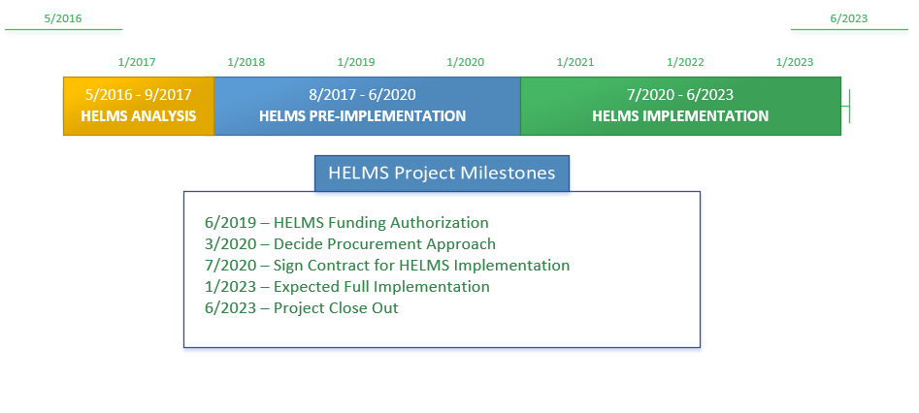
HELMS Timeline

Slide 36
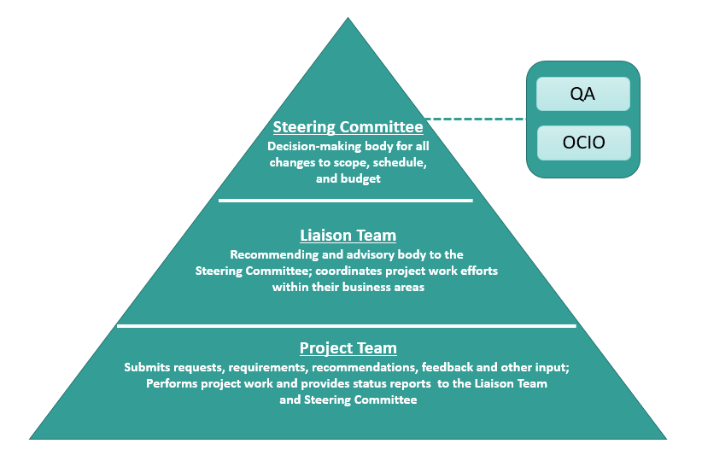
HELMS Governance

Slide 37
Current Project Status Update
Project Performance Indicators
Measure | Current Month | Prior Month
Scope
Schedule
Cost
Human Resources
Contracts
Risks
Quality
Communications
Stakeholders
Integration Planning
Financials (Thru November 2019)
HELMS FY20 Technology Budget: $1,581,111
Cumulative project expenditures $291,647
Next Milestone
Complete Vendor Evaluations March 2020
Risks, Issues
Open Project Risks = 15
Open Project Issues = 2
Success:
Submission of written requirements to potential vendors from the Cloud Master Contract
Data Migration Preparation Efforts Continuing
Engaging staff on Information Assessment
SAAG Solicitation Contract
Sponsor Coalition Assessment/Interviews are yielding valuable information that will be used for the development of OCM plans

Slide 38
HELMS Gate 1Deliverables (Gated Funding)
Gate 1 - Initiation and Planning
Description | Artifact | Status | Date Complete
IT Project Assessment | Online submission | Complete | 8/6/2019
Project Concept Brief | Document | Complete | 12/14/2017
Investment Plan | Approved Investment Plan | Complete | 1/11/2019
External Quality Assurance Procured | Signed Contract | Complete | 9/1/2018
Project Roles & Responsibilities | Project Charter | Complete | 5/8/2019
Communications Plan | Document | Complete | 8/7/2019
Risk Management Plan | Document | Complete | 5/20/2019
Change Management Plan | Document | Complete | 5/21/2019
Issue Management Plan | Document | Complete | 5/20/2019
Project Schedule | Document | Complete | 6/30/2019
QA Readiness Assessment | Document | Complete | 10/29/2018
Requirements Specification | Document | Complete | 10/24/2019
Acquire Special Assistant, Attorney General | Signed Contract | Complete | 12/6/2019
Technology Budget | Approved Technology Budget | In-Progress/Ongoing | Target - 12/2/2019
Investment Plan (Revision) | Approved Investment Plan | In-Progress/Ongoing | Target - 12/19/2019
HELMS Project Team | Select Project Team Positions Filled | In-Progress/Ongoing | Target - 2/1/2020
Request for Proposal/Select Master Contract Vendor | Publish RFP/Select Master Contract Vendor | Not Started | Target - 4/15/2020
Initiation and Planning Deliverable Assessment | Meeting | Not Started | Target - 6/5/2020
Initiation and Planning Lessons Learned | Document | Not Started | Target - 6/15/2020
Organizational Change Management Strategy and Plan | Document | In-Progress/Ongoing | Target - 06/26/2020

Slide 39
Procurement Approach
Decision Point
Validate
Requirements
Conduct Contract Negotiations
Engage Vendors
Provide Requirements
Review
Vendor Evaluations
Receive Written Response
–
Evaluate Demonstration
OR
Publicis.Sapient
Deloitte
Slalom
Shift to RFP
View
Demonstration
9/16/2019 –11/5/2020
11/5/2019-3/31/2020

Slide 40
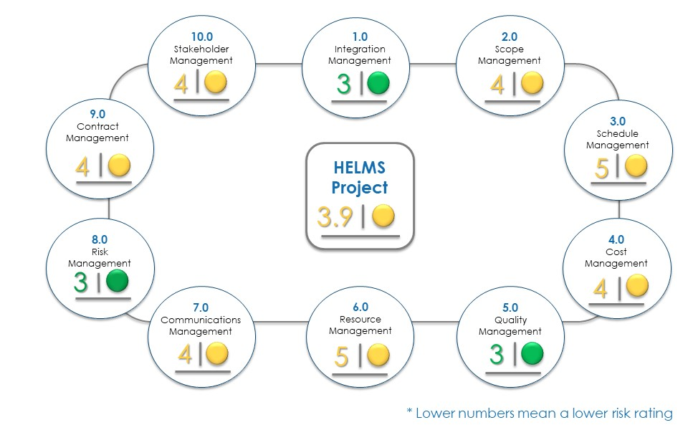
November QA Assessment
Legend: Green (1-3); Yellow (4-7); Red (8 -10)
Notes:
QA ISG Gena Cruciani

Slide 41
November QA Assessment
Schedule Management:
Risk that implementation phase doesn’t start July 2020 if stakeholders don’t accept Salesforce and a procurement is needed
Resource Management:
Although Technical Project Manager started there is increased risk due to loss of Project Director (and Business PM in Dec)
Stakeholder Management:
Large, complex stakeholder group requires a robust communication approach
Notes:
QA ISG Gena Cruciani

Slide 42
Questions?

Slide 43
Project Update – POLARIS

Slide 44
Business and Technology Modernization R3 (POLARIS)
TSB Presentation
January 9 2019

Slide 45
Agenda – POLARIS
Review of Umbrella Business and Technology Modernization Project
Business and Professions Overview
Schedule
Solution
Release 1
Release 2
Conclusion

Slide 46
Business and Technology Modernization
Multi-biennia effort to modernize the agency’s business processes and information technology systems
Business and Technology Modernization projects:
Prorate and Fuel Tax – June 2016
Central Issuance System – February 2017
DRIVES Vehicle – December 2017
DRIVES Driver – September 2018
Business and Professions (POLARIS)
Release 1 – November 2019
Release 2 – June 2020

Slide 47
Business and Professions Overview
Overall manages 44 programs
266,000 active professional licensees
36,000 licensed businesses
Division supports 10 different boards and commissions.
Collects approximately $1.8 billion in annual revenue for Washington through Prorate & Fuel Tax
Central Repository of Liens on personal property in WA State (UCC – Uniform Commercial Code)
Maintains Firearm Database used by Law Enforcement Agencies
Oversight of Combative Sporting events

Slide 48
Business and Professions Modernization – POLARIS
Release 1 - November 2019
120,000 Active Licenses
Architects
Appraisal Management
Cemeteries
Camping Resorts
Collection Agencies
Engineers and Land Surveyors
Funeral Establishments and Professionals
Geologists
Landscape Architects
Real Estate Appraisers
Notaries
Timeshares

Slide 49
Business and Professions Modernization – POLARIS
Release 2 – June 2020
182,000 Active Licenses
Auctioneers
Bail Bonds
Commercial Driver Licenses
Commercial Telephone Solicitors
Combative Sports
Cosmetology
Court Reporters
Driver Training Schools
Employment Agencies
Licenses Home Inspection
Motorcycles
Private Investigators
Real Estate
Security Guards
Sellers of Travel
Tattooing, Body Piercing and Body Art
Whitewater River Outfitters

Slide 50
POLARIS Schedule
Feb
Mar
Apr
May
Jun
Jul
Aug
Sep
Oct
Nov
Dec
Jan
Feb
Mar
Apr
May
Jun
Jul
Aug
Sep
Oct
Nov
2019
2020
August
Release 1
11/4/19
Discovery
Configuration/Development
SIT
UAT
Train
Sandbox
Deploy
Hpercare
Stabilize
1/30/2020
Release 2
6/29/2020
Plan/Discovery
SIT
UAT
Train
Configuration/Development
Sandbox
Deploy
Hpercare
Stabilize
Project closeout
11/30/2020
TODAY
January 9, 2020

Slide 51
The POLARIS Solution
Implemented by Deloitte
Built on Salesforce/BasicGov platform
Secure cloud-based infrastructure
Integrates with, complies, and supports Washington’s Enterprise Technology infrastructure and standards

Slide 52
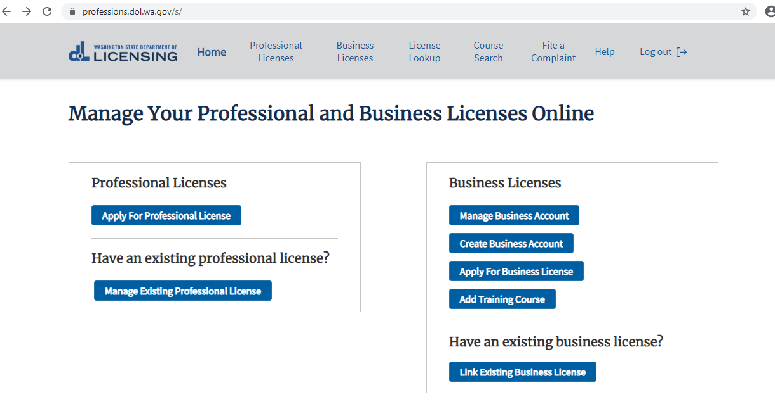
Customer Portal View

Slide 53
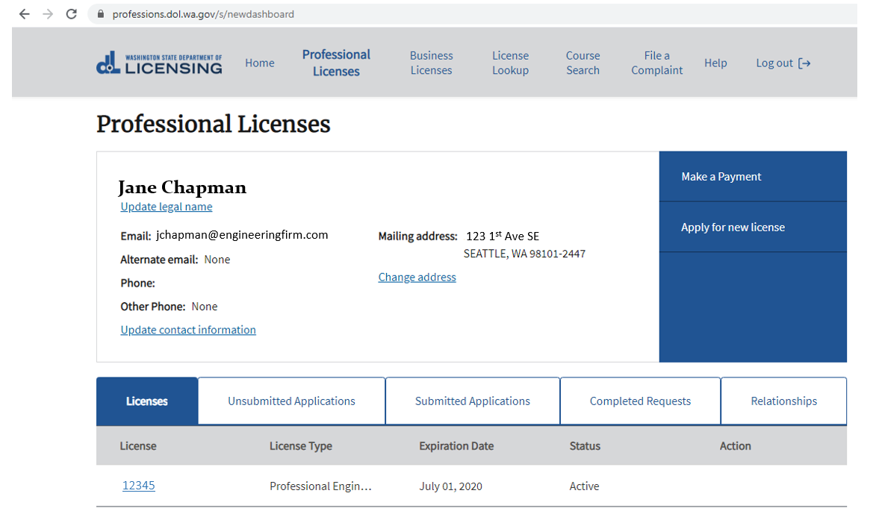
Customer Portal View

Slide 54
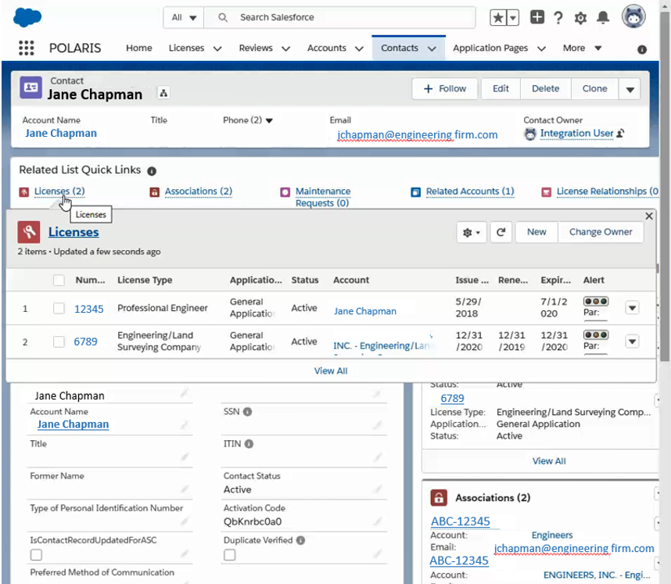
Back Office View

Slide 55
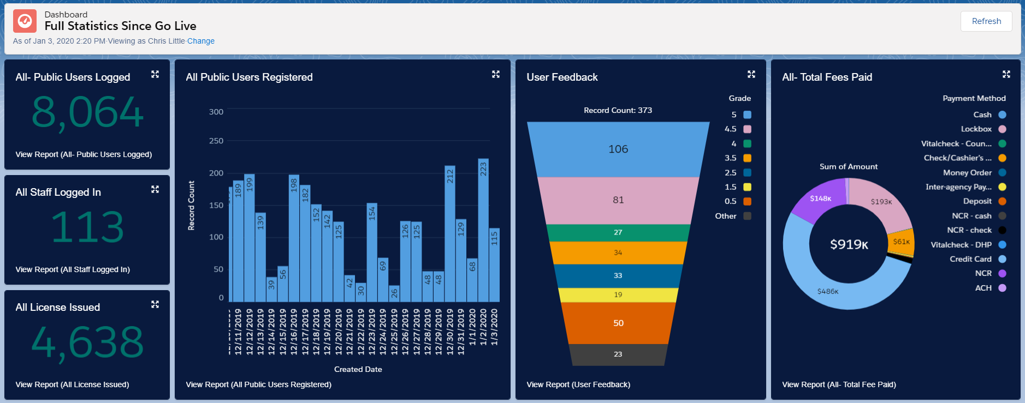
POLARIS Dashboard

Slide 56
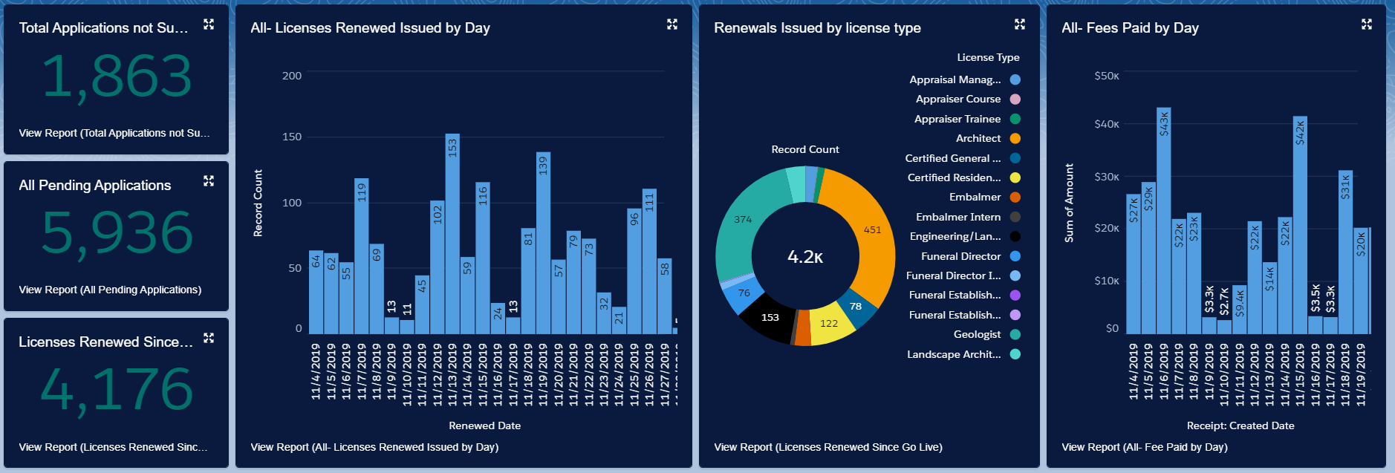
POLARIS Dashboard

Slide 57
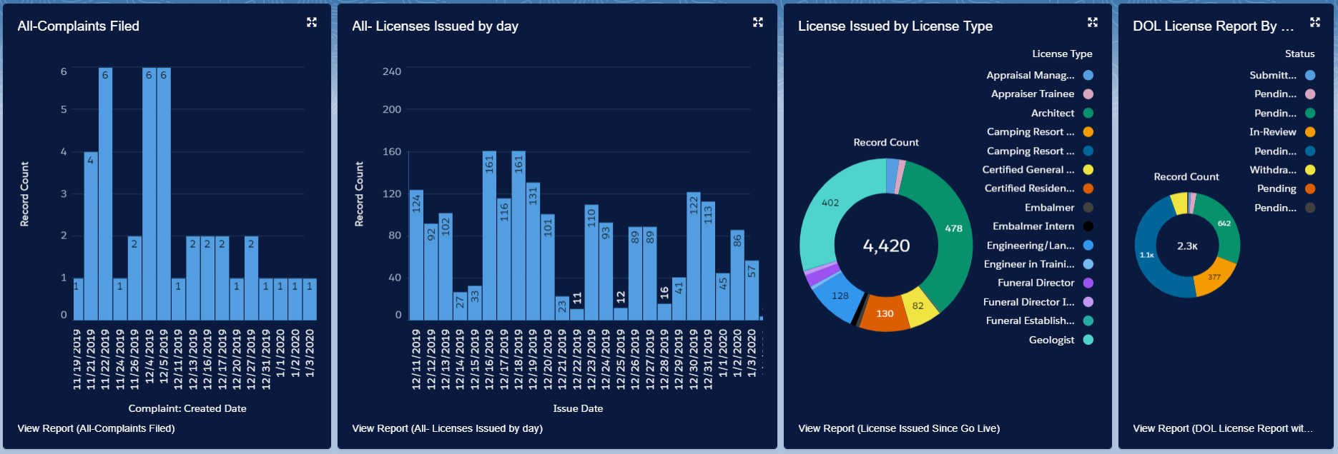
POLARIS Dashboard

Slide 58
POLARIS Dashboard

Slide 59
Release 1 Lessons learned
More agency staff dedicated to the project rather than splitting time with normal work
Smaller, more frequent meetings with key decision makers
More frequent testing and demonstrations of the product segments to speed development approval
Greater focus on standardizing requirements between license types
Not overlapping User Acceptance Testing and Training
Catch up on business/program backlog sooner

Slide 60
Release 2 Status
Finalizing discovery and design sessions
Configuration and development has started
Release 2 schedule is aggressive, applying lessons learned from release 1

Slide 61
Key Risks and Mitigations for Release 2
Aggressive schedule
Applying R1 Lessons Learned
Monitor schedule / metrics and quickly make adjustments (resources/scope) where needed
Release 1 issues impact Release 2 Resources/Schedule
Separate resources from Release 1 support and Release 2 support
Escalate as soon as appears schedule will be impacted to DOL/Deloitte leadership team for prioritization
Not all of scope can be completed within schedule
Develop full inventory of work with level of effort and assess whether it is reasonable.
Reduce complexity where possible.

Slide 62
Conclusion
POLARIS R1
Launched on November 4, 2019
Deskside support operations and the Command Center closed on schedule
Project staff have returned to the business units and will continue to provide
ad hoc support
Processed more than 4000 license transactions since November 4: new applications, renewals and reinstatements
POLARIS R2
Release 2 is well under way: aggressive, yet manageable schedule
Release 2 is on track to go live on June 29, 2020

Slide 63
OCIO Staff Update - ctcLink
Notes:
Content: Will
Presenter: Will

Slide 64
Public Comment

