Slide 1
Board of pilotage commissioners
Presentation to the
Office of the Chief Information Officer
Sheri Tonn, Chair
February 18, 2020

Slide 2
___________________________________
Today’s Presentation
  Marine Pilots
  Board of Pilotage Commissioners (BPC)
  Information Technology
  Q&A

Slide 3
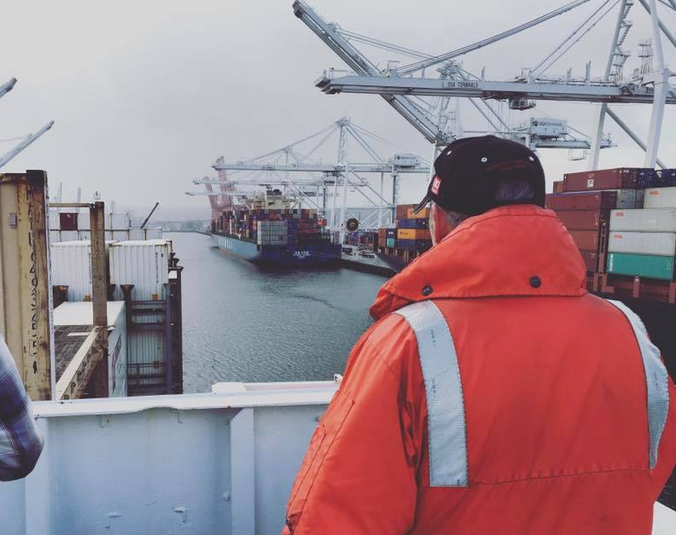
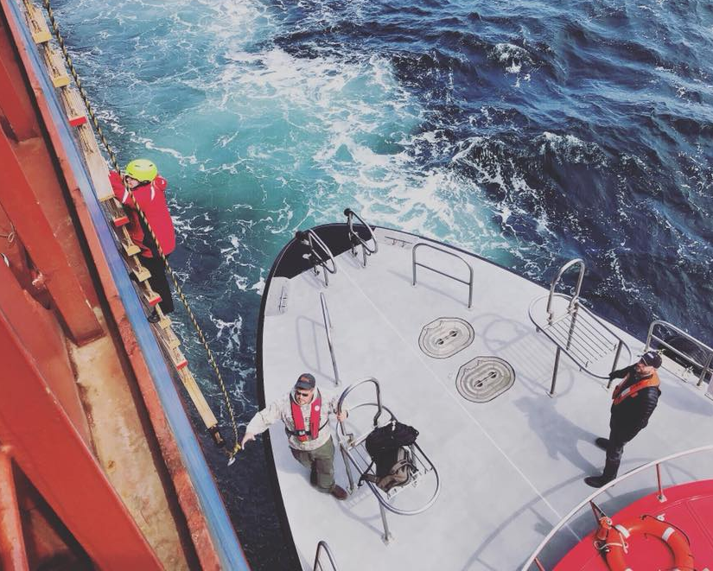
___________________________________
About Pilots
  High-level maritime professionals
  Local knowledge experts
  First line of safety
  Required on all tankers and foreign flagged vessels
Notes:
Local knowledge experts – successfully completed highly specialized training for the area
WA State licensed pilots are required on all oil tankers and foreign flagged vessels in WA’s inland waters
Capt. Neil Kelleher backing a container ship into the East Waterway in Seattle
Capt. Sandy Bendixen climbing the pilot ladder after from the pilot boat in Port Angeles

Slide 4
___________________________________
Pilotage Districts
Puget Sound Pilotage District
    Serviced by Puget Sound Pilots (PSP)
    56 state authorized licenses
Grays Harbor Pilotage District
    Serviced by Port of Grays Harbor (PGH)
    3 state authorized licenses
Notes:
1. Puget Sound Pilotage District - Geographic Area
PSP – an association of independent contractors
2. Grays Harbor Pilotage District – Geographic Area
GH – pilots are employees of the Port

Slide 5
___________________________________
Board of Pilotage Commissioners (BPC)
Washington State Regulatory Agency
Primary Mission – Safety
    Statutory Authority – RCW Chapter 88.16, Pilotage Act
    Nine Member Board, plus 3 staff
      training, licensing and regulation
Notes:
The mission of the Board of Pilotage Commissioners (BPC) is to ensure against the loss of lives, loss of or damage to property and vessels, and to protect the marine environment by maintaining efficient and competent pilotage service on our State’s inland waters

Slide 6
___________________________________
Agency History
  1935 - Created by Washington Legislature
  1977 – Moved from Labor and Industries to Transportation, Washington State Ferries (WSF) specifically
  1990’s – Became independent agency with support from WSF – operated as a non-appropriated agency for the past 10 years or so
  2019 – BPC became an appropriated agency
  Pilots Licensed Since 1935 – 224
  Current Number Authorized of Pilots - 59
Notes:
The mission of the Board of Pilotage Commissioners (BPC) is to ensure against the loss of lives, loss of or damage to property and vessels, and to protect the marine environment by maintaining efficient and competent pilotage service on our State’s inland waters

Slide 7
___________________________________
Commissioners
  Chair – Sheri Tonn
  Representing the Public at Large – Captain Jason Hamilton
  Representing the Public at Large – Timothy J. Farrell
  Representing American Shipping – Phil Morrell, TOTE Maritime
  Representing Foreign Shipping – Captain Rik Krombeen, Holland America Line
  Representing Pilots – Captain John Scragg, Puget Sound Pilots
  Representing Pilots – Captain Mike Anthony, Puget Sound Pilots
  Representing WA State Dept. of Ecology – Sara Thompson, Spills Prevention
  Representing the Marine Water Environment – Eleanor Kirtley, Green Marine

Slide 8
___________________________________
Support Staff
  Executive Director – Jaimie Bever (11/2/2015)
  Training Program Coordinator – Jolene Hamel (9/1/2017)
  Program Analyst – Bettina Maki (11/1/2019)
  Assistant Attorney General – Albert Wang (5/1/2017)

Slide 9

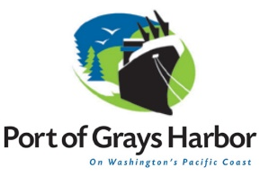
___________________________________
Role of the BPC
Regulatory oversight
Propose legislation
Adopt rules
Train and license pilots
Determine number of pilots
Report and investigate incidents
Vessel exemptions
Role of PSP & PGH
Provide efficient
pilotage services
Administer benefits
and retirement
packages
Tariff billing and revenue collection
Continuing education
Notes:
BPC
Regulator Oversight – of WA pilotage
Propose Legislation
Adopt Rules – to enforce adherence to the Pilotage Act
Train and License – marine pilots
Report and Investigate Incidents – and provide lessons learned for continuous improvement
Vessel exemptions – granted to qualifying vessels
Pilots
Provide pilot service: safely and independently pilot vessels, dispatch pilots, pilot operation
Continuing Education – for pilots

Slide 10
___________________________________
Training Program – Puget Sound
  3 Phases: Observation, Training, Evaluation ≈ 300 Trips
  18 Conning Quizzes/ 2 Local Knowledge Final Exams
  Federal Pilotage Endorsement – 24 charts
  Regular TEC and Board review of training program status for each trainee
  Physical Report from Board Designated Physician for entry to the training program and annual trainee license renewal
  Average duration 18-24 months
  Trainee stipend - $6,000/month
  * Grays Harbor Training Program scaled to size of the district

Slide 11
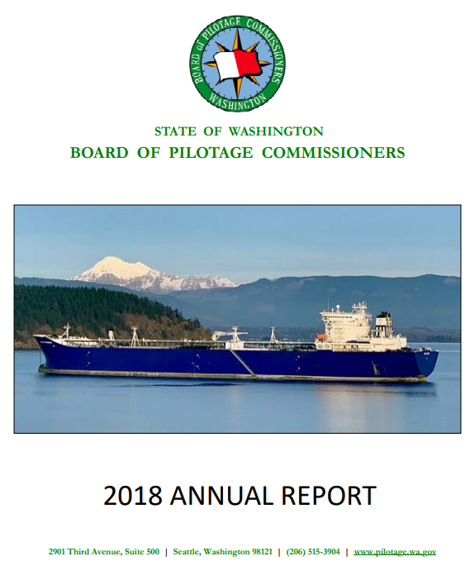
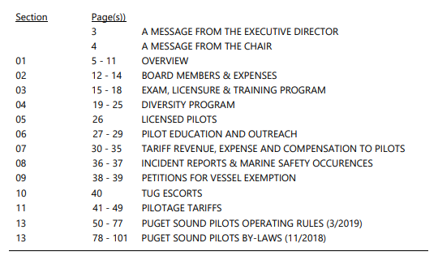
___________________________________
Annual Report to the Legislature

Slide 12
___________________________________
Information Technology Provided by WSF
Computers, printers, phones, software
IT support and administration
Compliance with State regulations

Slide 13
___________________________________
Information Technology Provided by BPC
Portable Piloting Units (PPU) - Leased
Pilot Trainee Radios
Go Daddy Website – maintained by BPC staff

Slide 14
___________________________________
Future Technology/Software
Database for tracking pilot information
SharePoint or other web based file sharing system

Slide 15
___________________________________
Questions?
TonnS@wsdot.wa.gov
www.pilotage.wa.gov
Thank you!

