Slide 1
CIO Forum
July 11, 2017

Slide 2
Agenda
Agenda
Time | Topic | Topic Lead
1:30 – 1:35 | Welcome and Introductions | Matt Bailey
1:35 – 1:55 | Review Annual Certification Requirements | Sue Langen, OCIO
1:55 – 2:05 | Working Group Announcement | Alex Alben, Chief Privacy Officer Will Saunders, OCIO
2:05 – 2:10 | Good of the Order Updates, Questions, Answers, Agenda Ideas | All

Slide 3
OCIO Update
CIO Forum
July 11, 2017

Slide 4
June 26, 2012
12 baktun
19 katun
19 tun
9 uinal
2 k'in

Slide 5
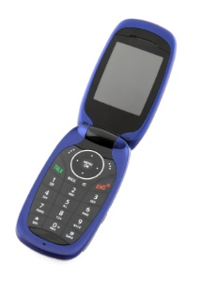
End of Days?
2011 Audit report said the state was paying too much for cellphones that were not being used

Slide 6
OCIO Policy
Agencies must actively manage
Based on job requirements
Sign an agreement
Security, Privacy, Records
No expectation of Privacy
Public records on personal devices
Optimize devices + plans
Stipends
Cellular Device Policy - 191
Cellular Device Policy - Appendix A: Cellular Device Authorization and Agreement - 191.10a
Cellular Device Policy Questions and Answers - 191.20

Slide 7
What now
Working group forming
3 meetings starting in August
Looking for a mix of records, business, tech people
Review policy, draft guidance
Email will.saunders@ocio.wa.gov
Policy revision to TSB in October
Coordinate with OFM on stipends

Slide 8
Good of the Order Updates, Questions, Answers, Agenda Ideas

