Slide 1
CIO Forum
September 12th, 2017

Slide 2
Agenda
Time | Topic | Topic Lead
1:30 – 1:35 | Welcome and Introductions | Matt Bailey
1:35 – 1:45 | OFM Update | Regan Hess, OFM
1:45 – 1:55 | Mobile Devices Policy | Alex Alben, Chief Privacy Officer
1:55 – 2:25 | Update from the Office of the Chief Information Officer (OCIO) Review the Supplemental Decision Package Process Geographic Information Technology (GIT) Meeting Summary | Whitney Dickinson, OCIO Joanne Markert, OCIO
2:25 – 2:35 | Cloud Highway Update | Heidi Geathers, WaTech Dan Mercer, WaTech
2:35 – 2:40 | Good of the Order Updates, Questions, Answers, Agenda Ideas | All
2:40 | Wrap Up | Matt Bailey

Slide 3
OFM Update
Regan Hesse, OFM

Slide 4
Mobile Devices Policy
Office of Privacy & Data Protection

Slide 5
Ye Olde Policy
Agencies must actively manage cellphones
  Based on job requirements
  Sign an agreement
Security, Privacy, Records
  No expectation of Privacy
  Public records on personal devices
Optimize devices + plans
Stipends
Cellular Device Policy - 191
Cellular Device Policy - Appendix A: Cellular Device Authorization and Agreement - 191.10a
Cellular Device Policy Questions and Answers - 191.20

Slide 6
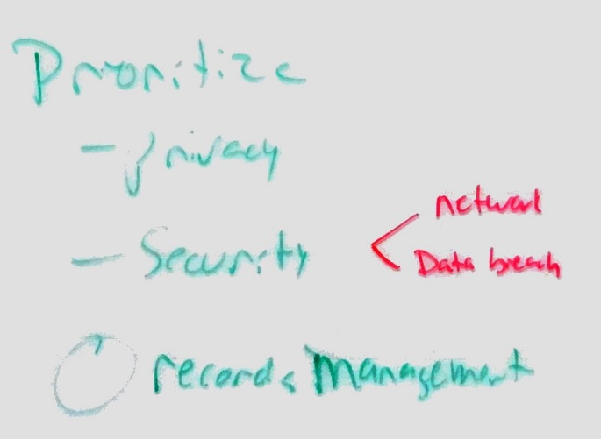
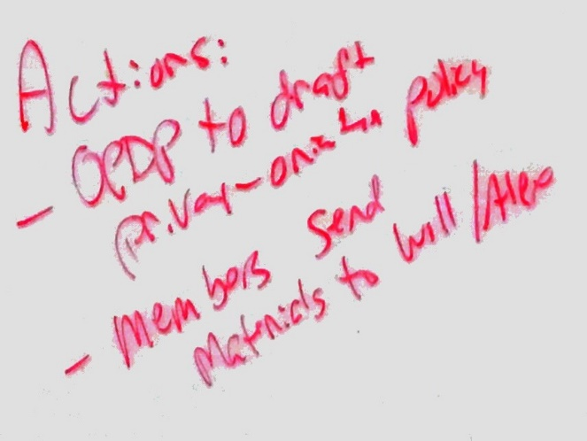
Workgroup
Announced June 2017 @ CIO forum
Agencies participating:
  DAHP, DOL
  DSHS,DOH
  DFW, AGR, ECY
  WaTech, DES, SAO
Help from UW Law school
Partnership with Enterprise Architecture community

Slide 7
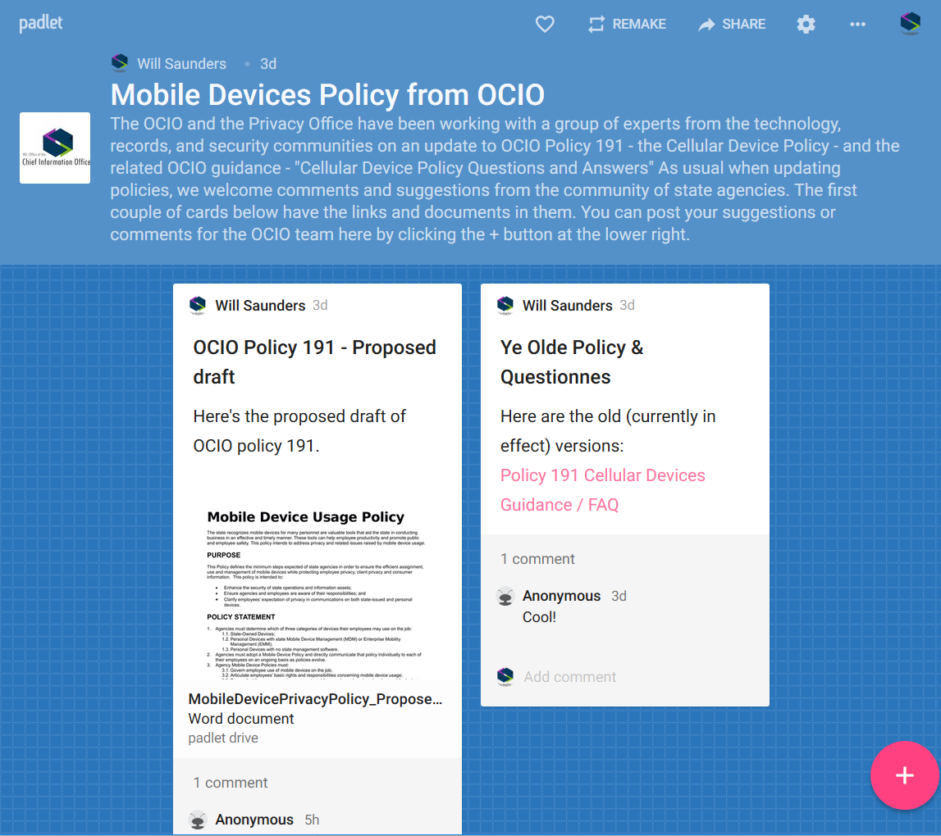
Proposed policy draft
Open for comment until November 3rd
Multiple ways to comment
  Email Will.Saunders@ocio.wa.gov
  Comment directly on SharePoint
  Web-based pinboard app called Padlet. https://padlet.com/will_saunders/3wbxucy2vmx0
Aiming for Nov. TSB
OCIO Website download (MS Word)
OCIO workgroup site if you want to sign up for more

Slide 8
OCIO Update
CIO Forum
September 12th, 2017

Slide 10
Joanne Markert, State GIS Coordinator
5 years with DNR and WSDOT
17 years in private consulting
Instructor at South Puget Sound Community College
Started with OCIO in June 2017
Geographic Information System (GIS)
  Helps us visualize, question, analyze, interpret, and understand data to reveal relationships, patterns, and trends in a geographic context.

Slide 11
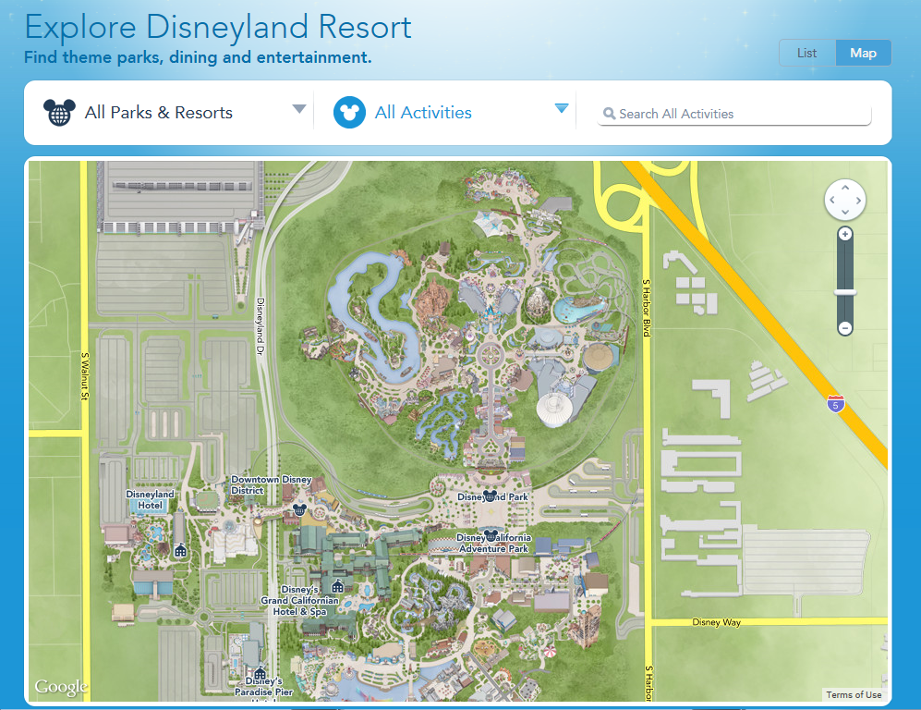
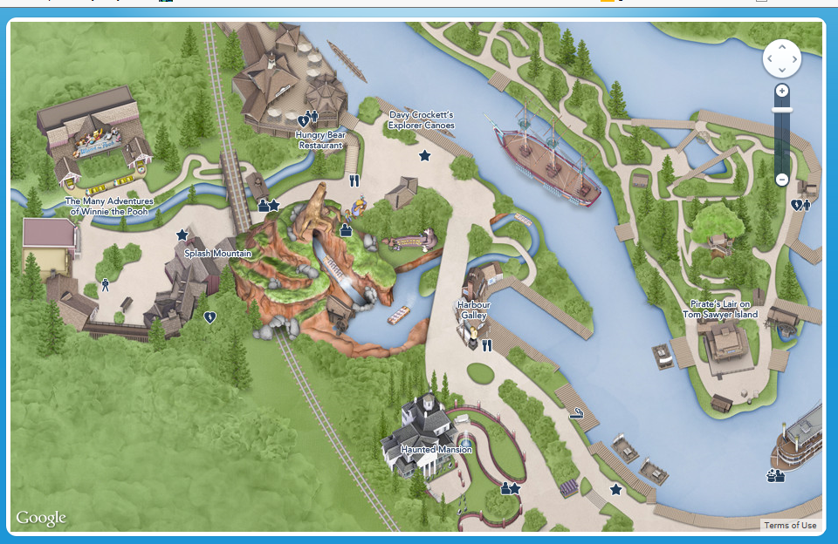

Slide 12
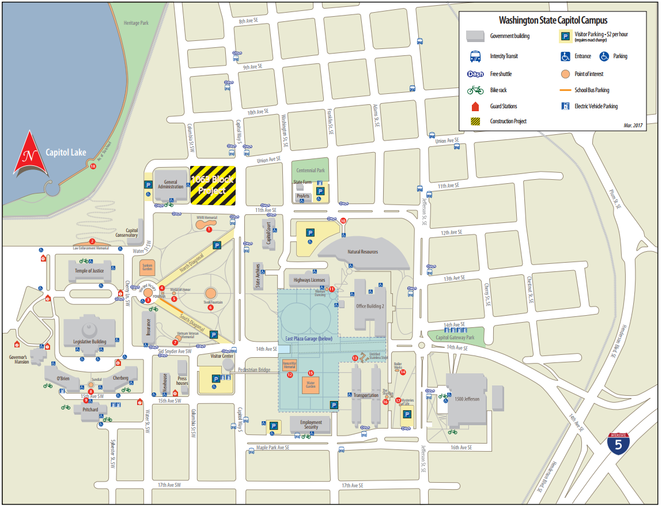

Slide 13
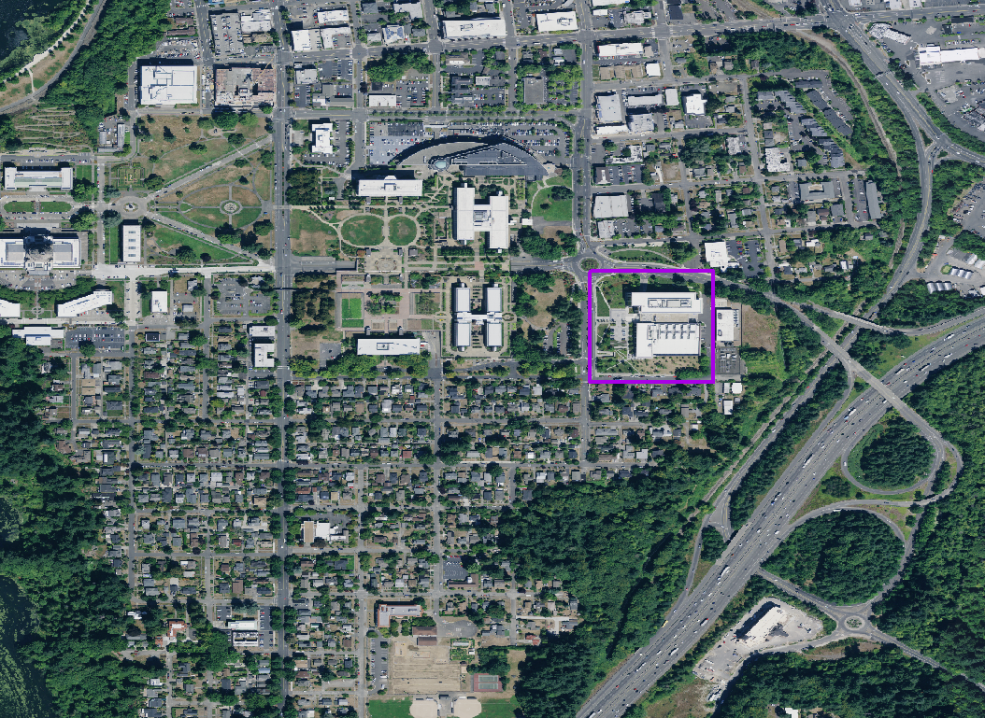
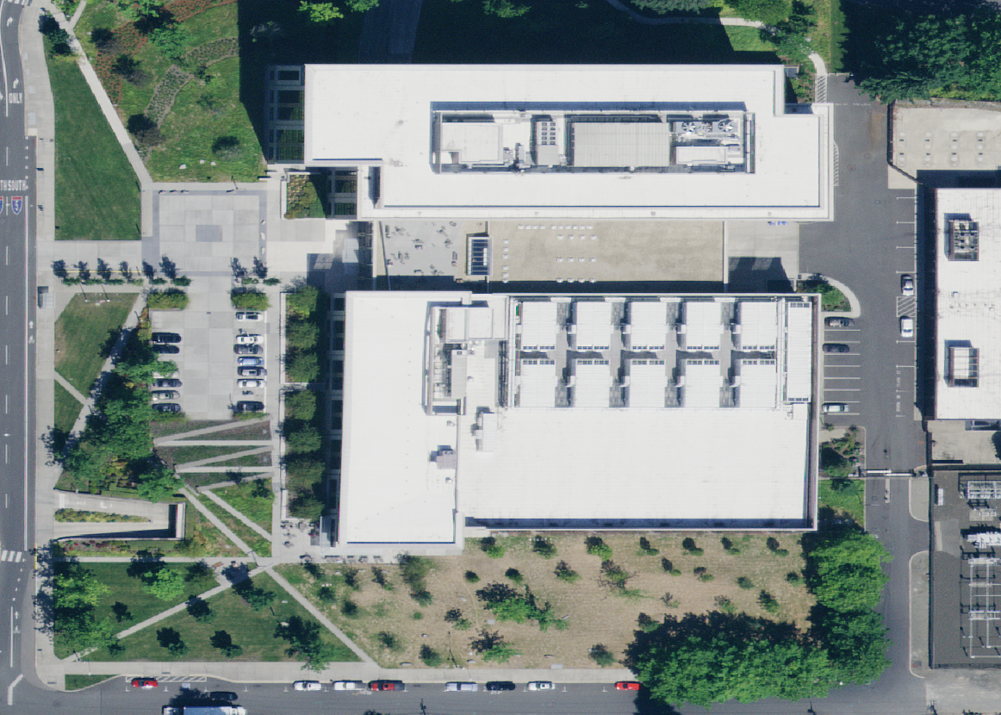

Slide 14
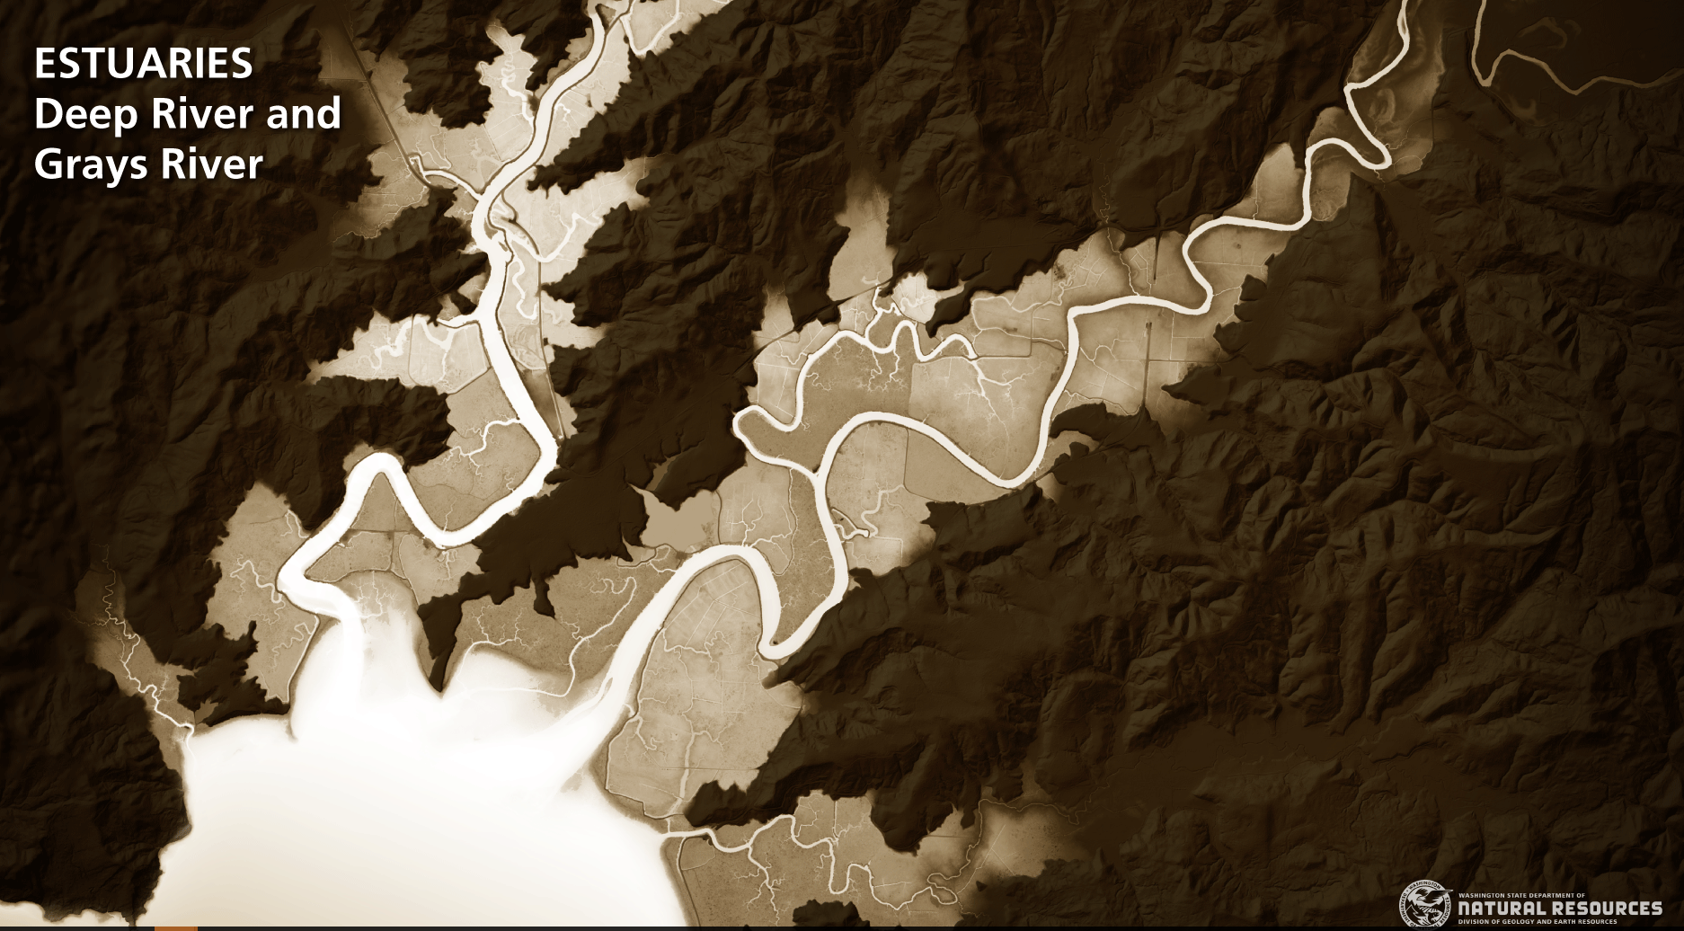

Slide 15
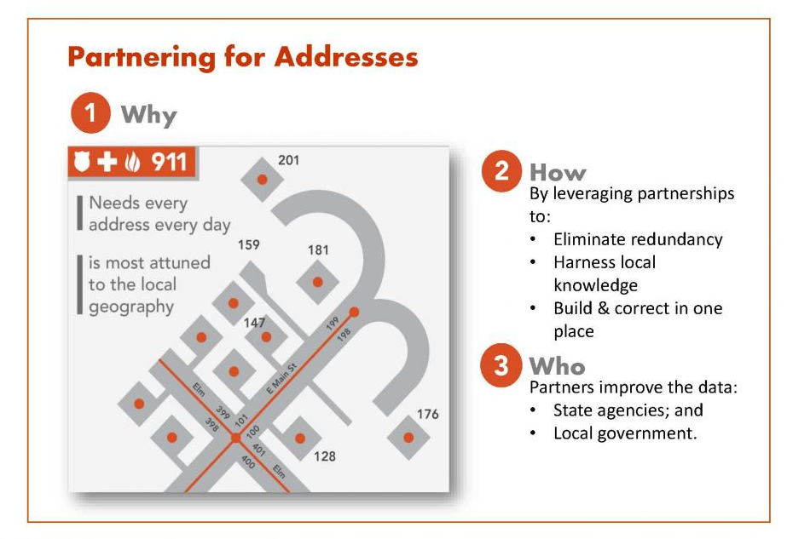
Oso Landslide

Slide 16
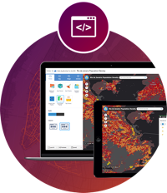
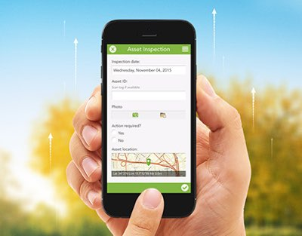
OCIO – Geospatial Program Office:
Harnessing the Power of Where
Simplify Access to Geospatial Data
Help Every State Agency Benefit From GIS
Develop Strategic Partnerships and Policies to Help Make this Happen
Examples:
    Imagery
    Drones
    NG9-1-1
    Cities and Counties
Joanne Markert | State GIS Coordinator
Washington Technology Solutions (WaTech)
o: 360.407.8691 m: 360.522.2643

Slide 17
Cloud Highway Update
Heidi Geathers, WaTech

Slide 18
Good of the Order Updates, Questions, Answers, Agenda Ideas

