Slide 1
CIO Forum
June 13, 2017

Slide 2
Agenda
Agenda
Time | Topic | Topic Lead
1:30 – 1:35 | Welcome and Introductions | Matt Bailey
1:35 – 1:40 | OFM Update | Regan Hesse, OFM
1:40 – 2:25 | Update from the Office of the Chief Information Officer (OCIO) Project Process Improvements IT Procurement IPv6 Strategy & Related New Strategic Plan Annual Certification Process Supplemental DP Process Other Announcements | Sue Langen, OCIO Becci Riley, DES Robert Gaskill-Clemons, OCIO Cammy Webster, OCIO David Walddon, OCIO
2:25 – 2:55 | TBM Program Reporting | Ann Bruner, DOL Mara Tallman, DOL Cammy Webster, OCIO Derek Puckett, OCIO
2:55 – 3:10 | OneDrive | Will Saunders, OCIO
3:10 – 3:20 | Impacts of dial.wa.gov | Heidi Geathers, WaTech
3:20 – 3:25 | Good of the Order Updates, Questions, Answers, Agenda Ideas | All
3:25 – 3:30 | Wrap Up | Matt Bailey

Slide 3
OFM Update
Regan Hesse

Slide 4
Oh, So Many Updates from the OCIO
CIO Forum
June 13, 2017

Slide 5
Today’s Topics
Project Process Improvements
IT Procurement
IPv6 Strategy & Related
New Strategic Plan
Annual Certification Process
Supplemental DP Process
Other Announcements
Notes:
Sue will lead – David is backup

Slide 6
Project Process Improvements
Assessment Tool
Intervening for Success
Readiness For Go Live
Oversight Framework
Notes:
David

Slide 7
Concept for Oversight Framework
Proposal:
Create definitions and triggers for the tiers within the updated approach
Allow for proactive oversight: Focus oversight resources and processes based on risk factors to achieve the greatest value
Target:
Levels of Oversight
Situation:
Current oversight methods and processes may not always apply resources and focus attention in the most appropriate fashion in a given situation or at the right time
Clearly define oversight framework components
Begin process to match components to projects
Recommend changes to policy/procedures
Project Risk Assessment
Negligible
Low
Moderate
High
Notes:
Whitney

Slide 8
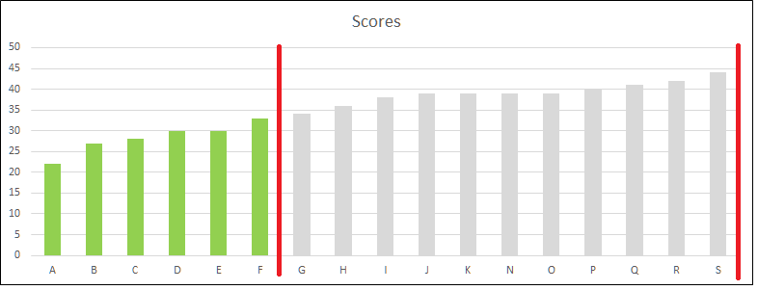
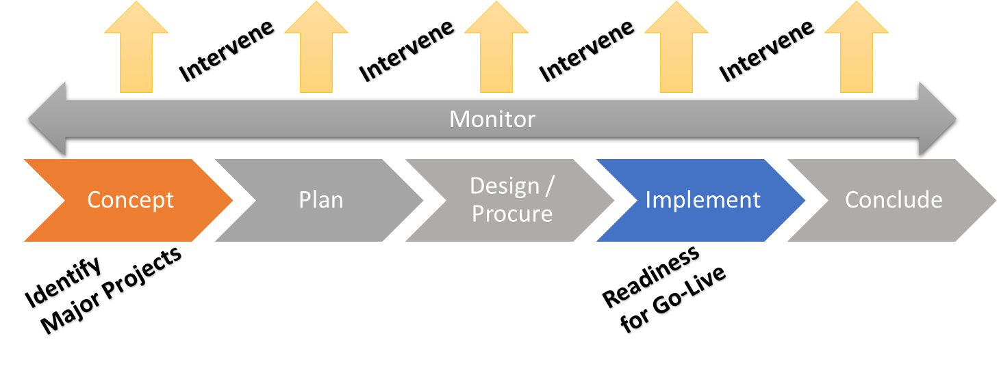
Identification of Major Project – Update May 1 to June 8
Update:
Implemented May 1
17 submissions/ 13 agencies
6 - 35% review not required
11 – 65% review required
No submissions required oversight by default
7 submissions self-identified Financial/Admin systems
Notes:
Rich

Slide 9
Identification of Major Project
Next Steps:
Agency request to add new functionality with RSS feed
Review and update OCIO Policy and Standards
Develop/implement change control process
Review and analyze data for potential adjustments to score ranges
May 1
Implement New Tool
Aug
Iterate on Policy and Procedure
Sep
Report Out
Mar-Apr Finalize Tool Communicate to Users
Notes:
Rich

Slide 10
Intervention/Escalation – what we wanted and why we wanted
Proposal:
Clearly define and socialize escalation concept and processes to set expectations that critical conversations at executive levels will occur when appropriate
Situation: concept and processes
not clearly defined
not consistently applied
Target: concept and processes
clearly defined and socialized
consistently applied
promote valuable executive level engagement in anticipation of critical conversations
Notes:
Rich

Slide 11
Intervention/Escalation – what we did, concluded and plan to do
Activities:
Convened workgroup of IT/PMO/Project Managers to identify triggers
Outcomes/Conclusions:
Virtually all triggers identified fall within normal project management or oversight processes (e.g. project governance. risk assessment, etc.)
Intervention/Escalation is triggered when OCIO/consultants assess need/risk
OCIO consultant assessment rating criteria are discretionary
Next Steps:
Incorporate trigger data collected into OCIO oversight framework process improvements in progress
Document and share the assessment criteria used for the OCIO assessment rating levels – GREEN, YELLOW, RED
Propose to TSB processes/policies as needed
Notes:
Rich

Slide 12
Readiness for Go-Live
Proposal:
Identify and publish best practices for assessing project readiness to go-live
Socialize and set expectations with community
Situation:
Agency maturity in making a go/no-go decision varies widely
These critical decisions should be discussed with the OCIO but there is no standard procedure or expectation published in policy or standard
Target:
Agencies apply a set of defined criteria for determining readiness and know how and when to involve the OCIO in this critical decision
Notes:
KPR

Slide 13
IT Procurement
Strategy & Principles
Stakeholder Work
IT Community
Lay the Groundwork
Develop Plans
Planning for chartered work
Goals and Measures
Procurement Community
Others?
Governance & Consultation Models
Staffing models
Training needs
Priorities for future work

Slide 14
Key Deliverables of Planned Work
Guiding principles
Work plan to create deliverables
Consultation protocols for IT good/services contracts
Draft policy management & governance model
Prioritized policy development areas
Delegated Authority Concept
Consultation for IT related sole source justifications
Recommended staffing levels
Implementation recommendations & key metrics
Communication/stakeholder plan for implementation & beyond
Proposal for training
Planned stakeholder activities – during this project

Slide 16
IPv6 Migration Policy: What you will see
Overall migration target date
Implementation planning target date
Application readiness target date
Investment IPv6 compliance
Status reporting

Slide 17
Strategic Plan: 2017 - 2021
Maintains continuity with the current strategic framework
Begin using July 2017
More communications to follow
Link to plan (1 page version)

Slide 18
Annual Certification Process for 2017
Announce Early July
Memo with attachments & due dates
Material due 9/30
Sent via email & published on OCIO.wa.gov
Certification Form
Application Inventory
Will get 2016 submission back
Identify admin/financial systems, mainframe systems and enterprise system integrations
OCIO coordinating closely with One Washington to avoid duplication
Security Attestation
Same as last year

Slide 19
Other Announcements
TSB Policy Decisions
TBM
Open Data
Accessibility
Supplemental DPs
Administrative Financial Systems Approval – Work team needed
OneWashington
Notes:
Sue and David

Slide 20
TBM Program Reporting
Ann Bruner, Mara Tallman, Cammy Webster, Derek Puckett

Slide 21
Technology Business Management Changes
Impacts of standardization
Results
Consolidated 19 separate cost mapping projects into 1
44 agencies – Using template process for agency cost mapping
Increased agency adoption rate
Leverage “Out of the Box” reporting
CIO now have insight into shadow IT in the agency
Moved to industry standard taxonomy
Improved Benchmarking – Agency to Agency & Agency to Industry
Standardization
Quickly identify coding gaps related to IT spend
Improved view into new IT spend versus M&O IT spend
Notes:
Presenter: Cammy

Slide 22
Technology Business Management Improvements
IT Spend
$1B - $1.3B Increase identified in minutes vs. hours
Trending +/- IT spend by government function
Leadership
Industry leader - Federated rollout to 44 agencies
Processes support TVO to agency business
Federal Government looking at us as a model
DOL – IT spend per drivers license
Program KPI
Agencies with TCO to applications increased to 100%
Identified IT spend coding errors is reduced to 0%
Increase number of agencies with TCO to business
Notes:
Presenter: Cammy

Slide 23
Technology Business Management
Live Demonstration
IT Spend by Cost Pool
IT Spend by Govt Function
IT Resource Tower (ITRT)
TCO Applications
Identifying Unmapped Costs
Benchmarking

Slide 24
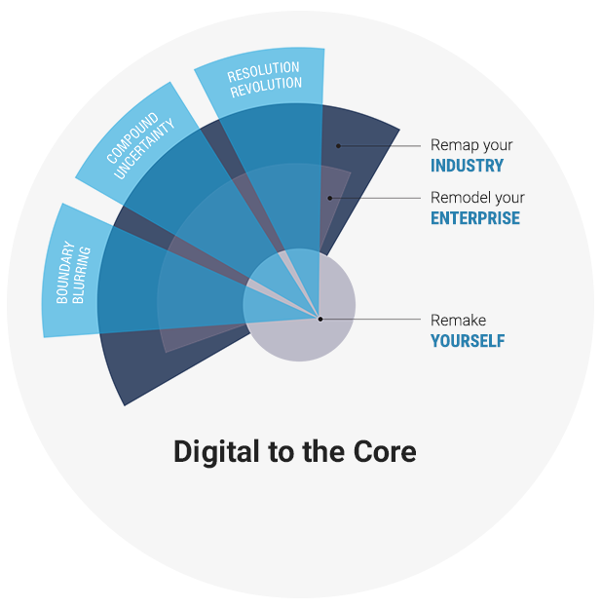
Department of Licensing
Digital Leadership?
ENTERPRISE
IT DEPARTMENT
YOURSELF
Ann Bruner, CIO
Mara Tallman, IS Portfolio Manager

Slide 25
IT Leaders Today
Focus on listening
Seek constant feedback
Think customer
Manage demand, create it.
Earn trust
Operating model change
Mindset change
Align strategy
Business: why & what
IT: how
Move faster
Minimum viable experiments
Frequent interactions

Slide 26
Transformational Leaders

Slide 27
Evaluate IT Capabilities
They ask
We ask
What is the cost to support the legacy vs modernized system?
Why does IT cost so much?
What is our IT cost allocation strategy?
Are the business results worth the level of IT investment?
Are IT staffing levels competitive?
Can we prove our IT investment success?

Slide 28
Analyze IT Capabilities
IT value
Strategic planning
Industry bench marks
Data quality
Service management
Business services
IT towers
IT services
Business transactions
$$
Transparent IT Costs
Technology Business Management

Slide 29
DOL IT FTE Distribution
84%
16%
Gov. Benchmark
Augment capacity for temporary demand
Fill knowledge, skill, and ability gaps
Deliver operations and major projects
Gov. Benchmark Source: Gartner IT Key Metrics Data (December 2016)

Slide 30
DOL IT Services Portfolio
40%
40%
20%
IT Industry Targets
IT services enable business capabilities
High “run” usually translates into a “cost center” role for IT
Gov. Benchmark and Industry Targets Source: Gartner IT Key Metrics Data (December 2016)

Slide 31
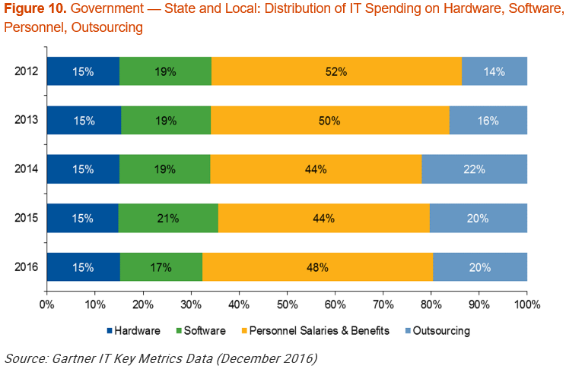
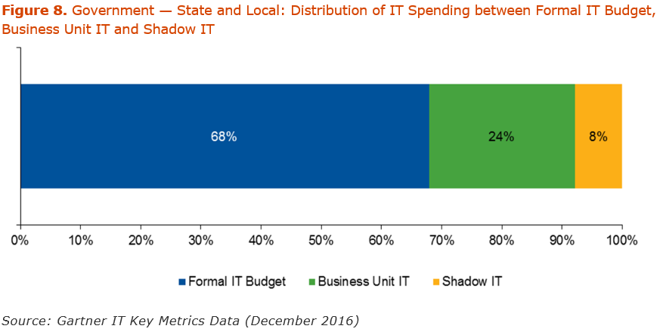
New Horizons for our TBM Analysis

Slide 32
DOL Results

Slide 33
Questions

Slide 34
OneDrive Evaluation
Will Saunders and Dave Kirk

Slide 35
State of Washington Evaluation of OneDrive for Business – May 2017
Creation
Writing
Active Use
Reading
Retention
Storing
Disposition
Destroy or
Archive
Receiving
Recording
Sharing
Publishing
Retrieving
Backups
Process for Study

Slide 36
State of Washington Evaluation of OneDrive for Business – May 2017
User
Central Admin.
Records Mgr.
Security
Public Disclosure
User Stories

Slide 37
Impacts of dial.wa.gov
Heidi Geathers

Slide 38
Good of the Order Updates, Questions, Answers, Agenda Ideas

