Slide 1
CIO Forum
August 8th, 2017

Slide 2
Agenda
Time | Topic | Topic Lead
1:30 – 1:35 | Welcome and Introductions | Matt Bailey
1:35 – 1:55 | IT Pool Process | Regan Hess, OFM Whitney Dickinson, OCIO
1:55 – 2:00 | Legislative Update | Connie Michener, WaTech
2:00 – 2:20 | SAW User Interface Modernization | Scott Barringer, WaTech
2:20 – 2:50 | One Washington Update | Stacey Scott, OFM
2:50 – 3:25 | Update from the Office of the Chief Information Officer (OCIO) 2017 – 2019 IT Strategic Technology Plan Supplemental Decision Package Process Executive Sponsor Training Policy Status & Update | Sue Langen, OCIO
3:25 – 3:30 | Good of the Order Updates, Questions, Answers, Agenda Ideas | All
3:30 | Wrap Up | Matt Bailey

Slide 3
2017-19 IT Pool
Information
Notes:
Content and Presenters: Whitney and Regan
OFM & OCIO working together to develop more meaningful oversight for IT Projects
Lots of lessons learned from last biennium
Stage gating useful tool: smaller buckets of money released incrementally based on predetermined outcomes. Agency can only move to next stage, after meeting the outcomes from the previous stage.
Need proactive coordination between agency, OFM, OCIO
Flexible & scalable process
Goals
Mitigate risk
Improve/maximize project success
Comply with statutory requirements
25 projects from 16 agencies for a total of approx. $126M
3 projects funded through dedicated pool account $19M, short-funded by $1.7M

Slide 4
Improving Upon the IT Pool for 2017-19
Lessons learned from the 2015-17 IT Pool
  Proactive coordination between the agency, OFM, and the OCIO
  Process should be flexible and scalable
  Stage gating is a useful tool
Goals:
  Mitigate risk
  Improve/maximize project success
  Comply with statutory requirements
Legislature established an IT Pool for 2017-19 biennium
  Section 724 of the Operating budget
  Section 701 of the Transportation budget
Notes:
Regan: I’ve been telling you for two years now that my goal is to work with the OCIO to improve how we oversee IT projects so much that the Legislature doesn’t feel inspired to make another IT Pool. We didn’t quite succeed at getting rid of the IT Pool, but we’ve come a long way in improving what the IT Pool is and does.
We’ve been working on determining what meaningful oversight looks like.
Goals
Mitigate risk
Improve/maximize project success
Comply with statutory requirements
25 projects from 16 agencies for a total of approx. $126M
3 projects funded through dedicated pool account $19M, short-funded by $1.7M

Slide 5
$126M of Project Spending Subject to IT Pool
(OFM/OCIO can “opt in” others at any time)
*DSB – Business Management System
*SEC – Modernize Elections System
*OSPI – School Financial System Redesign
BVFFO - Pension and Benefit Tracking System
DEL - Procure Time and Attendance System
DES - Risk Management System
DOC - IT Business Solutions
DSHS-ESA - Continue ESAR Architectural Development
DSHS-LTC – IPOne Overtime Completion
ESD - UTAB Agile Implementation
HCA - ACA Employer Shared Responsibility
HCA - Provider Credentialing System
HCA - ProviderOne CORE Operating Rules
HCA – ProviderOne DSHS Provider OT Proj
LCB - Traceability System Replacement
LNI - Business Transformation
OFM - All Payer Claims Database
OFM - One Washington Program
SBCTC - CTCLink
WSP - Reappropriation for Upgrade
WSP - SAK Tracking Database Funding
DOT – Land Mobile Radio System Replacement
DOT – Labor System Replacement
DOT – Ferry Network System Support
DOT – Back Office System Project
* Denotes a project funded through the IT Investment Pool Account

Slide 6
2017-19 IT Pool Process
Oversight Kickoff meeting
Agency applies to OCIO for certification of next stage
OCIO approves investment plan, certifies next stage
OFM and OCIO jointly approve project stage
Agency submits technology budget to OFM
OFM approves technology budget
Agency consults with DES (>$2M)
Agency proceeds with next project stage
Agency consults with OST (>$2M)
Updated 7.27.17

Slide 7
The Application Process – Where To Start
Kickoff Meeting
  Participants:
    WaTech: OCIO consultant
    OFM: Budget analysts assigned to the agency and to WaTech
    Agency executive sponsor, project manager, and fiscal/budget manager
  Goal:
    Determine project stages and deliverables
    Identify next stage and associated funding needs
    Provide agency with all information needed to successfully apply for project approval and funding
Application requirements:
  Application
  Technology Implementation Plan/Investment Plan
  Technology Budget

Slide 8
OCIO Certification Requirements
meets critical project success factors - Policy 131 Appendix D: Critical Indicators of Project Performance Early Warning Signs
  executive management Support
  user involvement
  experienced project manager
  clear business objectives
  minimized scope
  responsive business requirements process
  standard infrastructure
  formal methodology
  reliable estimates
  skilled staff
  contract negotiation and vendor management
  implementation
aligns with statewide technology strategy and architecture
reuses existing technology services and solutions
minimizes custom development
complies with security policy requirements
complies with other policy requirements
uses modularized, component-based architectures
technology implementation plan that includes:
  PM org chart - team members and their roles and responsibilities;
  OCIO consultant
  implementation schedule - activities, critical milestones, deliverables - at each stage - at each agency affected by the project
  performance measures used to determine that the project is on time, within budget, and meeting expectations for quality of work product
consistent with the state's enterprise architecture and other OCIO policies
organizational capacity, preparedness, and leadership
adequately assessed and minimized risks
management, staffing, and oversight resources needed for cost, complexity, and risks
implementation schedules and performance measures for timeliness, deliverables, quality, and budget
adequate risk management plan that also enables the office of the chief information officer to assess, intervene, and take necessary action when performance measures are not being met
non-COTS or SaaS - rationale
Notes:
- Big list of words!
- List of criteria from the legislation
Nothing really new here
If we had all the time in the world, we would do this for every project, all the time
Risk-based approach
We won’t do all of this for all the IT pool projects at every stage
The process is flexible and scalable so we’ll do what is appropriate

Slide 9
OFM Financial Oversight
Agencies must provide a technology budget:
    A technology budget using a method similar to the state capital budget, identifying project costs, funding sources, and anticipated deliverables through each stage of the investment and across fiscal periods and biennia from project initiation to implementation. If the project affects more than one agency, a technology budget must be prepared for each agency.
Format is flexible– OFM will work with whatever format meets agency and budget analyst’s needs as long as it meets the statutory requirements
  Stages
  Dates
  Cost (by fund)
  Milestones/deliverables
OFM can provide examples– have any to share?

Slide 10
Please provide feedback!
OCIOConsultants@ocio.wa.gov
Regan.Hesse@ofm.wa.gov

Slide 11
Backup only

Slide 12
2017-19 IT Pool Process
Agency/OCIO/OFM Kickoff meeting
  What is the project?
  What are the stages?
  Is there an investment plan approved?
  Is there a technology budget?
  What are the agency’s immediate funding needs?
Agency applies to OCIO for certification of next stage by emailing to ocioconsultants@ocio.wa.gov:
Application
Technology Implementation Plan/Investment Plan (waived for first stage if the project is new, or new to OCIO oversight, so project can do “planning”)
OCIO reviews Agency’s application
Initial stage has no prerequisites
Any other stages must have OCIO approved investment plan and comply with Section 724(3)(c)
OCIO sends certification letter to OFM and posts application, investment plan, and certification letter on OCIO dashboard
Agency works with OFM budget analyst to develop a technology budget that includes:
  Stages
  Costs
  Milestones/Deliverables
  Schedule
Format can vary; OFM can provide sample templates.
Agency posts technology budget on OCIO dashboard.
OFM reviews docs on OCIO Dashboard:
Agency application
OCIO Certification
Investment Plan (if not waived during planning)
Technology Budget
OFM approves next project stage on behalf of OCIO and OFM; dual purpose letter:
Notify Agency, Legislature, and OCIO of project approval
Allocates funding or authorizes allotment
Agency submits allotment consistent with Technology Budget
Agency consults with DES for review of all contracts (required for projects >$2M only)
OFM approves allotment
Agency commences approved project stage
Agency consults with OST during procurement to determine if products/services can be financed (required for projects >$2M only)
Agency completes Milestones/Deliverables, ready for next stage
Updated 7.27.17

Slide 13
IT Pool Process Comparison
Agency Applies
OCIO Certifies
OFM Notifies Leg
14 Day Waiting Period
OFM Authorizes Spending
FY15-17
Agency Applies
FY17-19
OCIO
Approves
OFM
Notes:
Content: Regan & Whitney
Presenters: Regan & Whitney
Last time
OCIO project / technical oversight
14-day waiting period
This time
Additional Project, Technical and Financial Oversight
OCIO assess project / technology
OFM assess financial outcomes

Slide 14
SecureAccess Washington
A Unified Single Sign-on Strategy

Slide 15

SAW Exists to Provide
A consistent authentication scheme for agency applications
Secure authentication (MFA, KBA) for high-security agency applications (CAT3 or CAT4)
A layer of protection for state agency applications (Proxy)
Selective access to agency online documents or services
Self-administered single sign-on access to multiple agency applications

Slide 16
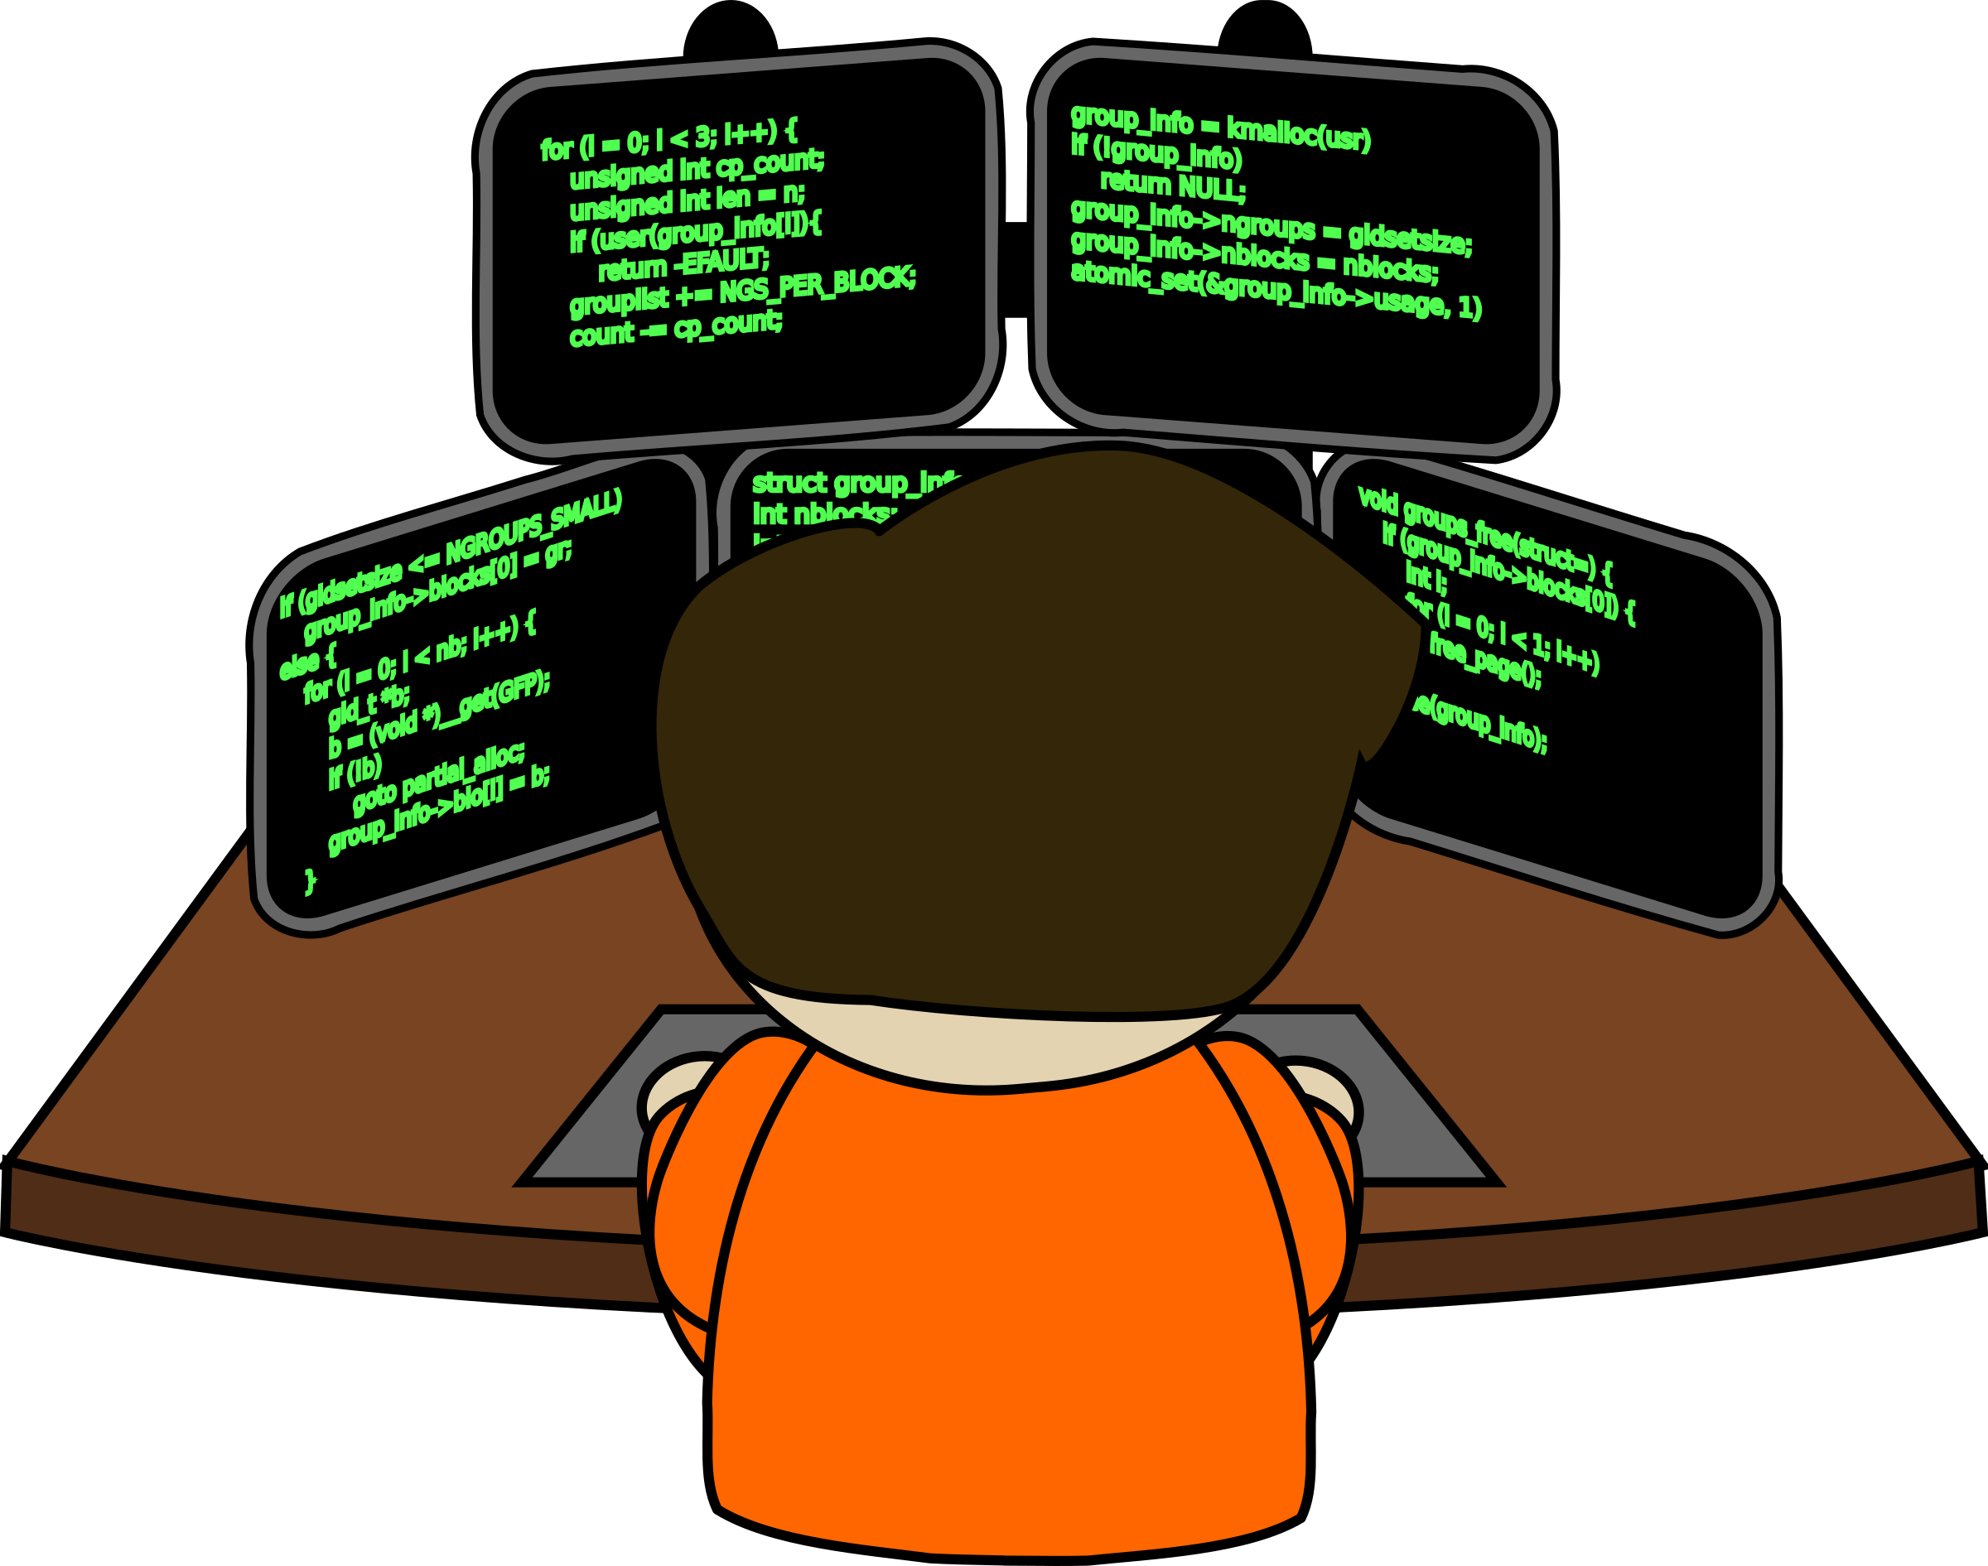

SEAP Exists to Provide
SAW Enabled Agency Portal
Customization of login portal for agency applications
Custom URL to access agency applications
User workflows
can be customized by agencies
  Agencies implement, manage, develop, support, and configure SEAP independent of SAW

Slide 17
SAW User Growth

Slide 18

New Functionality
Text Message Challenges now available for multi-factor authentication.

Slide 19

Customer feedback
User interface designed for mobile devices
User interface designed for Accessibility
Agency representation in SAW.
New look and feel representative of the state of Washington.
User Interface Update

Slide 20

Agency specific policies
Multi-factor authentication
Knowledge based authentication
Password requirements
Agency specific reporting
Improved Multi-tenant Capabilities

Slide 21

Areas Requiring Additional Agency Involvement:
What administrative functions are missing?
Improvements to Federated Workflow?
Biometric as a potential multi-factor authentication option?
What do agencies want to see in their SAW reports?

Slide 22
We need your input
What are the Business problems you are trying to solve with SAW?

Slide 23
SecureAccess Washington
WaTech

Slide 24
Business Challenges Identified
Multifactor Authentication
Environment is complex and “bolted on.”
Onboarding large user groups.
No ability to make changes to accommodate agency specific application requirements.
Costs associated with support and development of SEAP apps are multiplied across the enterprise.
Agency administrators lack sufficient management tools.
Users have challenges, impacts agency service desks.
Short lead times for implementation.
Testing of end to end impacts of large user groups
Challenges facing customer Agencies

Slide 25
Business Challenges Identified
Not a consistent “State of Washington” look and feel.
User confusion – who do I call if I need help?
Lack of clarity of on-screen direction and help.
Agency representation in SAW is inadequate.
SAW application directory is not user-friendly.
Not originally designed with mobile devices in mind.
Service interruptions to Multi-factor authentication due to maintenance.
Shorter timeframe for expiration of passwords
Challenges facing end-users

Slide 26



CIO Forum
August 8, 2017

Slide 27
One Washington
One Washington is a comprehensive business transformation program to modernize and improve aging administrative systems and related business processes that are common across state government.
One Washington Enterprise Business Processes
Notes:
Program Background:
One Washington is a comprehensive business transformation program to modernize and improve aging administrative systems and related business processes that are common across state government.
In the months and years ahead, we will take an all-inclusive, continual look at the state’s collective business processes and then identify key functions that need to be connected, consistent and managed in a unified, cohesive manner to provide reliable data. One Washington will help ensure we have access to data that is accurate, available in a timely fashion and meets the business needs of decision makers.
Change is Financial – Procurement combined deployment

Slide 28
2013 – 2015 Business Case: Our Foundation
Business benefit: proved “hard dollar” business case for One Washington program
Described the hard dollar benefits, costs, and mission impacts for three hypothetical ERP deployment scenarios
Recommendation to perform software-agnostic business process redesign in several work streams
Scope was enterprise Finance & Procurement
Concluded that implementing One Washington is a good business decision
Build
Implement Technology to Support Business Processes
Future Biennium
Document Business Requirements
Transform Business Processes
Future Biennium
Design
Program Blueprint
Business Intelligence Strategy
Mainframe and Integrations Plan
2017-19
Pre-Design
Strategic Partner
Change Management and Business Readiness
2015-17
Establish One Washington Program
The Business Case
2013-15
Notes:
Suggested speaker: Stacey
Background
2013-15 Biennium - Business Case
The legislature funded the One Washington program to publish a Business Case, with 16 agencies and Accenture, to develop the strategy for business transformation, replace the state’s aging financial system and implement an enterprise procurement system.
Business benefit: proved “hard dollar” business case for One Washington program
Described the hard dollar benefits, costs, and mission impacts for three hypothetical ERP deployment scenarios
Recommendation to perform software-agnostic business process redesign in several work streams
Scope was enterprise Finance & Procurement
Concluded that implementing One Washington is a good business decision

Slide 29
2015 – 2017 Activities: Our Building Blocks
Business benefit: enabling activities that prepared us for continued planning
Strategic Partner Evaluation process created and partner selected
Chart of Accounts Improvements
Procurement Readiness Activities
WSDOT Readiness Activities
Facilities Portfolio Management Tool
Budget System Improvements
Build
Implement Technology to Support Business Processes
Future Biennium
Document Business Requirements
Transform Business Processes
Future Biennium
Design
Program Blueprint
Business Intelligence Strategy
Mainframe and Integrations Plan
2017-19
Pre-Design
Strategic Partner
Change Management and Business Readiness
2015-17
Establish One Washington Program
The Business Case
2013-15
29
Notes:
Suggested speaker: Stacey
2015-17 Biennium – Transformation and Readiness Activities
The legislature funded transformation and readiness activities that included Business Readiness activities and selection of a Strategic Partner.
Business benefit: laid the groundwork for continued planning
6 work streams

Slide 30
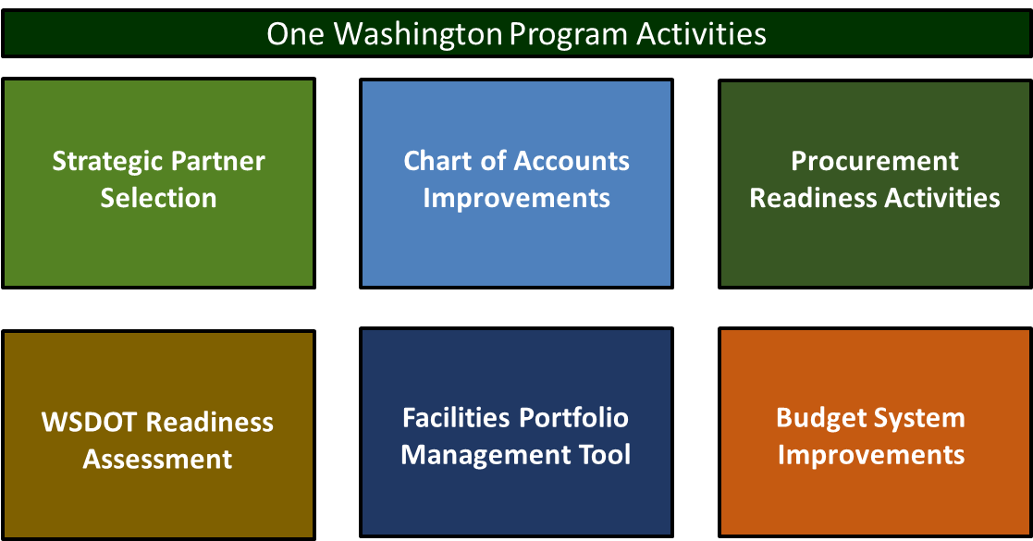
2015-17 Biennium Accomplishments
Accenture was selected as our Strategic Partner through a Competitive Procurement process
Process included participants from OFM, DES, LEAP, DOT, DSHS, DNR, SIB, LNI, HCA and OCIO
Work began early July

Slide 31
2015-17 Biennium Accomplishments
Completed a Future State Chart of Accounts Design
Coordinated with 10 pilot agencies to analyze the Chart of Accounts Expenditure Sub-sub-objects
The team reduced 23,000 unique data elements to around 2,000 common
Updated Chart of Accounts in SAAM and in use July 1, 2017
Notes:
The Chart of Accounts Improvement Project
completed a design for the future state COA,
established a COA governance process and
standardized use of the coding element Expenditure Sub-Sub-Object

Slide 32
2015-17 Biennium Accomplishments
Procurement Readiness Workgroup - contract and procurement experts from 15 agencies
Chartered work will complete n August
Results –
-defined common procurement processes
-defined common data elements
- definition dictionary
Notes:
Celebration August 16th!

Slide 33
2015-17 Biennium Accomplishments
Partnering with WSDOT to:
understand their unique business requirements
identify opportunities for enterprise systems
determine ability to integrate DOT’s needs to the One Washington Program
Notes:
Transportation Readiness partnered with the Department of Transportation to
identify WSDOT unique business processes
Understand business process differences and
identify commonality and opportunities for use of enterprise systems.

Slide 34
2015-17 Biennium Accomplishments
SAAS, web-based, facility inventory program.
Successful Project!
change management at a state wide level
effective communication to all state agencies
diverse training to all state agencies
System went live on June 30th!

Slide 35
2015-17 Biennium Accomplishments
Phase 1:
The OFM Budget Development Suite was successfully upgraded by leveraging LEAP applications.
Used these new tools to create the 17-19 Governor’s Budget.
Phase 2:
Using these tools to create a “BDS” replacement. Live date is targeted for Spring 2018.
Notes:
Bandaid
This is a stop gap, still planned for a future ERP solution

Slide 36
2017-19 Biennium Request
Program Blueprint – detailed, incremental plan with phased implementation schedule and budget estimates.
Integration Strategy and Plan - integration strategy and plan for the transition to a new enterprise solution.
Business Intelligence Strategy – strategy for collection and connection of data to provide transparency and access to decision makers.
Mainframe Plan – plan for the retirement of the mainframe system.
Build
Implement Technology to Support Business Processes
Future Biennium
Document Business Requirements
Transform Business Processes
Future Biennium
Design
Program Blueprint
Business Intelligence Strategy
Mainframe and Integrations Plan
2017-19
Pre-Design
Strategic Partner
Change Management and Business Readiness
2015-17
Establish One Washington Program
The Business Case
2013-15
Notes:
Suggested speaker: Stacey
Think of program like building a house
Business benefit: Establish long term benefits case including ‘hard dollars’ plus other benefits (e.g., improved services, lower risks)
Detailed design phase (implementation plan, schedule, estimates) of One Washington program over 10 years
Scope: enterprise Finance, Procurement, Budget Development, Human Resources/Payroll
Program Blueprint – detailed, incremental plan with phased implementation schedule and budget estimates.
Integration Strategy and Plan - integration strategy and plan for the transition to a new e
Enterprise solution.
Business Intelligence Strategy – strategy for collection and connection of data to provide transparency and access to decision makers.
Mainframe Plan – plan for the retirement of the mainframe system.

Slide 37
Future Biennia
2019-21
Document Business Requirements
Transform Business Processes
Write RFP for Finance, Procurement, and Budget
Choose Software
2021-23
Write RFP for HR/Payroll
Implementation for:
  Finance
  Procurement
  Budget
Build
Implement Technology to Support Business Processes
Future Biennium
Document Business Requirements
Transform Business Processes
Future Biennium
Design
Program Blueprint
Business Intelligence Strategy
Mainframe and Integrations Plan
2017-19
Pre-Design
Strategic Partner
Change Management and Business Readiness
2015-17
Establish One Washington Program
The Business Case
2013-15
Notes:
Suggested speaker: Stacey
Business benefit: Establish long term benefits case including ‘hard dollars’ plus other benefits (e.g., improved services, lower risks)
Detailed design phase (implementation plan, schedule, estimates) of One Washington program over 10 years
Scope change: enterprise Finance, Procurement, Budget Development, Human Resources/Payroll
Program Blueprint – detailed, incremental plan with phased implementation schedule and budget estimates. “fundable increments”
Integration Strategy and Plan - integration strategy and plan for the transition to a new
Enterprise solution.
Business Intelligence Strategy – strategy for collection and connection of data to provide transparency and access to decision makers.
Mainframe Plan – plan for the retirement of the mainframe system.

Slide 38
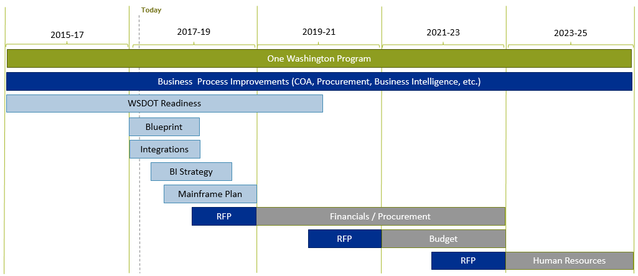
One Washington Program Timeline
Notes:
Urgency!
Need to be implanting in the 19-21 biennium
Which means we need to write business requirements and a procurement process next year, supplemental ask

Slide 39
Governance

Slide 40
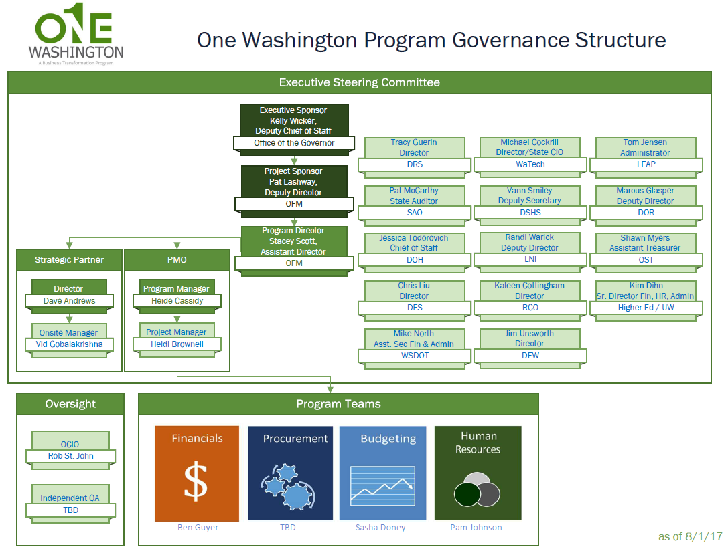
Notes:
Kelly wicker Executive Sponsor
First Executive Steering Committee meeting August 3rd

Slide 41
State of the ERP

Slide 42

Enterprise Resource Planning (ERP)
For the One Washington program, ERP can be defined as the common business practices across all state agencies and the technology that support them
Notes:
ERP can be defiend a many ways and mean many things. For us it means…….

Slide 43


Enterprise Resource Planning: Functional View
  ERP systems can be defined different ways
  By major functional areas
  By detailed software modules
  One Washington is focused on the business processes common to all agencies in these functional areas
Finance
$
HR / Payroll
Procurement
Budgeting

Slide 44
Enterprise Resource Planning (ERP)
Successful Organizations:
Tend to have highly integrated, automated systems
Include budgeting, finance, procurement, human resources, technology, and assets
Can deliver critical information quickly and accurately
Less Successful Organizations:
Tend to have disjointed, manual applications
Systems may be scattered across the organization & joined together by multiple technical or human interfaces
Difficult to obtain high quality of information to make key decisions in a timely way

Slide 45
Benefits of an Enterprise approach to ERP
Encourages cross boundary coordination
Creates operational efficiencies
Creates organizational effectiveness
  Unified business processes across programs & organizations
  Applications work together
  Data exchange across systems
  Standardize processes and data
  Simplify processes and data
  Streamline processes
  Improve workflows
  Improve productivity
  Increase cycle time and reduce errors
  Reduce Total Cost of Ownership (TCO)
  Empower new delivery models
  Exercise scale
  Adopt best practices
  Create shared services
  Reduce TCO

Slide 46
One Washington can take advantage of new trends in the ERP market
Characteristics of traditional ERP | Characteristics of modern ERP
Software license | Software as a service
Single tenant managed in State or vendor data center | Multi-tenant managed in the Cloud
Technology led | Business led
Numerous customizations | Configurations not customizations
Focus on detailed requirements | Focus on business benefits
Waterfall | Agile
Long time to see the system | Short time to see the system
Notes:
Massachusetts Has a modern ERP and is planning an RFP for Cloud / SaaS ERP replacement
Washington has to decide do we want to be cutting edge or risk being outdated by the time we implement

Slide 47
38 States have Modern ERPs
Only 12 States do not have modern ERP systems:
Florida
Hawaii
Idaho
Maryland
Missouri
Nebraska
Nevada
New Jersey
Oregon
Rhode Island
South Dakota
Washington

Slide 48
Accenture has helped 12 states implement ERPs
California
Connecticut
Delaware
Georgia
Kansas
Minnesota
Montana
New York
Ohio
Texas
Virginia
Wisconsin
Notes:
Wisconsin Implemented full suite of ERP functionality in accelerated timeline (24 months for 57 agencies and 6 additional months for DOT)
Virginia DOT went live first with all modules, followed by all other state agencies
California “Mega State” currently completing its 5th year of phased ERP rollout. Implemented budget functions first statewide, then phased in additional functionality in “waves” of agencies

Slide 49
The One Washington Blueprint

Slide 50

One Washington Blueprint Timeline
July
August
September
October
November
December
January
February
March
April
May
June
Supplemental Budget Request
Legislative Briefing Materials
State Milestones
Develop Deliverable #1
9/29/17
Develop Deliverable #2
10/2/17 - 12/29/17
Develop Deliverable #3
1/2/18 - 6/29/18
Final Blueprint
Program Milestones
Develop Integration Strategy 9/29/17
Develop Integration Implementation Plan
9/25/17 – 6/29/18
Integration Strategy
Integration Implementation Plan
Notes:
Foundational work this summer to include:
Scope workshop in July – all in
Interviews Defining business value
Gathering data sources for analytics - surveys
Business process assessment

Slide 51
Upcoming Agency Participation
Foundational Work
Initiative Development
Blueprint V1 Compilation & Drafting
Technology Dependent
Non-Technology Dependent
7/10/2017
8/4/2017
9/1/2017
9/29/2017
Change Management
Agency participation may include surveys, interviews, and/or workshops during the coming months
Notes:
Short timeline, lots of work during a very busy time.
Important to have participation so we get it right!

Slide 52

Prior Two Weeks of Key Activities
Blueprint kick-off events
  over 200 participants
  the materials are available on our website
A business processes in scope workshop
  Finance processes in scope
  Procurement processes in scope
Business value opportunities interviews
Oversight meetings with OCIO and Legislative Staff
Executive Steering Committee

Slide 53
Next Two Weeks of Key Activities
Technology Initiatives
  Deployment Options Workshop (16th)
    Best of breed vs. unified ERP
    On-prem, managed service, cloud, SaaS
  Review Deployment Options with Steering Committee (17th)
Business Process Initiatives
  Small group review and compile results of interviews (23rd)
    Finance
    Procurement
  Stakeholder workshop to discuss business process projects, prioritization and timing (29th)

Slide 54

The One Washington Blueprint will define the
“ERP of the Future” for the state of Washington!
Questions?
OneWA@ofm.wa.gov
http://one.wa.gov
Thank you!

Slide 55
OCIO Update
CIO Forum
August 8th, 2017

Slide 56
Good of the Order Updates, Questions, Answers, Agenda Ideas

