Slide 1
CIO Forum
January 9th, 2018

Slide 2
IPMA Update
Bryce Carlen, Commerce

Slide 3
State CIO Update
Rob St. John, WaTech

Slide 4
SAW Modernization Update
Scott Barringer, WaTech

Slide 5
OCIO Update
Sue Langen, OCIO

Slide 6
Washington State Imagery Program
September 2017

Slide 7
Geospatial Program Office: Harnessing the Power of Where
Access point for State Open Geospatial Portal
Washington Master Addressing Service (WAMAS)
Location Based Orthoimagery Services
Statewide support for governance, policy, and planning

Slide 8
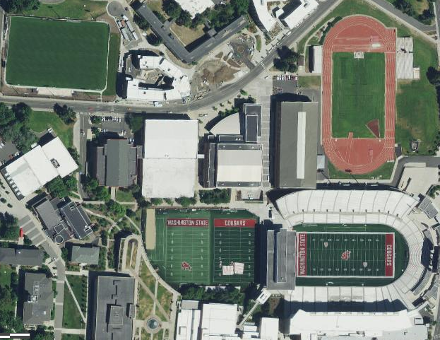
What is Location Based Orthoimagery Services?
Purchase High Resolution Imagery Through Statewide Contract – managed by OCIO.
Seamless imagery can be used for many different state and county business needs. It is highly useful and we all need it.
All state agencies and county partners are using the same base information to create streams, digitize buildings, emergency management, etc.
Many of the rural counties have joined because otherwise, they wouldn’t be able to afford it.
Notes:
Joanne Markert (OCIO): 2015 & 2016 imagery data is now available within the SGN and has been sent to imagery partners.
Greg Tudor (RCO): Is drone data shared on the portal/ where would that go into the future? How do we want to share it? Drone imagery can provide detailed images with minimal effort.
George Alvarado (DSHS): What are the policies and standards for drones?
Steve Young (DNR): There are policies around what you can and cannot record. Drone data needs to be screened before sharing due to privacy concerns. UAV’s are a big topic in the LEG at this time.
Will Saunders (OCIO): Alex Alben from the WATech Privacy Office has created some policy recommendations for drones, was originally shared with DNR a few years ago. Alex can come to a future GIT meeting to provide a brief presentation. There used to be a workgroup around drones, but it no longer exists.

Slide 9
Strategic Initiative
Need to make consistent, yearly, strategic investment in imagery
Provides services to state citizens through partner agencies:
OCIO, DNR, WSDOT, Ecology, Military/ Emergency Management, RCO, Local 911 dispatch centers, county assessor departments, public utility districts
Supported by the Washington Assessors Association, Northwest Indian Fishery Commission

Slide 10
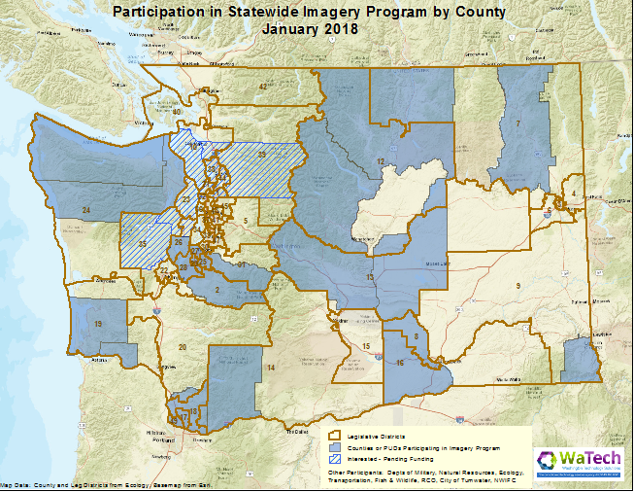
Progress: Imagery Acquisition
Notes:
Notice that many of the participating counties are in rural areas of the state that might not have access to high resolution imagery if they didn’t join the state program. Really is a statewide resource.
Greg Tudor (RCO) - Are cities running their own program?
Joanne Markert (OCIO) - Cities can join counties. If the county pays for it, all the cities within it can use it.

Slide 11
Example: Landslide Area in Island County
The next series of slides show changes to a landslide area over time using previous aerial imagery available and the latest high resolution imagery from 2015. In the final slide, the image is slightly blurry due to the changes in elevation of the landslide.

Slide 12
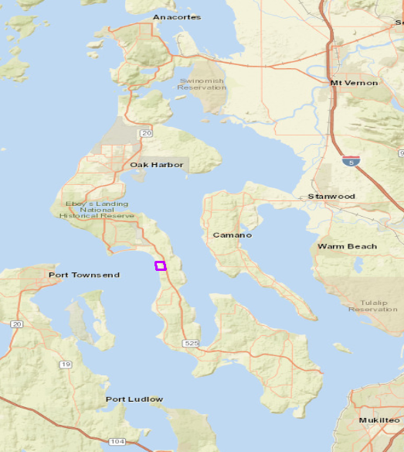

Slide 13
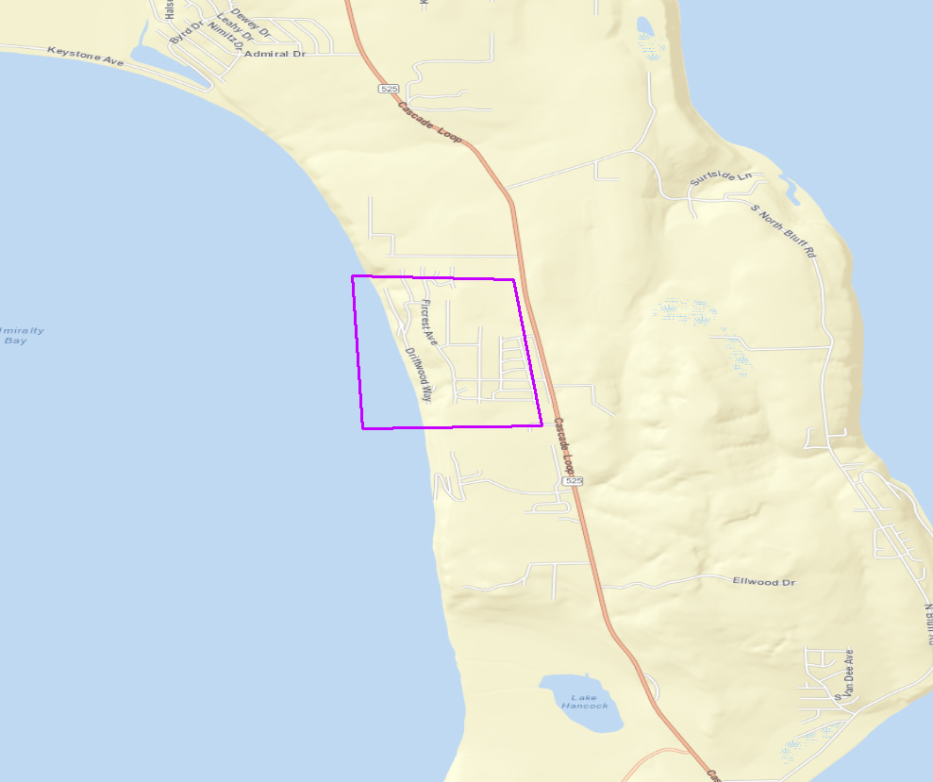

Slide 14
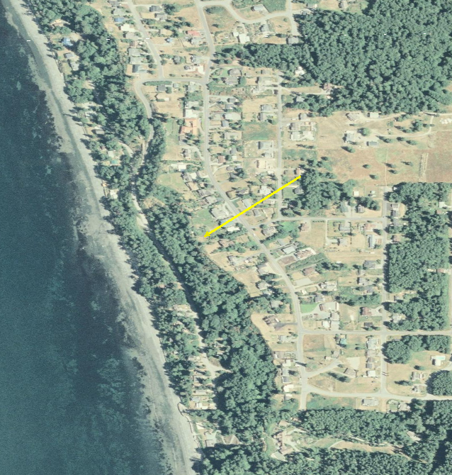
2006

Slide 15
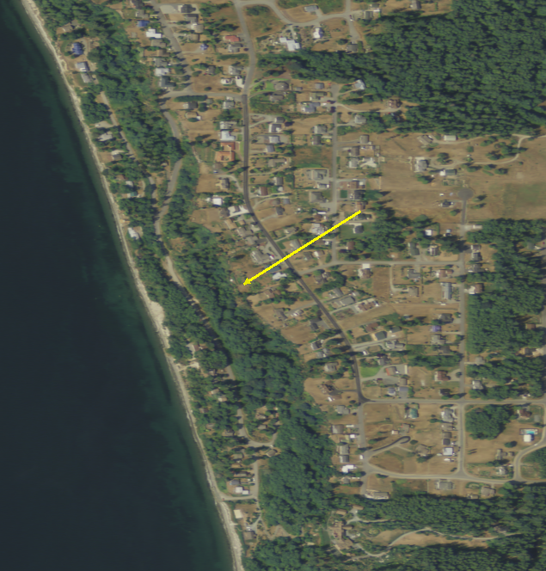
2009

Slide 16
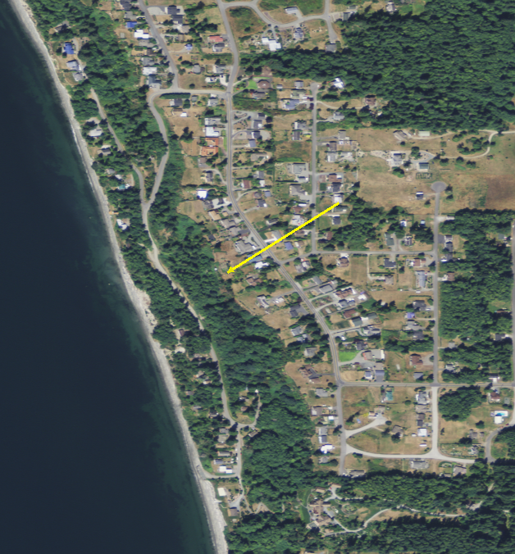
2011
Notes:
Notice the road that is downslope of the arrow

Slide 17
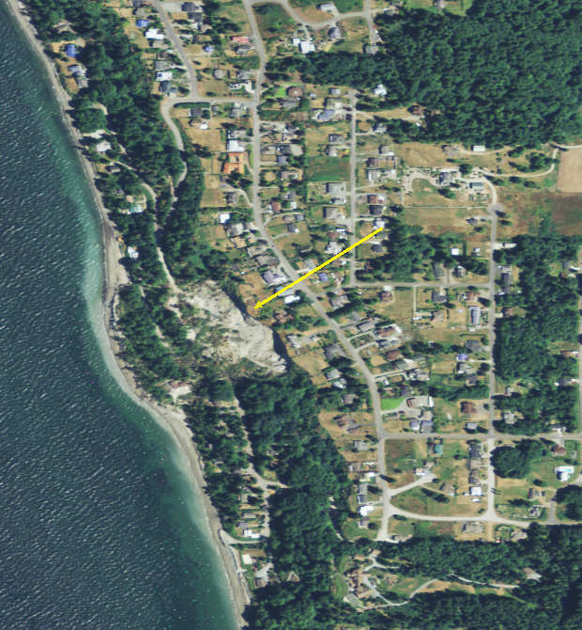
2013
Notes:
Landslide covered the road

Slide 18
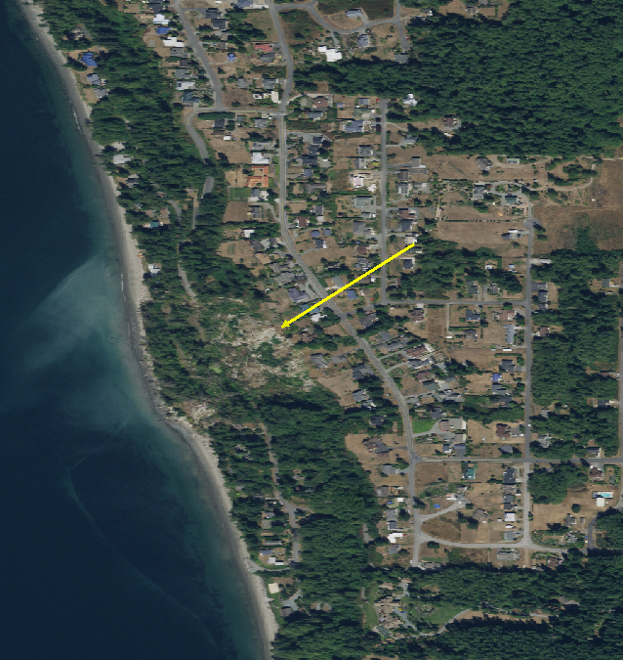
2015

Slide 19
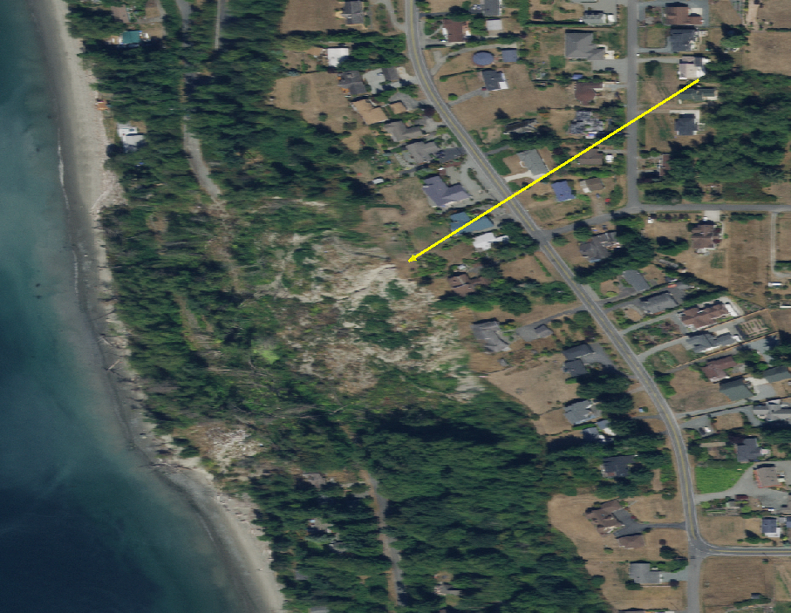
2015, Zoomed In

Slide 20
Contact us to join!
Joanne Markert | State GIS Coordinator Washington Technology Solutions (WaTech) o: 360.407.8691 m: 360.522.2643
Joanne.Markert@ocio.wa.gov
Or
Mike McGuire | Project Manager
Ascent GIS, Inc.
o: 509.747.2495 m: 509.995.2961
MikeM@AscentGIS.com
Need more details? Visit OCIO's Geospatial Program Office Website

Slide 21
One Washington Integrations Plan
January 9, 2018

Slide 22
One Washington
One Washington is a comprehensive business transformation program to modernize and improve aging administrative systems and related business processes that are common across state government.
S
Notes:
Program Background:
One Washington is a comprehensive business transformation program to modernize and improve aging administrative systems and related business processes that are common across state government.
In the months and years ahead, we will take an all-inclusive, continual look at the state’s collective business processes and then identify key functions that need to be connected, consistent and managed in a unified, cohesive manner to provide reliable data. One Washington will help ensure we have access to data that is accurate, available in a timely fashion and meets the business needs of decision makers.
The State of Washington currently relies on:
Cumbersome and time consuming financial processes with an aging financial infrastructure
Antiquated budgeting infrastructure that limits visibility and transparency
Non-uniform procurement processes and systems
An HR system implemented ten years ago
Financials first

Slide 23
Program Timeline
S
Notes:
Program Background:
One Washington is a comprehensive business transformation program to modernize and improve aging administrative systems and related business processes that are common across state government.
In the months and years ahead, we will take an all-inclusive, continual look at the state’s collective business processes and then identify key functions that need to be connected, consistent and managed in a unified, cohesive manner to provide reliable data. One Washington will help ensure we have access to data that is accurate, available in a timely fashion and meets the business needs of decision makers.
The State of Washington currently relies on:
Cumbersome and time consuming financial processes with an aging financial infrastructure
Antiquated budgeting infrastructure that limits visibility and transparency
Non-uniform procurement processes and systems
An HR system implemented ten years ago
Financials first

Slide 24
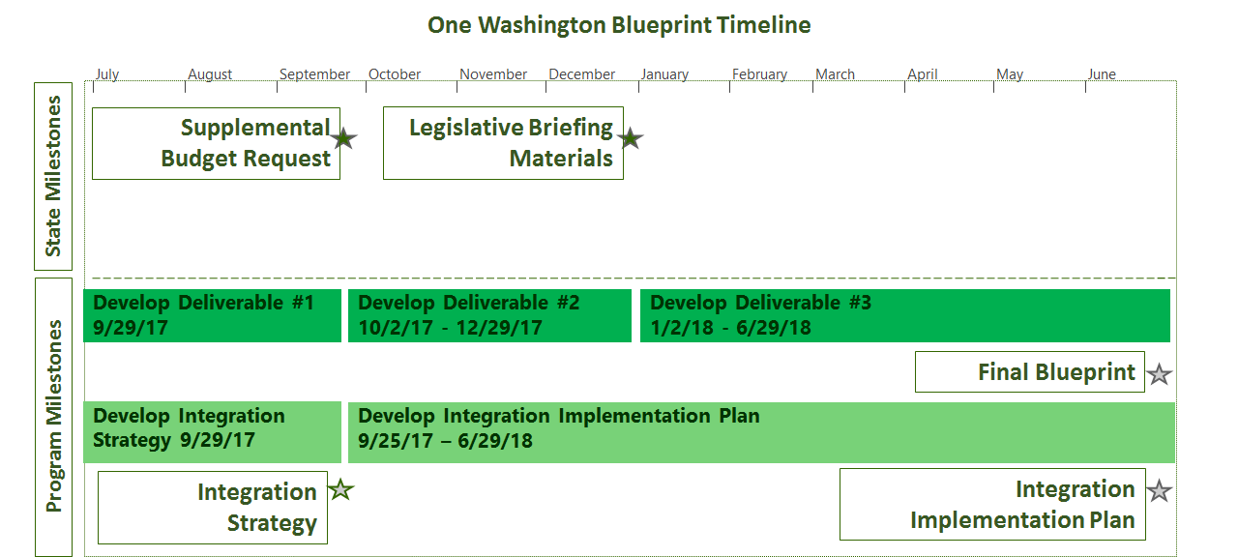
Blueprint Overview

Slide 25
Integrations Plan Overview
Gather information about individual agency systems
Functional and technical details
Generate a list of recommended systems to retire
Generate a list of One Washington interfaces and conversion

Slide 26
Integrations PlanTimeline
Accomplishments to date:
Identified 72 OFM systems (55 completed, 17 left)
36 retire, 9 keep
Upcoming events:
Complete OFM systems
In progress -> late January
Conduct interviews with agencies to review their systems
Late January -> end of March

Slide 27
Agency Integration Interviews
Identify the following elements:
System functionality
System owners
Integration details
Determine applicable conversion items
Sample System Impact Summary spreadsheet

Slide 28
Scope of Systems Identified
Systems were identified using the 2017 OCIO Application Inventory.
Criteria used to identify systems:
Systems identified as integrating with AFRS or HRMS
Other Systems that may be within the scope of One WA
Purchasing and contract systems
Accounts receivable systems
HR systems
Budget systems

Slide 29
Integration Agencies and Applications
Agency | Number of Applications
ATG | 21
COM | 1
DEL | 2
DOR | 9
DSB | 1
DSHS | 46
DES | 15
DFI | 4
DFW | 12
DNR | 7
DOH | 26
Agency | Number of Applications
DOC | 6
DOL | 13
DRS | 3
ECY | 14
HCA | 12
LNI | 15
LCB | 5
LOT | 9
OFM | 88
OSPI | 2
OST | 2
Agency | Number of Applications
WSP | 8
RCO | 1
SAO | 7
SBCTC | 2
SOS | 3
UTC | 3
DVA | 2
WSAC | 1
WSDOT | 63
WSHFC | 1
SIB | 2

Slide 30
Next Steps for Integration Plan
One Washington will send a list of systems to each agency CIO for validation
One Washington needs agency CIO’s to coordinate the point of contacts for the system interviews
If you have a system that we did not identify please reach out to the One Washington program

Slide 31
http://one.wa.gov
For Questions, Comments, or Concerns:
OneWA@ofm.wa.gov

Slide 32
PCI Standards Discussion
Heidi Geathers, WaTech

Slide 33
Please contact Michelle Tuscher michellet@cpaboard.wa.gov if you are interested in working on PCI Standards

Slide 34
Legislative Update
Connie Michener, WaTech

Slide 35
Exchange 2016 Update
Lance Calisch, WaTech

Slide 36
Good of the Order Updates, Questions, Answers, Agenda Ideas

