Slide 1
GovDelivery
Christine Gosda
11/29/2017

Slide 2
Agenda
Background
Subscribe
Categories
Topics
Q&A

Slide 3
Background
December 2015 - WaTech purchases GovDelivery, a web-based government communications platform used to deliver information to self-subscribed users.
April 2016 – Initial rollout of GovDelivery to migrate the HRMS, LMS and SWFS ListServs.
June 2017– Started migrating more ListServs and distribution lists to GovDelivery.

Slide 4
Benefits
Features address some of the communications concerns identified in the Customer Survey:
Reach right audience with self-managed subscriptions to opt in/out
Multiple delivery options: email, text
Messages can be sent out faster
Hosted offsite

Slide 5
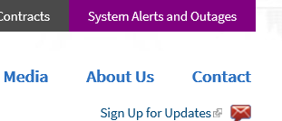
Subscribe
Go to watech.wa.gov
Click on Sign Up for Updates

Slide 6
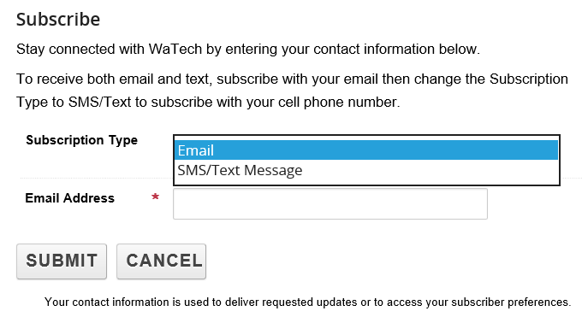
Subscribe
Sign up using an email and/or cell phone number
Lists to subscribe to are based upon subscription type (e.g. some lists are only available to state email addresses vs. private)

Slide 7
Subscribe
New
Prompted to confirm email and setup a password (optional)
Add Subscriptions
Existing
List of subscriptions
Delete subscriptions
Add subscriptions

Slide 8
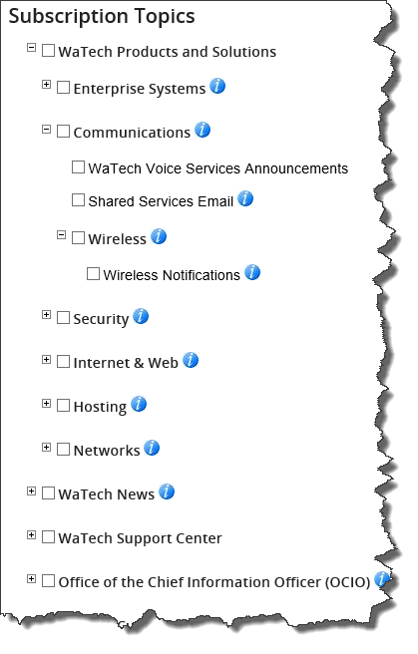
Topics to subscribe to are located under categories
Categories were built based upon WaTech Products and Solutions, units, business needs.
Hover over to determine if topic is of interest to you
Some topics are not visible
Periodically check for new topics…we’re expanding!

Slide 9
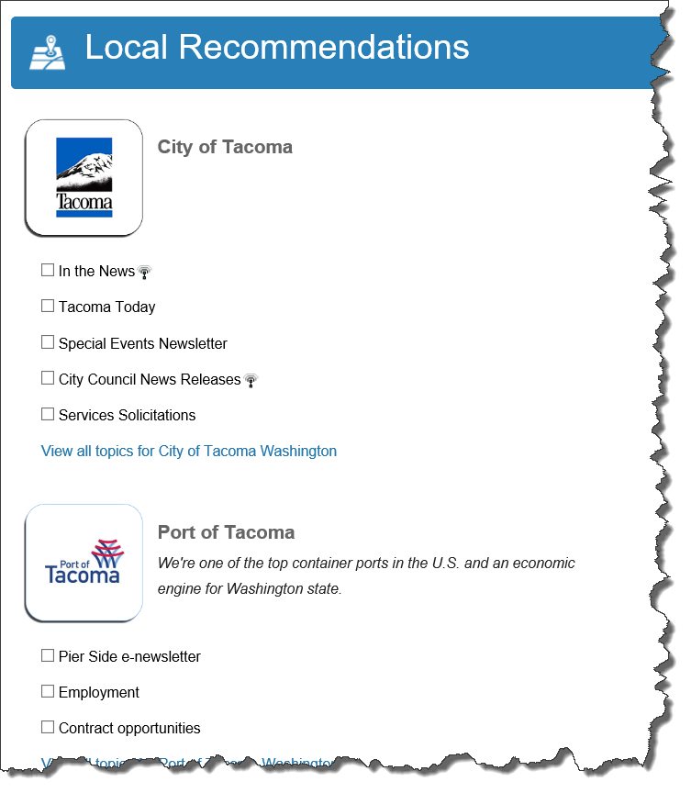
After subscribing to WaTech topics you will get a list of Local Recommendations, other government organizations who have purchased their own instance of GovDelivery (e.g. City of Tacoma, Sound Transit, DEL, State Parks and Recreation)
Visit other state agency websites to sign up to their topics (e.g. DOT, Governor’s Office)

Slide 10
Questions

