Slide 1
State Government Networks IPv6 Migration
November 2017

Slide 2
What Is An Internet Protocol (IP) Address?
Every “thing” on the Internet needs a globally-unique IP address
Today’s Internet of Things (IoT)
Laptops, tablets, phones, streaming video, TVs, fitness trackers, wearables, servers, mainframes, storage, cars, smart homes, smart cities, embedded sensors, game trackers, power plants, Amazon delivery drones, etc., etc., etc.

Slide 3
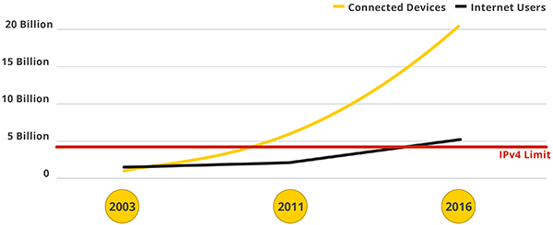
Problem: The Old System (IPv4) is Out Of Addresses
Past the Tipping Point
Growth / Innovation at risk (mobility, cloud, IoT)
Business at risk
Commerce / Economy at risk
By 2021:
50 BILLION Devices Online
Notes:
By 2021: 30-50 Billion devices on Internet

Slide 4
IPv6 To The Rescue!
The Next Generation of the IP Standard
IPv4 = 4.3 x 10⁹, 4.3 Billion Addresses
IPv6 = 3.4 x 10³⁸, 340 Undecillion Addresses
An entire IPv4 Internet for every star in the Universe!

Slide 5
IPv6 Worldwide Adoption
Percentage of IPv6 on Internet
Rank | Ipv6% | Country
1 | 46.4% | Belgium
2 | 40.4% | United States of America
3 | 36.6% | India
4 | 32.2% | Greece
5 | 25.5% | Germany
6 | 21.7% | Luxembourg
7 | 20.8% | Switzerland
8 | 20.7% | Finland
9 | 19.8% | Brazil
10 | 18.7% | Canada
IPv4 Addresses Depleted
Up 10% in 18 mo.
Goggle, Oct. 2017
Akamai, Aug. 2017
Notes:
Public Internet resources are transitioning to IPv6
Mandate for US government agencies (https://usgv6-deploymon.antd.nist.gov/cfo.html)
>50% of mobile content sites already IPv6 enabled
Google
Netflix
Facebook
YouTube
LinkedIn
Many more …
Mobile & Infrastructure providers default to IPv6
Verizon (84%)
Google Fiber (65%)
AT&T (51%)
T-Mobile USA (87% - IPv6 only!)
Comcast (54%)
Time Warner (30%)
Apple iOS9 – IPv6 preferred
IPv6 support required for all iOS9 apps

Slide 6
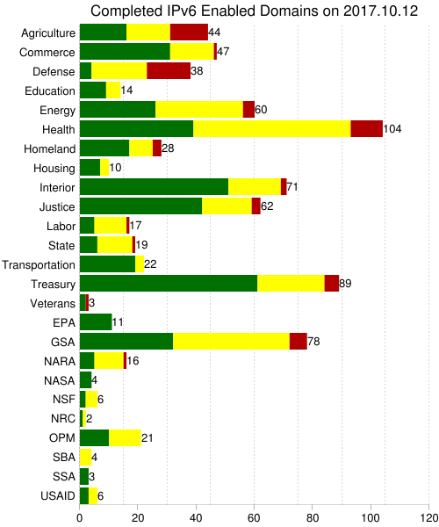
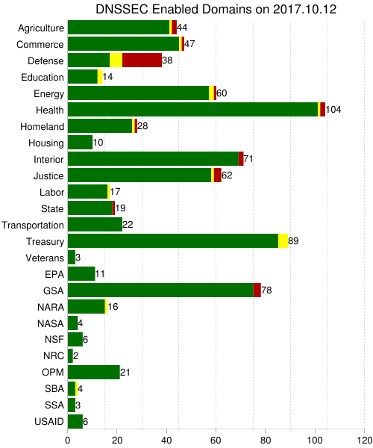
U.S. Government Mandate – All Federal Agencies
Federal Mandate In progress for 10+ yrs.
Most external sites IPv6
Internal network conversions in progress
Operational | In Progress | No Progress

Slide 7
Time to Stop Kicking the Can – Running Out of Road
Private Addressing
OCIO Proposed Policy - 2025 deadline to complete IPv6 migrations
WaTech completes Phase 1 in October 2017
Assessment of WaTech IT assets, i.e. hardware, software, biz applications
Massive IPv6 address block acquired for State
Supplemental Decision Package submitted
Agencies should start planning NOW:
Participate in OCIO multi-agency workgroups
Assess all IT assets for IPv6 compatibility
Specify IPv6 compatibility in all procurements
Gateways
NAT
Proxies

Slide 8
WaTech DP - Next Step to Prepare SGN for Migration
2018 Supplemental Budget Request - $1.442 Million and 1 FTE
Provide each agency with a large block of IPv6 addresses to begin planning and testing
Implement an enterprise IPv6 address management platform (IPAM)
Equip an IPv6 test environment
Contract an IPv6 consultant / project manager
Develop IPv6 deployment and security plan for SGN
Continue collaboration with OCIO multi-agency IPv6 workgroup

Slide 9
Key Take-Away Points
Time to get serious – 2025 target for completion
IPv6 is an enterprise effort – collaboration is essential!
WaTech is already moving on SGN migration plan
Agencies should start NOW:
Participate in OCIO IPv6 workgroup
Evaluate IT assets, identify upgrade costs, develop funding and deployment plan
Plan to get IPv6 address block and management tool from WaTech
Specify IPv6 compatibility on all procurements
IPv6
2025

Slide 10
More Information on IPv6
Contact your WaTech Customer Account Manager (CAM) http://watech.wa.gov/sites/default/files/customer-acct-mgrs-agncy-assign.pdf
WaTech Support Center: 855.WaTech1 (855.928.3241 or 360.586.1000) Email: support@watech.wa.gov
Notes:
Just tell your CAM or the Support Center you’d like more information on IPv6.

