Slide 1
Mainframe Services

Slide 2
Mainframe Services Manager
Lance Calisch – Mainframe Services Manager since February 2017
Experience includes Mainframe systems support, Technical Support Manager, and Data Center Manager
First order of business? Review the health of the service

Slide 3
Criteria for Service Review
Capital Expense
Demand
Scalability
Revenue Sustainability
Ability to Execute
Customer Value
1

Slide 4
Finances - Summary
FY15 FY16 FY17 (projected)
Total Revenue $18.3 M $17.1 M $13.1 M Unisys MF
Total Expenses $18.8 M $17.8 M $14.9 M
Net Profit (Loss) ($ .524 M) ($ .747 M) ($ 1.74 M)
Revenue is decreasing
Expenses are decreasing
Expenses still out pace revenue
$3.2 M

Slide 5
Finances – Decreasing Revenue
Customers are migrating off of the Mainframe
LNI migrating LINIIS - target is Summer 2017
ESD migrating all workload – target is June 2017
Significant drop $ 3.2 M
Similar to Unisys; going, going, gone
DOC migrating OBTS – target is August 2018 (project not started yet)
Plus Unisys mainframe now hosted off site

Slide 6
Finances - Expenses
Hardware:
IBM zBC 12: $2.2 M financed until 6/2019
EMC Virtual Tape Library: $ 800,000 financed until 12/2020
~ $ 500,000/year over 6 years
Software:
$4.5 M per year
IBM, Software A/G, Computer Associates

Slide 7
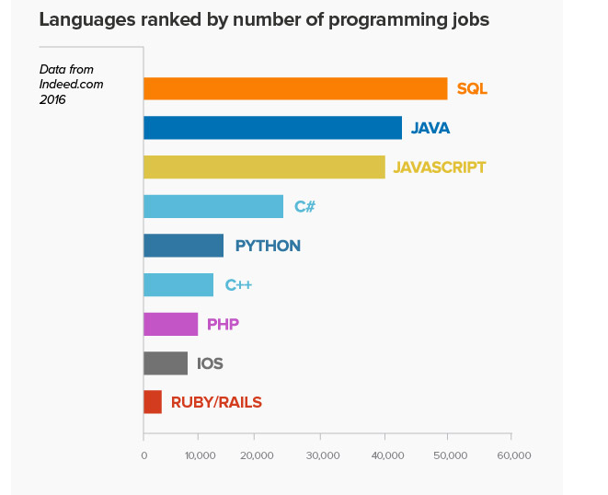
Challenges:
High expenses
Mainframe is no longer a platform of choice
Customers are re-hosting on Windows/Linux platforms
Agencies have dwindling support staff for their legacy systems
40% of WaTech mainframe employees eligible to retire within 5 years
Mainframe Languages:
JCL Natural COBOL REXX
Curriculum focuses

Slide 8
Criteria for Service
Capital Expense
High
Demand
Low
Scalability
Limited
Revenue Sustainability
Low
Ability to Execute
Medium
Customer Value
1

Slide 9
Strategy Plan
Informed decision regarding options for the future
Hired Information Services Group (ISG) in April 2017
June 2017 complete work of analysis and final report
Goal:
Review options for the mainframe
Reduce risk of financial burden to remaining agencies
Notes:
Private Cloud
2 CPU’s / 4 GIG RAM / 200 GIG St
Unlimited Egress
DR – 50% of Environment
Tech Support
$100 BH / $175 AH / $375 per server
Average $395 per server pm (No TS)
DR average $197.5 per server pm
Public Cloud
2 CPU’s / 4 GIG RAM / 200 GIG St
10 GIG Egress
DR – 100% of Environment
Tech Support
Three plans starting at $325
Average $350 per server pm (No TS)
DR average $350 per server pm

