Slide 1
Customer Survey

Slide 2
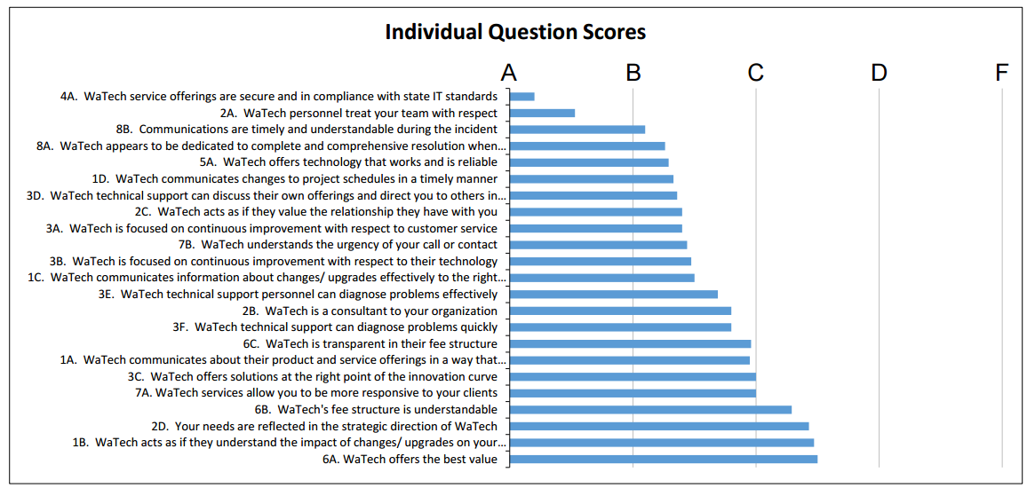
Customer Survey

Slide 3
Customer Survey

Slide 4
Primary focus areas
Customer communication
Service catalog utility
Internal process

Slide 5
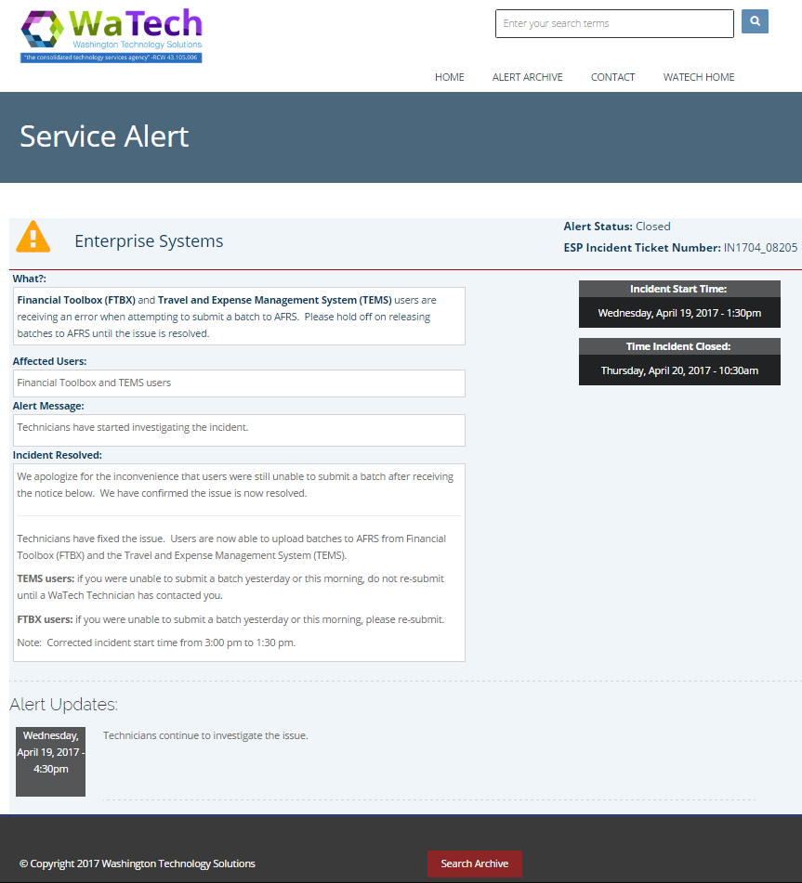
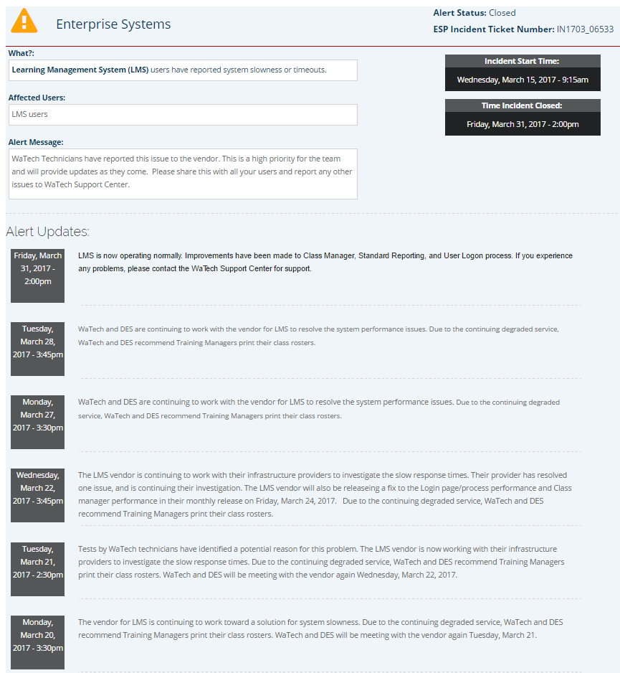
Improving communications
http://support.watech.wa.gov

Slide 6
Alert Notification
33%
reduction
In Alert notification
Spam
“Spam less, inform more”
Improve content to make it more consumable
Increase breadth of information on service portal
More self-service so agencies can get the info when it’s most relevant for team
Improve transparency and insight into Alert DLs, what they are for and if the customer signed up

Slide 7
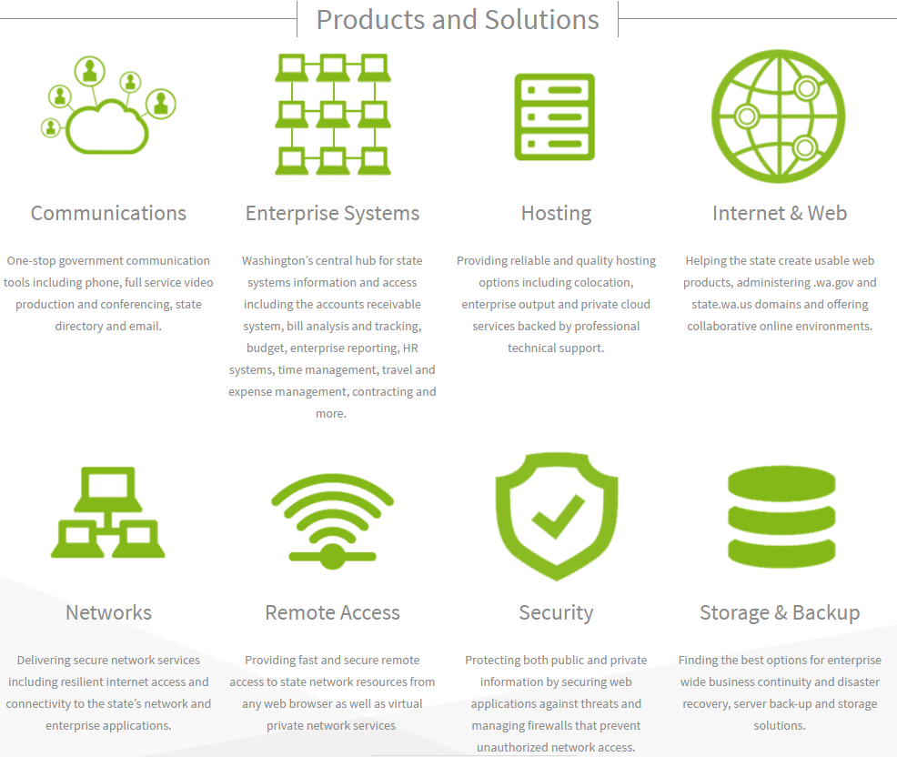
Published catalog
Billing
Support

