Slide 1
Support Communications
Christine Gosda – Incident Management
8/23/2017

Slide 2
Agenda
Background
Service Alerts
Service Notifications
Q&A

Slide 3
Background
November 2016 – completed a 3 month audit of communications sent to customers
February 21, 2017 - the Systems Status Page went live to post Service Alert updates rather than sending them to reduce email volume to customers
June 26, 2017 - it was enhanced to provide a central location for customers to view Alerts (incidents) and Notifications (changes)

Slide 4
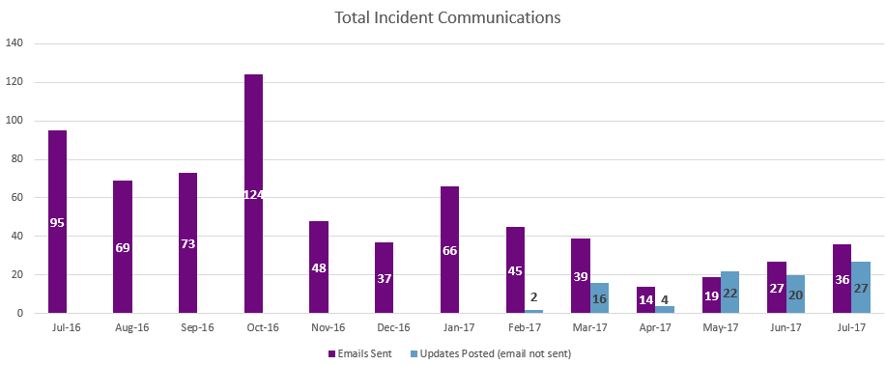
Metrics

Slide 5
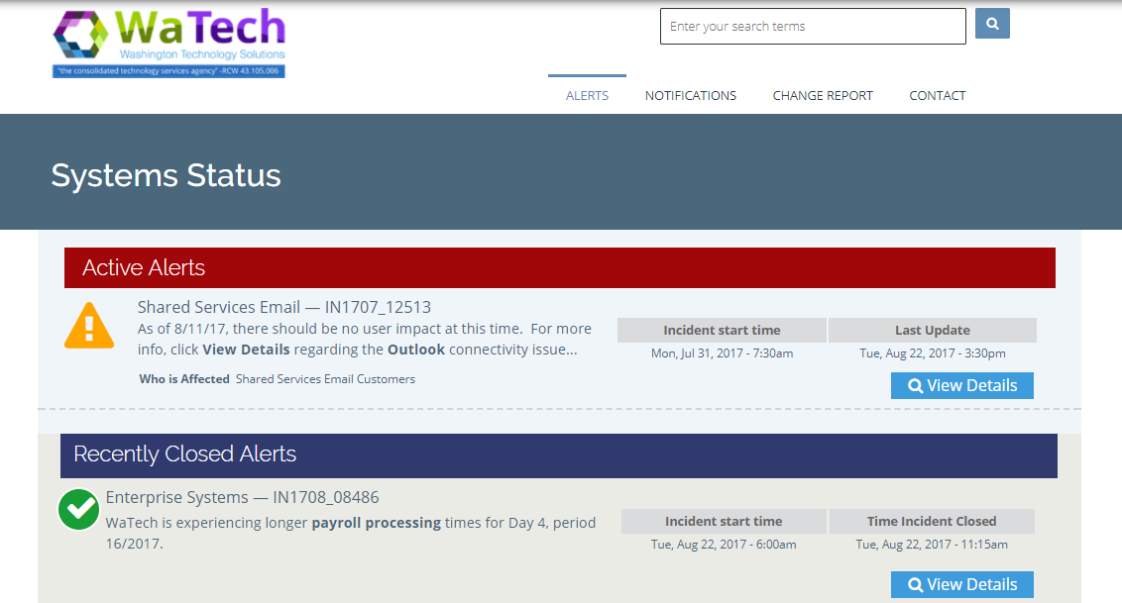
Service Alerts

Slide 6
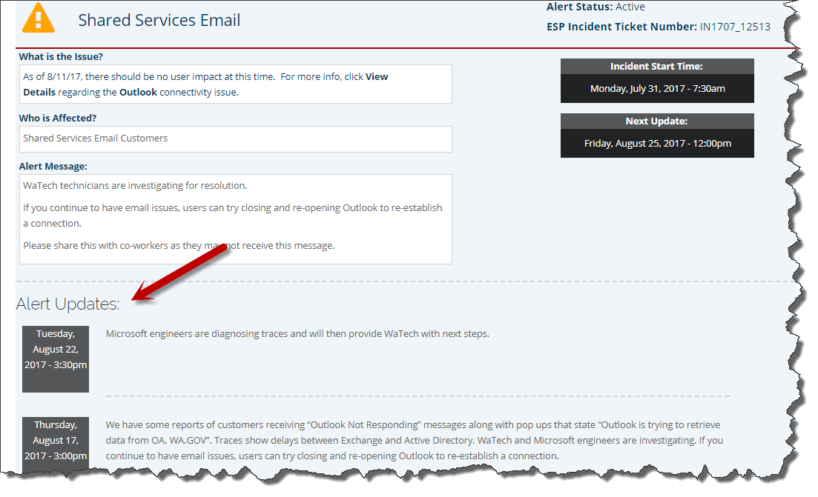

Slide 7
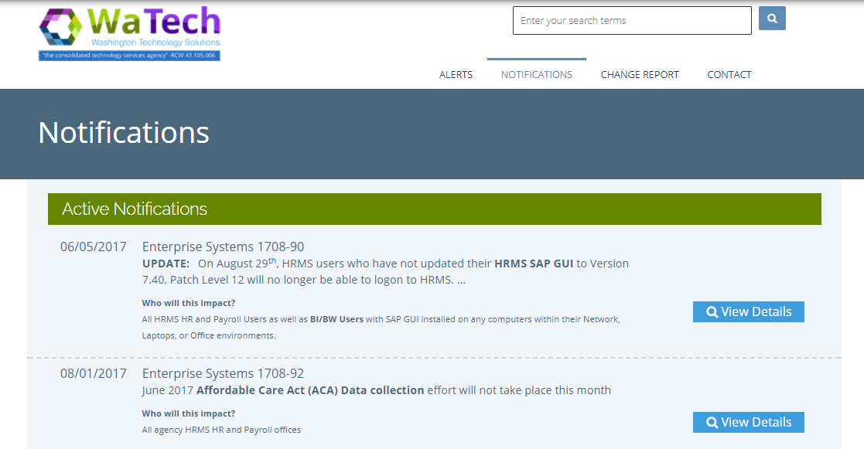
Service Notifications

Slide 8
Demo
http://support.watech.wa.gov

Slide 9
Q&A

