Slide 1
Migration to Mainframe as a Service (MFaaS)
MFaaS Steering Committee Meeting
November 10, 2020

Slide 2
Agenda
Data Replication
Timeline
Testing Update
Production Cutover
Contingency Dates
RAID Log Review
Sightline – Quality Assurance
Q&A
2

Slide 3
Data Replication Update
Production Virtual Tape (DLM) Replication started on Monday (Oct 26) – Omaha
Estimated finish – Sunday, November 1
Actual Finish – Sunday, November 9
Delay was due to Dell/EMC incorrectly sizing the capacity needed, thus requiring an additional module to be added to the server
Disaster Recovery Data Replication – Downers Grove
DASD replication completed @ ~3am on Nov 10
DLM replication has not started

Slide 4
Mock Testing and Production Cutover Timeline
2-Nov | 3-Nov | 4-Nov | 5-Nov | 6-Nov
Mock 1 Testing - Completed
9-Nov | 10-Nov | 11-Nov | 12-Nov | 13-Nov
Mock 2 Testing - Underway
16-Nov | 17-Nov | 18-Nov | 19-Nov | 20-Nov
Mock 2 Testing
Ensono DR Prep |  | DR Validation
23-Nov | 24-Nov | 25-Nov | 26-Nov | 27-Nov
Optional Mock 2 Testing |  |  | Holidays
Optional DR Validation
30-Nov | 1-Dec | 2-Dec | 3-Dec | 4-Dec
Mock 3 Testing
7-Dec | 8-Dec | 9-Dec | 10-Dec | 11-Dec | 12-Dec | 13-Dec
Cutover Prep |  |  |  |  | Production Cutover
Mock 1 concluded without Virtual Tape or ADABAS
Mock 2 all data (DASD and Virtual Tape) is available
External systems testing available
DR Validation delayed due to data replication delays

Slide 5
Testing Update
 | Mock Testing
 | Testing Status | # of Test Cases | Successful | Unsuccessful | % Complete
DCYF | In Process | 7 | 4 | 3 | 57%
DES | In Process |  |  |  | #DIV/0!
DNR | In Process | 98 | 16 | 0 | 16%
DRS | In Process | 48 | 10 | 0 | 21%
DSHS | In Process | 33 | 31 | 2 | 94%
ECY | N/A | 0 | N/A | N/A | 100%
ESD | In Process | 200 | 45 | 0 | 23%
HCA | In Process | 29 | 9 | 2 | 31%
L&I | In Process | 145 | 12 | 0 | 8%
OFM | In Process | 91 | 30 | 4 | 33%
TRE | In Process | 1 |  |  | 0%
WaTech | In Process | 17 | 16 | 1 | 94%
TOTAL |  | 669 | 173 | 12 | 26%

Slide 6
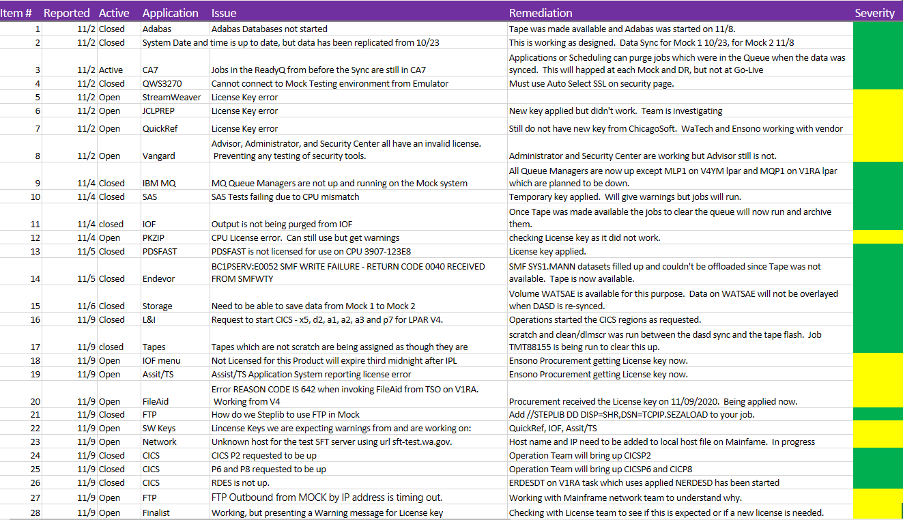
Testing Issue Log
Issues Overview
App License issues
10/13 open issues
43% of total issues
How do we ensure this will not be an issue during Production Cutover?
File Transfer
2 issues with file transfers being addressed by Ensono MF network team
Scheduler jobs in the ReadyQ in CA-7

Slide 7
Production Cutover
Production Go-Live
Still waiting to receive Production Go-Live times for Saturday, December 12 from SC members
Requested at Customer Testing Meeting each agency to create their initial Production Go/No-Go checklist and provide to Lance / Nehal by Wednesday, November 18
Contingency Date – January 16-17
Waiting for LNI to confirm this date is acceptable
LNI meeting on Thursday to discuss if acceptable
Upon affirmation Nehal will distribute this date to agencies not represented on SC
SSA Approval
Still waiting on written approval letter from SSA, initial letter incorrectly stated ACES mainframe migration to Ensono

Slide 8
RAID Log

Slide 9
Sightline
Quality Assurance information from Sightline…
October QA report is currently in draft

Slide 10
Questions and Answers

Slide 11
Thank you
Next Customer Group meeting is scheduled for November 17th
Meetings are held semi-monthly (first and third Tuesday of the month)
Next SC meeting is planned for December 8th at 2pm
Project documentation location:
https://teams.microsoft.com/_#/files/Project%20Management?threadId=19%3A82209f304c424891b99b82a42bb6bb1a%40thread.skype&ctx=channel
11

Slide 12
Appendix

Slide 13
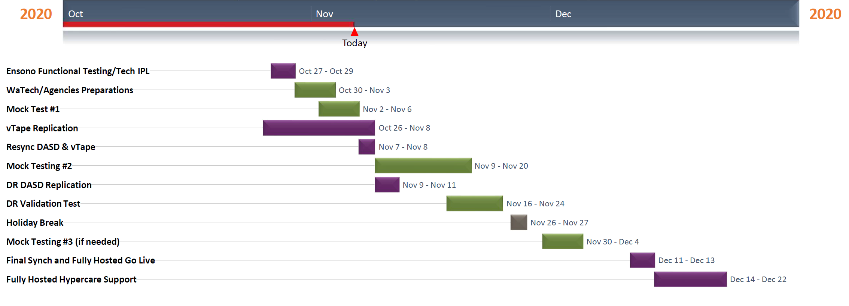
Ensono Timeline

