Slide 1

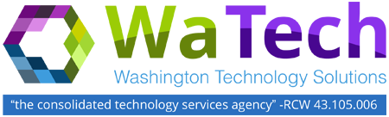
Private Cloud Infrastructure

Slide 2
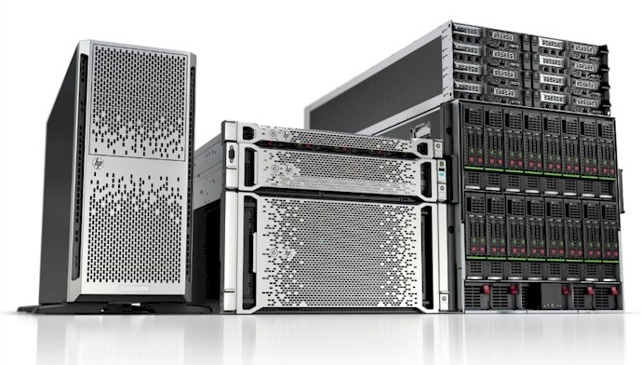
Pay No Attention
to the Servers
Behind the Cloud!

Slide 3
Private Cloud Infrastructure

Slide 4
We’re Listening!
Past Complaints & Concerns
“Does not perform like the Legacy cluster or physical hardware.”
“Yes, we have looked at the WaTech Private Cloud, but the pricing is way too high!”
“I can get it cheaper at Amazon”
“There’s no DR”
“The onboarding process takes too long.”

Slide 5
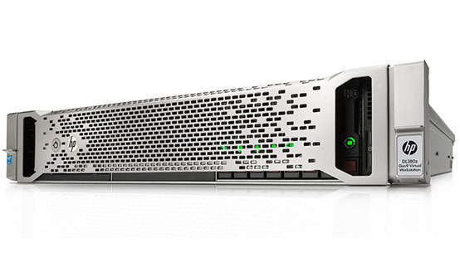
New Private Cloud Environment
  All Flash vSAN internal storage array
  High density multicore processors
  Redundant Hardware in Quincy Data Center
  Dedicated SQL Private Cloud Hardware
  Zerto DR Orchestration tool
  Dedicated Private Cloud SQL Cluster with SQL Data Center licensing
  Self Managed Trend Deep Security Firewall

Slide 6
Storage – All Flash High Speed Storage
WaTechs new Private Cloud environment includes a State of the Art storage technology called vSAN.
vSAN eliminates the need for expensive dedicated SAN equipment.
Does not require a dedicated Storage Administrator
Reduces network service dependencies
All storage is located in the host hardware allowing for faster response times
Less billing complexity - One price tier for storage

Slide 7
We Price Shopped!
Samples from environment
Ran AWS and Azure calculations
Sometimes we are more, other times we are less

Slide 8
Server Comparisons

Slide 9
SQL Comparisons

Slide 10
Private Cloud Pricing Model
Old Pricing Model
New Pricing Model
vCPU (Core/Hour) $75.52 Monthly
Memory (GB/Hour) $16.74 Monthly
Storage (GB/Hour) $0.1786 Monthly
One Time Setup Fee $700.00
vCPU (Core/Hour) $43.00 Monthly
Memory (GB/Hour) $9.00 Monthly
Storage (GB/Hour) $0.10 Monthly

Slide 11
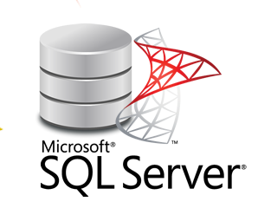
New Offering – Private Cloud SQL
Dedicated Virtual Environment for SQL VM’s
Pricing Model
vCPU (Core/Hour) $43.00 Monthly
Memory (GB/Hour) $11.00 Monthly
Storage (GB/Hour) $0.14 Monthly
Add-on:
MS SQL Licensing Per vCPU $75.00 Monthly
* Development SQL servers do not require a license.

Slide 12



Server OS Administration Offerings
Assigned Administrator (Dedicated Resource) – Phone/Email - $12,000.00 per month
  Time to Respond (M-F 8-5) 1 Hour
  Time to Respond (After Hours) 2 Hours
Gold – Phone/Email - $400.00 per month
  Time to Respond (M-F 8-5) 1 Hour
  Time to Respond (After Hours) 2 Hours
Silver – Service Ticket only - $200.00 per month
  Time to Respond (M-F 8-5) 4 Hour
  Time to Respond (After Hours) No After Hour Support
  Hours Per Month up to 4
Bronze – Service Ticket only - $100.00 per month
  Time to Respond (M-F 8-5) 48 Hour
  Time to Respond (After Hours) No After Hour Support
  Hours Per Month up to 2

Slide 13
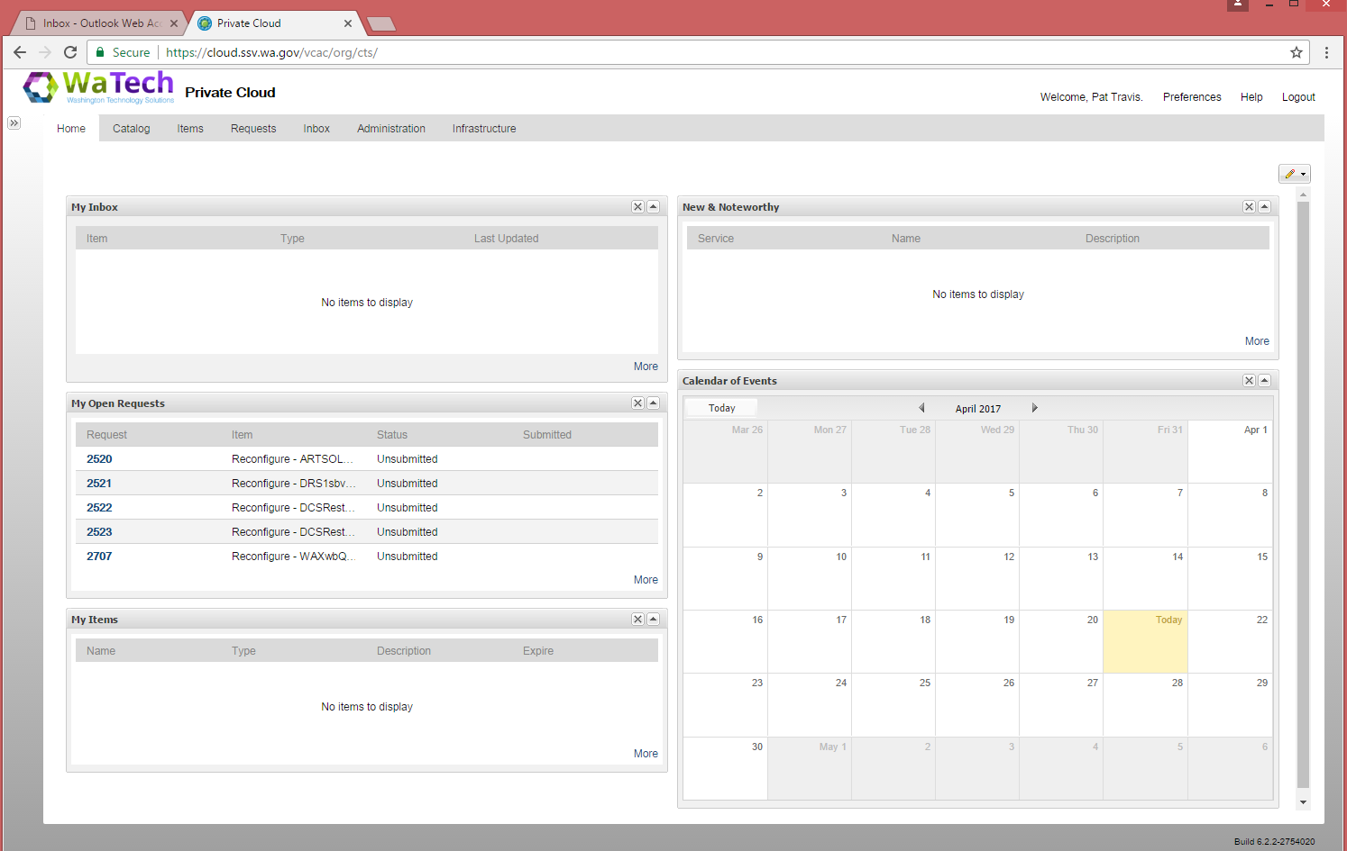
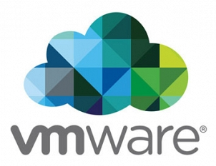
Private Cloud Portal Overview
VMWare vRealize Automation Home Page – Self Service Portal
Notes:
This slide shows a default Private Cloud portal home page which is customizable. This uses vRealize Automation.

Slide 14
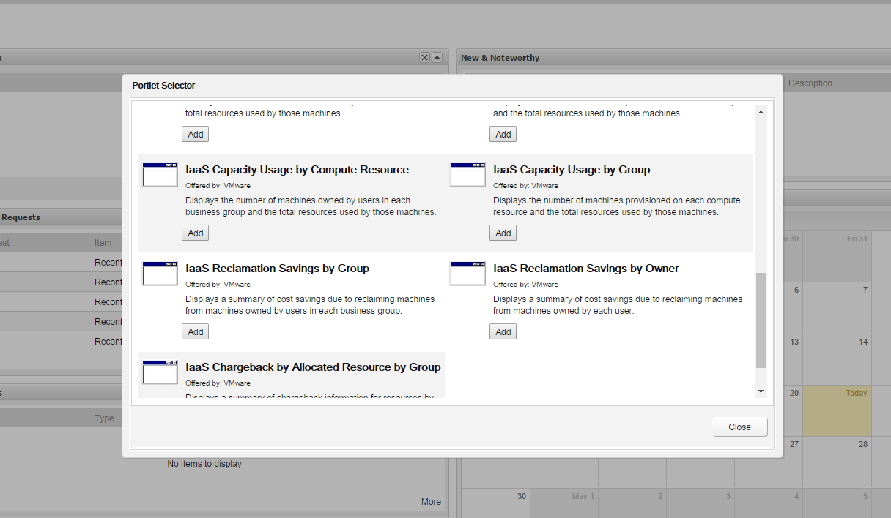
Private Cloud Portal Overview
Adding Portlets to the Home Page
Notes:
Customizing the Cloud portal Home page with preconfigured “Portlets”. This slide shows the IaaS Capacity Usage portlet being added. Adding portlets allows better visibility into your environment.

Slide 15
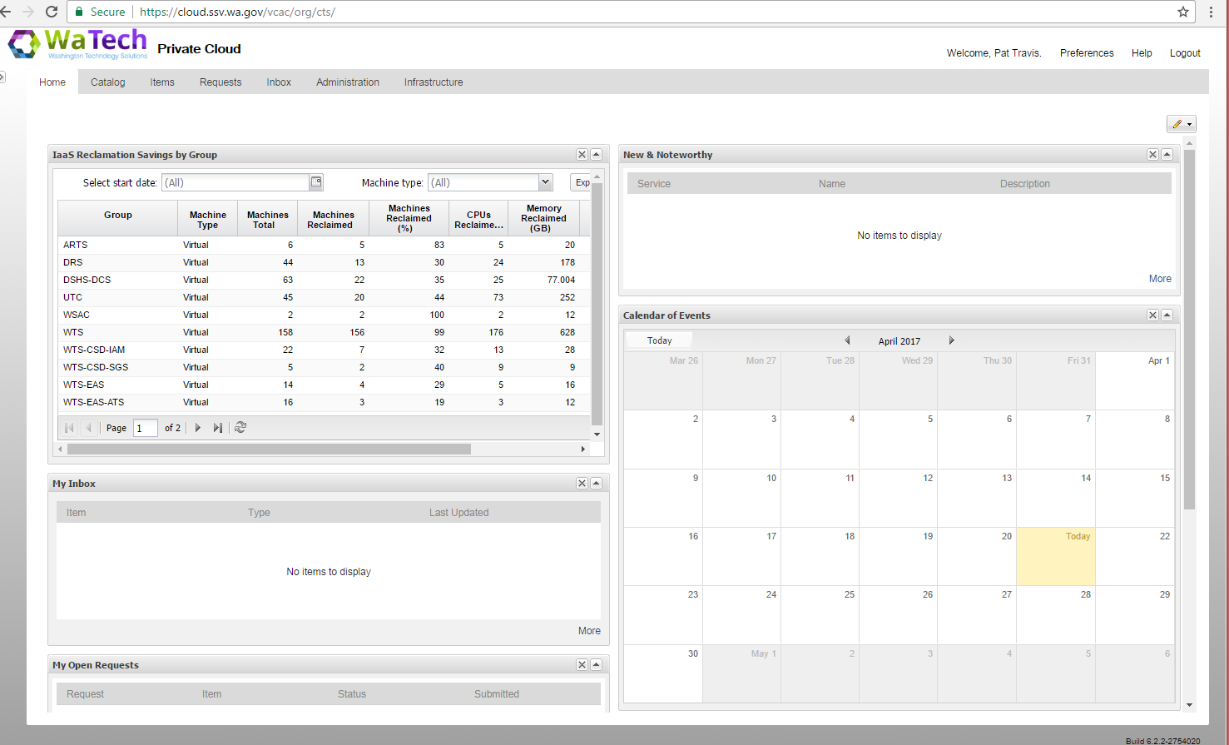
Private Cloud Portal Overview
Portlets provides better visibility into customer environments
Notes:
This slide shows the new portlet added. The portlet shows where savings can be had by reclaiming resources from over provisioned servers.

Slide 16
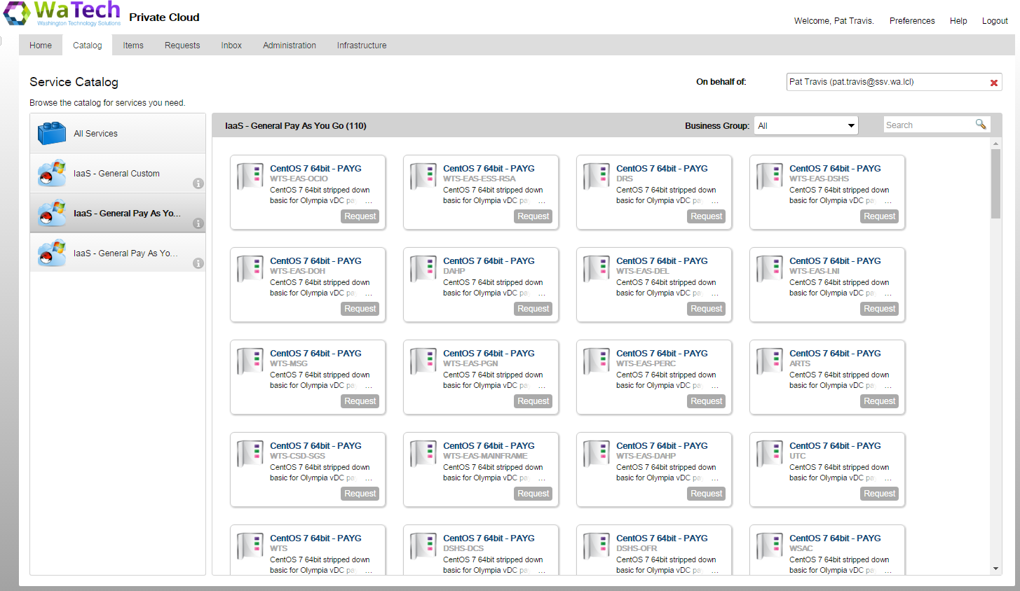
Customer Catalog
Customers see a custom environment with only their agency server Blueprints
Notes:
When a Customer is set up in the Private Cloud they will have their own catalog of “Blueprints” for all the servers. Blueprint is a server image which can be customized to the customers specifications.

Slide 17
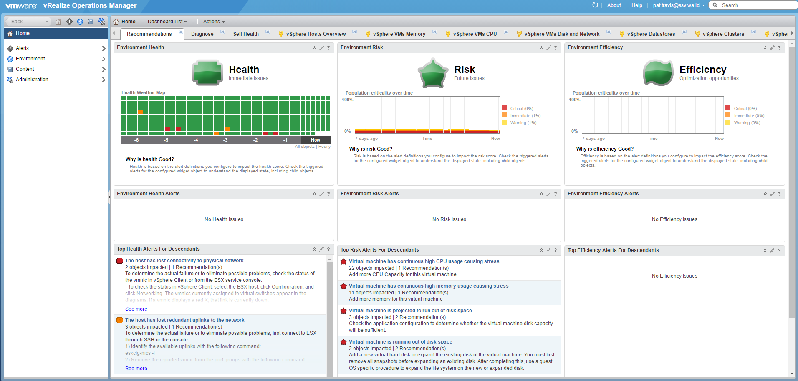
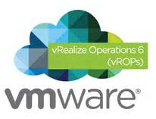
VMWare vRealize Operations Manager (vROPs)
Self Service Monitoring Portal
All Private Cloud customers get access to vROPs
Allows customers to actively monitor the health of their environment
Users can run reports or have them scheduled to run at needed intervals
Notes:
vRealize Operations Manager customizable Home Page. It is used for monitoring, troubleshooting and capacity planning in the environment

Slide 18
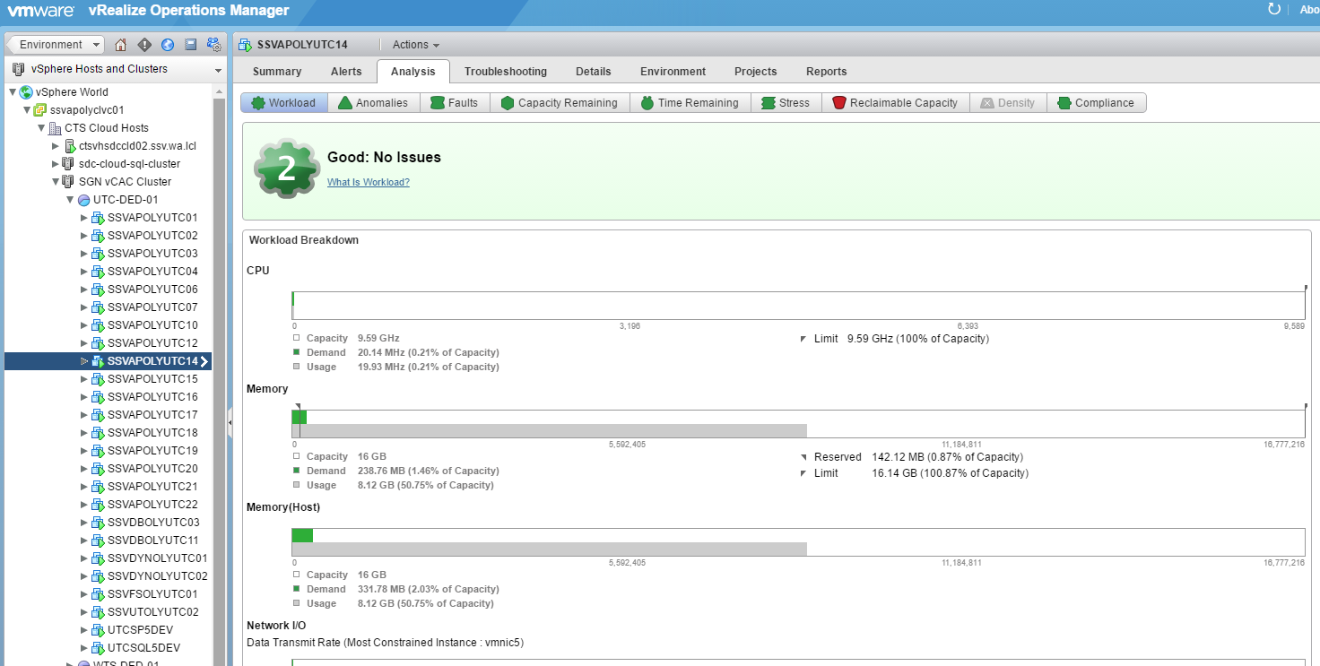
VMWare vRealize Operations Manager
Self Service Monitoring Portal
Monitor VMs down to a individual resource level
Troubleshooting and Analysis
Capacity Planning and Resource Reclamation
Notes:
vRealize Operations Manager showing analysis data for a virtual machine.

Slide 19
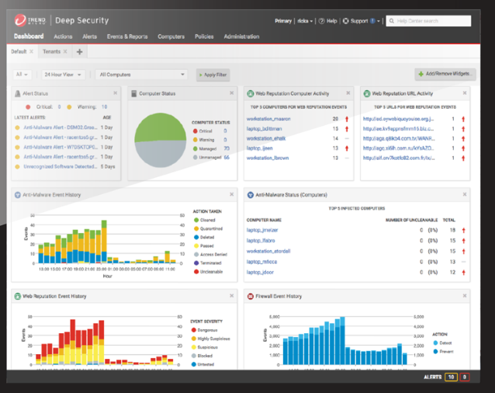
Trend Micro Deep Security
All Private Cloud VM will be protected by Deep Security which provides advanced server security for physical, virtual, and cloud servers. It protects enterprise applications and data from breaches and business disruptions without requiring emergency patching. This comprehensive, centrally-managed platform helps you simplify security operations while enabling regulatory compliance and accelerating the ROI of virtualization and cloud projects.
Anti-Malware is also included in this package.

Slide 20
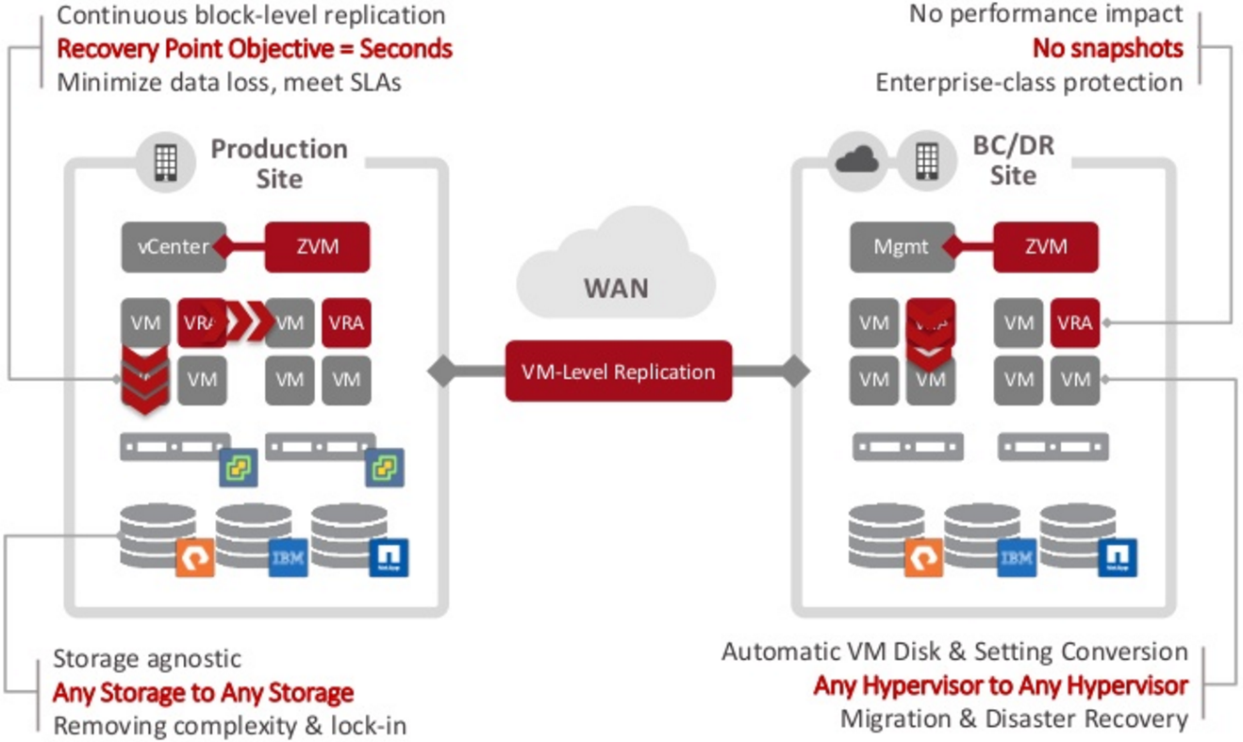
Zerto DR Orchestrator
Notes:
This slide shows the Zerto configuration which will reside between the SDC and the QDC.

Slide 21
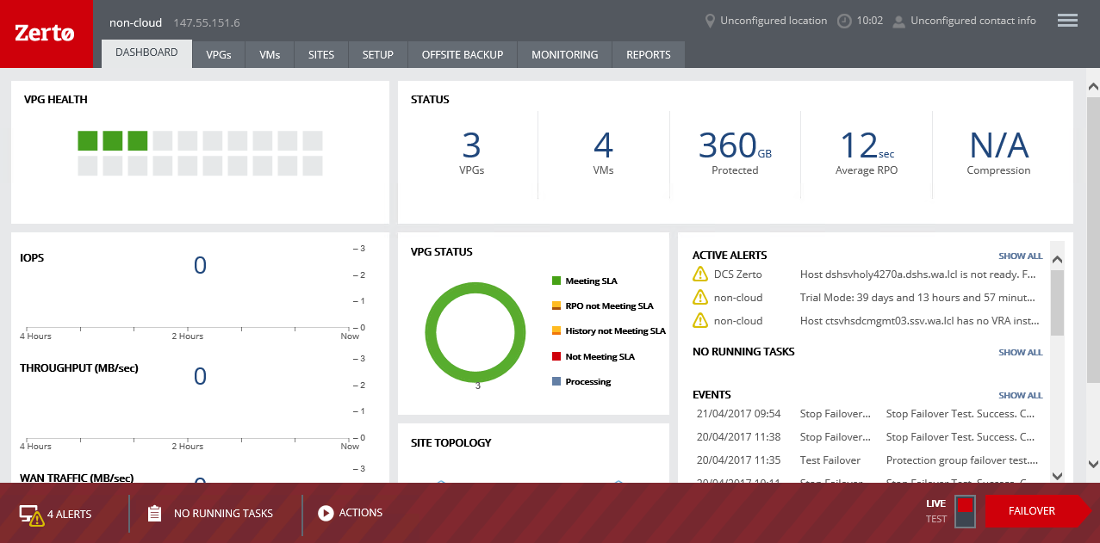
Zerto DR Orchestrator
Self-Service DR Dashboard
Notes:
The slide shows the Zerto Portal Home page. This page is customizable.

Slide 22
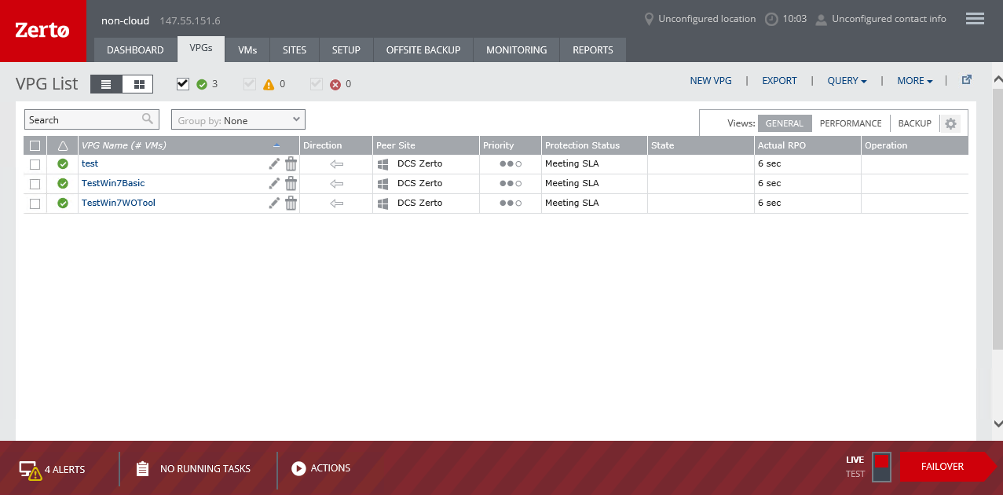
Zerto DR Orchestrator
Virtual Protection Groups (VPGs) enable grouping and tiering of VMs for protection which ensures consistent recovery points (RPOs) across all grouped machines.
Notes:
The slide shows the Zerto Portal Virtual Protection Group page. The would be where you would set up your DR groups. Specifying the order of recovery and recovery points (RPO’s). You can start Failover tests from this page.

Slide 23
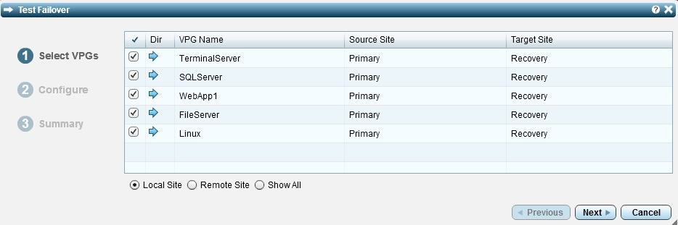
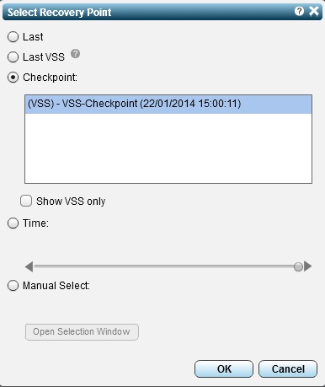
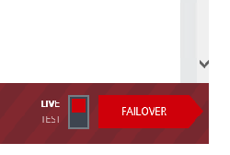
Zerto DR Orchestrator
With Zerto Virtual Replication performing failover and failback testing involves three steps:
Selecting the Virtual Protection Groups to test.
Selecting the point in time to test from using the journal of changes.
Clicking ‘failover test’.
Notes:
Once VM’s are added to a Virtual Protection Group you can initiate a Failover Test. The process is really simple as noted in the next few slides. Import thing to remember is that this Test is non-disruptive to the production environment. Zerto creates a contained area to preform the tests.

Slide 24
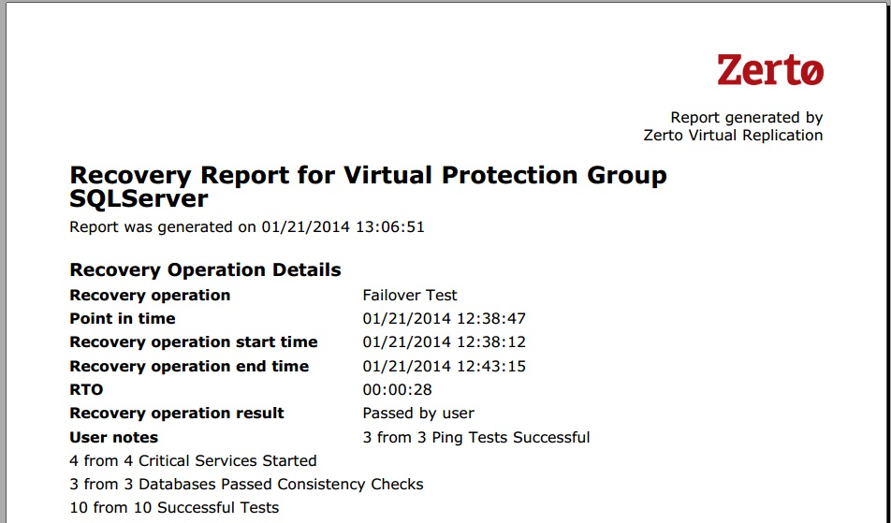
Zerto DR Orchestrator
Failover Test Procedures (continued)
This is done with no break in the replication or impact in production meaning you can perform disaster recovery failover and failback testing in working hours, in minutes with just a few clicks. Once you have finished your failover testing you click to stop the failover test and Zerto asks for the result in testing the application and allows the addition of notes.
Zerto will remove all test VMs and
configurations. A report
will be generated to show
the results of the DR test.

Slide 25
Zerto DR Orchestrator
DR Road Map
 Private Cloud
 Public Cloud
 Hybrid Cloud
Notes:
The left side of this diagram is currently funded. The second half will depend on the “Highway To The Cloud”.

Slide 26
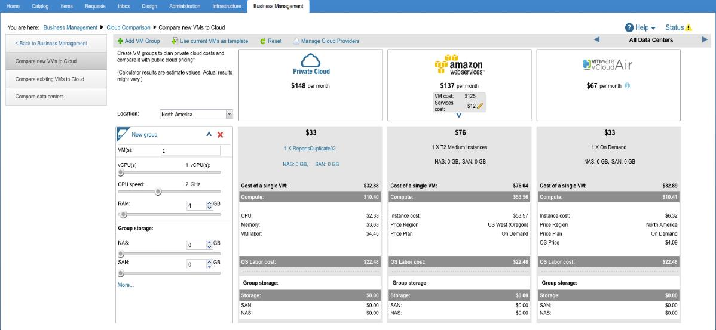
Compare Cloud Costs – Private vs. Public
Add additional charges to create more realistic compares
Compare existing and planned VMs to Public Cloud alternatives
Notes:
This slide shows what the portal would look like once the Hybrid design is completed. It demonstrates the cost comparison Business Management module of vRealize Automation. Amazon and other cloud provider cost will be dynamically captured from the cloud provider so that costs are presented with current pricing.

Slide 27
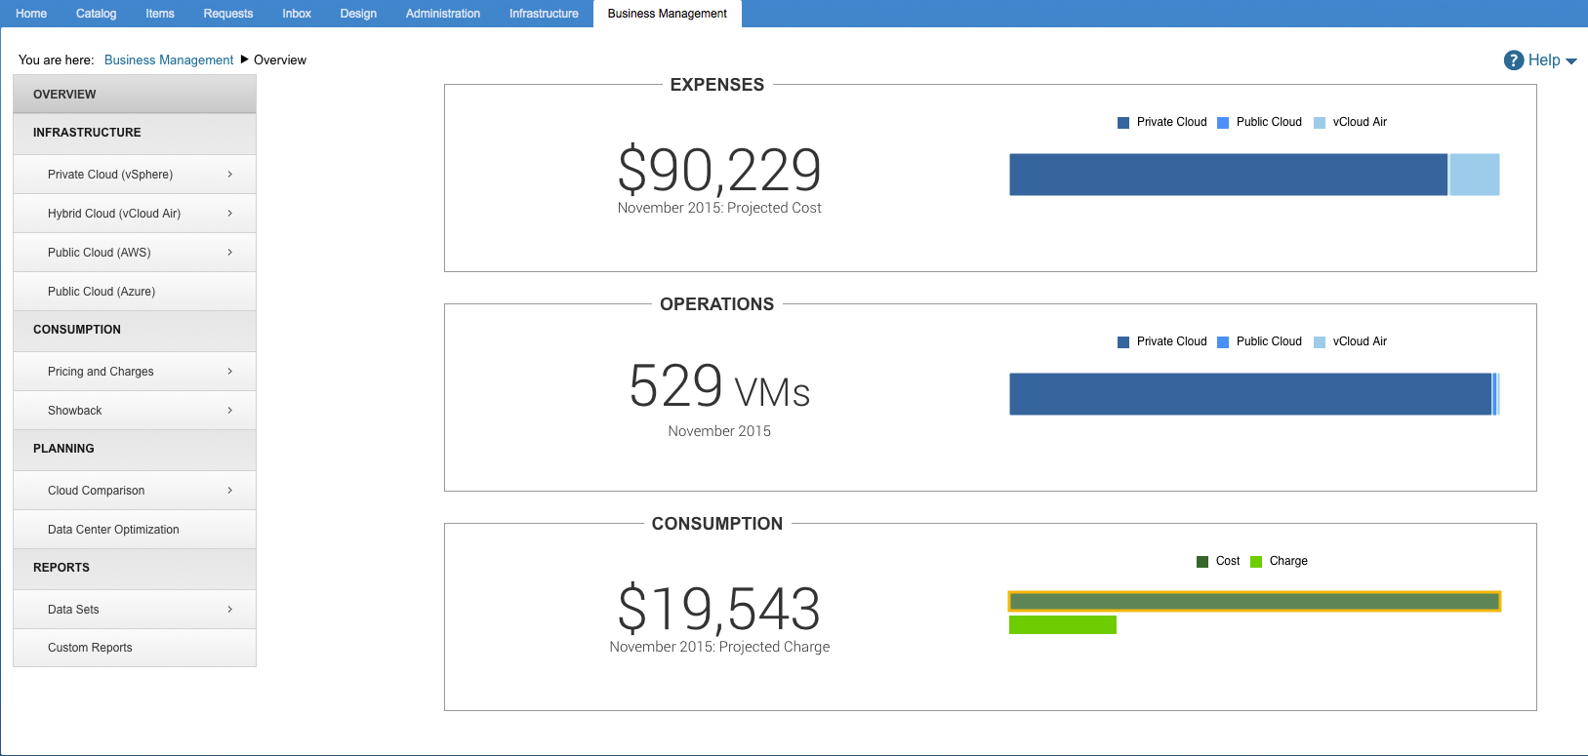
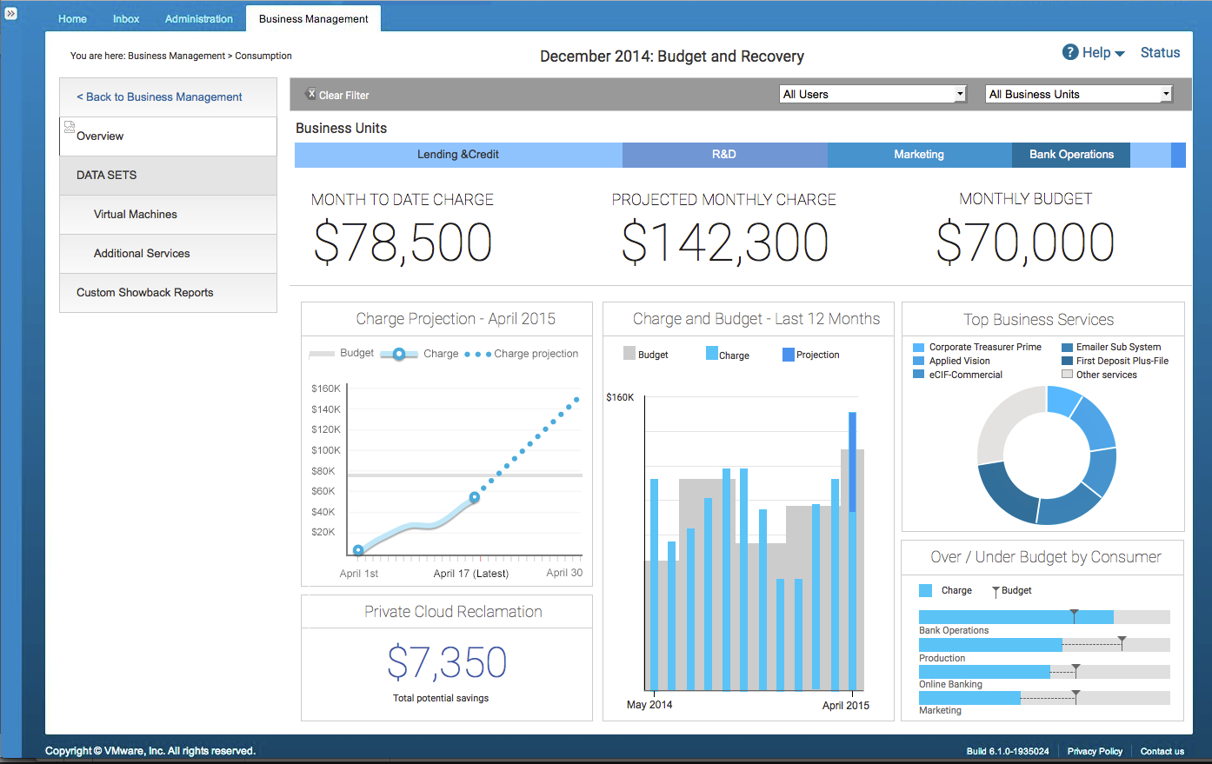
Business Management - Resource Consumption
Total cost of Cloud infrastructure
Cloud Consumption
Notes:
Another feature of vRealize Automation Business Management will give the customer the ability to see their real-time and projected expenses for there environment. This will provide more realistic numbers when building budgets.

Slide 28

On The Horizon
Migration of WaTech environments to Private Cloud
Onboarding New Clients
Continued Improvements to User Experience
VMWare NSX
Hybrid Cloud Offerings
Amazon and Azure Partnerships

