Slide 1
WaTech Telephony Services Ch-ch-changes
Prepared by:
Eric Talberg
Telephony Services
August 23, 2017

Slide 2
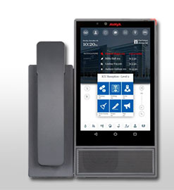
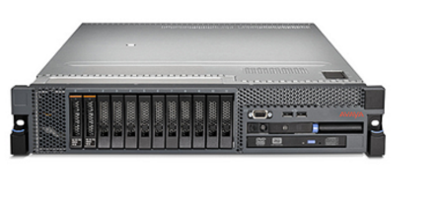
Progression of Service 1997-2017
VoIP/SIP
Digital
Analog

Slide 3
Telephony Services Statewide
Dialtone
49,000+ lines of PBX service at 190+ locations Statewide, 8,500 lines analog service from CenturyLink and Frontier statewide
Voicemail
28,000+ subscribers to PBX and analog VM
Call Centers, IVR, Call Recording
1300+ call centers statewide small to large
Audio and Web collaboration Conferencing
500+ subscribers statewide
Service Support
Dedicated Technical and service teams to address business problems

Slide 4
Telework/Remote Workers Business Problem
Governor’s Initiative
EXECUTIVE ORDER 16-07| BUILDING A MODERN WORK ENVIRONMENT
Allow For Mobile Workforce and Workspace
Help to recruit and retain non-local employees
Enable geographically dispersed resources and out of hours support

Slide 5
Mobility Options
Avaya One-X Communicator
Enables users to use their desk telephone on their computer.
Avaya One-X Agent
Leverages staffing resources by enabling remote staff to answer calls that originate to the customers primary call center location.
Avaya Skype for Business Plugin
Integrates user’s desk telephone with Skype for Business for features such as click to dial, collaboration and presence.
One Number Service/Extension to Cellular

Slide 6
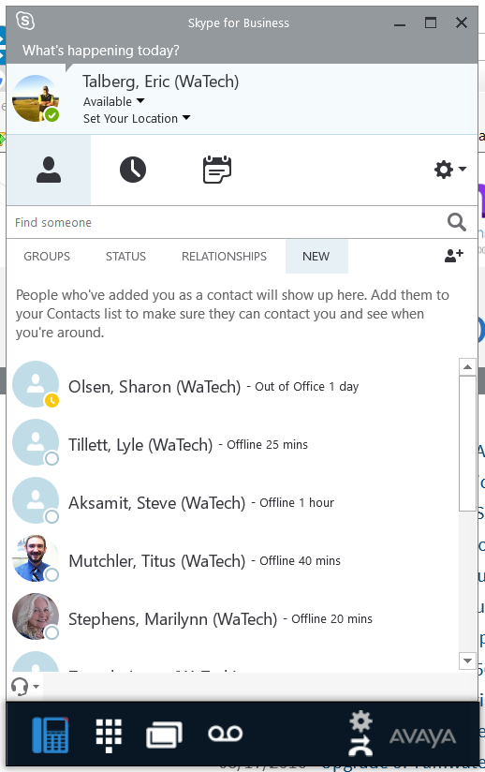
Current Mobility Solutions
One-X Communicator
Avaya w/Skype for Business
One-X Agent

Slide 7
Voice mail Avaya Aura
22,000+ Subscribers
Voice Controlled Auto attendant-(360)-407-1113
(Premium Mailbox Features)
Notification of new voice mail – Email, text or phone call
Delivery of new voice mail to multiple email addresses
User web page for features
Call up to 3 additional phone numbers before routing callers to voice mail to leave a message (Reach Me)

Slide 8
Coming Soon SIP (Session Initiation Protocol)
SIP is data optimized voice service
SIP Phones
Easier secure connectivity of phones and devices to the PBX Network
Oceana/Breeze Contact Center products to add functionality to Call Centers (Web chat, E-Mail, Text messaging) Breeze adds new functionality to phone system
Equinox Brings consistent interface for softphones and cellular instances of software phones

Slide 9
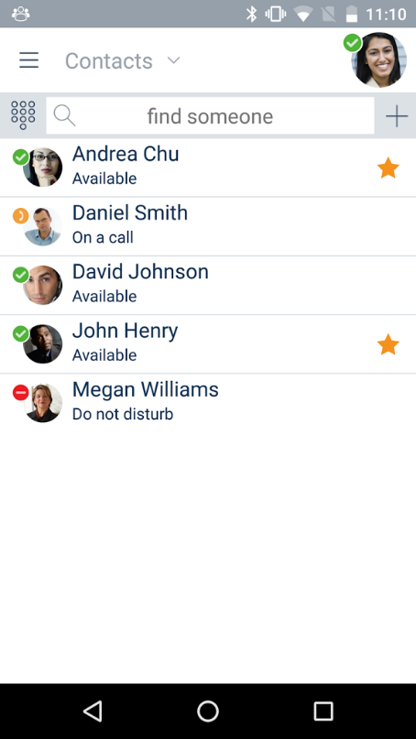
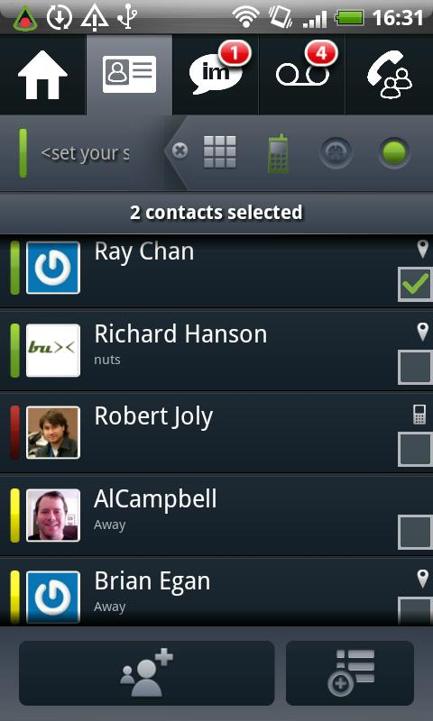
EQUINOX
Brings consistent interface for softphones and cellular instances of software phones.

Slide 10
WebEx Moves to New Service
Moving to new service in September same rates, enhanced feature set
Consolidated site/Easier access for end users
Integration with traditional video conferencing systems and Microsoft Skype for Business
Personal Room enhancements – you can now start your personal room from your phone without joining on your computer More emphasis on callback feature – cost efficient
VoIP capable – utilize computer to join meetings
Can join meetings from mobile devices

