Slide 1
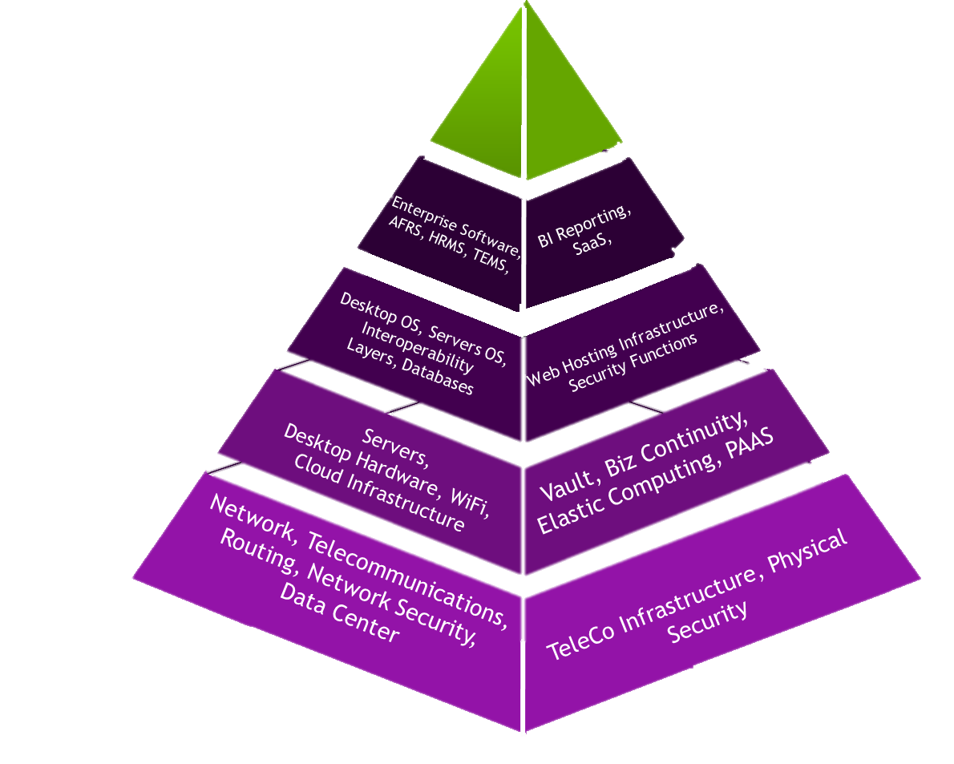
Revenue vs Expense
Alignment of Services
Customer Experience
WaTech Focus Areas

Slide 2
Criteria for Decisions
Return on Investment
Demand
Scalability
Revenue Sustainability
Ability to Execute
Customer Value

Slide 3
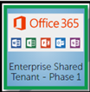
Cloud Roadmap
Microsoft Shared Tenant Phase 1
Customer targeted services leveraging brokered cloud connections
Production activity in O365 Licensed Services
2014-2016
2017
2018

Slide 4
Strategic Direction
Cloud Enablement
O365
Brokered Cloud Services
Identity & Access Management
Infrastructure for Cloud Services
Notes:
Change colors of the boxes

Slide 5
Strategic Direction
Cloud Enablement
Mobile Device Management
O365
Brokered Cloud Services
Web Hosting
Identity & Access Management
Software as a Service
Infrastructure for Cloud Services
Notes:
Change colors of the boxes

Slide 6
O365 Service Activities
Shared Tenant Pilot
SharePoint/OneDrive
Active Directory Cleanup
Cloud E-Mail
PowerBI
Project Online
ESD
Parks
DSHS
UTC
WaTech
MIL
HCA
Exchange Online
Shared Tenant (Production)
Support for Office365 ProPlus
O365 License Activation
Cloud Highway
ADFS Single Sign-On for SAAS
Shared Tenant (Work Under Way)

Slide 7
Funding Approaches
Fee for Service
Enterprise Co-Op
Allocation

Slide 8
Fee for Service Rate changes
Wireless Access Points
Site to Site VPN
State Data Center / Quincy
Centrex Circuits
Desktop Services
$50
$35mo.
$variesmo.
$45
$285
$variesmo.
$350-400
$200-260KWH
$3500
$ 5000per desktop annually

Slide 9
Defined Thresholds
Serve the whole when possible
Alignment with Customer needs
Sustainable Predictable expense profile
Allocation Clarification
Allocation Name
Service within allocation
Service Boundary strategy
Security Gateway Allocation
Network Allocation
Network Allocation
Network Allocation
Network Allocation
Secure Access WA
Vulnerability Assessment
Logging and Monitoring
Network
Firewall
SEAP, Multi Factor, and Knowledge Based Authentication
Thresholds on logs, packet analysis
Network vulnerability
5 routing tables per agency
Thresholds of 3 firewalls per agency

Slide 10
Enterprise Co-Op
Cloud Highway
Application Vulnerability Assessment
GIS Imagery
Agencies aggregate funding to cover implementation and ongoing costs
In Practice Today
Data Standards, resource sharing
Application Assessment for security design risks

Slide 11
Listserv
Storage
(OpX)
Shared Web Hosting
Cloud Based Service Delivery
Mainframe Hosting
Transforming our Services

Slide 12
Is this helpful?
Customer
Value
Outcomes

