Slide 1
CTS Wireless Service
Quarterly Customer Meeting
April 23, 2015

Slide 2
Wireless Service Overview
CTS Wireless is a statewide service which offers greater mobility and productivity via one secure, centrally-managed and supported common infrastructure by providing:
  No up-front or recurring equipment costs
  Easy-to-acquire subscription pricing
  Full integration to state government networks
  Full compliance with state security standards and policies
  Easy, secure roaming to your agency’s network resources
  Professional network design
  Highly reliable state-of-the-art equipment
  Local agency control and administration
  A consistent mobile experience
  Expert-level centralized support

Slide 3
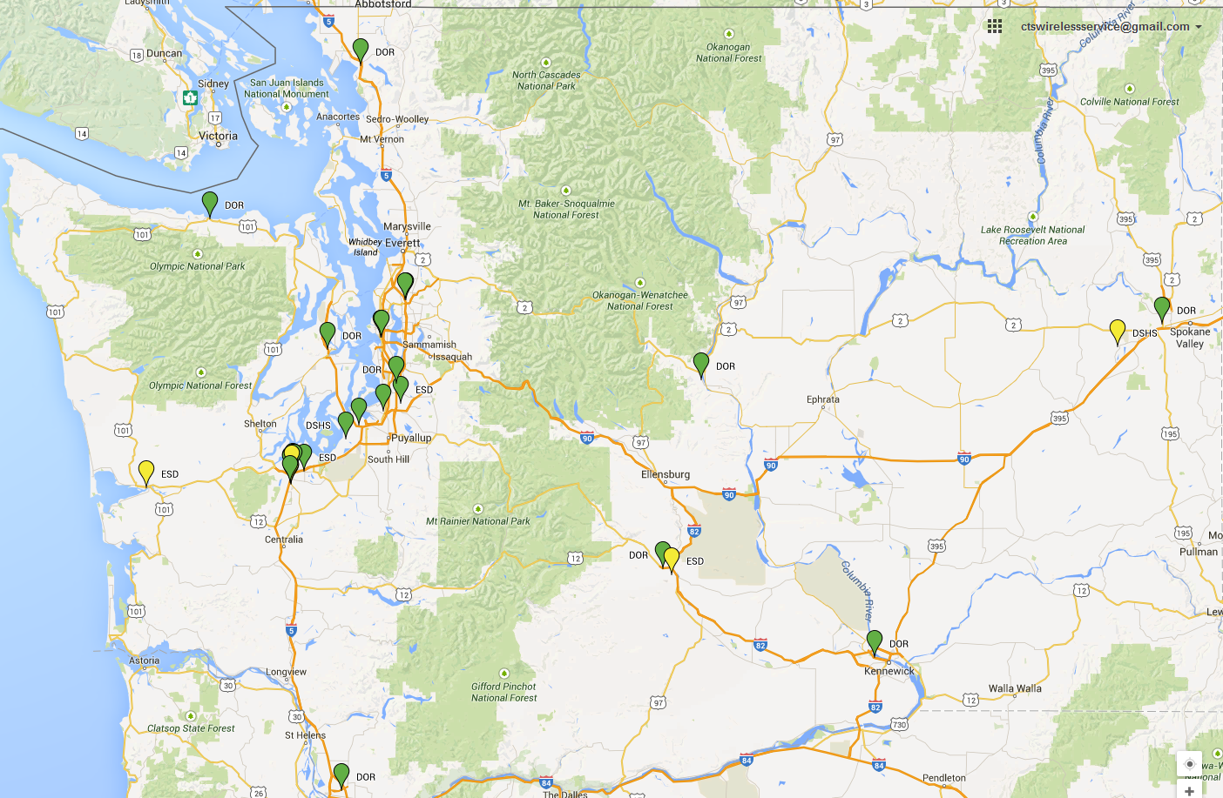
Current Service Footprint
The new CTS Wireless Service already has access points in locations across the state and is growing.
Current customers = 8
Current sites = 26
Sites underway = 17+

Slide 4
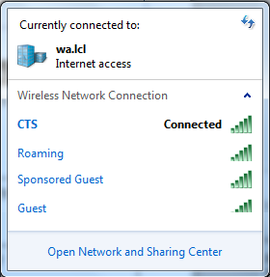
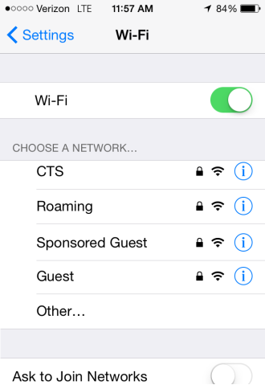
CTS Wireless Networks
Wireless Networks | Users | Access to | Authentication
<Local Agency Name> | Employees | Agency resources | Joined to Active Directory & User Certificate
Roaming | Employees | Your Agency resources while visiting another agency | Joined to Active Directory & User Certificate
Sponsored Guest | Guests | Internet | Assigned Username & Password
Guest | Guests | Internet | Pre-Shared Key
Mobile Devices
Laptops

Slide 5




<Local Agency Name> Access
Connects to “DOR” SSID
Internet
AP
AP
DOR
Employee
DOR VRF
Other Agency VRFs
Placed on Agency VLAN
CAPWAP Tunnels
AP
CTS WLC
AP
802.1x Authentication via ISE
ISE
CTS Datacenter
Query AD: User Belongs to Agency Group
Agency

Slide 6
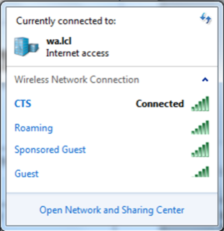

Roaming Access
Internet
DOR VRF
AP
AP
Connects to “Roaming”
SSID
DSHS VRF
Placed on Agency B VLAN
CAPWAP Tunnels
CAPWAP Tunnels
(from other agencies)
CTS WLC
AP
AP
Roaming
DSHS
Employee
802.1x Authentication via ISE
ISE
Query AD: User Belongs to Roaming Agency B Group
CTS Datacenter
Agency A

Slide 7


Guest Access
(Guest and/or Sponsored Guest)
Internet
Guest Users placed on
Internet VLAN
Agency VRF
AP
AP
Other Agency VRF
Guest SSID: Pre-shared key
CTS WLC
CAPWAP Tunnels
AP
AP
Sponsored Guest SSID: 802.1X Authentication using ISE guest account
Connects to “Guest” or “Sponsored Guest” SSID
Guest
ISE
CTS Datacenter
Agency

Slide 8
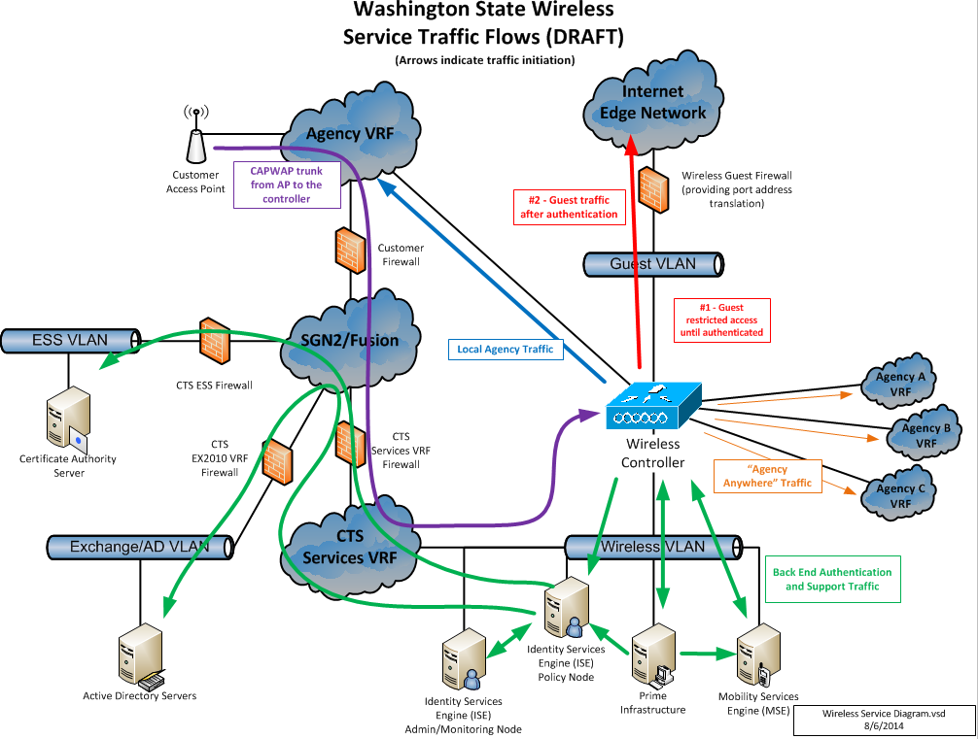
High Level Architecture
Not for Distribution.
Internal Use Only.
The CTS Wireless Service removes the worry for agencies considering wireless solutions.
The CTS Wireless Service complies with OCIO Security Standards.

Slide 9
Phased Approach
Phase 1 – Customer Interest & Kick-Off
Customer expresses interest in CTS Wireless Service and completes the Interest Form. A kick-off meeting is held to provide details about the service and learn more about the Customer’s technical environment and wireless needs. Customer completes a Site Survey Questionnaire and provides a floor plan.
Phase 2 – Site Design
CTS conducts a predictive site survey, provides Customer with a budgetary estimate for Wireless Service and a quote for an on-site survey, depending on requirements. CTS conducts an on-site survey and provides Customer with a CTS Wireless Service quote.
Phase 3 – Provisioning & Installation
Customer acquires infrastructure, CTS orders and configures access points, training, provision activities are completed and Customer installs access points.
Phase 4 – Service Turn-up
Wireless service turn-up, testing, post-deployment verification survey, and acceptance. Then billing begins.

Slide 10
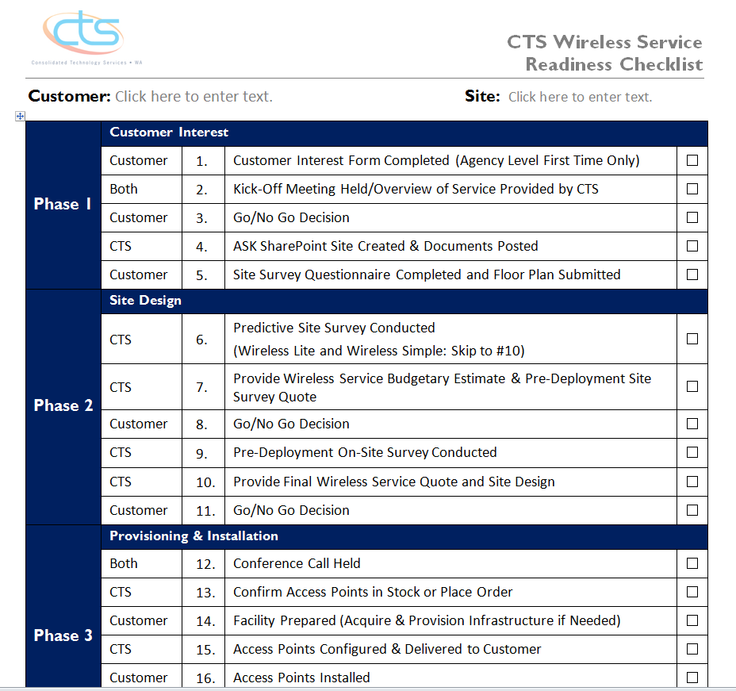
Readiness Checklist
The Readiness Checklist tracks progress during implementation.

Slide 11
Wireless Service Responsibilities
CTS Responsibilities:
Provide wireless Access Points (AP).
Provide wireless site surveys and design.
Provide IP addressing for wireless APs and users.
Manage the infrastructure components: Prime Infrastructure (PI), Identity Services Engine (ISE), Mobility Services Engine (MSE), wireless controllers, and APs.
Manage web filtering, firewall, IPS/IDS, and DHCP services for Guest access.
Monitor, troubleshoot, and provide second-tier support.
Customer Responsibilities:
Provide wiring and install Access Points (APs).
Provide AP connectivity, switching, and routing (layer 1-3) services for APs.
Update LAN and firewall configurations to enable wireless service in their environment.
Manage and maintain AD groups, GPOs, and DHCP services for wireless access to Local Agency and Roaming networks.
Perform user administration and troubleshoot using PI.
Use the Sponsor Portal to set up Guest Access (optional).
Ensure current maps are loaded into PI.
Provide first-tier end user support.

Slide 12
Wireless Service Requirements
The first step to becoming a CTS Wireless Customer is to confirm that the basic requirements are met:
Basic Requirements for the CTS Wireless Service | Local Agency Access | Roaming Access | Guest Access
Connectivity to the State Government Network (SGN) | Required | Required | Required
Member of the CTS Enterprise Active Directory Forest (EAD) | Required | Required | -
Connectivity to the CTS MPLS Wide Area Network (Agency VRF) | Required | Required | -
These requirements do not need to be met for customers only needing Guest access.
Notes:
Customers must have connectivity to the State Government Network (SGN).
The wireless service is hosted via the SGN just like other shared services such as Exchange Email and Active Directory.
Access to agency resources requires the customer be a member of CTS Enterprise Active Directory (EAD) forest.
Certificates are used to authenticate wireless access to agency resources based on AD group membership.
Certificates are issued by the CTS EAD Internal Certificate Authority (ICA) server.
Access to agency resources also requires the customer to have a connection to the CTS MPLS Wide Area Network (WAN) also known as an agency VRF typically used to connect multiple customer locations across the state.
There are options for customers to get a CTS MPLS WAN connection who do not have one today.

Slide 13
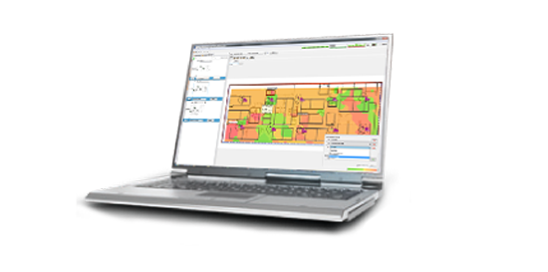
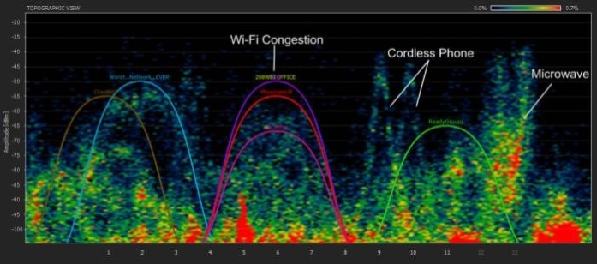
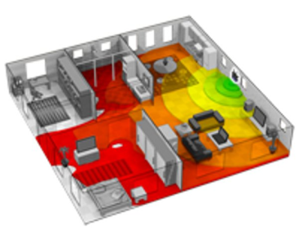
Wireless Site Surveys
Wireless Site Surveys are used in the wireless design and verification processes. There are three types of surveys performed:
  Predictive Survey – Performed off-site with a software program to model the environment to see the RF propagation. Used as the foundation of the wireless design. AP count for the Budgetary Estimate.
  Pre-deployment – Performed on-site prior to installation to validate the predictive design and identify sources of interference, congested airspace, or neighboring networks that can negatively affect your wireless network. Final AP count for the Quote.
  Post-deployment – Performed on-site after installation to validate that the wireless network meets all of the requirements identified.

Slide 14
Service Cost Model
Recurring Costs
Monthly rate: $35 per Access Point (AP) for all networks (SSIDs)
  CTS provides the APs, enterprise infrastructure, service and support.
One-Time Costs (NRCs)
Site Surveys (depending on quote)
AP installations (including wiring and power) are customer responsibility
Each access point requires connectivity to an Ethernet network and cabling needs to be routed to all access point locations.
CTS does not offer cabling as a service. Customers often use their facilities staff to install cabling or have a cabling contractor.
Other possible costs for unique/rare situations
Custom brackets, AP security, PoE switch or power injectors, antennae

Slide 15
Service Cost Deployment Scenarios
Use Case #1
Small agency office desires one access point in a conference room:
$40 Setup Fee
Purchase AP Security (nominal one-time cost)
$35 per month/AP
Use Case #2
Mid-Large agency office desires full coverage with no coverage gaps for staff walking across the building:
Pre-Deployment Site Survey Fee (per quote)
Wiring/cabling installation costs
$35 per month/AP
Post-Implementation Site Survey Fee (per quote)
CTS Wireless eliminates most procurement and upfront costs for agencies.

Slide 16
Post Implementation

Slide 17
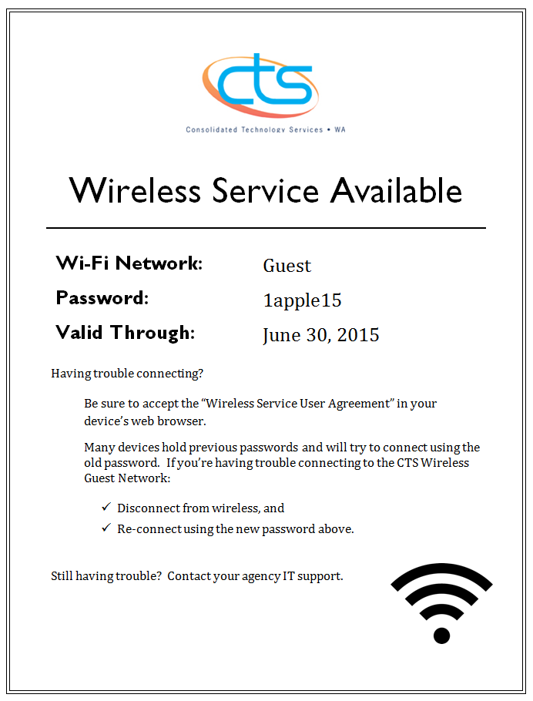
Guest Pre-Shared Key

Slide 18
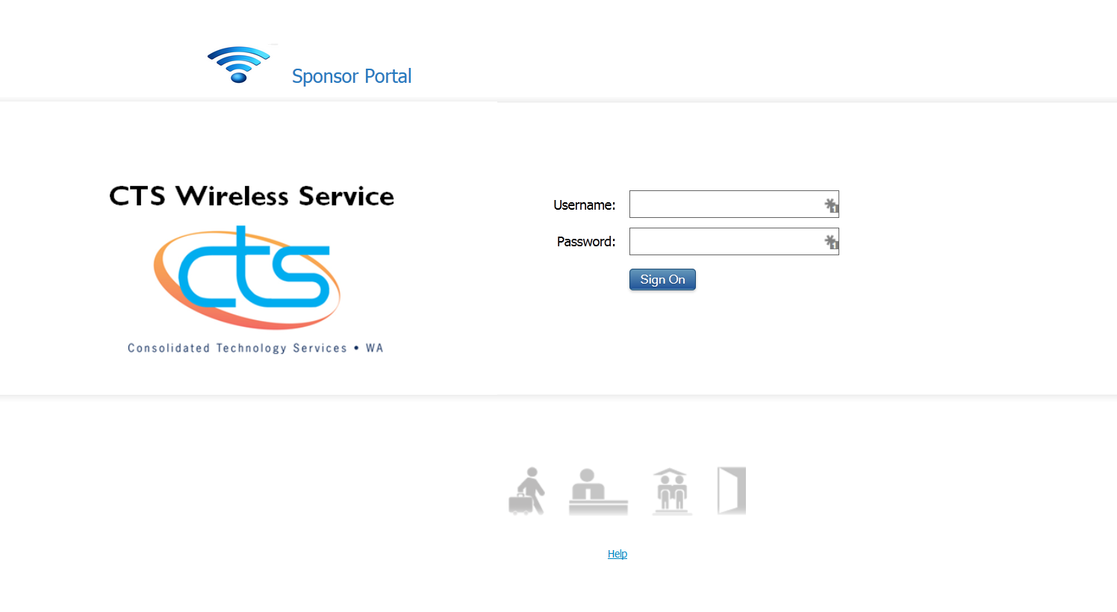
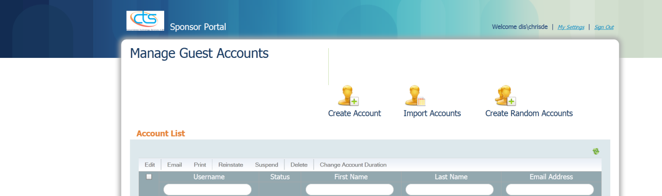
Sponsored Guest Portal

Slide 19
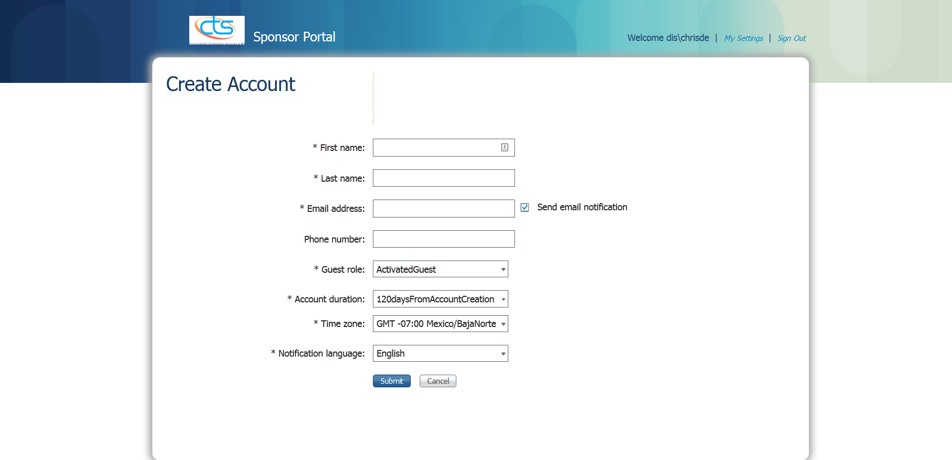
Sponsored Guest Account Creation

Slide 20
Guest Network(s) Use Cases
Pre-Shared Key
Multiple guests use one key that has been shared with all
  Use Case #1 – Post pre-shared key on the conference room wall
  Use Case #2 – Share pre-shared key on intranet page
  Use Case #3 – Handout pre-shared key to a select few
Sponsored Guest
One guest is given a username and password that is active for a pre-selected amount of time.
  Use Case #1 – Front desk creates account upon guest arrival
  Use Case #2 – IT Staff creates account to prepare for partner arrival
  Use Case #3 – Kiosk in lobby has designated account
  Example: To provide guests with internet access, some agencies set up LAN connections, AD accounts, perform background checks, configure routing to partner agencies, etc. CTS Wireless removes these steps.

Slide 21
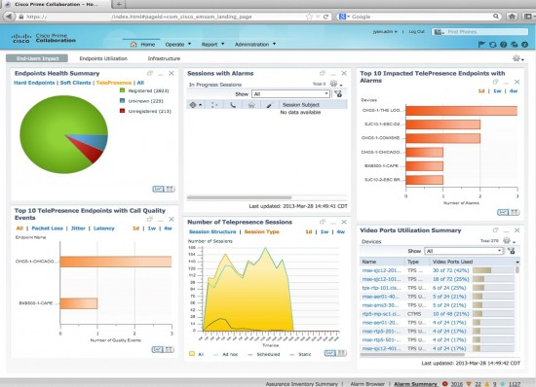
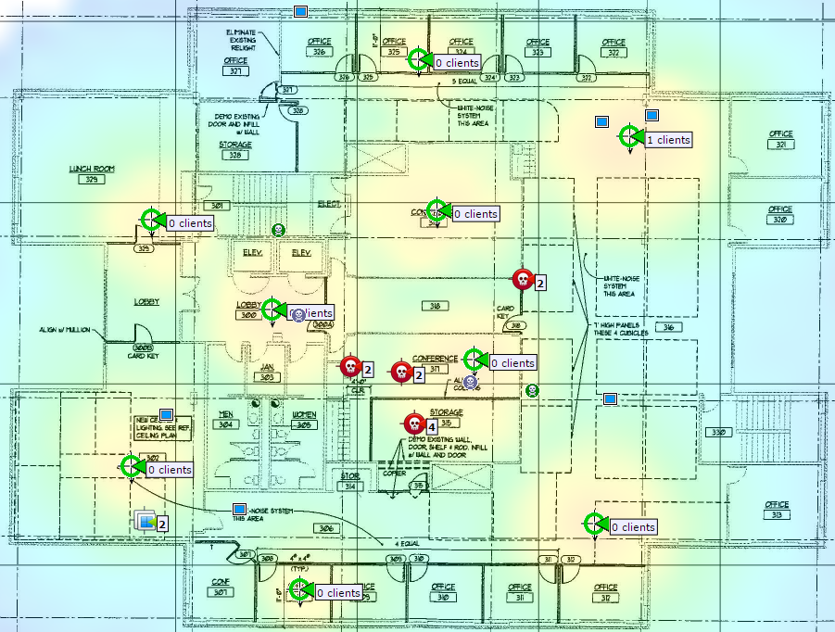
Delegated Administration
Customized monitoring dashboards
Rogue access point detection
Source of interference identification
Application visibility and control
Device connectivity troubleshooting
Detailed device information
Reporting and analytics

Slide 22
Other Resources
Wireless User Group
  CTS hosts a customer meeting every month to answer questions, encourage discussion, and information sharing. Next Meeting: May 7th, 2015
Recurring Administrator Training
CTS offers training every other month. Next Training: May 14th, 2015
2015 IPMA Forum
May 19th 2:45 – 3:45 Mobility Solutions and the CTS Wireless Offering – Cisco
May 20th 9:45 – noon Anytime, Anywhere, Any Device: Strategies and Tools to Enable a Mobile Workforce – CTS, AirWatch, VMware, DSB

Slide 23
What’s Next?
If you would like more information about CTS Wireless, please open a CTS Service Desk ticket and we will contact you to schedule an orientation session.

