Slide 1
WaTech’s Journey towards Zero Trust
Notes:
MQ to kick-off this information-sharing event.

Slide 2



Mikel Costello
Strategic Planning and Design Manager
WaTech
Daniel Langley
Network Security Architect
WaTech
Andrew Johnson
Solutions Architect
WaTech
Notes:
MQ introducing presenters.

Slide 3
Agenda
Secure Access Service Edge
  How is WaTech aligning with SASE?
Gap Analysis Overview
  Capability Taxonomy Summary
The Future is Zero Trust
  Next steps in our evolution
Notes:
Mikel to summarize the agenda and expectations to be shared about the following content.

Slide 4
Secure Access Service Edge
How is WaTech aligning with SASE?
Notes:
Andrew to brief the next four slides about how WaTech is alignment with Secure Access Service Edge (SASE); not about what SASE is.

Slide 5
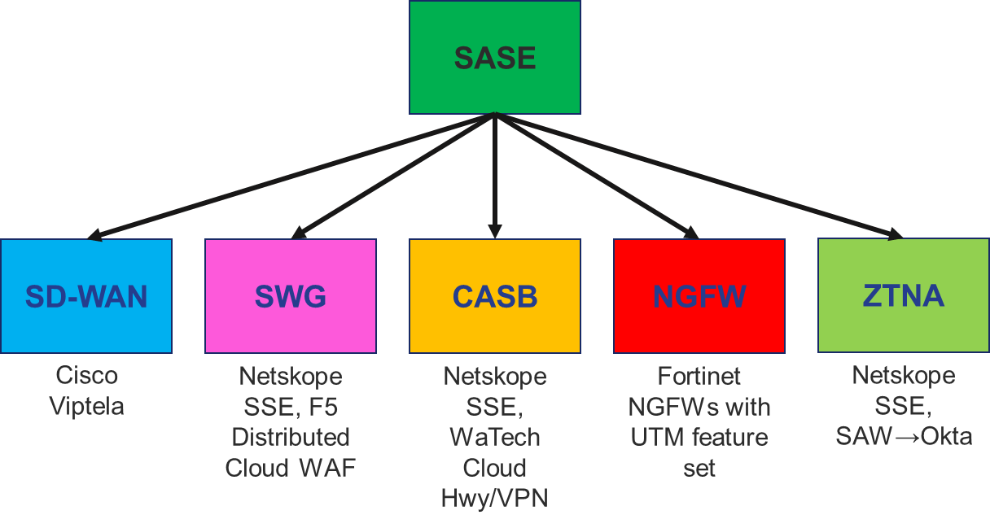
Secure Access Service Edge Alignment
SD-WAN
  Cisco Viptela
Expanding cloud security
  F5 Distributed Cloud WAF
Secure Service Edge
  Netskope
Next Generation Firewalls
  Fortinet with UTM features
Cloud Highway/VPN (CASB)
Notes:
Slide Talking Points
This slide illustrates how WaTech is aligning with a Secure Access Service Edge (SASE) Framework.
WaTech has integrated Cisco Viptela as an inherent feature of WaTech’s Wide Area Network (WAN) Transport and Connectivity service.
WaTech is in the process of expanding its cloud security capabilities by deploying a Distributed Cloud Web Application Firewall (WAF).
WaTech is diligently working to deploy Netskope’s Secure Service Edge (SSE) as an enterprise service to state-owned laptops, desktops, and mobile devices.
WaTech is upgrading the state’s Cloud Highway to 30Gb of capacity to expand this Cloud Access Security Broker (CASB) service.
WaTech has implemented Next Generation Firewalls (NGFWs) with a Unified Threat Management (UTM) feature set that is available to state agencies to leverage while continuing to expand security capabilities on-premises.

Slide 6
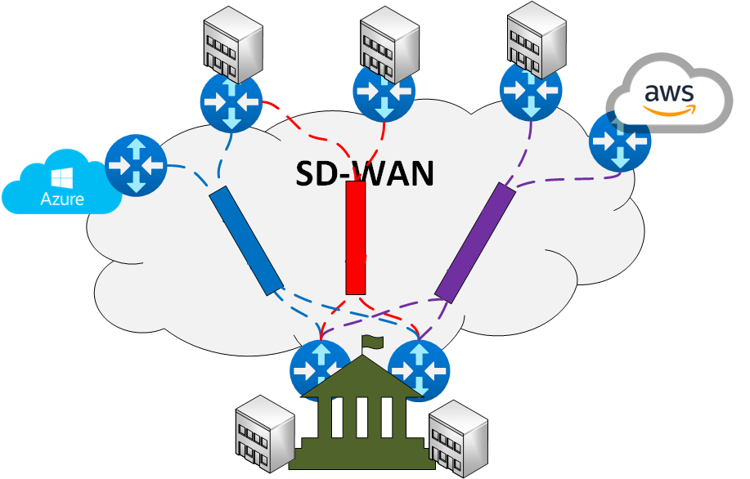
SD-WAN Implementation
Broadband Internet adoption
Centralize management and visibility
Cloud-direct connectivity
Dynamic fault tolerance
Low-touch appliance provisioning
Increase WAN resiliency
Improve user experience
Notes:
Slide Talking Points
SD-WAN is bolstering the resiliency of the state’s Wide Area Network (WAN) by coupling dynamic fault tolerance (self-healing networking) with the resiliency of broadband Internet.
SD-WAN will be providing direct-to-cloud (cloud-direct) connectivity to shared services in the clouds while enabling cloud-to-cloud interconnectivity without having to traverse on-premises for cloud-based resources.

Slide 7
NGFW Implementation
Firewall as a Service (FWaaS) model
Coupled with SIEM
Edge IDS/IPS functionality
Constrains lateral movements
Identity-based policies
Increases cybersecurity intelligence
Faster threat remediation
Notes:
Slide Talking Points
WaTech’s Next Generation Firewalls (NGFWs) are implemented within a Firewall as a Service (FWaaS) model that is interoperable with WaTech’s SIEM service using Azure Sentinel.
WaTech’s NGFWs constrains lateral movements between agencies by ensuring north-south and east-west network security inspection capabilities.
The capabilities that are available for agencies to use include advanced firewall inspection, Intrusion Prevention Systems (IPS) functionality, network isolation, and eventually Deep Packet Inspection (DPI) using identity-based policy enforcement.
Using WaTech’s NGFWs increases the state’s cybersecurity intelligence to improve the state’s threat remediation tactics if/when a breach occurs.

Slide 8
Secure Service Edge (SSE)
SASE Subcomponent
  Couples SWG, CASB, ZTNA
  Capability set aligns with zero trust
Use Cases
  SaaS applications
  Internet websites
  Private (proxied) applications
Supportability
  Remote workforce
  Hybrid, multi-cloud ecosystem
Notes:
Slide Talking Points
Secure Service Edge (SSE) is essential for modernizing our security strategy in an era where remote work and cloud applications are the norm. SSE integrates crucial security functions like secure web gateways, cloud access security brokers, and zero trust network access into a unified cloud-native platform. By implementing SSE, WaTech can ensure consistent, scalable protection across all user connections, regardless of their location or device. This approach not only simplifies our security infrastructure but also enhances our ability to quickly adapt to emerging threats and shifting business needs. Adopting SSE means gaining robust, streamlined security that effectively safeguards our digital environment while supporting the state’s growth and agility.
SSE Use Cases (per Gartner) consist of:
SaaS applications (accessed using the Internet).
Internet-accessible websites.
Private applications accessed via the Internet or via a proxy (which WaTech proxies for state government).

Slide 9
Gap Analysis
Business Capability Analysis and Taxonomy
Notes:
Daniel to brief the next three slides about WaTech’s Capability Taxonomy.

Slide 10
Gap Analysis Framework
Outcome: identify capability gaps (shortfalls)
Ascertain current state
  Identify business capabilities (enterprise architecture, business partners)
Confirm future state
  Desired service capabilities by WaTech service
  Capabilities inherent to SASE Framework (Secure Service Edge)
Conduct crosswalk with strategic considerations and standards
  Enterprise Strategic IT Plan, NIST, CIS, CISA, DoD, CSA, Gartner, Info-Tech, etc.
Deliverable: capability taxonomy
  Reconciled capability sets and dependencies
  Characterized current vs. future state models
  Capability catalogued per service offering (service mapping)
  Result: partial and future gaps identified
Notes:
Slide Talking Points
WaTech conducted a comprehensive gap analysis to discover its capability shortfalls pertaining to a Secure Access Service Edge (SASE) Framework and zero trust.
After a thorough exploration of WaTech’s business capabilities, WaTech’s current state was ascertained.
Next, WaTech incorporated the capabilities inherent to SASE, Secure Service Edge (SSE), and zero trust into the gap analysis as its future state (desired capabilities); yielding a total of 423 capabilities.
Then, WaTech cross-walked the entire capability set with the WaTech’s strategic considerations (like the state’s Enterprise Strategic IT Plan) and applicable industry standards belonging to National Institute of Standards and Technology (NIST), Center of Internet Security (CIS), Cybersecurity and Infrastructure Security Agency (CISA), Department of Defense (DoD), Cloud Security Alliance (CSA), Gartner, Info-Tech, and others.
Following a methodical cross-walk, WaTech compiled a detailed capability taxonomy that reconciled WaTech’s capability sets and dependencies which characterized WaTech’s current and future state (by capability) and catalogued each capability by enterprise service (referred to as service mapping).
The result enabled WaTech to identify its capability shortfalls (gaps) while discovering the business improvements that WaTech should consider.

Slide 11
What is a Capability Taxonomy?
What the taxonomy is not
  Not a strategy (cloud smart)
  Not a principle (secure by design)
  Not a process (nor activity)
  Not a service model (IaaS, SaaS, PaaS)
  Not a resource (hardware, software, people)
What the taxonomy is
  A resource outcome
  Something WaTech is capable of
  Reconciliation of capability sets
  Current (existing) vs. Future (desired) characterization
  Capability dependencies
  Catalogued per service offering (service mapping)
Notes:
Slide Talking Points
This slide differentiates what the capability taxonomy is and is not for clarity.
The taxonomy is not a strategy, decision-making principle, process, service model, nor a resource.
The taxonomy compiled a multitude of capabilities reflecting WaTech’s ability to execute a specified course of action to achieve a desired outcome and a feature or function of enterprise architecture (as defined by NIST).
A capability is a combination of the people potential, processes, and technology that an organization needs to perform a task or function (as defined by NIST).
In short, a capability is something that WaTech can produce or provide.
The taxonomy differentiated between technical and business capabilities.
The taxonomy categorized each capability by-service and characterized each capability as current (existing), partial, or future (desired).
Note: A business capability is the ability of an organization to achieve a specific outcome or objective.
Business capabilities are the building blocks of an organization's strategy and are essential for achieving its goals.

Slide 12
Capability Taxonomy Overview
Notes:
Slide Talking Points
First, WaTech Service Owners derived their existing capabilities from WaTech’s enterprise architecture (Cisco, Fortinet, Microsoft, F5, InfoBlox, VMware, AWS, Trend Micro, etc.).
Next, WaTech integrated the capabilities and security best practices associated with the following security frameworks.
NIST Cybersecurity Framework, Gartner’s SASE Framework, the Dept. of Defense (DoD) Zero Trust Strategy, the Center of Internet Security (CIS) Critical Security Controls, and CISA’s Zero Trust Maturity Model (ZTMM).
WaTech then consulted with Planet Technologies, BlueVoyant, Gartner, and the Cloud Security Alliance to flush-out cloud capabilities inherent to Azure and AWS.
Finally, WaTech reconciled all the existing (current) and desired (future) capabilities into a taxonomy spreadsheet which allowed WaTech to discover its business opportunities to remediate capability shortfalls.

Slide 13
Capability Taxonomy Summary
Total capabilities = 423
Current capabilities = 174
Capability Gaps = 249
  Partial gaps = 135
  Future gaps = 114
Note: the format (16/48) represents 16 partial capabilities, and 48 future capabilities associated with the theme
Gap Themes (partial/future)
SSE Deployment (Partial 16 / Future 48)
CGN Deployment (Partial 14 / Future 20)
NGFW w/ UTM Functionality (Partial 16 / Future 4)
Data Mgmt. Strategy (Partial 5 / Future 6)
Cloud WAF Strategy (Partial 9)
Automated Patch Mgmt. (Partial 6 / Future 2)
IAM Strategy (Partial 7)
F5 Lifecycle Strategy (Partial 7)
DNS Strategy 2.0 (Partial 1 / Future 4)
Okta Implementation Strategy (Partial 4 / Future 1)
IT Operations Mgmt. Strategy (Partial 2 / Future 0)
Notes:
Slide Talking Points
This slide summarizes the total capabilities that were compiled along, and the commonalities associated with the partial and future capabilities within.

Slide 14
Zero Trust
Next steps to adopt (align with) zero trust
Notes:
Mikel to brief the following slides.

Slide 15
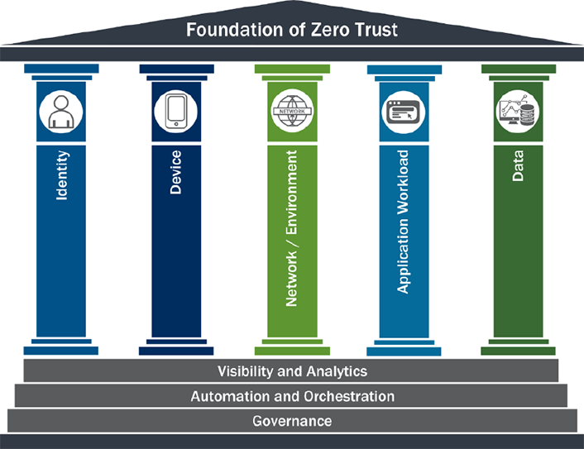
Next Steps
SSE Implementation
  Pilot Agencies: WaTech, DSHS, ECY
  Project Timeline: 9-12 months
Workforce Identity (Okta)
ADFS to Entra ID migration
Cloud Government Network (next slide)
Zero Trust Blueprint
  Construct Zero Trust Framework
  Align with Zero Trust ‘pillars’ (see right)
  Determine shortfalls to remediate
  Create Zero Trust White Paper
  Develop Zero Trust Implementation Plan
Training zero trust change agents
Notes:
Slide Talking Points
Next steps to adopt and align with zero trust consists of implementing Secure Service Edge (SSE) as an enterprise service, migrating resident identity from SecureAcecss Washington (SAW) to Okta, and migrating workforce identity from ADFS to Entra ID.
WaTech continues to develop an actionable zero trust blueprint which includes constructing a zero-trust framework with aligns with CISA’s zero trust pillars to determine how to remediate the remaining capability shortfalls.
WaTech is currently creating a zero-trust white paper which should be available to the enterprise this fall that will layout a logical timeline of how will continue to integrate zero trust into its digital ecosystem.
Lastly, and the most important is properly training change agents who understand why zero trust is so important, what zero trust is, and how to implement zero trust over time.

Slide 16
Cloud Government Network (CGN)
Shared Service Model
Private Digital Ecosystem
Centralized Visibility
Cloud Security Perimeter
Agency Isolation
Security Segmentation
Improve enterprise security
Notes:
Slide Talking Points
WaTech is currently implementing a secured digital ecosystem which will span across Azure, AWS, and eventually GCP to deliver shared enterprise services (SIEM, DCaaS, Community Cloud, etc.) from the clouds which we refer to as the Cloud Government Network (CGN). The initial shared services available within the CGN will consist of:
WaTech’s Security Information and Event Management (SIEM) leveraging Azure Sentinel for consolidated security log analysis and threat intelligence.
WaTech’s Domain Controller as a Service (DCaaS).
WaTech’s Community Cloud (IaaS).
The CGN is essentially a ‘hub of [cloud] hubs’ which leverages SD-WAN to interconnect WaTech’s shared service clouds while employing Security as a Service (SECaaS) protections to safeguard state agency clouds.
The CGN centralizes visibility and isolates state agency clouds from the threats inherent to the Internet and each other.
The CGN’s security segmentation will enable cloud-based traffic to traverse between public clouds without having to pass through an on-premises data center which will improve performance and a user’s experience.
The CGN will also enable WaTech to effectively constrain lateral movement of security incidents from one cloud environment (agency) to another while allowing WaTech to orchestrate threat remediation activities more efficiently (reducing the blast radius of a cybersecurity attack).

Slide 17

Questions?
Contributors include:
WaTech Planning & Design
Notes:
Thank you for your time and attention concerning this matter.
Please let us know if we can address any clarifying questions that you may have.
Questions may be sent to: Mike.costello@watech.wa.gov.

