Slide 1
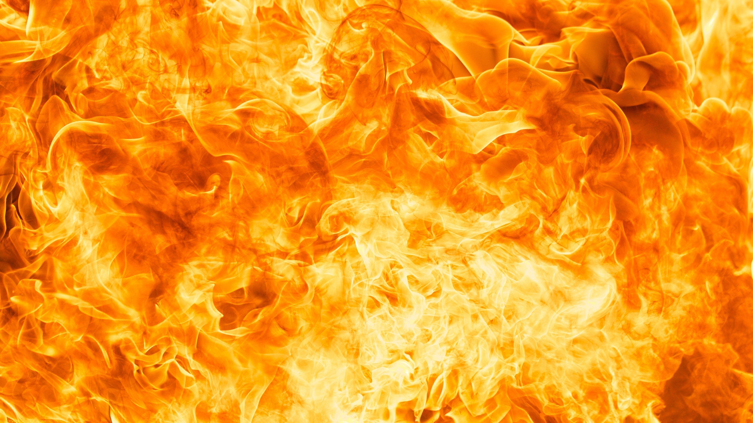
Don’t Panic!
The Hitchhikers guide to Incident Response
1
Iain Sloan © 2025

Slide 2
What do you get when you multiply six by seven?
2
Iain Sloan © 2025

Slide 3
Know where your towel is!
Runbooks - Step-by-step procedures that work when your brain doesn’t
Contact Lists - Updated this century, preferably
Communication Templates - Pre-written because words are hard during incidents
Evidence Collection Tools – A Digital forensics kit of somesort
Decision Trees - For when "should we pull the plug?" becomes urgent
4
Iain Sloan © 2025

Slide 4
The Babel Fish Problem
Communicating during a Crisis
“The poor Babel fish has caused more and bloodier wars than anything else in the history of creation.”
Technical teams vs. Executive teams speak different languages
Legal wants details, PR wants silence, IT wants coffee
External communications while maintaining operational security
6
Iain Sloan © 2025

Slide 5
The Infinite Improbability Drive
Why Murphy's Law Rules Incident Response
“Everything that can go wrong, will go wrong... at the worst possible moment”
Backup communication channels that aren't actually accessible
Decision makers who are unreachable when needed
Tools that work in testing but fail under load
Procedures that assume everything goes perfectly
8
Iain Sloan © 2025

Slide 6
The Total Perspective Vortex
Maintaining Perspective Under Pressure
“The Total Perspective Vortex derives its picture of the whole Universe on the principle of extrapolation from a piece of fairy cake.”
Step back and assess the bigger picture
Don't extrapolate massive conclusions from limited data
Remember: most incidents aren't existential threats
Document everything, assume nothing
10
Iain Sloan © 2025

Slide 7
The Heart of Gold's Crew
Roles and Responsibilities
Incident Commander – (Arthur Dent) - Confused but learning fast
Security Staff (Ford Prefect) - Knows the real threats
Communications Staff (Trillian) - Actually competent at talking to people
Executive Sponsor (Zaphod) - Makes decisions (hopefully better ones)
IT Operations Team (Marvin) - Depressed but gets stuff done
12
Iain Sloan © 2025

Slide 8
The Restaurant at the End of the Universe
Tabletop Exercises That Don't Suck
Scenario-Based Practice:
Start simple: "The website's down and customers are angry“
Escalate realistically: Add time pressure, communication failures
Include curveballs: Key personnel unavailable, tools fail
End with lessons learned, not blame
14
Iain Sloan © 2025

Slide 9
Vogon Bureaucracy
When Compliance Meets Chaos
"Resistance is useless!"
Regulatory Reality:
GDPR breach notifications (72 hours)
SEC disclosure requirements (4 business days)
Industry-specific mandates (HIPAA, PCI-DSS, etc.)
Documentation requirements that actually help
16
Iain Sloan © 2025

Slide 10
Deep Thought's Answer
Metrics That Actually Matter
"I think the problem, to be quite honest with you, is that you've never actually known what the question is.
Regulatory Reality:
Mean Time to Detection (MTTD) - How fast you spot problems
Mean Time to Containment (MTTC) - How fast you stop the bleeding
Communication Timeline - Who knew what when
Process Adherence - Did people actually follow the plan?
18
Iain Sloan © 2025

Slide 11
The Guide's Philosophy
Building Muscle Memory
"Don't Panic" - Easy to say, harder to do without practice
Why Regular Drills Matter:
Stress makes smart people forget basic procedures
Tools work differently under pressure
Communication breaks down when it matters most
Confidence comes from repetition, not documentation
20
Iain Sloan © 2025

Slide 12
Mostly Harmless
Learning from Practice (Without the Trauma)
After Action Reviews:
What worked as expected?
What failed spectacularly?
Where did communication break down?
What assumptions were wrong?
22
Iain Sloan © 2025

Slide 13
So Long, and Thanks for All the Fish
Key Takeaways
Practice like lives depend on it (because careers do)
Communication is harder than containment
Your plan will fail in creative ways
Regular drills beat perfect documentation
Don't panic, but do prepare
"In the beginning the Universe was created. This has made a lot of people very angry and been widely regarded as a bad move."
24
Iain Sloan © 2025

Slide 14
Don't Forget Your Guide
NIST SP 800-61: Computer Security Incident Handling Guide
SANS Incident Response Process
Your organization's actual IR procedures (read your guide and keep it close)
NIST Cybersecurity Framework
Tabletop exercise scenarios
Industry-specific playbooks
Remember: The best incident response plan is the one your team actually knows how to execute.
26
Iain Sloan © 2025

Slide 15
When basic drills become routine
Nightmare Scenarios to Practice:
The Magrathea Special: Total infrastructure rebuild required
The Vogon Constructor Fleet: Compliance deadlines during active incident
The Bistromathic Drive: When your backup plans have backup plans
The Somebody Else's Problem Field: When it's definitely your problem
28
Iain Sloan © 2025

