Slide 1
How to apply CISA Guidance, Services, Tools, and more...
Presented to the State of Washington for Cybersecurity Awareness Month
October 29, 2025
Cindy Munoz, M.S. - Security Analyst

Slide 2
Agenda
Who am I
What is CISA’s Role & Mission
What CISA Isn’t
CISA Offerings at a Glance
How to Apply: Advisories
Case Study: How to Apply Advisories
Ransomware Advisory Example
Actionable Next Steps
Additional Insights
CISA Contacts and Support
Key Takeaways
Q&A

Slide 3
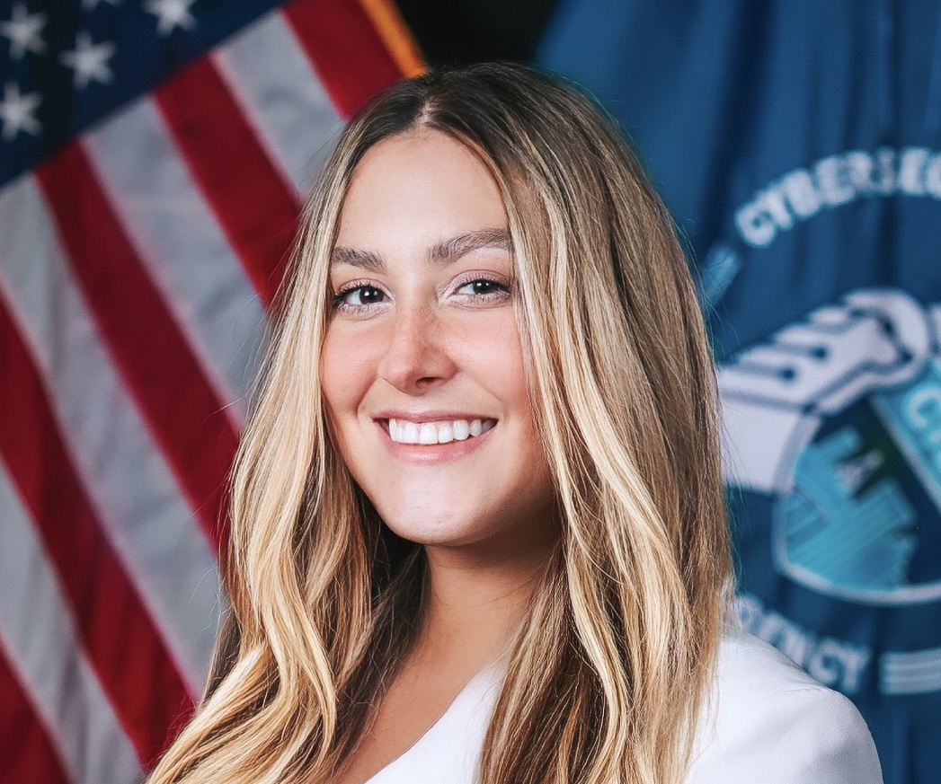
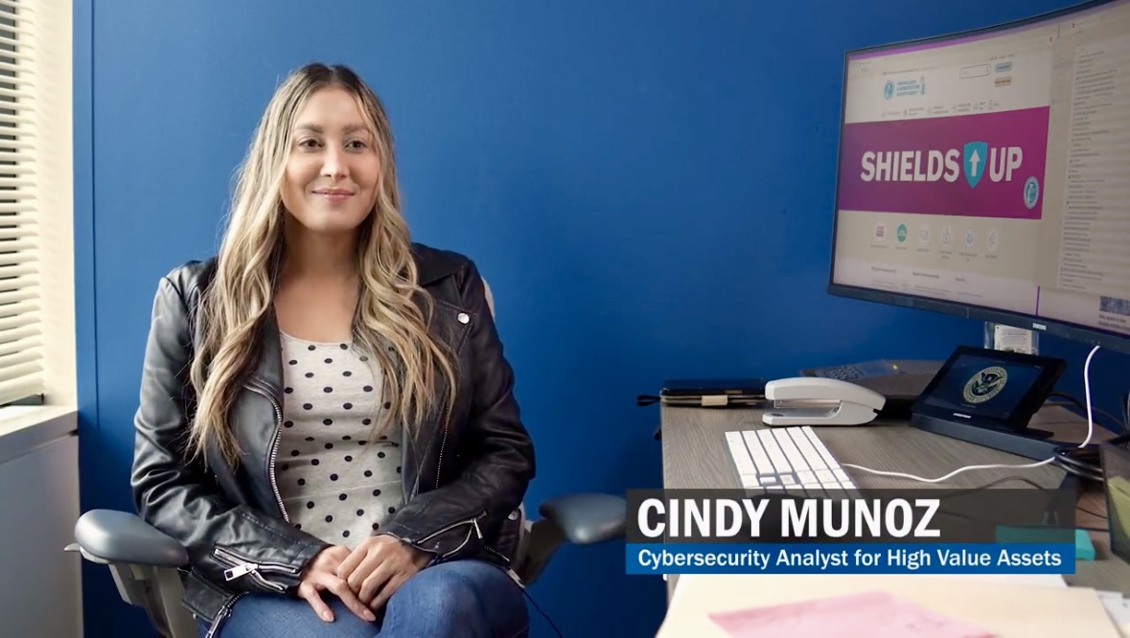
Who am I?
Cindy Munoz is a TS/SCI cleared Security Analyst with the Cybersecurity and Infrastructure Security Agency (CISA) and an Adjunct Professor at Northern Virginia Community College. Cindy earned her M.S. in Cybersecurity from California State University and was a National Science Foundation (NSF): Scholarship-for-Service (SFS) recipient. She has contributed to GRC, attack surface management, security research, incident response surge support, workforce engagement, and volunteer initiatives in service of CISA’s mission.
Experience includes living in Seoul, South Korea, where she represented the U.S. Embassy in joint cybersecurity initiatives with South Korean counterparts to counter malign cyber threats and improve bilateral information sharing and R&D activities.
Fun Fact: You may (or many not have) have seen Cindy in CISA images, videos, or other media. She has appeared in content shown at RSA, BlackHat/DefCon, USAJOBS.gov, and CISA.gov.
When she’s not tackling cyber challenges or exploring emerging tech issues, Cindy enjoys traveling, trying new restaurants, learning languages (1000+ day streak on Duolingo), staying active, playing videogames (Legend of Zelda is her favorite), and spending time with friends and family.
Fun fact: Whenever Cindy travels abroad, she conducts her own security research into each country’s cybersecurity posture, national initiatives, and active APT activity—comparing them to U.S. Cindy’s portfolio includes 25 countries.

Slide 4
What is CISA’s Role and Mission?
CISA = Cybersecurity and Infrastructure Security Agency
Mission: “Lead the national effort to understand and manage cyber and physical risk to our critical infrastructure.”
“Sih-zuh”
Falls under the DHS umbrella (e.g. USCIS, FEMA, etc)
Key roles:
Protecting federal networks
Protect and defend U.S. critical infrastructure from cyber and physical threats
Threat response coordination
Provide tools, services, and guidance for organizations of all sizes
Promote secure-by-design technology adoption
Run by binding directives, collaboration with SLTT, private sector
Lead federal efforts for cybersecurity resilience
Facilitate public-private-SLTT collaboration and information sharing
CISA was created and signed into law in November 2018
PSA: Pronounced like “scissors” or the grammy award winning artist Sza
“Sih-suh” is acceptable

Slide 5
What is CISA’s Role and Mission?
🏛️ CISA’s Placement:
Component agency under the Department of Homeland Security (DHS)
Director of CISA reports directly to the DHS Secretary
Many teams have Supreme Court designation/authority
🗂️ Internal Divisions:
Cybersecurity Division (CSD): Cyber defense, advisories, threat intel
Infrastructure Security Division (ISD): Critical infrastructure protection
Emergency Communications Division (ECD): Public safety/emergency comms
🌍 Regional Presence:
10 Regional Offices with Cybersecurity Advisors (CSAs) and Protective Security Advisors (PSAs)
🤝 Partnerships:
FBI: Law enforcement and investigations
NSA / U.S. Cyber Command: Intelligence and military cyber defense
Sector Risk Management Agencies (Energy, Treasury, HHS, etc.)
SLTT
Private Sector

Slide 6
What CISA Isn’t
CISA is not law enforcement but works with FBI (law enforcement) and NSA (intelligence), and other agencies in cyber defense/incident response, information sharing, and national defense activities.
CISA doesn’t replace local IT teams - it provides support and tools. Security is a shared responsibility - a team sport!
CISA is not a regulator but collaborates with regulators and industry partners.
CISA serves federal, State Local Tribal Territorial (SLTT), and private sector organizations - not just federal systems or agencies.

Slide 7

CISA Offerings at a Glance
CISA Services Catalog – Unified listing of services
Free Cybersecurity Services & Tools Portal – Curated database of free services
Resources & Tools Library – Landing page for all tools and guidance
SLTT Services Catalog – Tailored for state, local, tribal, territorial entities
TIC 3.0 Security Capabilities Catalog – Federal network boundary controls

Slide 8

CISA Offerings at a Glance (Deeper Dive)
Cyber Hygiene Services – Free scanning & vulnerability checks
Cybersecurity Performance Goals (CPGs) – Prioritized best practices
Automated Indicator Sharing (AIS) – Real-time threat intel sharing
EINSTEIN – Intrusion detection/prevention for federal networks
Incident Response Support – Assistance during major cyber events

Slide 9
CISA Offerings at a Glance (Deeper Dive)
Cyber Resilience Reviews (CRRs) – Evaluate cyber maturity
Tabletop Exercise Packages – Ready-made scenarios for testing readiness
Risk and Vulnerability Assessments – In-depth testing of organizational risk
Infrastructure Resilience Assessments – Identify critical weak points

Slide 10
CISA Offerings at a Glance (Engagement)
Joint Cyber Defense Collaborative (JCDC) – Public-private coordination
MS-ISAC – Multi-State Information Sharing & Analysis Center
*Recently the MS ISAC lost U.S. government funding, TBD on the future of this group.
Sector Risk Management Agencies (SRMAs) – Industry-specific partnerships
Nationwide Cybersecurity Review (NCSR) – CISA sponsored program, voluntary anonymous annual self-assessment survey to measure maturity across SLTT
*No public confirmation whether it will be defunded.
Public Comment Periods – Shape guidance and policy initiatives

Slide 11
Case Study: How to Apply Advisories
📌 Scenarios: Interlock Ransomware Advisory (CISA, FBI, MS-ISAC) and “Cascadia Lockdown” (TTX)
Joint advisory released with threat actor tactics, techniques, and procedures (TTPs).
Provided indicators of compromise (IOCs) and recommended mitigations.
Example mitigations: network segmentation, timely patching, disabling unused ports, update playbooks.
✅ How to Apply:
Sign up for CISA Cybersecurity Advisories and search for free TTXs.
Share IOCs with your SOC or security team OR share with leadership/stakeholders to participate.
Integrate recommendations into incident response plans.
Use guidance to improve resilience against ransomware.
🔗 Link: https://www.cisa.gov/news-events/alerts/2025/07/22/joint-advisory-issued-protecting-against-interlock-ransomware

Slide 12
Case Study: Ransomware Advisory Example
Overview: 🔗 Link: https://www.cisa.gov/news-events/alerts/2025/07/22/joint-advisory-issued-protecting-against-interlock-ransomware
On July 22, 2025, CISA, FBI, HHS, and MS-ISAC published a joint advisory on the Interlock ransomware campaign. CISA+2CISA+2
Interlock is relatively new (first observed ~September 2024) and targets both business and critical infrastructure organizations across North America and Europe. CISA+2CISA+2
It’s financially motivated, using a double extortion model: exfiltrate data, then encrypt systems. Victims face pressure to pay for decryption and to prevent leakage. CISA+2CISA+2
Tactics, Techniques & Procedures (TTPs):
Initial Access:
Drive-by download from compromised legitimate websites (uncommon in ransomware). CISA+2CISA+2
ClickFix social engineering: victims are tricked into running payloads disguised as a fix or CAPTCHA procedure. Ransomware.org+3CISA+3CISA+3
Lateral Movement & Persistence:
After access, use credential harvesting, remote access tools (e.g. RATs), PowerShell scripts, registry run keys, placing files in Startup folders. Industrial Cyber+2CISA+2
Use Cobalt Strike, AnyDesk, SystemBC, and other common attacker tools for command & control. Industrial Cyber+2Ransomware.org+2
Notable Behaviors:
Interlock does not leave an initial ransom demand or payment instructions. Victims receive a unique code and must contact the group via a .onion (Tor) address to negotiate. CISA+2CISA+2
It has encryptors for Windows and Linux platforms, focusing on encrypted virtual machines across both. Picus Security+3CISA+3CISA+3
Recommended Mitigations (from the Advisory):
Prevent initial access
Use DNS filtering, web access firewalls
Train users on spotting social engineering attempts CISA+1
Patch and update systems / software / firmware
Address known vulnerabilities promptly Ransomware.org+3CISA+3CISA+3
Segment networks
Restrict lateral movement between systems Picus Security+3CISA+3CISA+3
Strengthen identity, credential, access management
Enforce multifactor authentication wherever possible CISA+2CISA+2
Integrate IOCs into security monitoring and response workflows
Download and use provided STIX / JSON indicator feeds from the advisory

Slide 13
Case Study: Tabletop Example – “Cascadia Lockdown”
Overview: Ransomware attack hits multiple Washington state & county system during a Cascadia tremor disrupting power and communications.
Objective:
1. Test interagency cyber crisis coordination.
2. Maintain operations amidst dual cyber+physical emergencies
3. Evaluate response alignment with CISA CPG’s & NIST CSF
Key Injects
Morning:
Ransomware detected in DOE systems → Isolate or contain?
Midday:
Counties report outages + disruption → coordination stress test
Afternoon:
Backups compromised
Framework Alignments and Outcome
Conduct step-by-step plans to assess cyber resilience, refine escalation paths, update state cyber incident plans.
Examples:
1.Asset & risk mapping
2. Incident response actions
3. Interagency info sharing
4. Coop & after-action/lessons learned

Slide 14
Actionable Next Steps
📧 Subscribe to Alerts & Updates:
National Cyber Awareness System: https://www.cisa.gov/news-events/alerts
GovDelivery Email Updates: https://public.govdelivery.com/accounts/USDHSCISA/subscriber/new
📱 Follow on Social Media:
LinkedIn: https://www.linkedin.com/company/cisagov/
X (Twitter): https://twitter.com/CISAgov and @CISACyber
🛠️ Explore CISA Resources:
Free Cybersecurity Services & Tools: https://www.cisa.gov/free-cybersecurity-services-and-tools
CISA Cybersecurity Advisories: https://www.cisa.gov/news-events/cybersecurity-advisories
🌍 Engage Locally:
Connect with your Regional Cybersecurity Advisor (CSA) via CISA.gov
Homeland Information Security Network (HSIN): Homeland Security Information Network (HSIN) | Homeland Security

Slide 15
Additional Insights
🔔 Alerts & Advisory Tips
CISA Alerts Are Action-Oriented: Each advisory isn’t just “for awareness” — it usually comes with concrete mitigations and IOCs (indicators of compromise) you can directly plug into your SIEM or SOC workflows. Many orgs skim the headline but don’t apply the technical content.
Customizable Alerts: You can subscribe to tailored alerts by category (e.g., vulnerabilities, malware, ransomware). Not everyone realizes you don’t have to sign up for “everything.”
🛠️ Free Tools & Services That Are Underused
Cyber Hygiene Scans Are Free: Organizations (even small nonprofits, schools, municipalities) can sign up for continuous vulnerability scanning of their internet-facing assets at no cost. This is often overlooked outside of federal agencies.
Malcolm: CISA maintains free open-source tools like Malcolm, a full packet-capture and analysis suite. It’s basically a free Splunk/ELK-style environment for traffic analysis.
CSET (Cyber Security Evaluation Tool): A self-assessment tool many organizations don’t know exists. It helps benchmark security posture against standards like NIST CSF.
🧩 Information Sharing Insights
AIS (Automated Indicator Sharing): Real-time threat intel exchange with CISA. Most orgs don’t know you can set up a free connection to receive machine-readable indicators directly into your SIEM.
JCDC (Joint Cyber Defense Collaborative): Not just for “big tech” — regional stakeholders and critical infrastructure operators can sometimes plug into working groups.

Slide 16
Additional Insights (continued)
📚 Guidance That’s Practical
Secure by Design Initiative: CISA’s push for vendors to build security in at the development stage is not just theory — they publish actionable checklists for procurement officers to use with vendors.
SBOM Guidance: They provide sample policies and recommended practices on Software Bills of Materials, which can be adapted by smaller organizations.
🌎 Engagement Opportunities
Regional Cybersecurity Advisors (CSAs): Every state has one. They’re a great human contact point for tailored advice, tabletop exercises, and local coordination. Few organizations know these exist.
Public Comment Periods: CISA actively invites input on draft guidance (like Zero Trust or Secure-by-Design docs). Engaging in these lets orgs shape national cybersecurity policy.
🧠 Extra Tips
LinkedIn & YouTube: CISA frequently posts summaries, explainer videos, and quick-hit guidance on social media — worked with publication team at times and LinkedIn was the most active platform
CISA is not “the FBI of cyber”: They don’t arrest or prosecute. Instead, they coordinate, guide, and provide services. That misconception is widespread.
CISA “alerts” ≠ “panic”: They’re meant to empower action, not simply warn. The best orgs fold these into their playbooks instead of treating them as FYIs.

Slide 17
CISA Contacts & Support
📧 General Inquiries
CISA Service Desk and General Inquiries: central@cisa.dhs.gov
CISA Main Contact Page: https://www.cisa.gov/about/contact-us
Includes numbers for media, public inquiries, and more
🛡️ Cybersecurity-Specific Contacts
CISA Cybersecurity Division: cyberdirectives@cisa.dhs.gov (for federal BODs/Emergency Directives)
Incident Reporting: report@cisa.gov or Report an Incident Portal
Media Inquiries: CISAMedia@cisa.dhs.gov
After hours: Central@cisa.gov
Report anomalous cyber activity and/or cyber incidents 24/7:
Contact@cisa.dhs.gov
or by calling 1-844-Say-CISA
Cybersecurity Advisors (CSAs): Regional contacts for state, local, tribal, territorial (SLTT) governments and private sector—listed here: Regional Offices Directory
Region 10 Director (A) Barrett Adams-Simmons
Cybersecurity State Coordinator – Ian Moore
Daniel Brown, CSA – Region 10 for Washington State
Additional contacts: Ron Waters, RJ Niesen
CISARegion10@cisa.dhs.gov
IMPORTANT NOTE: Please note that CSAs are considered excepted, which means they are limited to working on incident response coordination and conducting vulnerability/threat hunting notifications only. This means they are generally not able to respond to requests for introductions, regional assessments, site visits, etc until the government reopens.

Slide 18
CISA Contacts & Support
📢 Alerts & Subscriptions
Updates from CISA: email updates, popular feeds, etc
https://www.cisa.gov/about/contact-us/subscribe-updates-cisa
GovDelivery Alerts: for advisories, bulletins, and tips
https://public.govdelivery.com/accounts/USDHSCISA/subscriber/new?utm_source=chatgpt.com
National Cyber Awareness System: general news alerts
https://www.cisa.gov/news-events/alerts
Ransomware Alerts: Ransomware-specific alerts and statements
https://www.cisa.gov/stopransomware/official-alerts-statements-cisa
👥 Social & Professional Channels
LinkedIn: linkedin.com/company/cisagov
X (Twitter): @CISAgov & @CISACyber

Slide 19

Key Takeaways
CISA provides no-cost services and guidance to reduce cyber risk.
Free scanning, threat intel sharing, and advisories.
Partnerships and exercises improve collective resilience.
Stay informed by subscribing to alerts and connecting with CISA regional staff, like CSAs.
Applying CISA guidance builds long-term cybersecurity maturity.

Slide 20
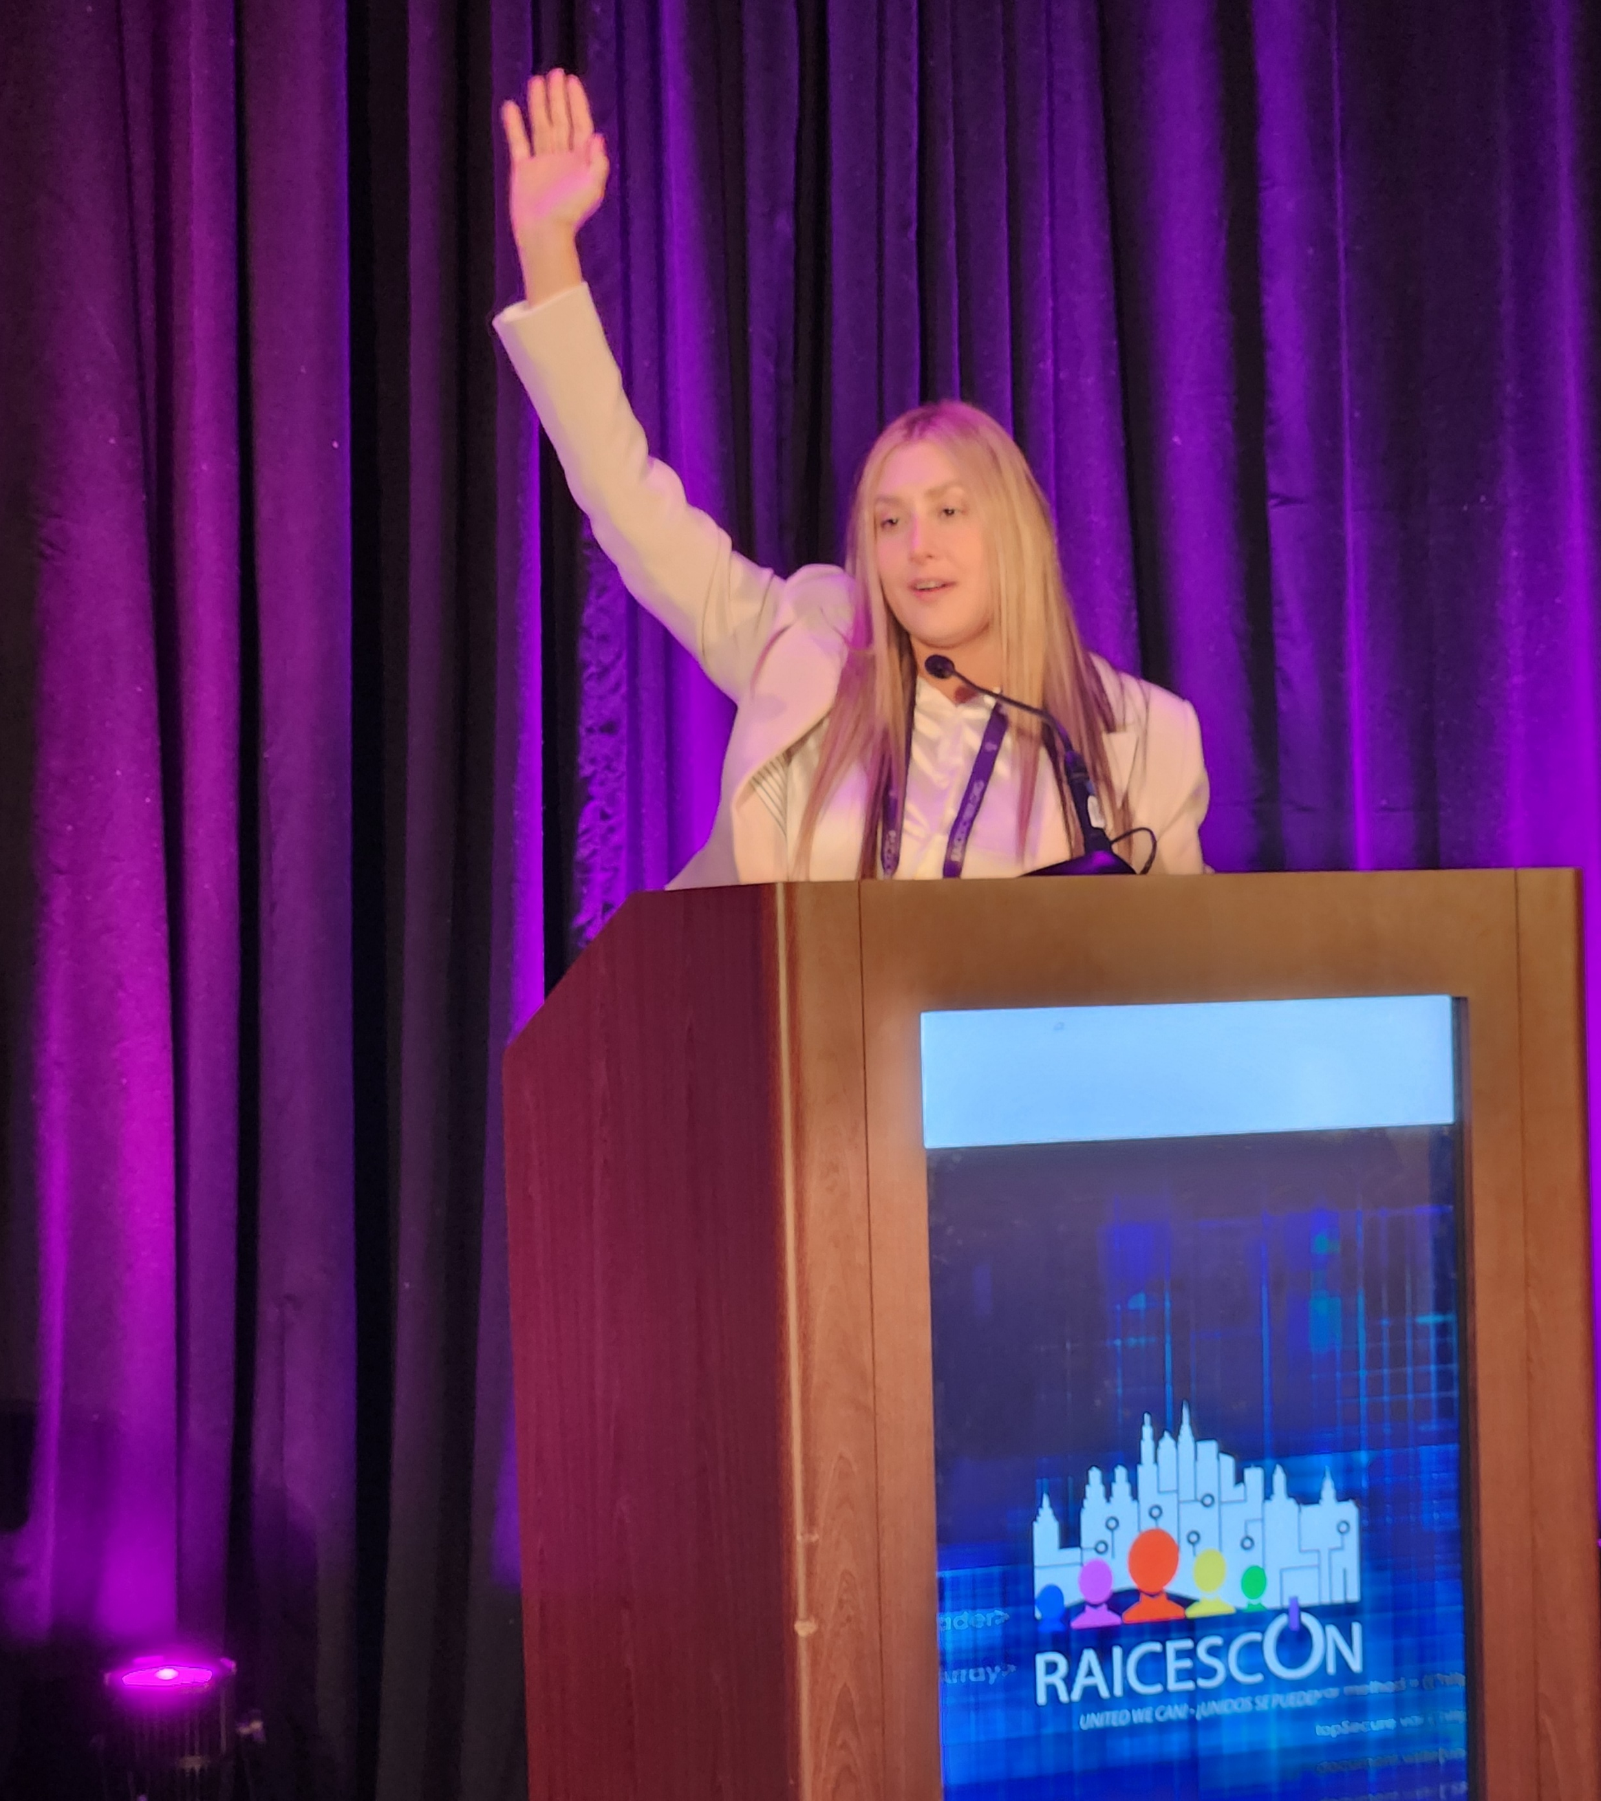
Q&A

Slide 21



Thank you!
Happy Cybersecurity Awareness Month and Happy Halloween to those who celebrate!
Feel free to connect and reach out anytime: Linkedin.com/in/CindyinCyber
CindyinCyber@gmail.com

