Slide 1

Home Network and
Computer Security
ENTERPRISE-LEVEL PROTECTION FOR ALL

Slide 2

Mike Hamilton
Your Presenter
Field CISO: Lumifi Cyber
Founder: Critical Insight
Founder: The PISCES Project
Policy Adviser: Washington State
Vice-Chair: SLTTGCC
CISO: City of Seattle
Managing Consultant: VeriSign Global Security
Ocean Scientist: NASA/JPL

Slide 3
It’s Cybersecurity Awareness Month!
In 2004, the Department of Homeland Security and the National Cyber Security Alliance launched National Cyber Security Awareness Month as a broad effort to help Americans stay safe and secure online. Initial efforts included advice like keeping antivirus programs up to date. Since 2009, the month has included an overall theme, "Our Shared Responsibility," and weekly themes throughout the month were introduced in 2011. In October 2023, a new theme "Secure Our World" was announced as an enduring theme for future years.

Slide 4
Why Your Home Network?
Covid sent everyone to work from home
Your home network is now part of the “attack surface” of your organization
This puts critical infrastructure at risk – local government, healthcare, manufacturing, etc.
Nation-states use your commodity networking gear, smart TVs, cameras and more to attack the United States and hide attribution
TP-Link faces possible US ban as hijacked routers fuel Chinese attacks
Cybersecurity Experts Worried by Chinese Firm’s Control of Smart Devices

Slide 5
5 Business outcomes we want to avoid:
Unauthorized disclosure of protected records
Theft
Extortion
Your network used to attack others
Destructive disruption
Don’t let your home network be the reason your business organization gets cybered

Slide 6
Three Things To Watch Out For
Credential (password) abuse
Vulnerability exploit – cracking your home technology
Social Engineering – fooling you into giving something up

Slide 7
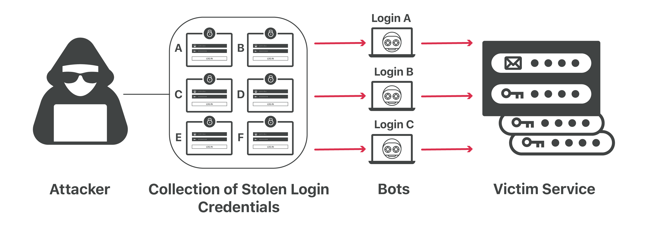
Credential Stuffing
Credential abuse
Image Credit: OWASP Foundation

Slide 8
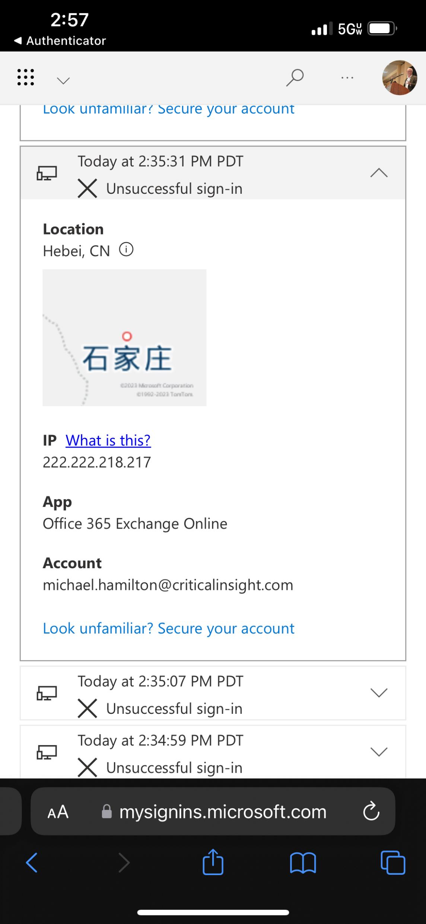
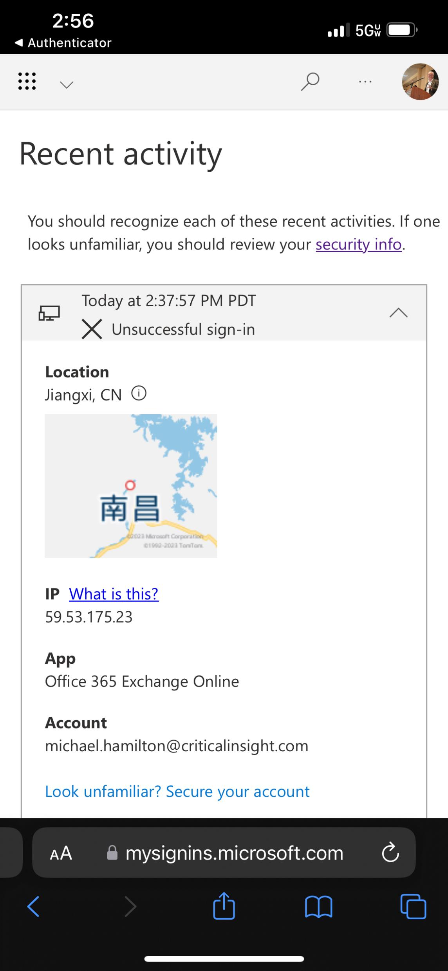
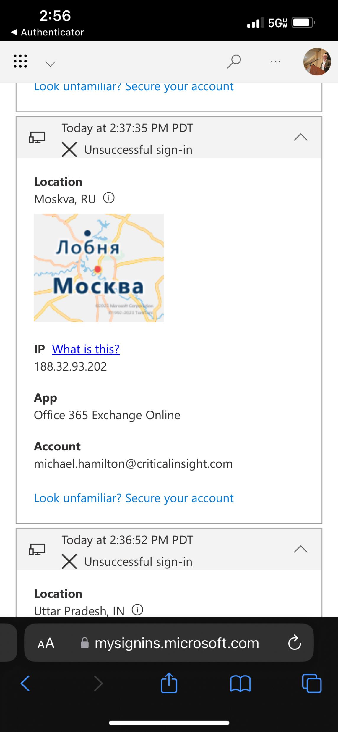
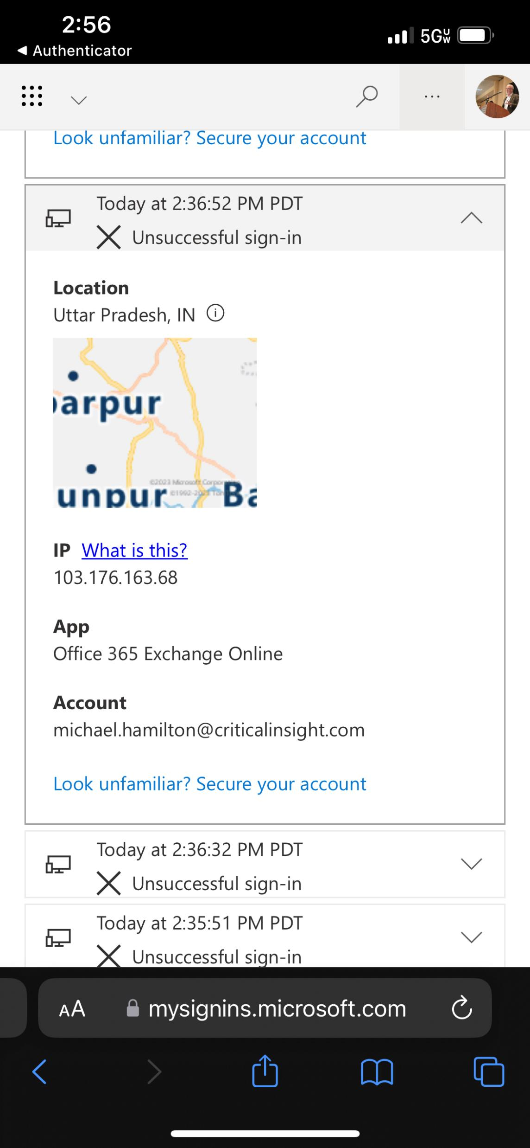
Credential abuse

Slide 9
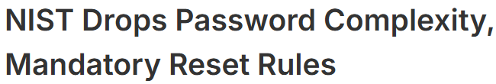
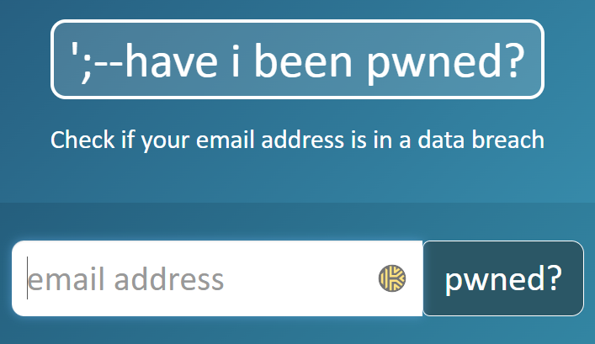
Avoiding Credential Abuse
Special topic
Use pass phrases – first sentence of a book, or five words separated by spaces
Combine with multi-factor authentication, and use an authenticator app (MSFT, Google)
Use a password vault, and unique passwords with every system or service you access
Best NOT to store passwords in browsers
Check your e-mail addresses on haveibeenpwned.com

Slide 10
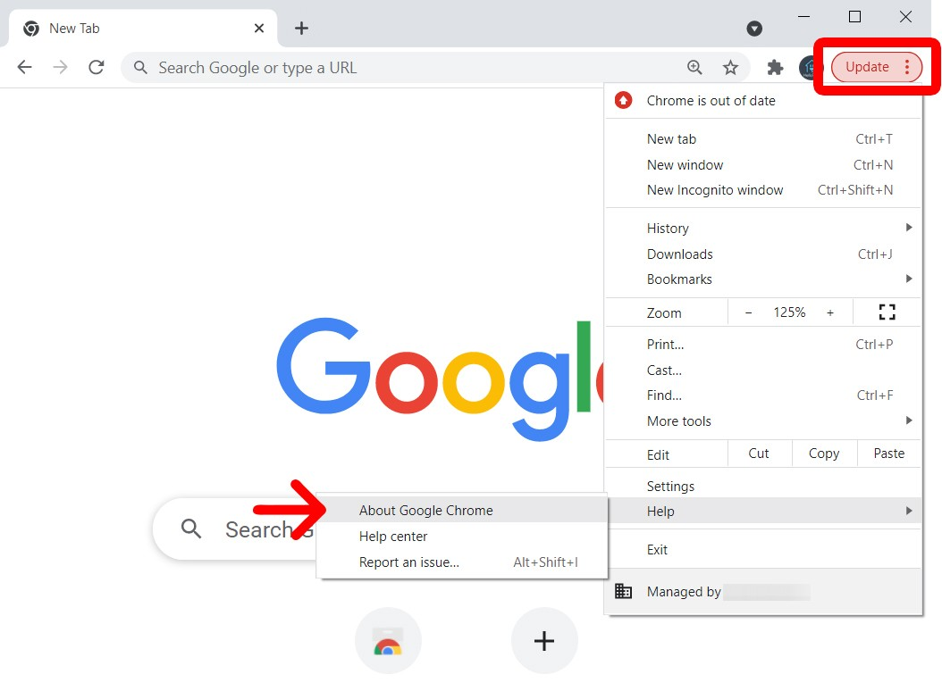
Keep Your Browser Updated
Credential abuse
An unpatched browser + site rigged with an infostealer + bait to draw you to that site:
All your credentials now belong to the bad guy

Slide 11
On Your Network, Made in China
TVs—almost all 4K UHD, QLED, and Mini-LED are made there. Even South Korean-based LG and Samsung use many Chinese components in their premium TVs.
Windows PCs/Laptops, MacBooks, Android and iOS tablets, and smart monitors, even if the brand owner is a Western company or the product is assembled outside China.
Smart lights and IoT, including thermostats, thermometers, smoke detectors, water detectors, printers and scanners.
Smart speakers, soundbars, headphones.
Kitchen appliances with an app.
Cleaning appliances like robot vacuums, window robots and pool robots with an app
Cars – especially EVs that have a Wi-Fi or mobile data connection for firmware updates (all)
Routers, mesh, switches, docks
Security cameras, smart doorbells, and security hubs.

Slide 12
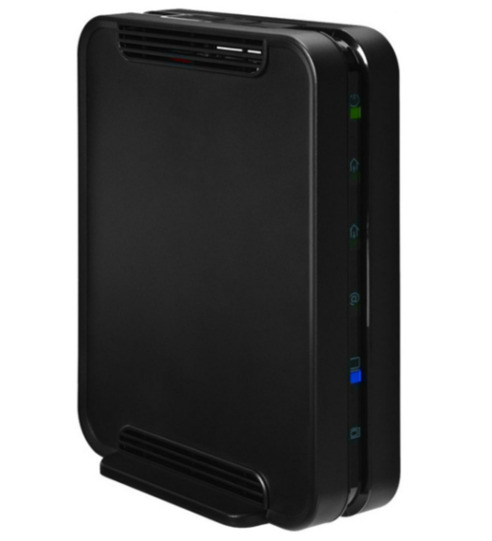
Your Home Router
Change default credentials: Replace the default administrator username and password for your router immediately.
Use strong Wi-Fi passwords: Create a long, complex password for your Wi-Fi network, combining letters, numbers, and symbols.
Enable WPA3 encryption: Use WPA3 or at least WPA2 AES to encrypt your Wi-Fi network, making it harder for unauthorized users to access.
Rename your network (SSID): Change the default Wi-Fi network name to something that doesn't reveal personal information.
Keep firmware updated: Regularly check for and install firmware updates for your router and other smart devices to patch security vulnerabilities.

Slide 13
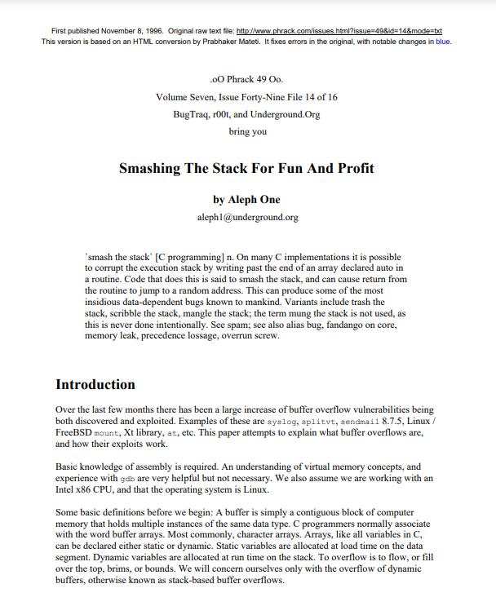
What is a vulnerability?
Vulnerability exploit
Vulnerabilities can be problems in how the software was coded – for example allowing the memory space assigned to a variable in the software to be exceeded (known as a “buffer overflow”).

Slide 14
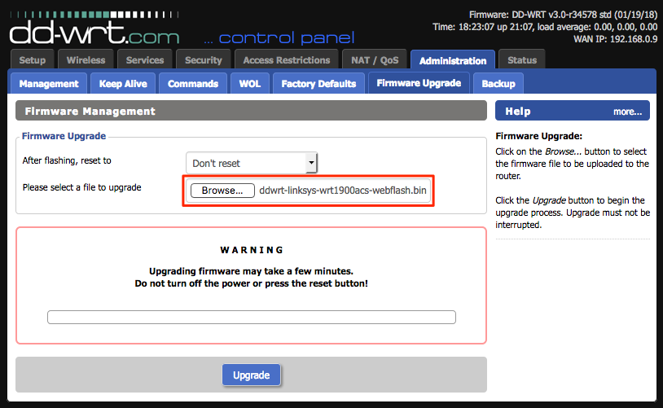
Installing Firmware – How To
ONLY do this over a wired connection and NOT wi-fi.
You will brick the device.
I say this with some authority.

Slide 15
Your Home Router
Enable the firewall: Activate the firewall on your router and ensure each connected device also has its firewall enabled.
Disable remote management: Turn off the ability for anyone to manage your router from outside your home network unless you need it.
Disable WPS: Turn off the Wi-Fi Protected Setup (WPS) feature, as it can create a security risk.
Disable UPnP: Disable Universal Plug-n-Play to prevent devices from automatically opening ports, which can be a security hole.

Slide 16
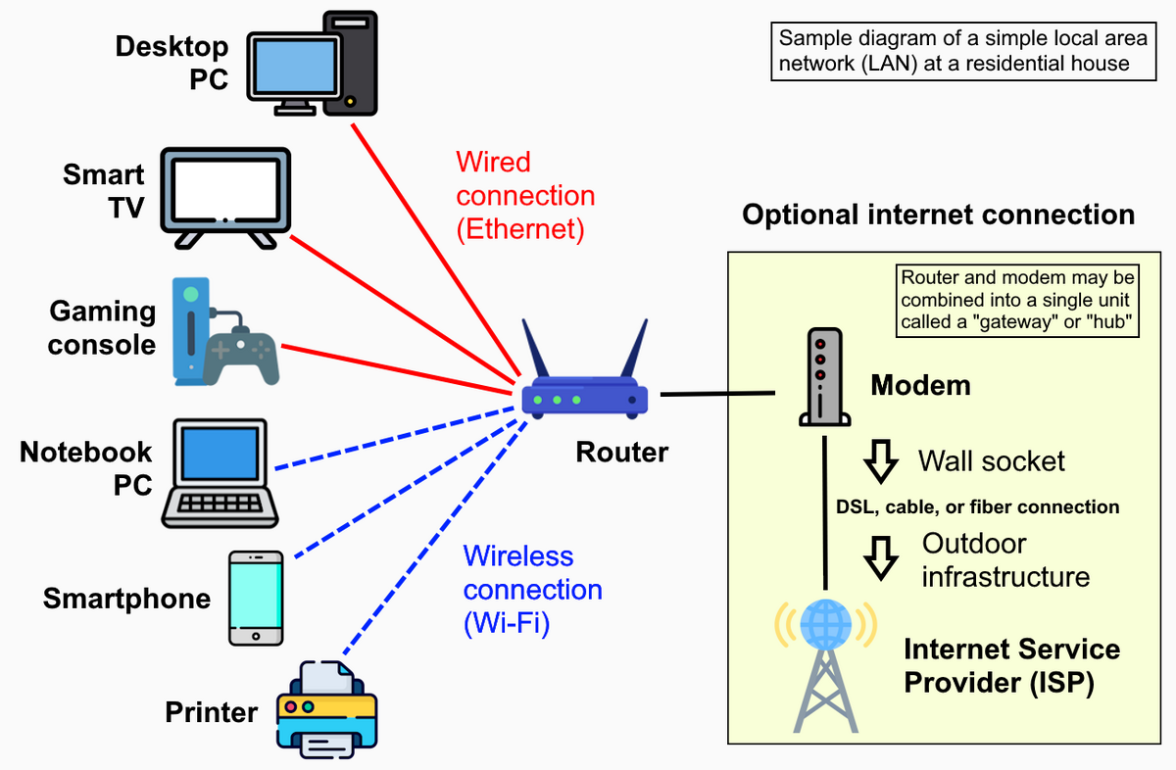
Your Network Structure
Create a guest network: Set up a separate Wi-Fi network for guests, which gives them internet access but keeps them separate from your main network.
Isolate smart devices: Create a separate network for your IoT (Internet of Things) devices, such as smart TVs, thermostats, and cameras, to protect them and your other devices.
Secure smart devices: Always keep your smart home devices updated and use strong, unique passwords on them.
Keep your devices patched/updated – including the most recent version of your operating system (Windows, MacOS, Linux)

Slide 17
Your Security Practices
Monitor your network: Periodically check the list of devices connected to your network and block any that you don't recognize.
Install antivirus software: Run reputable antivirus and antimalware software on all your computers and phones and keep it updated.
Conduct remote work securely

Slide 18
Your Security Practices
Use a VPN: Consider using a Virtual Private Network (VPN) to add an extra layer of security to your connection.
Reboot devices: Periodically reboot your router, computers, and smartphones to clear any temporary malicious implants and to ensure that patches have been activated.

Slide 19
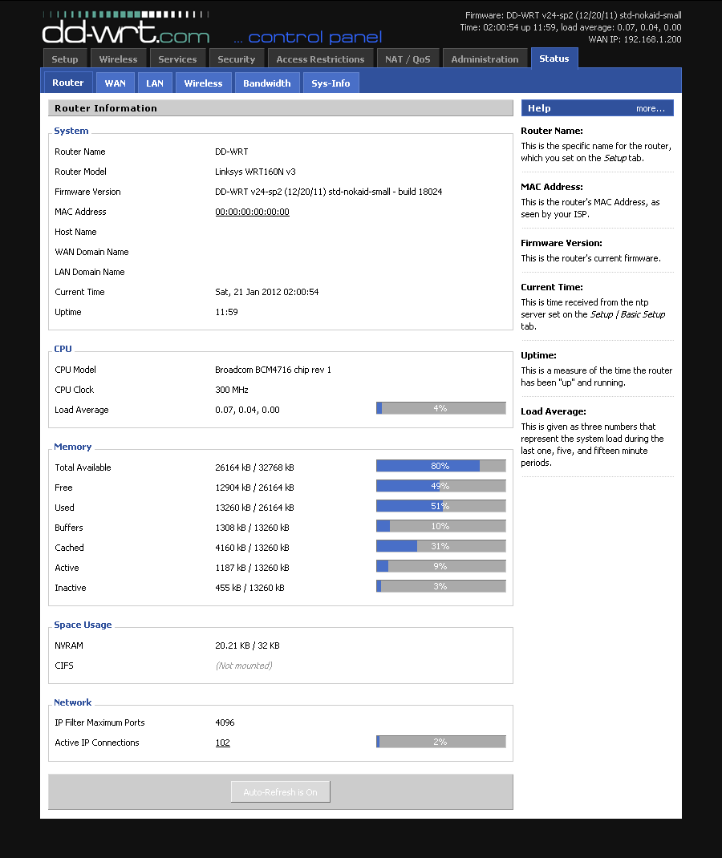
Advanced
Segment your network
Firewall your home network off from the ISP router - DD-WRT firmware
Use zenmap or other to map the devices on your network
Keep your DHCP scope tight

Slide 20
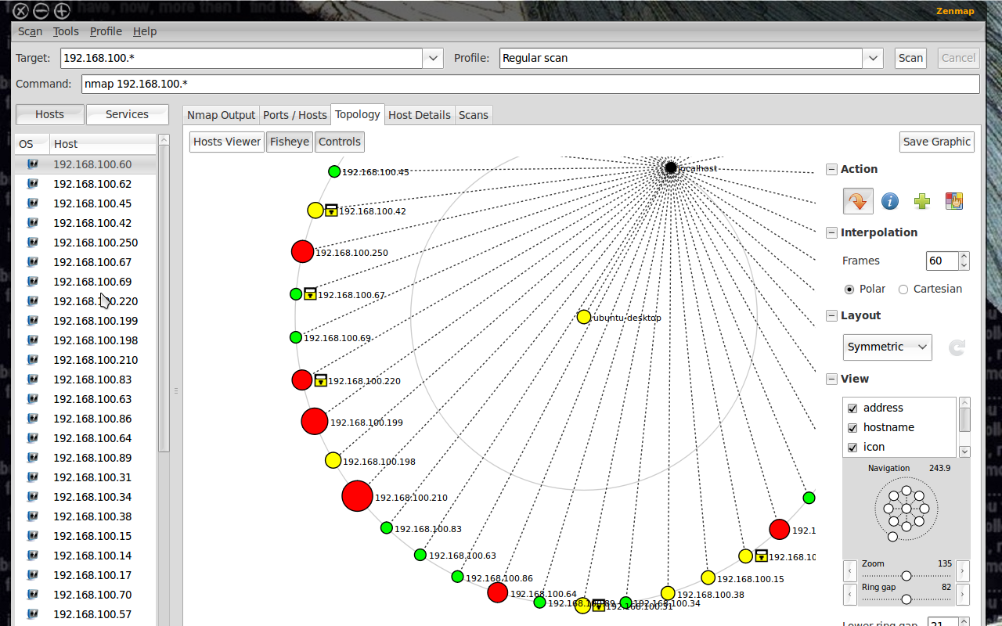
Nmap/Zenmap

Slide 21
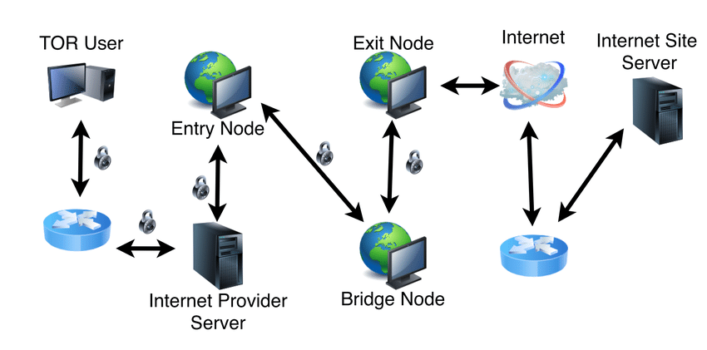
Privacy
DuckDuckGo: good privacy browser
TOR: fully anonymous web browsing
Protonmail: E2E encrypted e-mail
7zip: File encryption
Signal: E2E encrypted messaging
WhatsApp: similar to Signal, but Meta owns it

Slide 22
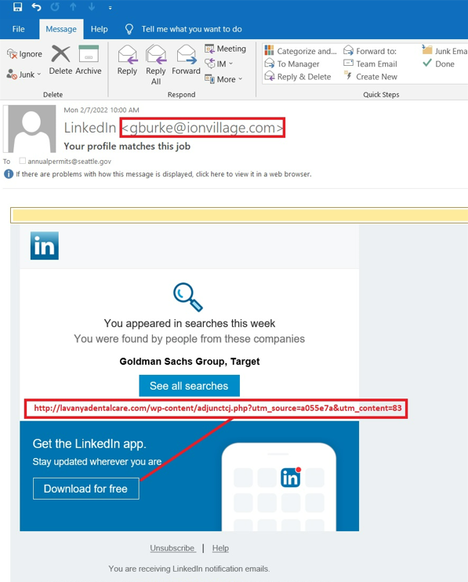
Recent Campaign
Real example
Fake job offer from LinkedIn
Offers a download of the LinkedIn mobile app
URL points to a dental office, not an app store

Slide 23
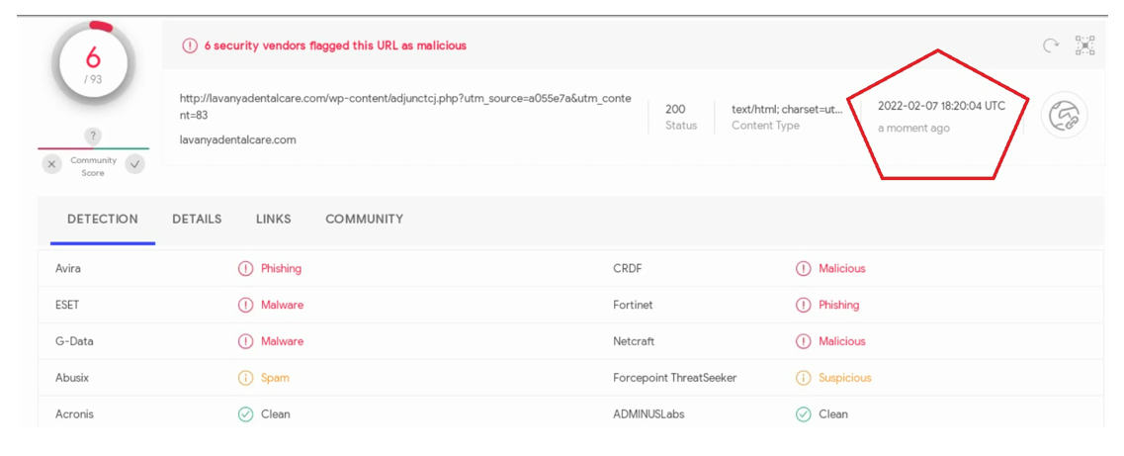
Confirming it’s bad via virustotal.com
Real example

Slide 24
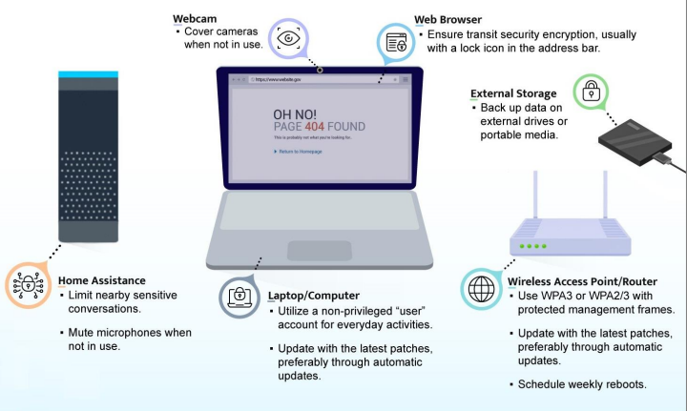
CSI_BEST_PRACTICES_FOR_SECURING_YOUR_HOME_NETWORK.PDF
Compliments of the NSA

Slide 25
Pro Tips
If you didn’t expect it,
suspect it!
Use virustotal.com and haveibeenpwned.com
Conduct personal on a personal device

Slide 26
Stay Connected
Thank you!
📩 Subscribe to our Infosec Insider: Daily IT Security News Blast email
💻 Join us for cybersecurity awareness trainings in 2025
🎙️ Be sure to subscribe to our Weekly Threat Watch Podcast

